Slide 1
Bio-medical Image Processing
Dr. R. Devika Rubi

Slide 2
Python Image - Basic functionalities
PIL Image – Read Image, Gray conversion, Binary, Display
Numpy – Image to array Conversion, Shape, Ravel
Histogram – Matplot, CV2 – Gray and RGB channelwise
(Histogram_images.ipynb)

Slide 3
Contrast Enhancement
Used to improve contrast of an image
Features or details which are not clear in original image are now clear in the contrast-enhanced image
The transformation is
s = p * (r ^ y), where p = 1, y = 0.1, 0.9, 5, 10
Performance is improved by identifying lower and upper bounds of the enhanced transformation of the gray input image
The expression for improved contrast enhancement is
s1 = (s – c) * [ (b – a) /(d – c) ]
Where s1 is output image, s is the enhanced image, a, b are the lower and upper bounds of gray scale values, c and d are the lower and upper bounds of the enhanced image

Slide 4
Contrast Enhancement ….
It observes the relationship between the gray values of original value and the enhanced image
Narrow range of dark input values into wider range of output values
Contrast_enhancement.ipynb

Slide 5
Image as Signal
According to the IEEE Transactions on Signal Processing, a signal can be audio, video, speech, image, sonar and radar-related and so on
Any imaging device will allow light onto to its sensor
Light is a wave, which has a frequency, wavelength, etc
Different wavelengths/frequencies (Frequency Domain) correspond to different colors which is an analog signal
When sensor detects "signal" it converts it into a digital equivalent by sampling and quantizing, i.e. detects it as a set of RGB values (Spatial domain)
So an image is nothing more than a digital representation of light which is a wave with the context in which it's called a signal

Slide 6
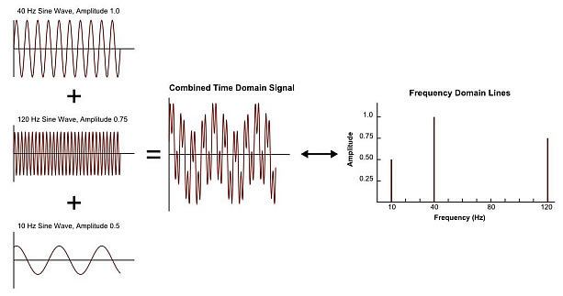
Frequency Domain
Frequency domain analysis is used to indicate how signal energy can be distributed in a range of frequency

Slide 7
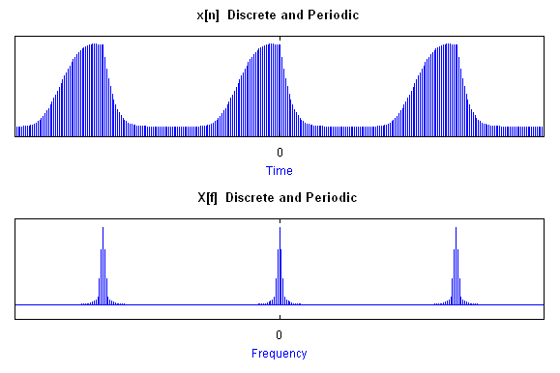
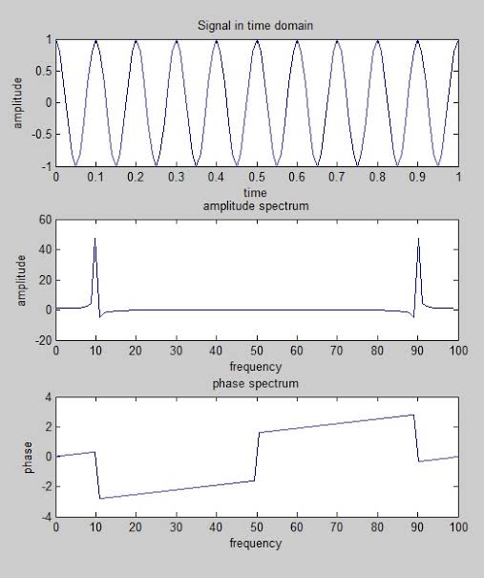
Spatial Domain vs Frequency Domain

Slide 8
Fourier Transform
Switch between the spatial and Fourier (i.e frequency) domain
Used to decompose an image into its sine (imaginary) and cosine (real) components i.e. an array of complex numbers
The output of the transformation represents the image in the Fourier or frequency domain, while the input image is the spatial domain equivalent (Forward FFT), and vice versa (Inverse FFT)
The Fourier Transform is used in a wide range of applications, such as image analysis, image filtering, image reconstruction and image compression

Slide 9
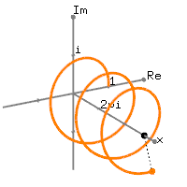
Fourier Transform
The Fourier Transform produces a complex number valued output image which can be displayed with two images, either with the real and imaginary part or with magnitude and phase

Slide 10
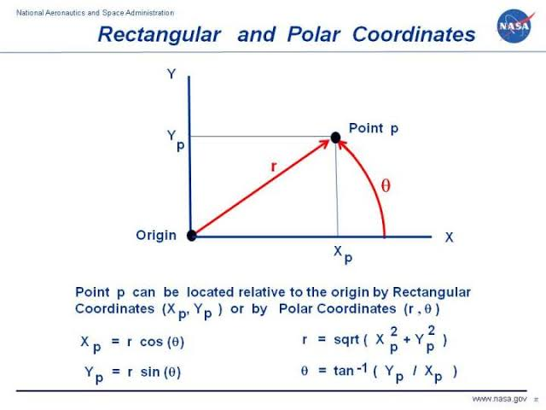
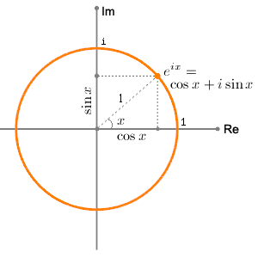
Cartesian Coordinates and Polar Coordinates
Euler’s Formula

Slide 11
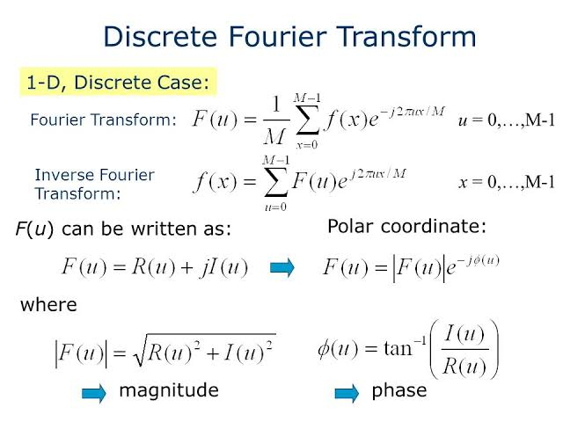
DFT for 1-Dimensional
dft_idft.ipynb

Slide 12
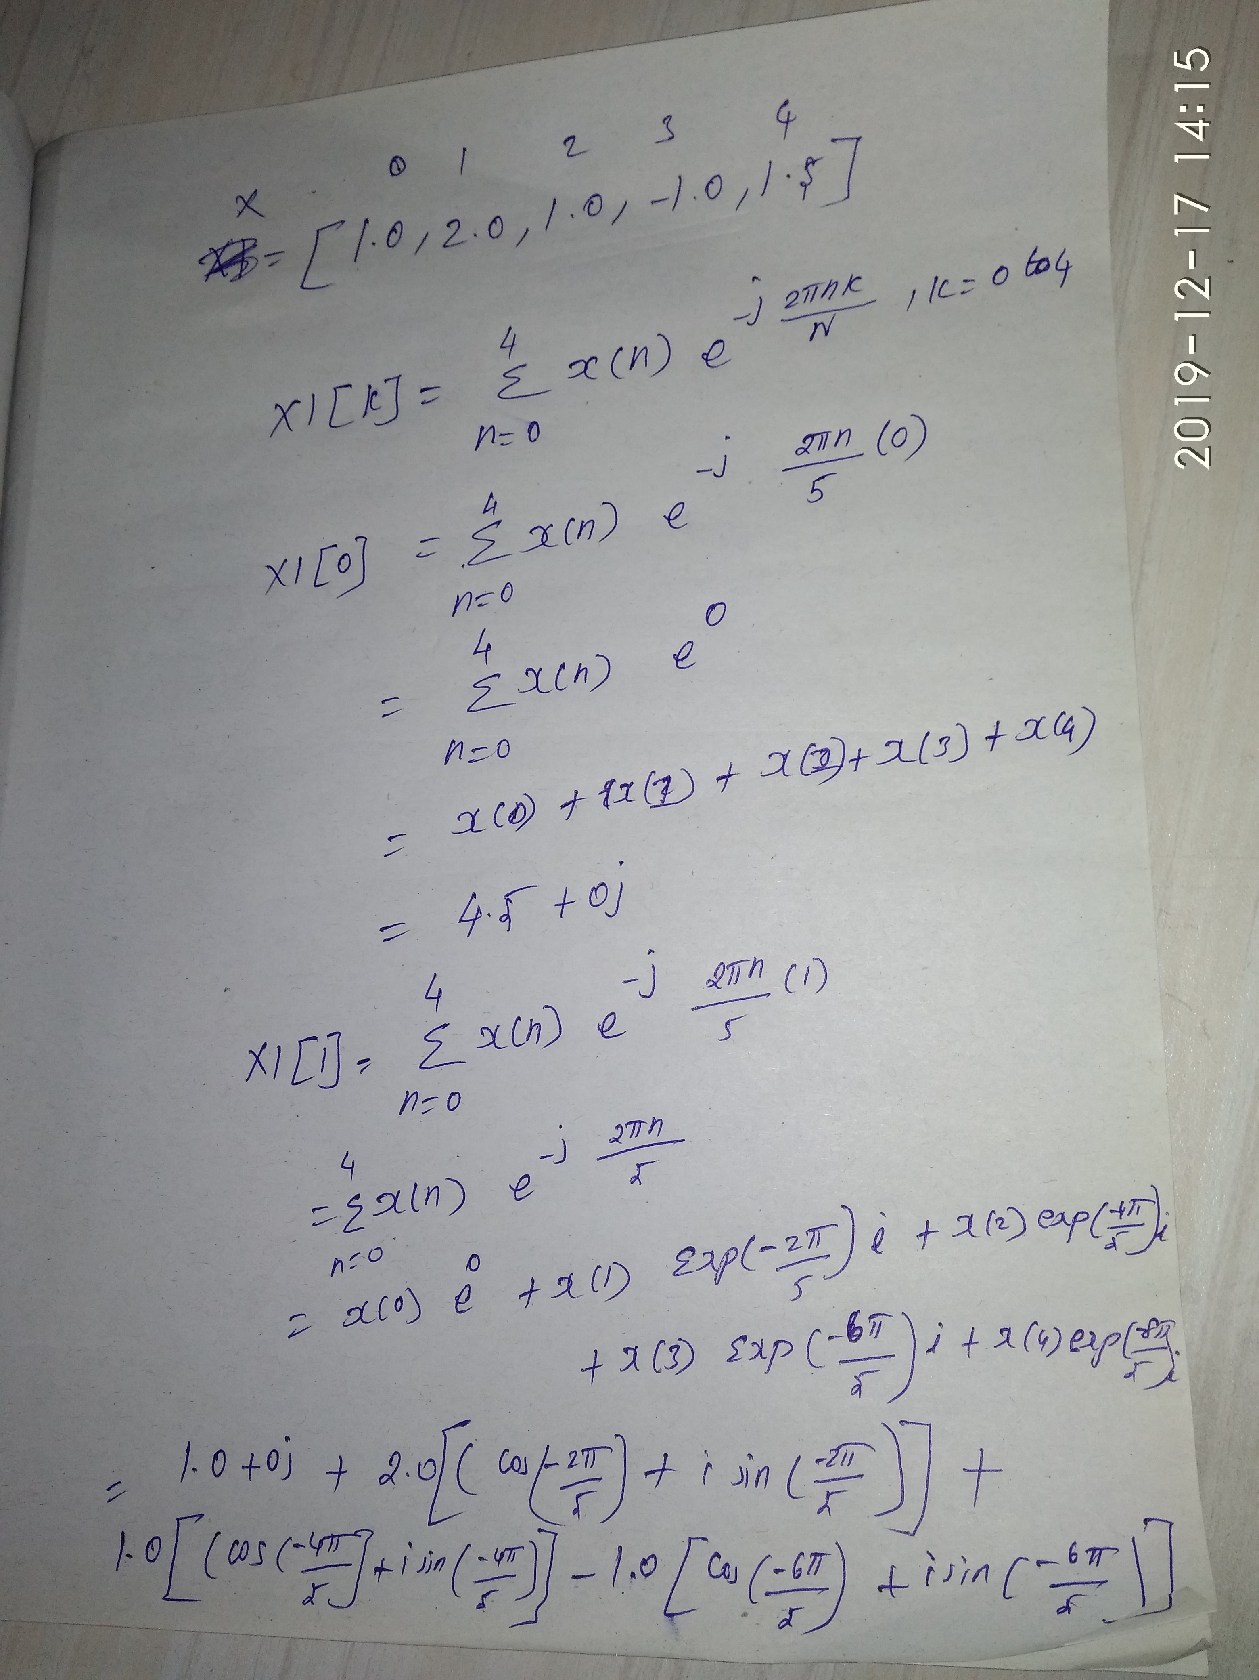

Slide 13
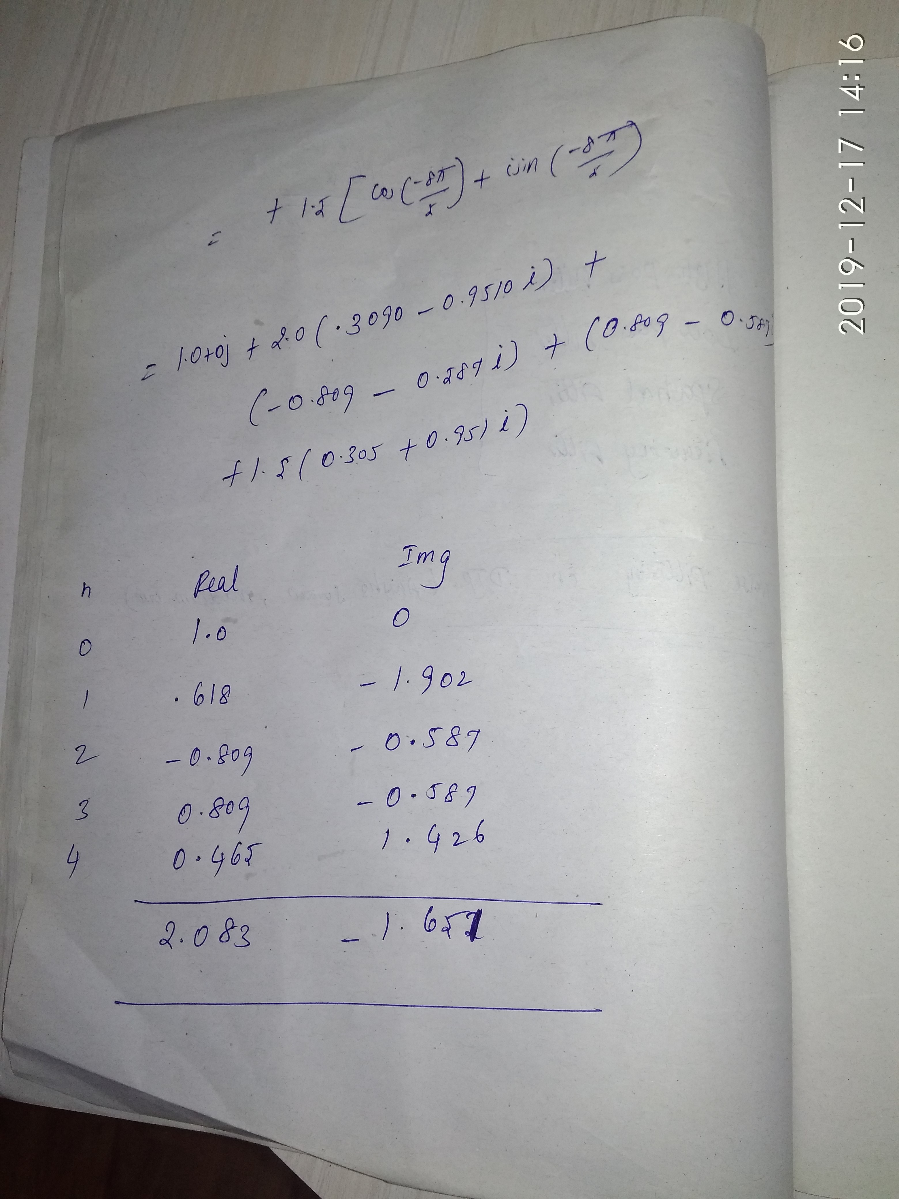

Slide 14
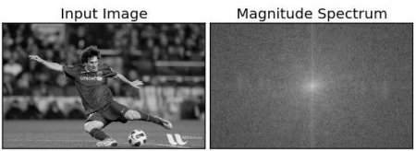
Discrete Fourier Transform (DFT)
Input Image f(x,y)
Fourier
Transform
Magnitude
Spectrum
Inverse
Transform
Magnitude_fft.ipynb

Slide 15
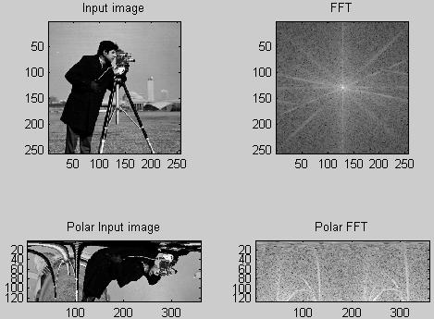
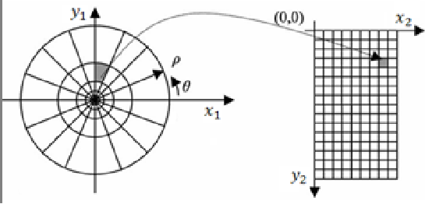
FFT and Polar FFT

Slide 16
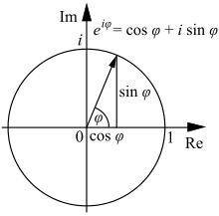
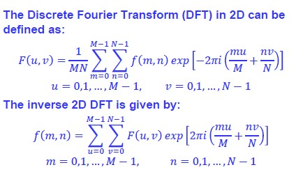
Discrete Fourier Transform (DFT)
Where F(u,v) is the frequency domain image, M,N are maximum intensity values of the input image f(m,n)
dft_idft.ipynb

Slide 17
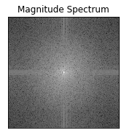
Spectrum Image - Inference
F(0,0) represents average brightness of the input image, which present either in the Top-Left Or Center (By Shift Operator) of the magnitude spectrum image
F(N-1, N-1) represents the highest frequency of the input image in the magnitude spectrum image

Slide 18
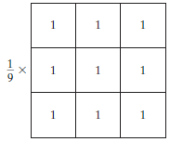
Kernel/Mask/Filter
A lot of times in texts/research papers/books related to image processing, use the terms mask, kernel, and filter interchangeably
“Is a square matrix of numbers that is used to compute various properties or characteristics in an image”
Average Kernel
Convolution:
“Is defined as the sum of the product of the corresponding elements of a kernel matrix to an image matrix”

Slide 19
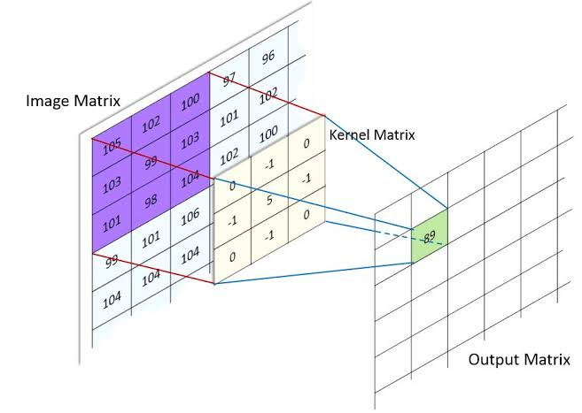
Image Convolution
Output Matrix = Sum of the product of corresponding elements of image matrix with Kernel Matrix
-102-103+495-103-98 = 89

Slide 20
Spatial Kernal vs Frequency Kernal
The Fourier Transform converts spatial image data into a frequency representation
Both representations contain equivalent information
Spatial Domain Frequency Domain
Intuitive Representation Non-intuitive representation
Designing filters can be hard Designing filters often easier
Filtering with large kernels may result Filtering with large kernels can
in long processing times be performed very quickly
Kernels applied directly to spatial data Image and Kernel must first be
converted to frequency domain
modified, then reconverted

Slide 21
Image Enhancement through Fourier Transform
Fourier transform is computed of both original image and suitable filter function
Then, a convolution is applied between the two , the inverse Fourier transform gives an enhanced image

