Slide 1
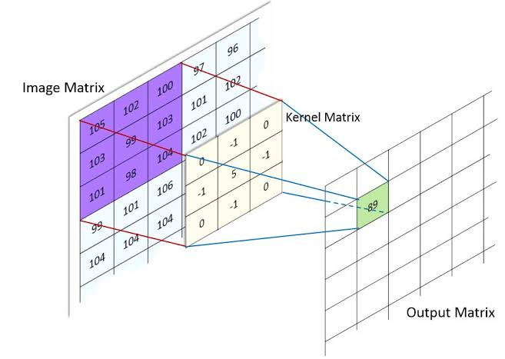
Image Convolution
Output Matrix = Sum of the product of corresponding elements of image matrix with Kernel Matrix
-102-103+495-103-98 = 89

Slide 2
Image Filters
image pre-processing to help improve the machine learning models that planning to build
Image pre-processing involves applying image filters to an image
Image filters can be used to reduce the amount of noise in an image and to enhance the edges in an image.

Slide 3
Image Filters
images also can be filtered with various low-pass filters (LPF), high-pass filters (HPF), etc
A LPF helps in removing noise, or blurring the image
A HPF filters helps in finding edges in an image.
Speck noise is the noise that occurs during image acquisition
while salt-and-pepper noise (which refers to sparsely occurring white and black pixels) is caused by sudden disturbances in an image signal.

Slide 4
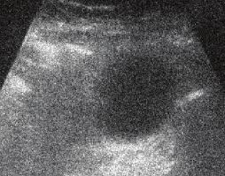
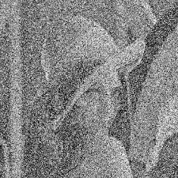
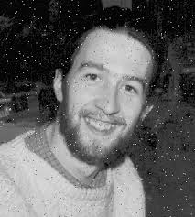
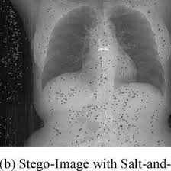
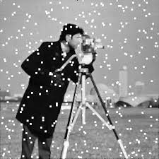
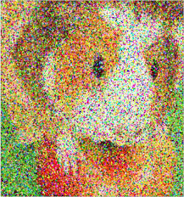
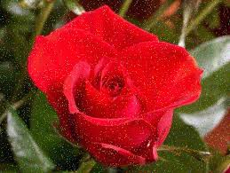
Image Filters

Slide 5
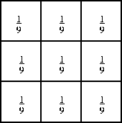
Mean Filter
The mean filter is used to blur an image in order to remove noise.
It involves determining the mean of the pixel values within a n x n kernel.
The pixel intensity of the center element is then replaced by the mean.
This eliminates some of the noise in the image and smooths the edges of the image.
The blur function from the Open-CV library can be used to apply a mean filter to an image.

Slide 6
Mean Filter
When dealing with color images it is first necessary to convert from RGB to HSV
since the dimensions of RGB are dependent on one another
where as the three dimensions in HSV are independent of one another (this allows us to apply filters to each of the three dimensions separately.)
mean filtering removes some of the noise and does not create artifacts for a grayscale image.
However, some detail has been lost.

Slide 7
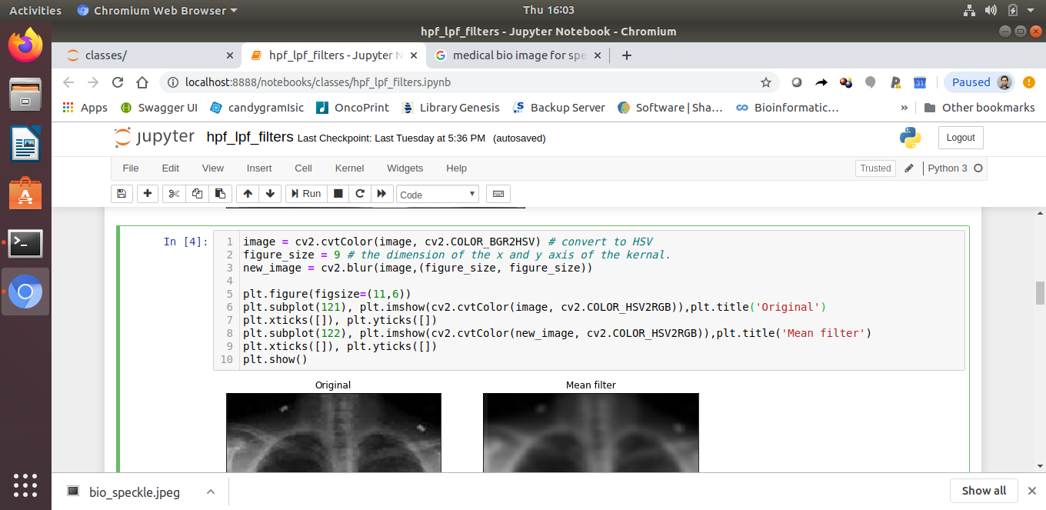
Mean Filter

Slide 8
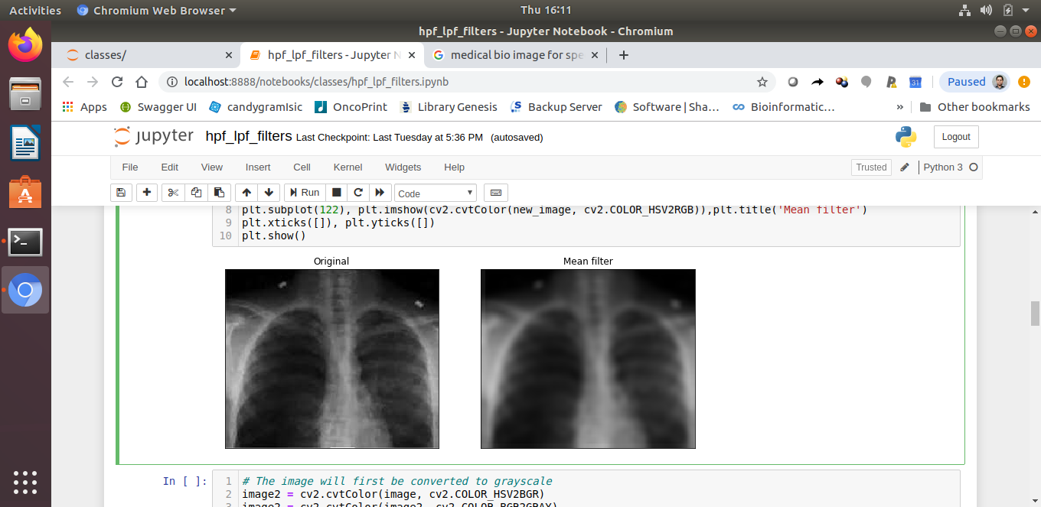
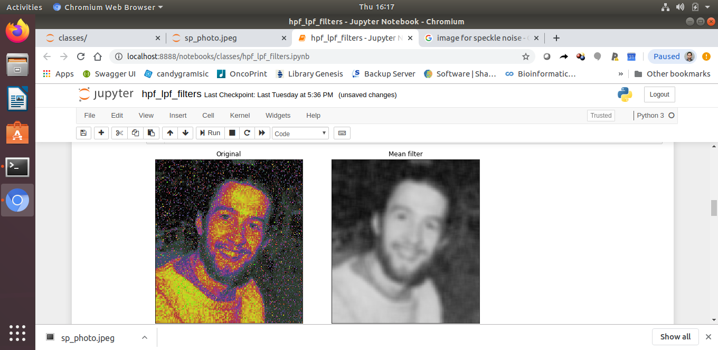
Mean filter

Slide 9
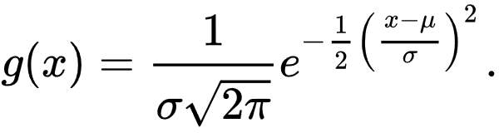

Gaussian Filter
it involves a weighted average of the surrounding pixels and has a parameter sigma.
The kernel represents a discrete approximation of a Gaussian distribution.
Gaussian filter blurs the edges of an image and preserving edges
The function allows to specify the shape of the kernel and also specify the standard deviation for the x and y directions separately.
If only one sigma value is specified then it is considered the sigma value for both the x and y directions.

Slide 10
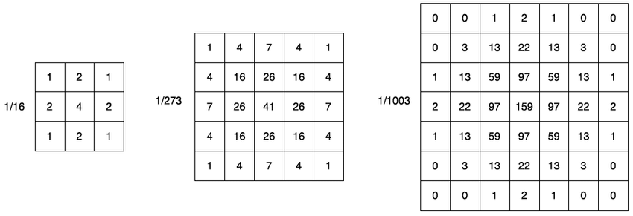
Gaussian Filter

Slide 11
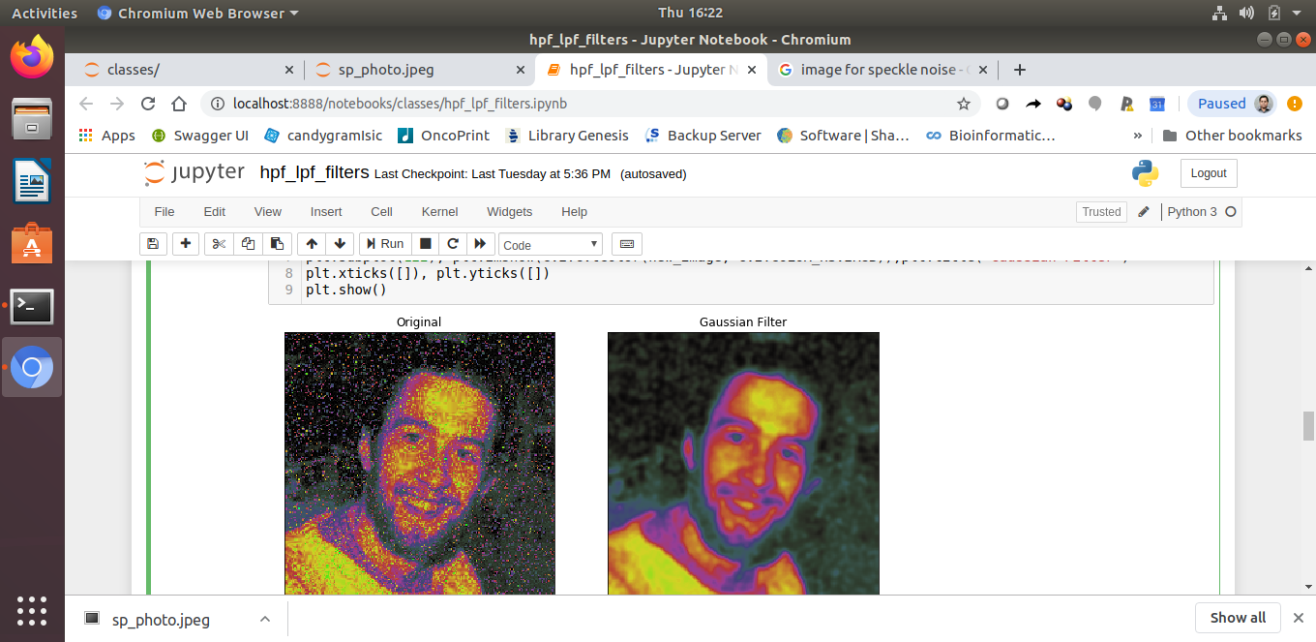
Gaussian filter
Gaussian filter does not produce artifacts when applied to a grayscale image
The filter can retain more detail than a 9 x 9 mean filter and remove some noise.
new_image = cv2.GaussianBlur(image, (figure_size, figure_size),0)

Slide 12
Gaussian filter
new_image = cv2.GaussianBlur(image, (figure_size, figure_size),0)

Slide 13
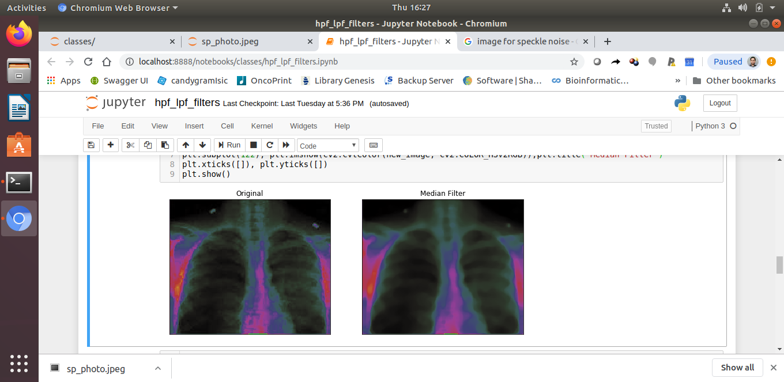
Median Filter
The median filter calculates the median of the pixel intensities that surround the center pixel in a n x n kernel.
The median replaces the pixel intensity of the center pixel
removing salt and pepper noise than the mean and Gaussian filters
The median filter preserves the edges of an image
it does not deal with speckle noise
Unlike the mean and Gaussian filter, the median filter does not produce artifacts on a color image.
new_image = cv2.medianBlur(image, figure_size)

Slide 14
Conservative Filter
The conservative filter is used to remove salt and pepper noise.
Determines the minimum intensity and maximum intensity within a neighborhood of a pixel.
If the intensity of the center pixel is greater than the maximum value it is replaced by the maximum value.
If it is less than the minimum value than it is replaced by the minimum value.
The conservative filter preserves edges but does not remove speckle noise.
the filter is not able to remove as much salt-and-pepper noise as a median filter (although it does preserve more detail.)

Slide 15
Conservative Filter
# first a conservative filter for grayscale images will be defined.
def conservative_smoothing_gray(data, filter_size):
temp = []
indexer = filter_size // 2
new_image = data.copy()
nrow, ncol = data.shape
for i in range(nrow):
for j in range(ncol):
for k in range(i-indexer, i+indexer+1):
for m in range(j-indexer, j+indexer+1):
if (k > -1) and (k < nrow):
if (m > -1) and (m < ncol):
temp.append(data[k,m])
temp.remove(data[i,j])
max_value = max(temp)
min_value = min(temp)
if data[i,j] > max_value:
new_image[i,j] = max_value
elif data[i,j] < min_value:
new_image[i,j] = min_value
temp =[]
return new_image.copy()

Slide 16
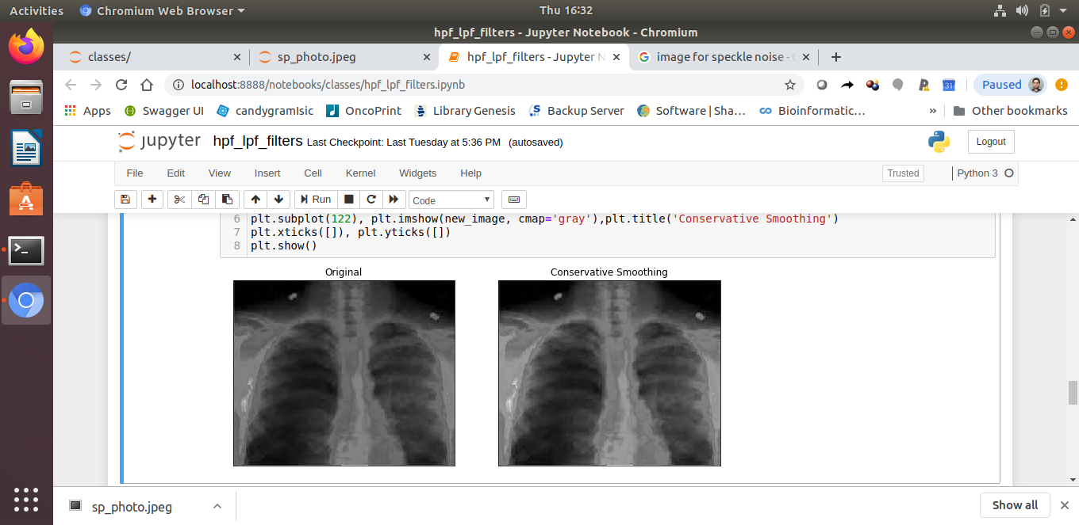
Conservative Filter

Slide 17
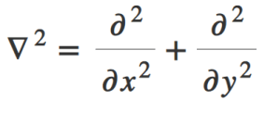
Laplacian Filter
The Laplacian of an image highlights the areas of rapid changes in intensity and can thus be used for edge detection.
let I(x,y) represent the intensities of an image then the Laplacian of the image is given by the following formula:
The discrete approximation of the Laplacian at a specific pixel can be determined by taking the weighted mean of the pixel intensities in a small neighborhood of the pixel

Slide 18
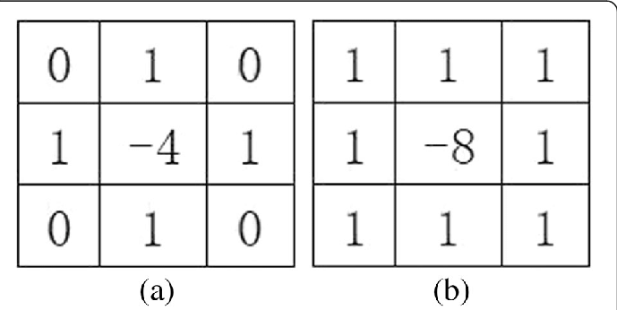
Laplacian Filter
two kernels which represent two different ways of approximating the Laplacian.
Since the Laplacian filter detects the edges of an image it can be used along with a Gaussian filter in order to first remove speckle noise and then to highlight the edges of an image.
This method is referred to as the Lapalcian of Gaussian filtering.
while adding the Laplacian of an image to the original image may enhance the edges, some of the noise is also enhanced.

Slide 19
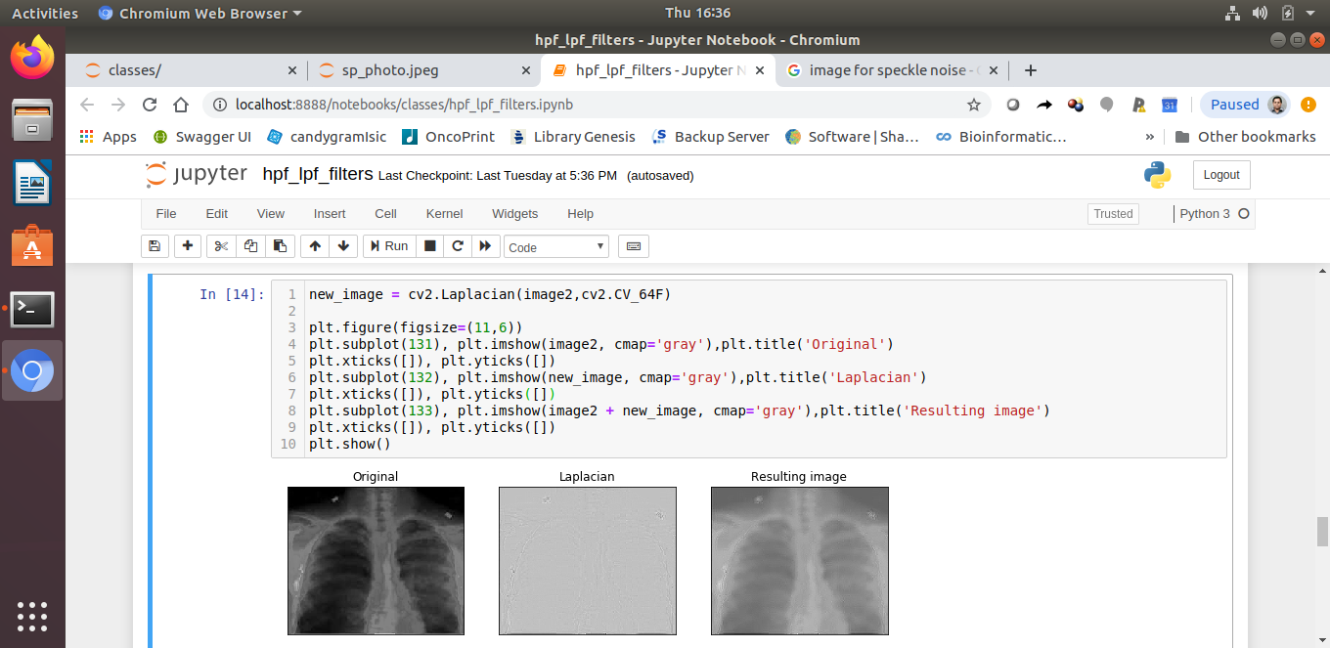
Laplacian Filter
new_image = cv2.Laplacian(image2,cv2.CV_64F)
plt.imshow(image2 + new_image, cmap='gray'),plt.title('Resulting image')

Slide 20
Frequency Filter
When applying frequency filters to an image it is important to first convert the image to the frequency domain representation of the image.
The Fourier transform (which decomposes a function into its sine and cosine components) can be applied to an image in order to obtain its frequency domain representation.
The reason we are interested in an image’s frequency domain representation is that it is less expensive to apply frequency filters to an image in the frequency domain than it is to apply the filters in the spatial domain.

Slide 21
Frequency Filter
it is less expensive to apply frequency filters to an image in the frequency domain than it is to apply the filters in the spatial domain.
This is due to the fact that each pixel in the frequency domain representation corresponds to a frequency rather than a location of the image.
a decent amount of detail was lost however some of the speckle noise was removed.

Slide 22
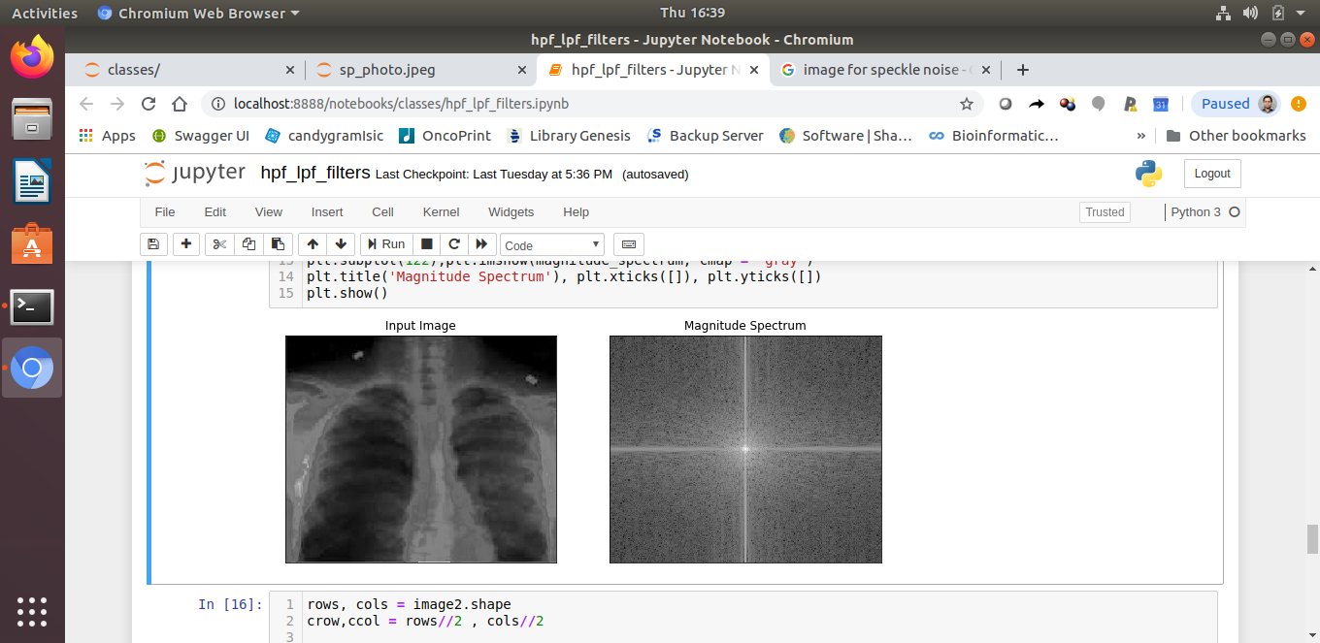
Frequency Filter

Slide 23
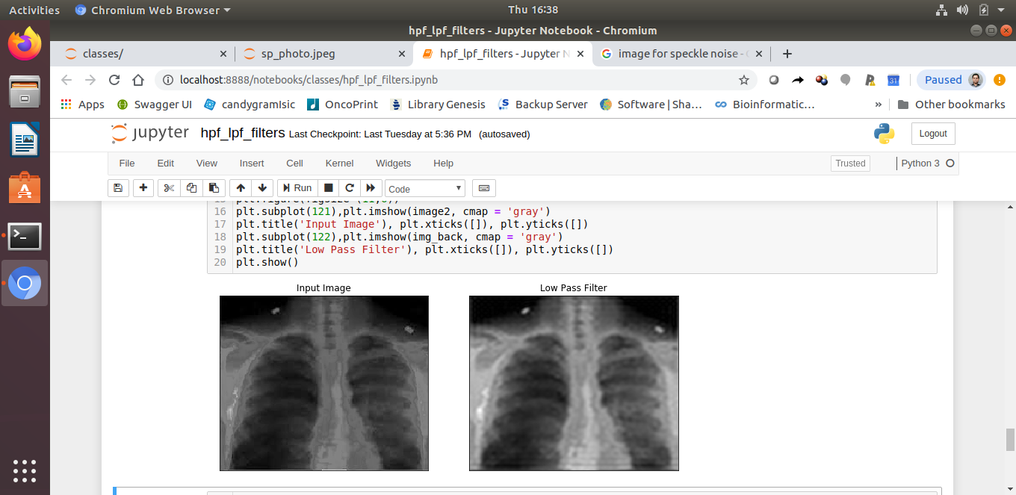
Frequency Filter

Slide 24
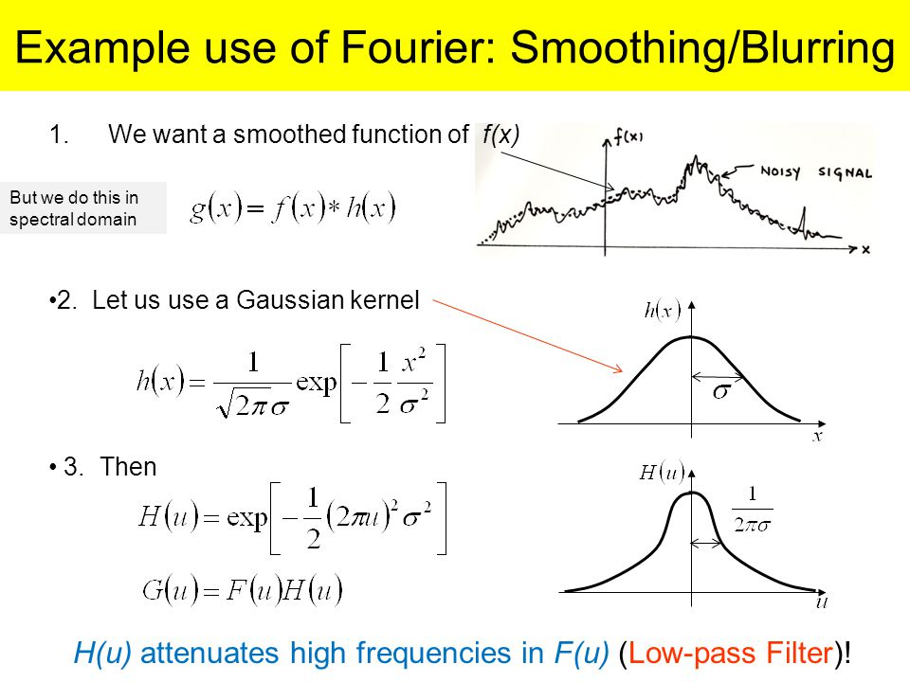
Frequency Filter

Slide 25
Unsharp Filter
The Unsharp filter can be used to enhance the edges of an image.
The ImageFilter.Unsharpmask function has three parameters.
The ‘radius’ parameter specifies how many neighboring pixels around edges get affected.
The ‘percentage’ parameter specifies how much darker or lighter the edges become.
The third parameter ‘threshold’ defines how far apart adjacent tonal values have to be before the filter does anything.

Slide 26
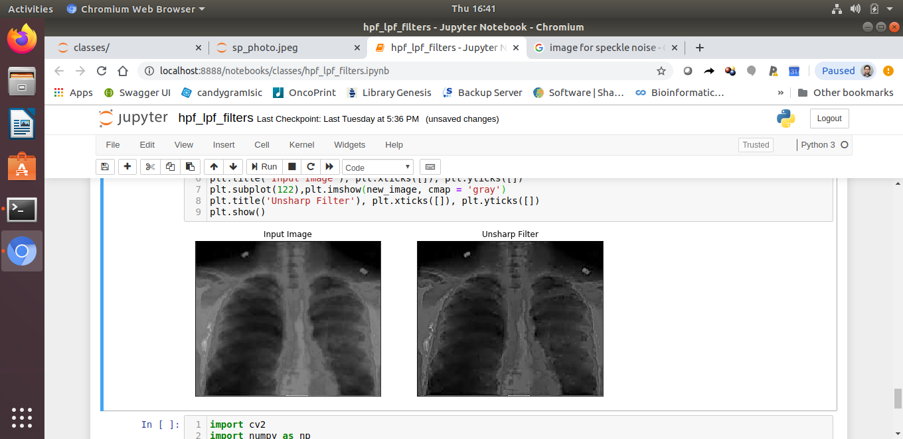
Unsharp Filter
image2 = Image.fromarray(image2.astype('uint8'))
new_image = image2.filter(ImageFilter.UnsharpMask(radius=2, percent=150))

Slide 27
Bilateral Filtering
Bilateral filtering also takes a Gaussian filter in space, but one more Gaussian filter which is a function of pixel difference.(two gaussian)
The Gaussian function of space makes sure that only nearby pixels are considered for blurring, while the Gaussian function of intensity difference makes sure that only those pixels with similar intensities to the central pixel are considered for blurring.
So it preserves the edges since pixels at edges will have large intensity variation.
The below sample shows use of a bilateral filter
blur = cv.bilateralFilter(img,9,75,75)

Slide 28
Bilateral Filtering
cv.bilateralFilter() is highly effective in noise removal while keeping edges sharp. But the operation is slower compared to other filters.
We already saw that a Gaussian filter takes the neighbourhood around the pixel and finds its Gaussian weighted average.
This Gaussian filter is a function of space alone, that is, nearby pixels are considered while filtering. It doesn't consider whether pixels have almost the same intensity.
It doesn't consider whether a pixel is an edge pixel or not. So it blurs the edges also, which we don't want to do.

Slide 29
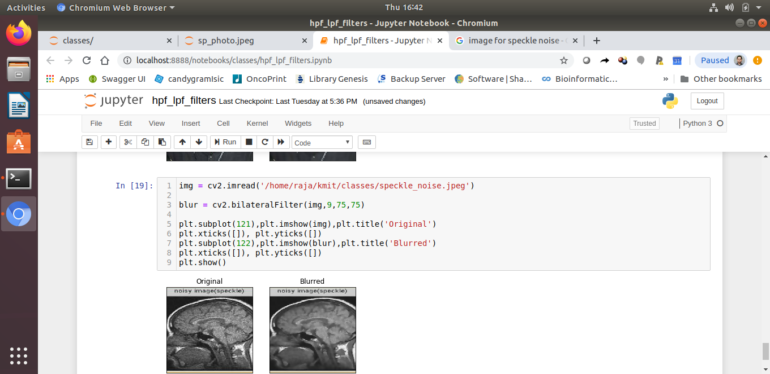
Bilateral Filtering

Slide 30
Mode Filter
The mode filter replaces each pixel of a Digital image with the mode value of its neighborhood pixel window.
The class ImageFilter.ModeFilter implements the mode filter.
As per Pillow's implementation, to consider a pixel value as mode, the value should at least occur twice in the neighborhood. Else the original pixel value is retained in the image.
Similar to the median filter the mode filter as well is an edge preserving filter.

Slide 31
Linear and Non-Linear Filtering of Images
Linear filtering is filtering in which the value of an output pixel is a linear combination of the values of the pixels in the input pixel's neighborhood.
Linear filtering of an image is accomplished through an operation called convolution
Convolution is a neighborhood operation in which each output pixel is the weighted sum of neighboring input pixels.
The matrix of weights is called the convolution kernel, also known as the filter.

Slide 32
Image filters;
There is always a trade off between removing noise and preserving the edges of an image.
In order to remove the speckle noise in an image ,a blurring filter needs to be applied which in turn blurs the edges of the image.
To retain the edges of an image the only noise that can remove is the salt-and-pepper noise.

Slide 33
Linear and Non-Linear Filtering of Images

Slide 34
Linear and Non-Linear Filtering of Images

Slide 35
Mode Filter

