Slide 1
Non-local Denoising
Have seen many image smoothing techniques like Gaussian Blurring, Median Blurring etc
Those techniques took a small neighbourhood around a pixel and did some operations like gaussian weighted average, median of the values etc to replace the central element.
In short, noise removal at a pixel was local to its neighbourhood.

Slide 2
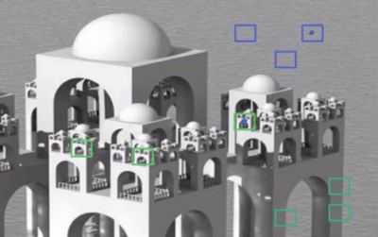
Non-local Denoising
The blue patches in the image looks the similar.
Green patches looks similar. take a pixel,
take small window around it, search for similar windows in the image,
average all the windows and replace the pixel with the result.
This method is Non-Local Means Denoising.
It takes more time compared to blurring techniques, but its result is very good.

Slide 3
Non-local Denoising
The blue patches in the image looks the similar.
Green patches looks similar. take a pixel,
take small window around it, search for similar windows in the image,
average all the windows and replace the pixel with the result.
This method is Non-Local Means Denoising.
It takes more time compared to blurring techniques, but its result is very good.

Slide 4
Non-local Denoising
This method is Non-Local Means Denoising.
It takes more time compared to blurring techniques, but its result is very good.
For color images, image is converted to CIELAB colorspace and then it separately denoise L and AB components.

Slide 5
Non-local Denoising
cv.fastNlMeansDenoisingColored()
it is used to remove noise from color images. (Noise is expected to be gaussian).
import numpy as np
import cv2 as cv
from matplotlib import pyplot as plt
img = cv.imread('die.png')
dst = cv.fastNlMeansDenoisingColored(img,None,10,10,7,21)
plt.subplot(121),plt.imshow(img)
plt.subplot(122),plt.imshow(dst)
plt.show()

Slide 6
Non-local Denoising
cv.fastNlMeansDenoisingColored()
it is used to remove noise from color images. (Noise is expected to be gaussian).
import numpy as np
import cv2 as cv
from matplotlib import pyplot as plt
img = cv.imread('die.png')
dst = cv.fastNlMeansDenoisingColored(img,None,10,10,7,21)
plt.subplot(121),plt.imshow(img)
plt.subplot(122),plt.imshow(dst)
plt.show()

Slide 7
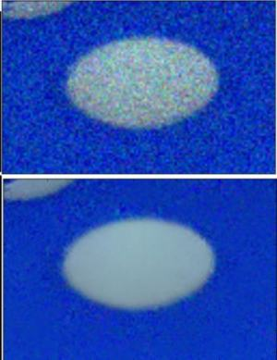
Non-local Denoising
h : parameter deciding filter strength. Higher h value removes noise better, but removes details of image also. (10)
templateWindowSize : should be odd. (recommended 7)
searchWindowSize : should be odd. (recommended 21)

Slide 8
RGB to Lab space
L stands for lightness, and
a and b for the color spectrums green–red and blue–yellow.
A Lab encoded image has one layer for grayscale and
have packed three color layers into two.
import numpy as np
from skimage import color, io
# Open image and make Numpy arrays 'rgb' and 'Lab'
rgb = io.imread('image.png')
Lab = color.rgb2lab(rgb)

Slide 9
RGB to Lab space -output
Lab[:,:,0].min() # L min
32.29567256501352
Lab[:,:,0].max() # L max
97.13950703971322
Lab[:,:,1].min() # a min
-86.18302974439501
Lab[:,:,1].max() # a max
98.23305386311316
Lab[:,:,2].min() # b min
-107.85730020669489
Lab[:,:,2].max() # b max
94.47812227647823

Slide 10
Image Restoration
Image restoration is the operation of taking a corrupt/noisy image and estimating the clean, original image.
Corruption may come in many forms such as motion blur, noise and camera mis-focus. ...
More advanced image processing techniques must be applied to recover the object.

Slide 11
Image Restoration
import numpy as np
import cv2
img = cv2.imread('people.jpg')
grayscale = cv2.cvtColor(img, cv2.COLOR_BGR2GRAY)
# edgekernel = np.array([[-1,-1,-1], [-1,9,-1], [-1,-1,-1]])
sharpen_kernel = np.array([[0,-1,0], [-1,5,-1], [0,-1,0]])
img = cv2.filter2D(grayscale, -1, sharpen_kernel)
# Smooth out image
# blur = cv2.medianBlur(img, 3)
blur = cv2.GaussianBlur(img, (3,3), 0)
cv2.imshow('img',img)
cv2.imwrite('img.png',img)
cv2.imshow('blur',blur)
cv2.waitKey(0)

Slide 12
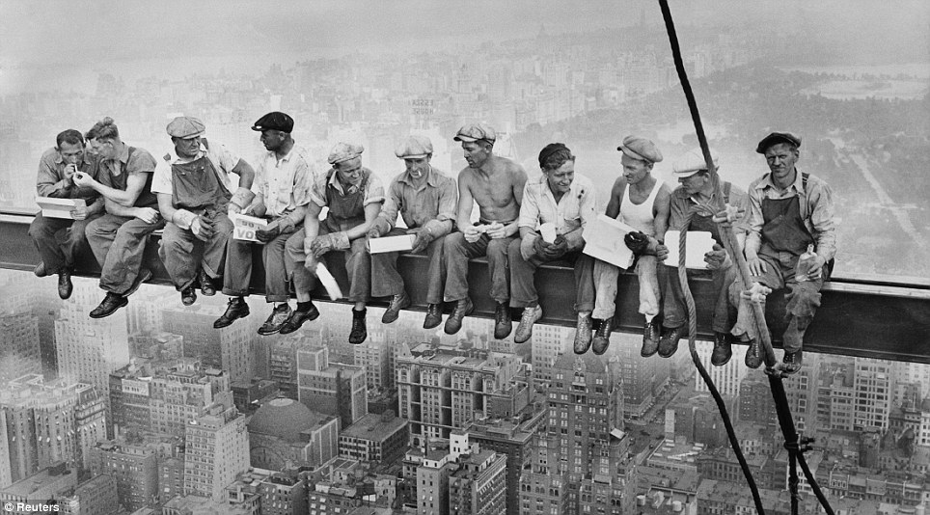
Histogram Equalizer

Slide 13
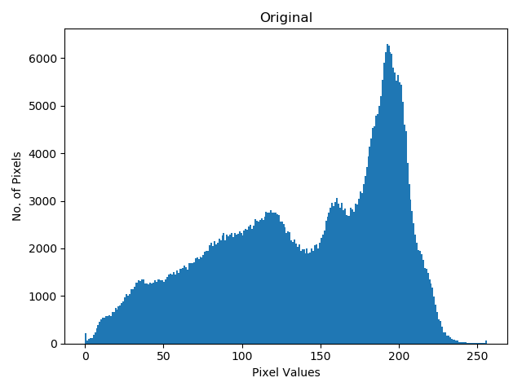
Histogram
from matplotlib import pyplot as plt
import cv2
# Load in image as grayscale
image = cv2.imread('1.jpg', 0)
plt.hist(image.ravel(), 256, [0,256])

Slide 14
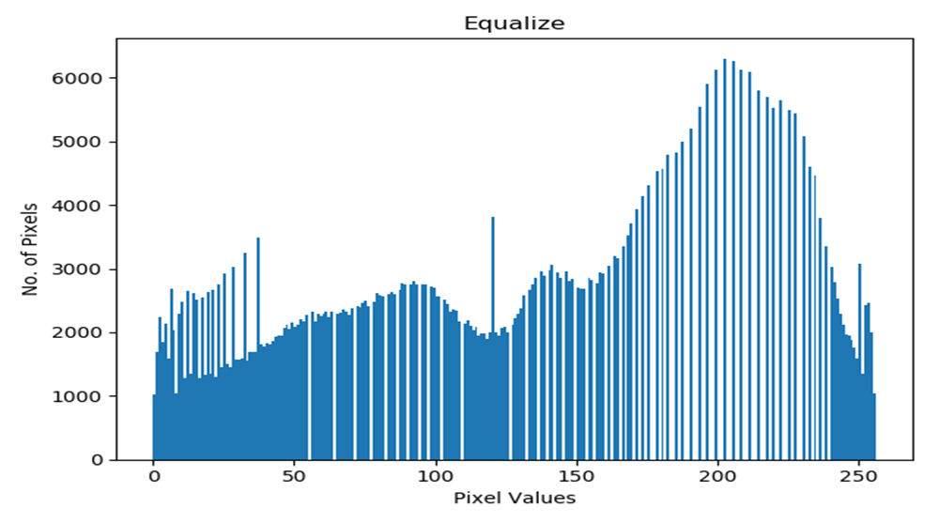
Histogram Equalizer
equalize = cv2.equalizeHist(image)
plt.hist(equalize.ravel(), 256, [0,256])

Slide 15
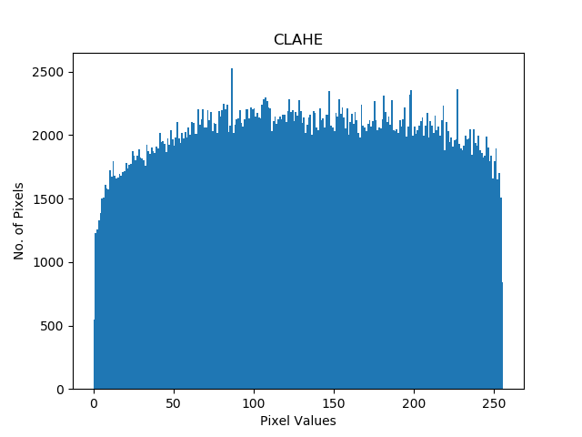
CLAHE
In some cases where there are intensity variations across a large region, CLAHE (Contrast Limited Adaptive Histogram Equalization) may be better
clahe = cv2.createCLAHE().apply(image)
plt.hist(clahe.ravel(), 256, [0,256])

Slide 16
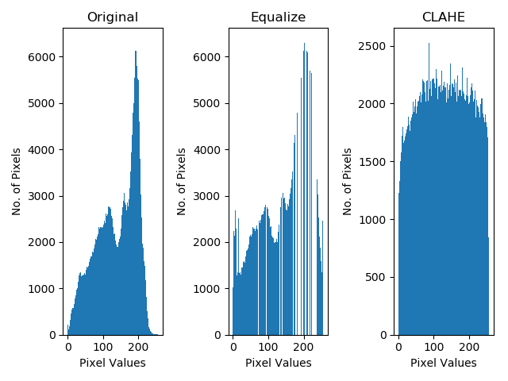
Histogram Analysis

Slide 17
Unsharp Masking and Highboost filtering
sharpen an image or perform edge enhancement using a smoothing filter.
First blur the image. smoothing an image suppress most of the high-frequency components.
Then subtract this smoothed image from the original image(the resulting difference is known as a mask).
Thus, the output image will have most of the high-frequency components that are blocked by the smoothing filter.
Adding this mask back to the original will enhance the high-frequency components.

Slide 18

Unsharp Masking and Highboost filtering
Because using a blurred or unsharp image to create a mask this technique is known as Unsharp Masking.
Thus, unsharp masking first produces a mask m(x,y) as
where, f(x,y) is the original image and fb(x,y) is the blurred version of the original image.
Then this mask is added back to the original image which results in enhancing the high-frequency components.
where k specifies what portion of the mask to be added. When k= 1 this is known as Unsharp masking. For k>1 we call this as high-boost filtering because we are boosting the high-frequency components by giving more weight to the masked (edge) image.

Slide 19
Unsharp Masking and Highboost filtering
Then this mask is added back to the original image which results in enhancing the high-frequency components.
where k specifies what portion of the mask to be added.
When k= 1 this is known as Unsharp masking.
For k>1 we call this as high-boost filtering because we are boosting the high-frequency components by giving more weight to the masked (edge) image.

Slide 20
Unsharp Masking and Highboost filtering
We can also write the above two equations into one as the weighted average of the original and the blurred image.
Note: Instead of subtracting the blurred image from the original, we can directly use a negative Laplacian filter to obtain the mask.
If the image contains noise, this method will not produce satisfactory results, like most of the other sharpening filters.

Slide 21
Unsharp Masking and Highboost filtering
OpenCV-Python
Since in the last equation we described unsharp masking as the weighted average of the original and the input image, we will simply use OpenCV cv2.addWeighted() function.
import cv2
# Load the image
image = cv2.imread("D:/downloads/kang.jpg")
# Blur the image
gauss = cv2.GaussianBlur(image, (7,7), 0)
# Apply Unsharp masking
unsharp_image = cv2.addWeighted(image, 2, gauss, -1, 0)

Slide 22
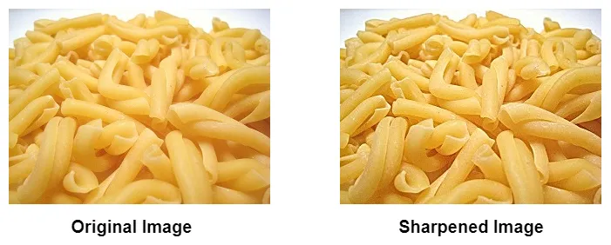
Unsharp Masking and Highboost filtering

Slide 23
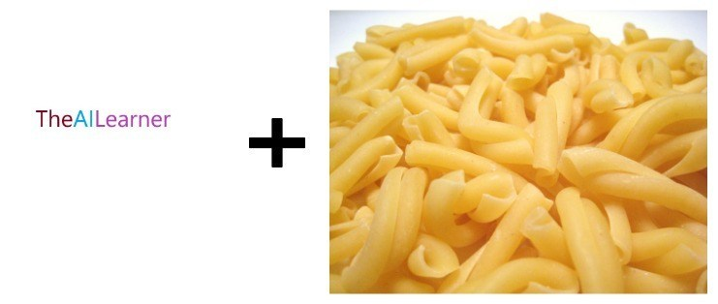
Image Overlays using Bitwise Operations
to overlay an image to another image using OpenCV

Slide 24
Bitwise Operations
TheAILearner text is non-rectangular, we will be using OpenCV cv2.bitwise_and(img1, img2, mask)
where the mask is an 8-bit single channel array, that specifies elements of the output array to be changed.
For Bitwise_and you need to know the following two rules
Black + Any Color = Black
White + Any Color = That Color

Slide 25
Bitwise Operations
First load the two images
img1 = cv2.imread('D:/downloads/pasta_screen.jpg')
img2 = cv2.imread('D:/downloads/logo.jpg’)

Slide 26
Bitwise Operations
Select the region in the image where you want to put the logo. Here, we are putting this in the top left corner.
rows,cols,channels = img2.shape
roi = img1[0:rows, 0:cols ]
Now, we will create a mask. we will be using thresholding for this as shown in the code below. We will also create an inverse mask.
Depending on the image you need to change the thresholding function parameters.
img2gray = cv2.cvtColor(img2,cv2.COLOR_BGR2GRAY)
ret, mask = cv2.threshold(img2gray, 200, 255, cv2.THRESH_BINARY_INV)
mask_inv = cv2.bitwise_not(mask)

Slide 27
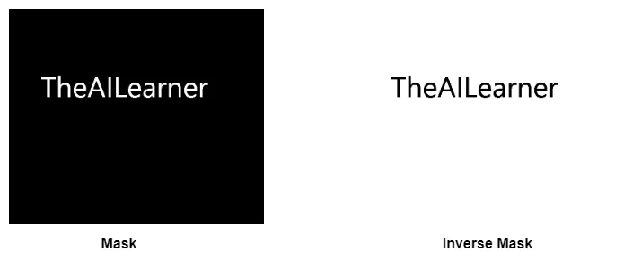
Bitwise Operations
The mask and mask_inv looks like this
Now black out the area of logo in the roi created above using the bitwise_and as shown in the code below
img1_bg = cv2.bitwise_and(roi,roi,mask = mask_inv)

Slide 28
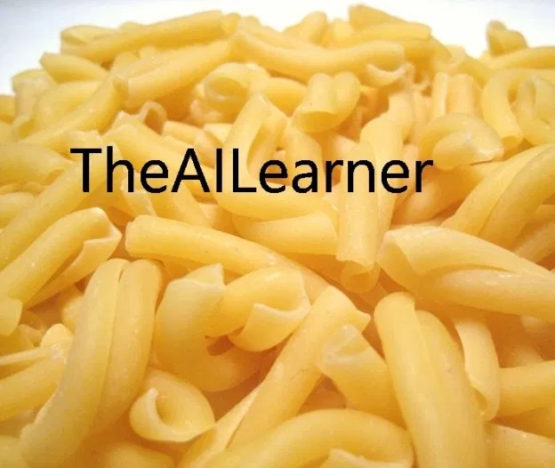
Bitwise Operations
This looks like this
Now, we will extract the logo region (with colors) from the logo image using the following code
img2_fg = cv2.bitwise_and(img2,img2,mask = mask)

Slide 29

Bitwise Operations
The output looks like this
Now, we will simply add the above two images because black has intensity 0 so adding this doesn’t change anything and outputs the same color. This is done using the following code
out_img = cv2.add(img1_bg,img2_fg)
img1[0:rows, 0:cols ] = out_img

Slide 30
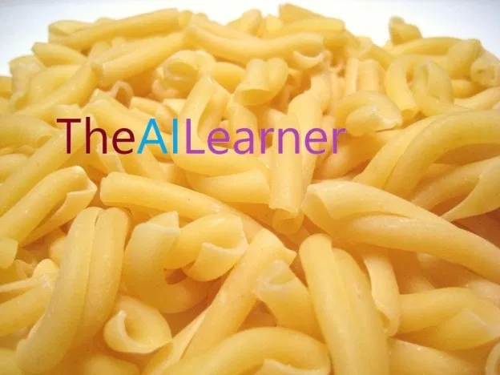
Bitwise Operations
The final output looks like this

Slide 31
Image Restoration –Inverse filter
Given a known image function, f(x,y), and a blurring function, h(x,y), we need to recover f(x,y) from the convolution g(x,y)=f(x,y)*h(x,y).
(Note: * is used to represent convolution and x is used to represent multiplication).
A Possible Solution: Inverse Filtering
In the frequency domain we have: G(u,v)=F(u,v) x H(u,v)
F is the FFT2 of the image matrix, f.
H is the FFT2 of the complex distoring function, h.
G is the FFT2 of the "observed" image, g
The noise solution to this problem is to filter by dividing the 2-dimensional fft of the blurred function by the reciprocal of H(u,v):
G(u,v)/H(u,v)=F(u,v) x H(u,v)/H(u,v) = F(u,v).
This is commonly reffered to as the inverse filtering method where 1/H(u,v) is the inverse filter.

Slide 32
Image Restoration –Inverse filter
dft = cv2.dft(np.float32(image2),flags = cv2.DFT_COMPLEX_OUTPUT
# shift the zero-frequncy component to the center of the spectrum
dft_shift = np.fft.fftshift(dft)
rows, cols = image2.shapecrow,ccol = rows//2 , cols//2
# create a mask first, center square is 1, remaining all zeros
mask = np.zeros((rows,cols,2),np.uint8)
mask[crow-30:crow+30, ccol-30:ccol+30] =1
# apply mask and inverse DFT
fshift = dft_shift*maskf_ishift = np.fft.ifftshift(fshift)
img_back = cv2.idft(f_ishift)
img_back = cv2.magnitude(img_back[:,:,0],img_back[:,:,1])

Slide 33
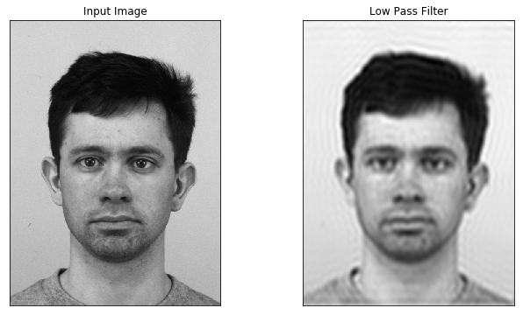
Image Restoration –Inverse filter
# plot both images
plt.figure(figsize=(11,6))plt.subplot(121),
plt.imshow(image2, cmap = 'gray')plt.title('Input Image’),
plt.xticks([]), plt.yticks([])plt.subplot(122),
plt.imshow(img_back, cmap = 'gray’)
plt.title('Low Pass Filter'), plt.xticks([]), plt.yticks([])plt.show()

Slide 34
Image Restoration –Wiener filter
Theory
The inverse filtering is a restoration technique for deconvolution, i.e., when the image is blurred by a known lowpass filter,
it is possible to recover the image by inverse filtering or generalized inverse filtering.
However, inverse filtering is very sensitive to additive noise.
The approach of reducing one degradation at a time allows us to develop a restoration algorithm for each type of degradation and simply combine them.

Slide 35
Image Restoration –Wiener filter
The Wiener filtering executes an optimal tradeoff between inverse filtering and noise smoothing.
It removes the additive noise and inverts the blurring simultaneously.
The Wiener filtering is optimal in terms of the mean square error.
In other words, it minimizes the overall mean square error in the process of inverse filtering and noise smoothing.
The Wiener filtering is a linear estimation of the original image. The approach is based on a stochastic framework

Slide 36
Image Restoration –Wiener filter
import os
import numpy as np
from numpy.fft import fft2, ifft2
from scipy.signal import gaussian, convolve2d
import matplotlib.pyplot as plt
def blur(img, kernel_size = 3):
dummy = np.copy(img)
h = np.eye(kernel_size) / kernel_size
dummy = convolve2d(dummy, h, mode = 'valid')
return dummy
def add_gaussian_noise(img, sigma):
gauss = np.random.normal(0, sigma, np.shape(img))
noisy_img = img + gauss
noisy_img[noisy_img < 0] = 0
noisy_img[noisy_img > 255] = 255
return noisy_img

Slide 37
Image Restoration –Wiener filter
def wiener_filter(img, kernel, K):
kernel /= np.sum(kernel)
dummy = np.copy(img)
dummy = fft2(dummy)
kernel = fft2(kernel, s = img.shape)
kernel = np.conj(kernel) / (np.abs(kernel) ** 2 + K)
dummy = dummy * kernel
dummy = np.abs(ifft2(dummy))
return dummy
def gaussian_kernel(kernel_size = 3):
h = gaussian(kernel_size, kernel_size / 3).reshape(kernel_size, 1)
h = np.dot(h, h.transpose())
h /= np.sum(h)
return h

Slide 38
Image Restoration –Wiener filter
def rgb2gray(rgb):
return np.dot(rgb[...,:3], [0.2989, 0.5870, 0.1140])
if __name__ == '__main__':
# Load image and convert it to gray scale
file_name = os.path.join('/home/raja/kmit/classes/lena_rgb.jpeg')
img = rgb2gray(plt.imread(file_name))
# Blur the image
blurred_img = blur(img, kernel_size = 15)
# Add Gaussian noise
noisy_img = add_gaussian_noise(blurred_img, sigma = 20)

Slide 39
Image Restoration –Wiener filter
# Apply Wiener Filter
kernel = gaussian_kernel(3)
filtered_img = wiener_filter(noisy_img, kernel, K = 10)
# Display results
display = [img, blurred_img, noisy_img, filtered_img]
label = ['Original Image', 'Motion Blurred Image', 'Motion Blurring + Gaussian Noise', 'Wiener Filter applied']
fig = plt.figure(figsize=(12, 10))
for i in range(len(display)):
fig.add_subplot(2, 2, i+1)
plt.imshow(display[i], cmap = 'gray')
plt.title(label[i])
plt.show()

Slide 40
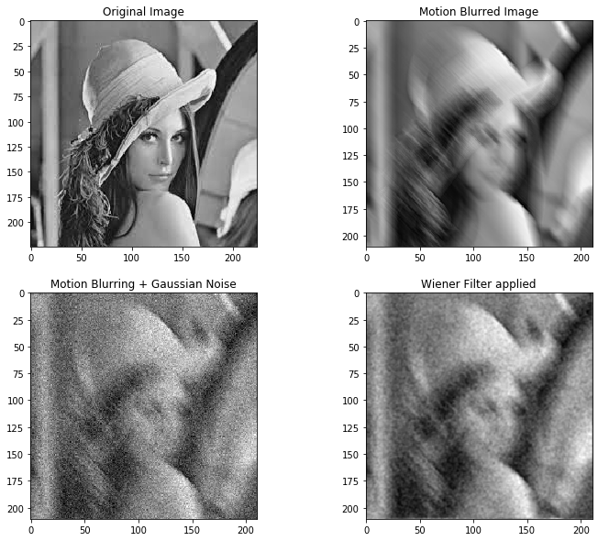
Image Restoration –Wiener filter

Slide 41
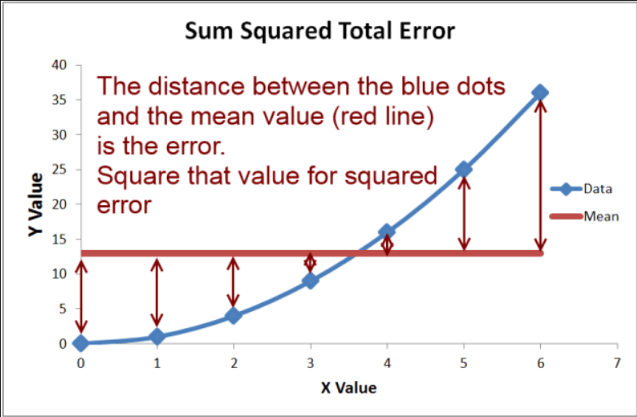
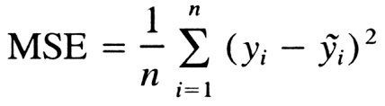
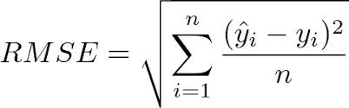
Image Restoration –Mean Square Error
the average squared difference between the estimated values and the actual value.

Slide 42
Image Restoration –Mean Square Error
import cv2
import numpy as np
from skimage.measure import compare_ssim as ssim
def mse(imageA, imageB):
# the 'Mean Squared Error' between the two images is the
# sum of the squared difference between the two images;
# NOTE: the two images must have the same dimension
err = np.sum((imageA.astype("float") - imageB.astype("float")) ** 2)
err /= float(imageA.shape[0] * imageA.shape[1])
# return the MSE, the lower the error, the more "similar"
# the two images are

Slide 43
Image Restoration –Mean Square Error
def diff_remove_bg(img0, img, img1):
d1 = diff(img0, img)
d2 = diff(img, img1)
return cv2.bitwise_and(d1, d2)
x1 = cv2.imread("/home/raja/kmit/classes/face_filter.jpeg")
x2 = cv2.imread("/home/raja/kmit/classes/face_filtr2.png")
x1 = cv2.cvtColor(x1, cv2.COLOR_BGR2GRAY)
x2 = cv2.cvtColor(x2, cv2.COLOR_BGR2GRAY)
absdiff = cv2.absdiff(x1, x2)
cv2.imwrite("/home/raja/kmit/classes/absdiff.png", absdiff)
diff = cv2.subtract(x1, x2)
result = not np.any(diff)

Slide 44
Image Restoration –Mean Square Error
m = mse(x1, x2)
s = ssim(x1, x2)
print("mse: %s, ssim: %s" % (m, s))
if result:
print("The images are the same")
else:
cv2.imwrite("images/diff.png", diff)
print("The images are different")

Slide 45
Image Restoration –Mean Square Error
image_restoration(python)

