Slide 1
Mode Filter
class PIL.ImageFilter.ModeFilter(size=3)
Create a mode filter. Picks the most frequent pixel value in a box with the given size.
Pixel values that occur only once or twice are ignored; if no pixel value occurs more than twice, the original pixel value is preserved.
Parameters: size – The kernel size, in pixels.

Slide 2
Rank Filter
PIL.ImageFilter.RankFilter(size, rank)
Create a rank filter.
The rank filter sorts all pixels in a window of the given size, and returns the rank’th value.
Parameters:
size – The kernel size, in pixels.
rank – What pixel value to pick. Use 0 for a min filter, size * size / 2 for a median filter, size * size - 1 for a max filter, etc.

Slide 3
Equation of convolution
In general, a signal can be decomposed as a weighted sum of basis signals
In Fourier Series, any periodic signal (even rectangular pulse signal) can be represented by a sum of sine and cosine functions.
But here, we use impulse (delta) functions for the basis signals, instead of sine and cosine.

Slide 4
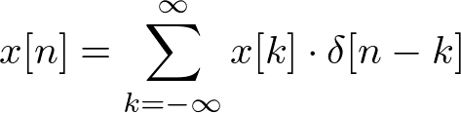

Equation of convolution
a signal can be written as sum of scaled and shifted delta functions;
then the output will be

Slide 5
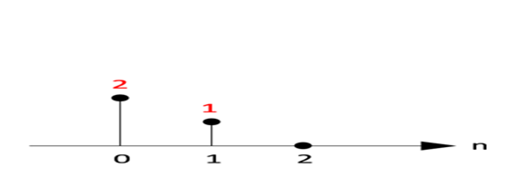
Equation of convolution
a signal is decomposed into a set of impulses and the output signal can be computed by adding the scaled and shifted impulse responses.
ImpulseResponse: h[n]

Slide 6
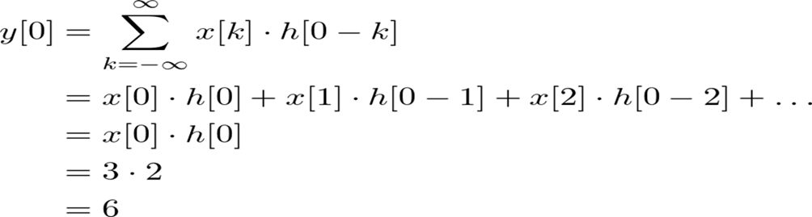
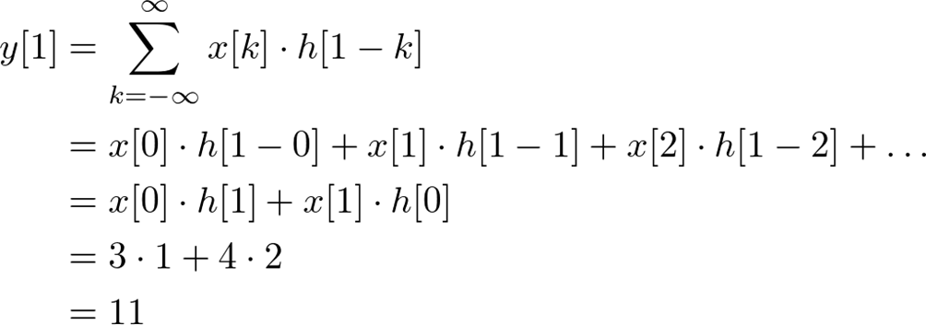
Equation of convolution

Slide 7
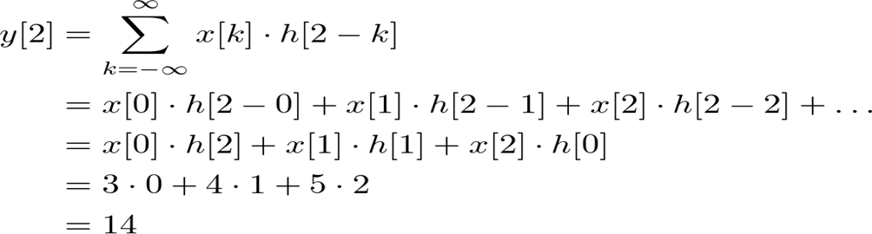
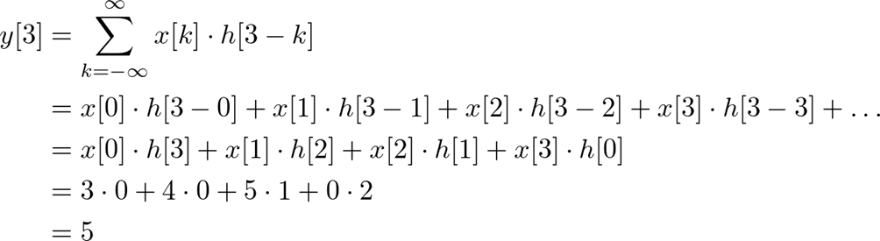
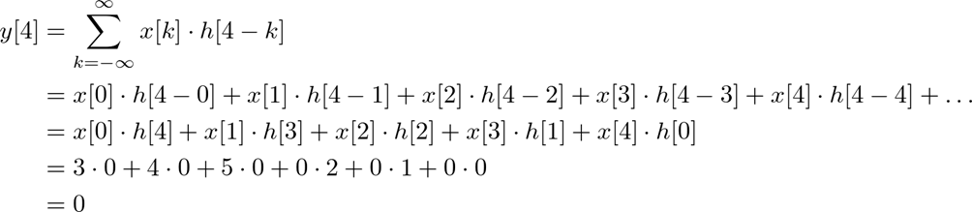
Equation of convolution

Slide 8
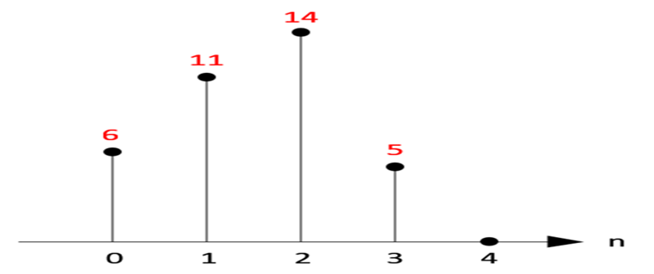
Equation of convolution

Slide 9
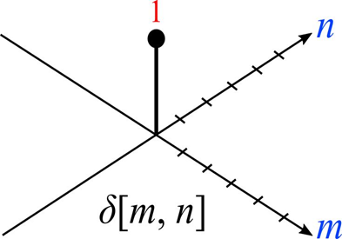
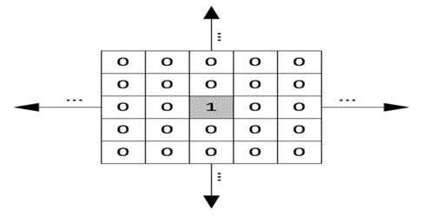
convolution in 2D
The impulse (delta) function is also in 2D space, so δ[m, n] has 1
The impulse response in 2D is usually called "kernel" or "filter" in image processing.
Delta function (Impulse function) in 2D space

Slide 10

convolution in 2D
The second image is 2D matrix representation of impulse function. The shaded center point is the origin where m=n=0.
And, the output of linear and time invariant system can be written by convolution of input signal x[m, n], and impulse response, h[m, n];
Notice that the kernel (impulse response) in 2D is center originated in most cases, which means the center point of a kernel is h[0, 0].

