Slide 1




UE19CS343 – Topics in Deep learning
Project Title : HISTOPATHOLOGIC CANCER DETECTION
Project Guide : Prof.ASHA JOSEPH
Project Team :
DEBOLEENA S MUKHERJEE PES2UG19CS102
DEVIKA S P PES2UG19CS109
ESHA H PES2UG19CS122

Slide 2



Outline
Problem Statement
Scope and Feasibility study
Applications/Use cases
Expected Deliverables
Capstone (Phase-I & Phase-II) Project Timeline
Any other information

Slide 3

Problem Statement
Analyzing an image and predicting whether it is cancerous cell or not , to analyze the degree of severity of the cancer cell. Also to work on a model which detects various type of cancer cell. Investigation of malignant cell growth and their characteristics by classifying the structure of the cell.

Slide 4
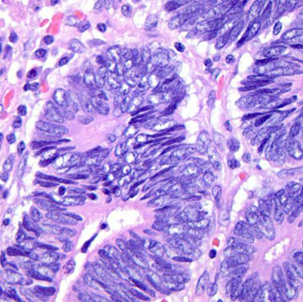
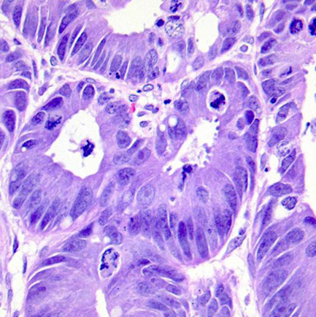
Cancer cells can grow uncontrollably throughout the body by changing the genetically DNA forms. In biologically cells normally divide and grow multiple amount on each division.
When this process applied on abnormal and damaged cells they grow multiple times then those form huge amount of tumors, but we have some benign tumors cells don’t grow back but they quite large can cause the mild symptoms if in brain it may be life threatening and that can’t be removed but comes to malignant tumors are dangerous that spread throughout the body leads to removal of the whole part.
To prevent this type of action we need to detect cancerous cell in the early stage will helps to take proper medicine that leads to probability of overcoming from the diseases is high.

Slide 5
objective
Assess the performance of automated deep learning algorithms at detecting metastases in hematoxylin and eosin–stained tissue sections of lymph nodes of women with breast cancer and compare it with pathologists’ diagnoses in a diagnostic setting.

Slide 6

Scope and Feasibility study
To analyze an image through a model and detect whether it is cancerous/not, benign/malignant and some other object classifications
Possible Shortcomings/Challenges:
To find datasets and build an object detection model with high accuracy.
To find a standard dataset for histopathologic metastatic cancer.
To use CNN model for the project.
Explore on GAN model
Constraints/Risk/challenges :
Doing object detection with high accuracy

Slide 7









Applications/Use cases
This capability is particularly well-suited to medical applications, especially those that depend on complex proteomic and genomic measurements.
As a result, machine learning is frequently used in cancer diagnosis and detection. More recently machine learning has been applied to cancer prognosis and prediction.
*An advantage of RT-PCR is that it can detect very small numbers of cancer cells in blood or tissue samples that would be missed by other tests.

Slide 8
Expected Deliverables
Review-I deliverables
-Defining clear problem statement and objectives
Literature Survey
-Reviewing scholarly articles ,research papers from various websites and
understanding theories and methods.
Review-II deliverables
-Implementation of the module of the project
-Demonstration of the project

Slide 9
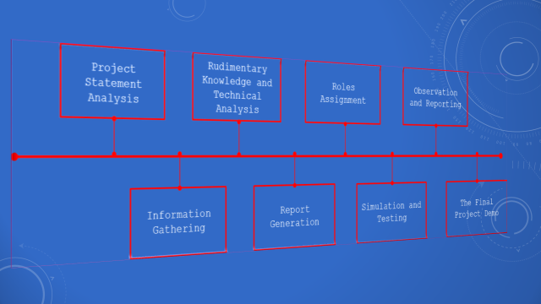

Slide 10
Literature Survey
A critical assessment of the research that has been conducted on histopathologic cancer cell detection.
▪Few recently published research papers/products.
(IEEE, ACM, Springer, Elsevier conference papers and Journal papers)
▪We summarize the individual papers/products with as much detail as each deserves, depending up on its relative importance in the overall literature on the topic.

Slide 11
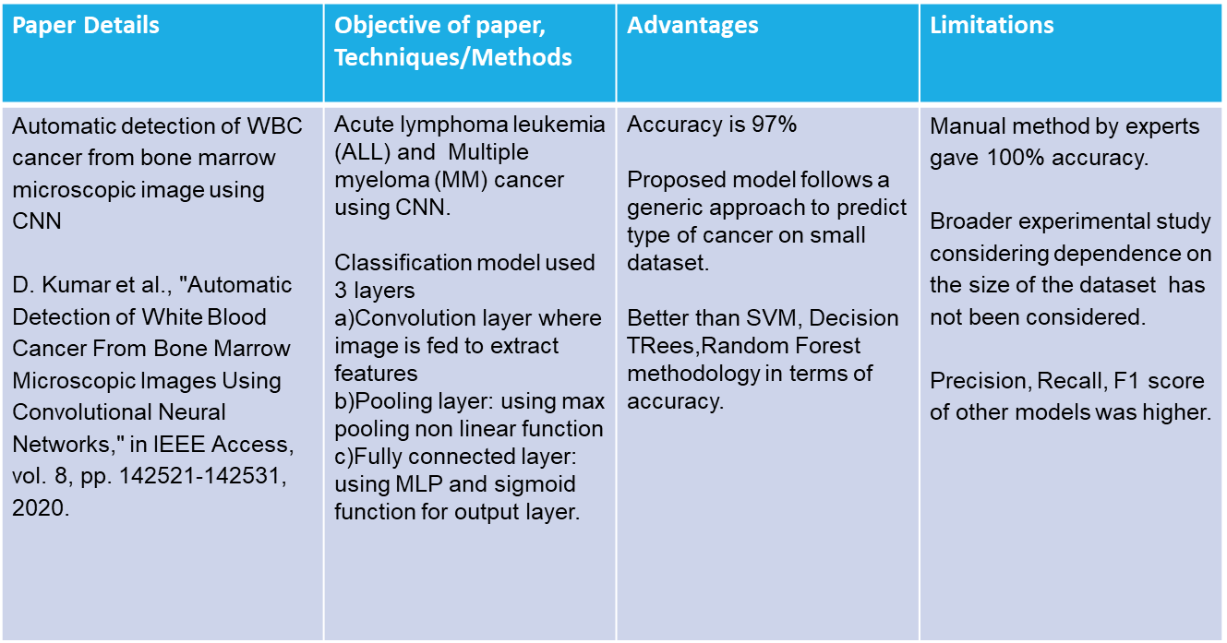

Slide 12
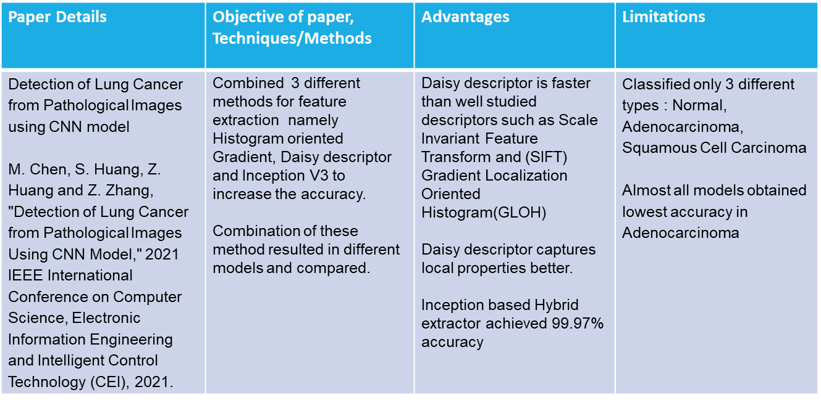

Slide 13
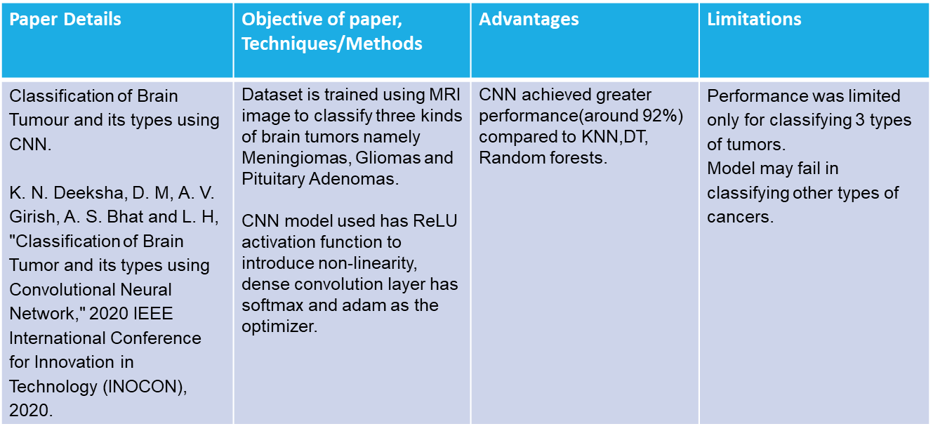

Slide 14
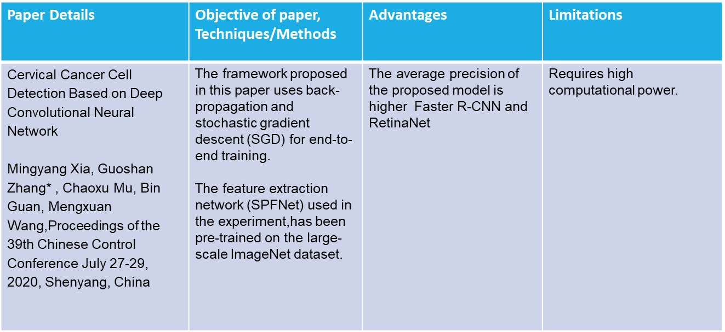

Slide 15
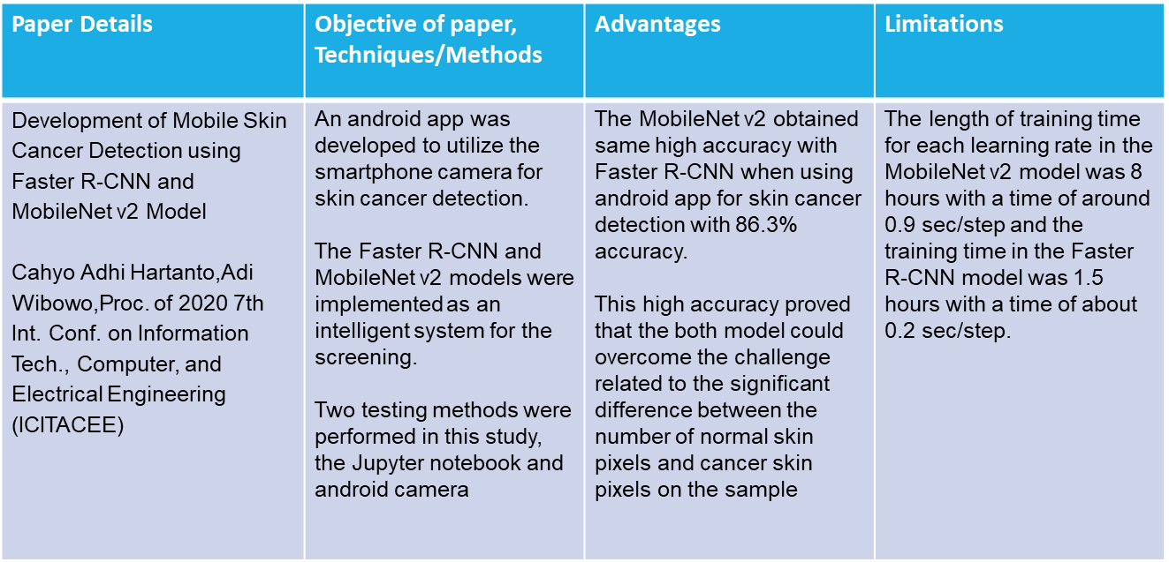

Slide 16
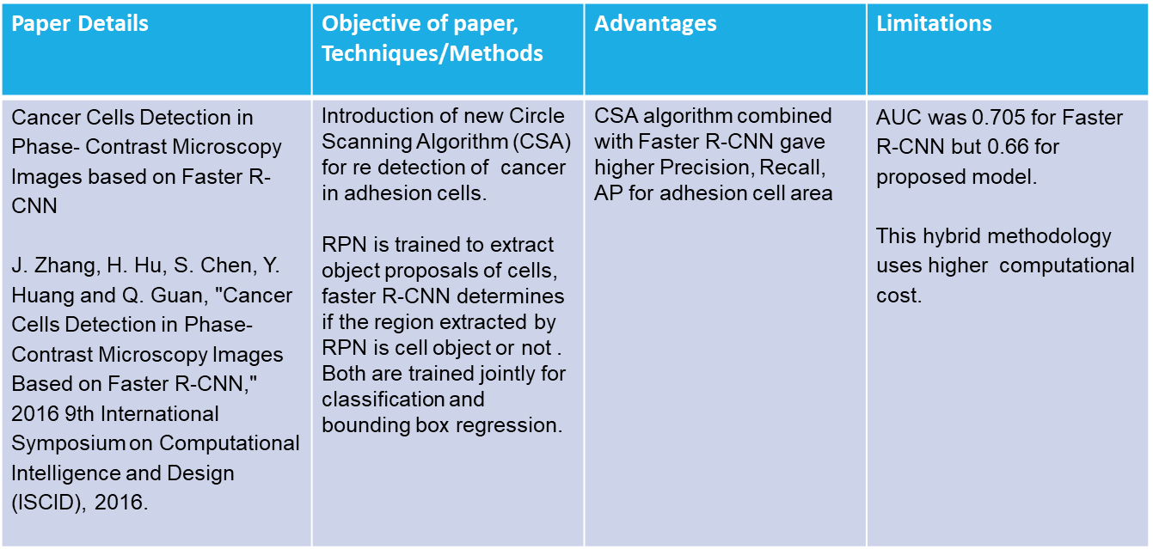

Slide 17
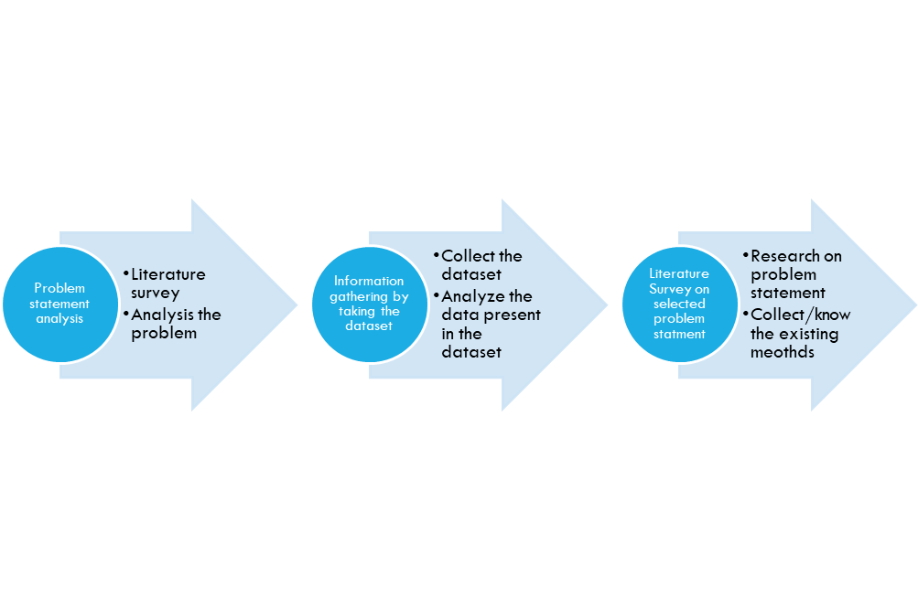

Slide 18
Any other information
Progress overview
The data for this kernel is a slightly modified version of the PatchCamelyon (PCam) benchmark dataset.The PatchCamelyon benchmark is a new and challenging image classification dataset. It consists of 327.680 color images (96 x 96px) extracted from histopathologic scans of lymph node sections.

Slide 19
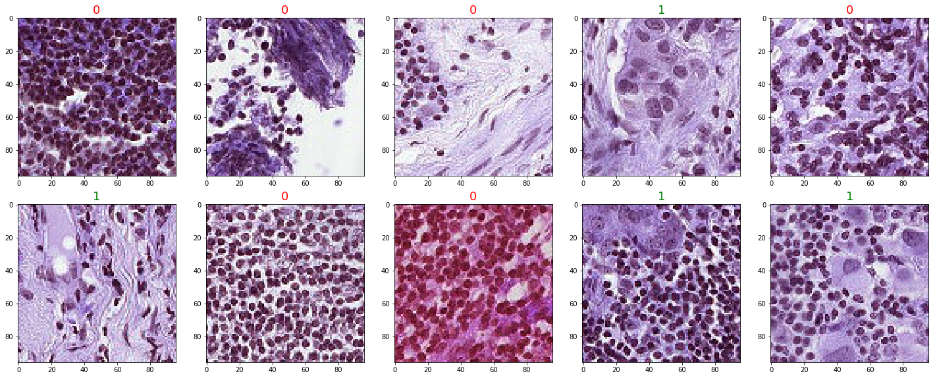

Slide 20

Thank You!

