Slide 1

Logistic Regression for Heart Disease Prediction
Applying statistical modelling to understand and predict coronary artery disease risk using real health data.
DATA SCIENCE
HEALTH ANALYTICS

Slide 2

Understanding Logistic Regression: The Basics
What is it?
A statistical method for predicting a binary outcome — such as the presence or absence of disease.
Key Goal
Determine whether predictor variables (exposures) have a significant relationship with the outcome.
Learning Objectives
Understand the model, how it differs from linear regression, and how to interpret odds ratios.

Slide 3
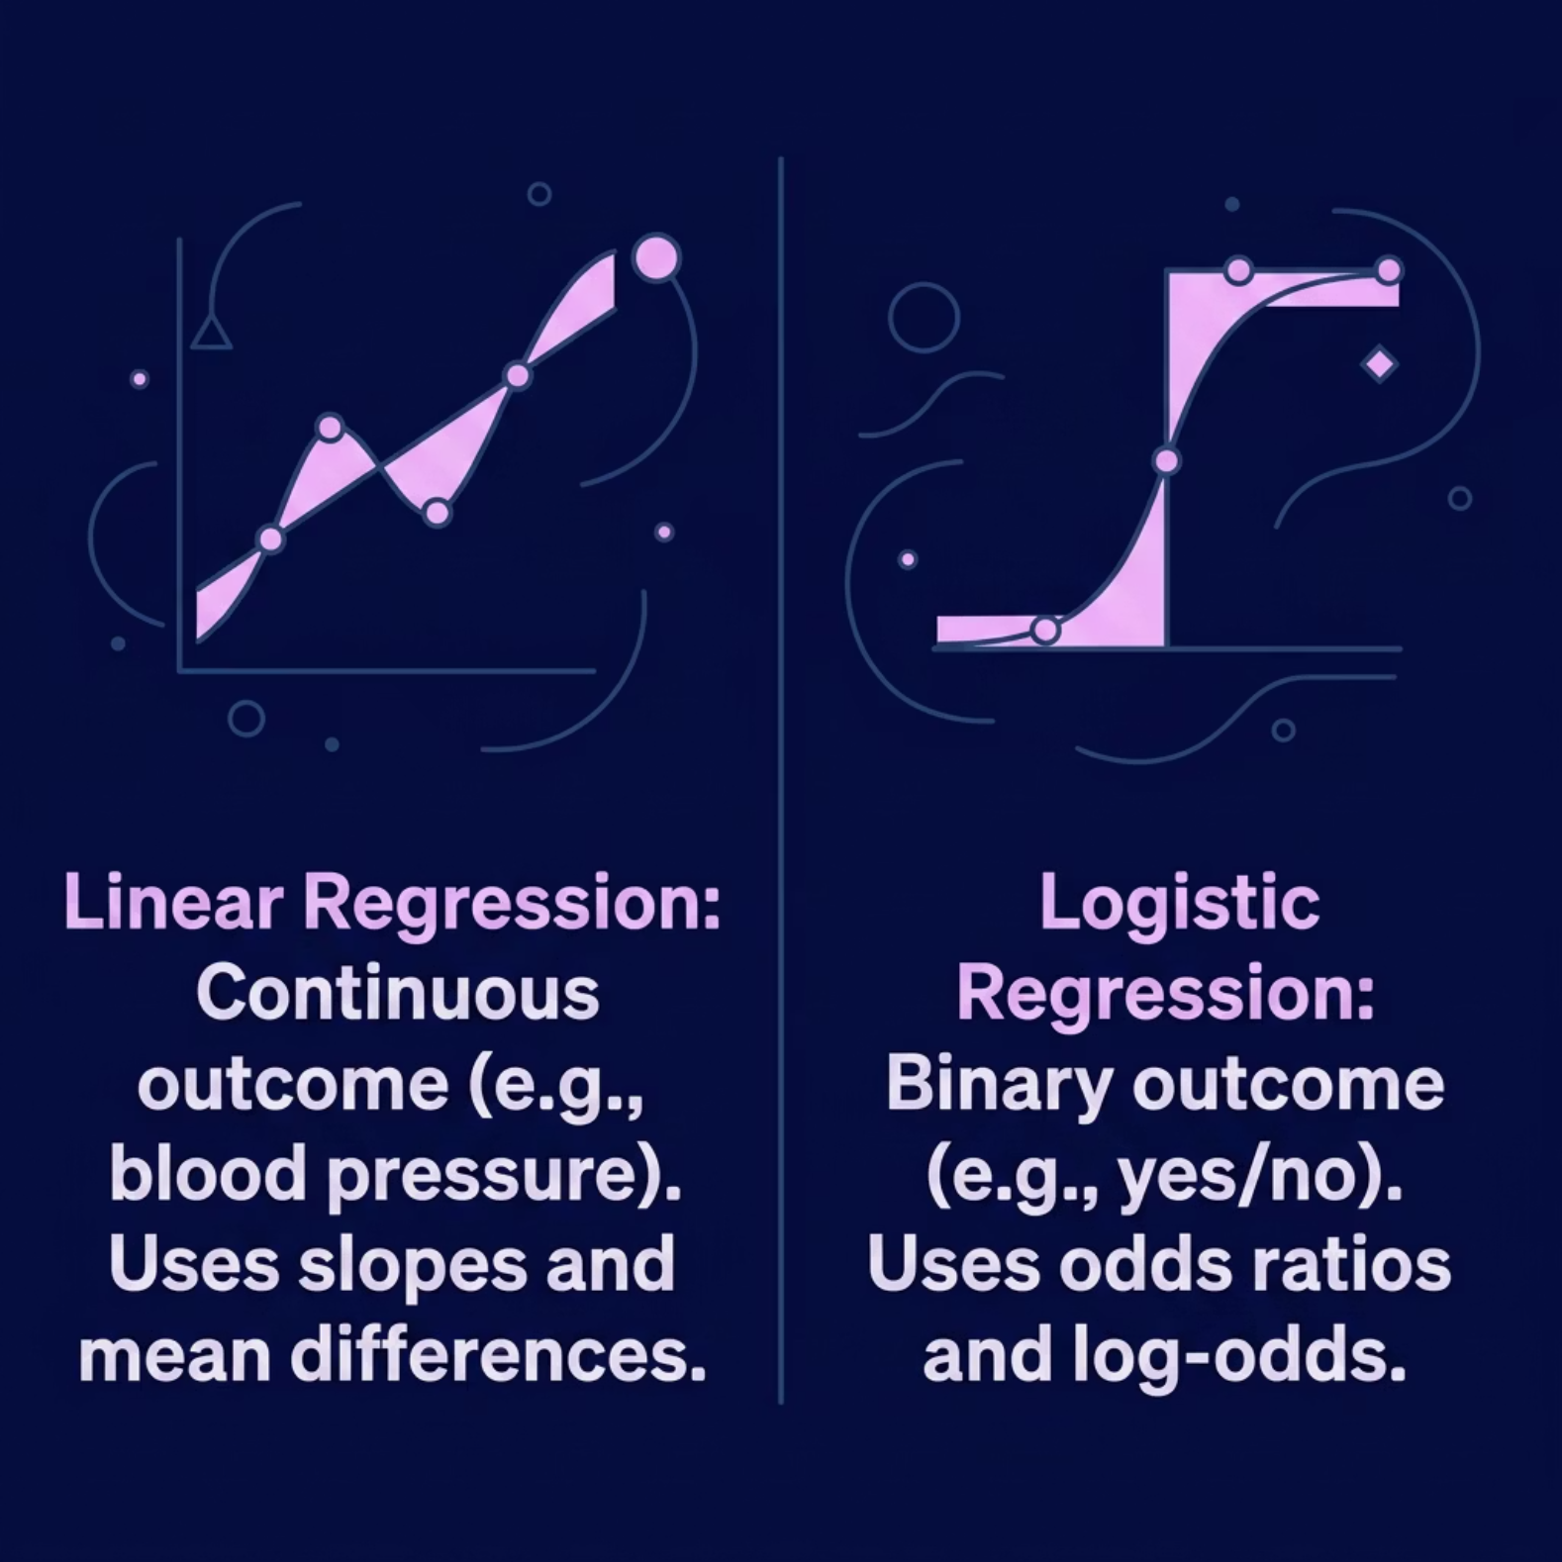

Linear vs. Logistic Regression: A Crucial Distinction
The choice of regression model depends entirely on the nature of your outcome variable.
Linear Regression
Logistic Regression
Continuous outcomes — quantifies effects using slopes and differences in means.
Binary outcomes — quantifies effects using odds ratios and log-odds.

Slide 4


Case Study: Predicting Coronary Artery Disease
Outcome
Coronary Artery Disease — Yes or No
Age
Continuous variable ranging from 24 to 72 years
Cholesterol
Continuous variable ranging from 150 to 299 range
BP (Blood Pressure)
Continuous variable ranging from 110 to 169 range
Max Heart Rate
Continuous variable ranging from 120 to 189 range
ECG Result
it is lies between 0.00 to 2.00
With a binary outcome and mixed predictor types, logistic regression is the appropriate analytical method.
Notes:
• We're looking at a real-world case study on predicting coronary artery disease using patient data • Our target outcome is binary — patients either have coronary artery disease or they don't • We have four key predictors: Sex (male/female) — this is categorical and an important risk factor Age — ranges from 24 to 72 years, a continuous variable Weight and BMI — categorized into four groups: underweight, normal, overweight, and obese • Notice we're mixing categorical and continuous variables, which is typical in medical data • Given this setup — a binary outcome with mixed predictor types — logistic regression is our ideal analytical approach • This method will help us estimate the probability of disease presence based on these patient characteristics

Slide 5
Interpreting Model Coefficients
Stats
Age
Cholesterol
BP(Blood Pressure)
Heart Rate
ECG
Disease
count
500.00
500.00
500.00
500.00
500.00
500.00
mean
49.326
225.106
140.662
154.532
0.948
0.314
std
12.200386
44.052378
16.911646
20.266189
0.801612
0.464581
min
28.00
150.00
110.00
120.00
0.00
0.00
25%
39.00
187.00
127.00
137.00
0.00
0.00
50%
51.00
224.50
141.00
155.00
1.00
0.00
75%
60.00
262.00
155.00
172.00
2.00
1.00
max
69.00
299.00
169.00
189.00
2.00
1.00

Slide 6
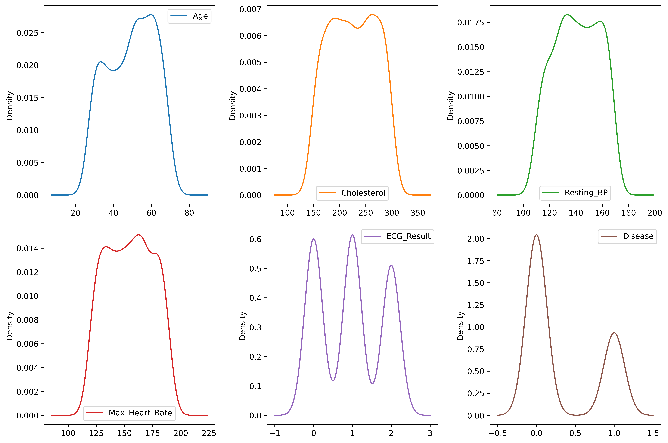
This is PDFs (Probability Density Function of my data)
Here The top four data is more near to normalize data (Bell Curve)
The last one is the is the show the outcome feature Pdf contain 2 outcomes
For more analysis open this link :

Slide 7
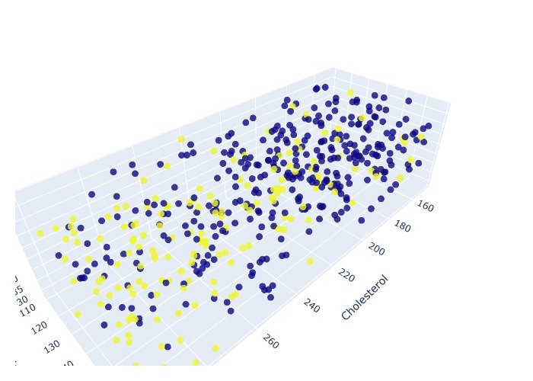
Data visualization in Scatter Plot
3d plot for visualization
X axis for Cholesterol
Y axis for Blood Pressure (BP)
Z axis for Age
Yellow points shows that have a Disease person
Blue points shows that have a not Disease person

Slide 8



EQUATION FOR FINDING THE BEST FIT HYPER PLANE
$$S\left(x\right)=\frac{1}{1+e^{−x}}$$
This is a Sigmoid Function to calculates the Hyper Plane
Where
-x is represents the value of Betas (coefficient’s and Intercept)

Slide 9

Building a Logistic Model for Heart Disease Risk
Partition of data : divide data for training and testing
Training : Use Training data to Train the model
Prediction : To prediction we use the testing portion for data
Here is the Accuracy Score for Logistic regression model
72 % Accuracy of my model

Slide 10
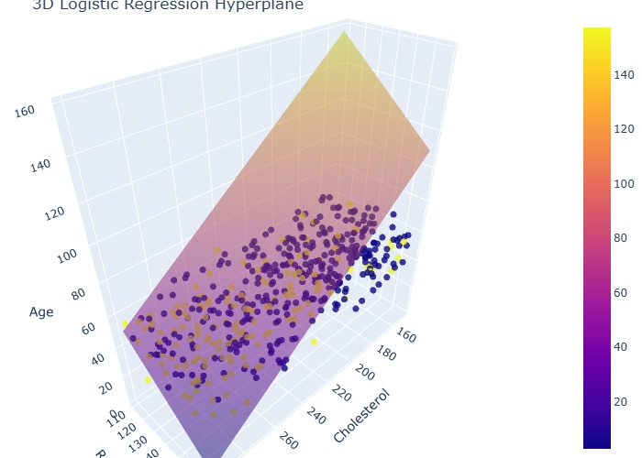
Data visualization after model trainings in Scatter Plot
3d plot for visualization
X axis for Cholesterol
Y axis for Blood Pressure (BP)
Z axis for Age
Yellow points shows that have a Disease person
Blue points shows that have a not Disease person
Here the plane shows the classification of the model

Slide 11

Conclusion: Unlocking Heart Health Insights
Powerful Tool
Key Risk Factors
Logistic regression is uniquely suited to binary health outcomes like heart disease risk.
The high age , high Cholesterol and High BP causes the Heart Disease
Actionable Insights
Does weakly checkups and monitoring the vitals
Less eats oily food and consume less sugar.

