Slide 1

Title: E-Waste Management System Using Deep Learning
18CSP83
Review
Date : 08/05/24
1CR20CS028 APARNA MOHAN
1CR20CS050 VAMSI KRISHNA
1CR21CS156 KUSHWANTH REDDY
Under the guidance of:
Mrs. Navaneeta M
Assistant Professor (CSE)
Department of Computer Science & Engineering
Notes:
1

Slide 2
Abstract
2
E-waste management system using deep learning: Method of scanning electronic items images and if waste is found, they can be segregated.
In this project, a convolutional neural network (CNN) image-recognition algorithm was developed to classify e-waste into different categories with high accuracy.
Our aim is to create an automated system for efficient sorting and separation of e-waste.
*

Slide 3
Outline
3
Introduction
Problem Statement
Relevance of the Problem
Objectives
Proposed System
Implementation
Results and Discussion
Conclusion
Future work
References
*

Slide 4
Introduction
4
Title: E-waste management system using deep learning
E-waste management system using deep learning is a technique used to classify and segregate e-waste by implementing deep learning algorithms.
By training deep learning models on large datasets of electronic waste images, we can develop systems capable of automatically identifying and categorizing various types of e-waste, with high accuracy.
Usage of CNN algorithm gives high accuracy in detection of e-waste and separation of it.
Efficient, scalable, and sustainable solution to address the challenges of e-waste management in the modern era.
*

Slide 5
Problem Statement
5
Project Goal:
The goal of this project is to create an efficient E-waste management System employing advanced machine learning and computer vision techniques. Our goal is to bring a new system for automated segregation of E-waste, as it is very necessary for today’s era.This system aims to improve accessibility, and address existing limitations in segregation methods for the E-waste management.
*

Slide 6
Relevance of the Problem
6
1. Efficient Sorting and Recycling: - Automated sorting through YOLOv8 enhances accuracy and speed, improving recycling efficiency.
2. Environmental Conservation: -Effective identification and segregation of e-waste mitigate environmental risks posed by hazardous materials like lead and mercury.
3. Resource Recovery: - Resource recovery is optimized as deep learning algorithms precisely identify valuable metals within electronic components
4. Promotion of Circular Economy: - Adoption of YOLOv8 aligns with circular economy principles, promoting resource reuse and minimizing waste.
5. Technological Innovation: - The project showcases technological innovation, demonstrating AI's role in sustainable waste management solutions.
*

Slide 7
Objectives
7
1. Model Training and Optimization:
Rationale: Training the YOLOv8 model on a comprehensive dataset allows for fine-tuning and optimization, ensuring accurate identification and classification of e-waste items. This step is crucial for enhancing the system's performance and reliability in real-world applications.
2. Real-Time Processing Implementation:
Rationale: Implementing deep learning algorithms for real-time processing enables swift and efficient detection of e-waste items from input images. This capability enhances the system's usability and effectiveness in dynamic waste management environments where quick decision-making is essential.
*

Slide 8
Objective
8
3.User Interface Development:
Rationele: Developing a user-friendly interface simplifies the interaction with the e-waste management system, allowing users to input images easily and view the detected e-waste items along with their classifications. This enhances usability and facilitates seamless integration into existing waste management workflows.
4. Performance Evaluation and Testing:
Rationale: Evaluating the system's performance through rigorous testing on diverse datasets helps validate its accuracy, speed, and scalability. This step ensures that the system meets the requirements for efficient resource recovery and environmental conservation, contributing to its successful deployment and adoption.
*

Slide 9
Overview
9
The E-waste management system project aims to create a system for efficiently identifying e-waste, which helps in segregating the waste. The system includes a model which has trained images of e-waste items like keyboard,phone,laptop etc. The system can either scan images directly in real time or we can upload photos,so that it scans the image by drawing a box around it and it identifies if e-waste is found so that we can segregate it efficiently.
*

Slide 10
Development Tools
10
Hardware
Software
Testing Tools
*

Slide 11
Hardware and Software tools
11
Hardware:
1. Camera or Input Device: A camera or similar input device is required to capture real-time images for e-waste recognition.
Software:
1. OpenCV: Used for obtaining real-time images from the camera.
2.Ultralytics: This library provides various deep learning utilities and tools, particularly focused on computer vision tasks.
3. YOLOV8: YOLO (You Only Look Once) v8 is an object detection model commonly used in computer vision tasks.It is used to identify and classify various electronic devices and components within images or videos.
4. Streamlit: A framework for building interactive web applications with Python. It simplifies the process of creating data-driven web apps.
*

Slide 12
Implementation
12
Flowchart
Explanation
*

Slide 13
Flowchart
13
P.T.O
*

Slide 14
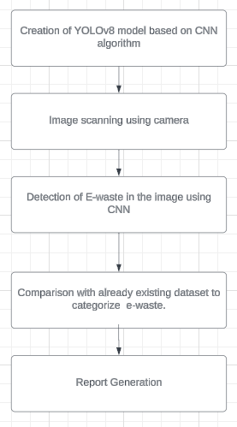
So here's a little rundown of how OpenCV, YOLOv8,Streamlit and other applications work together to create a E-waste management system:
14
Creation of YOLOv8 model: Creating a YOLOv8 model based on CNN for image recognition and classification.
Image scanning using camera:: To capture pictures of electronic items so that e-waste can be detected.
Detection of E-waste in the image: Boxes are drawn around E-waste identified in the image.
Comparison with already existing dataset to categorize e-waste: Image is compared with the already existing dataset to classify the identified waste.
Report Generation: TA report is generated which consists of details about the e-waste identified, the classification of it, if it is reusable,recyclable and if it is hazardous or not.
*

Slide 15
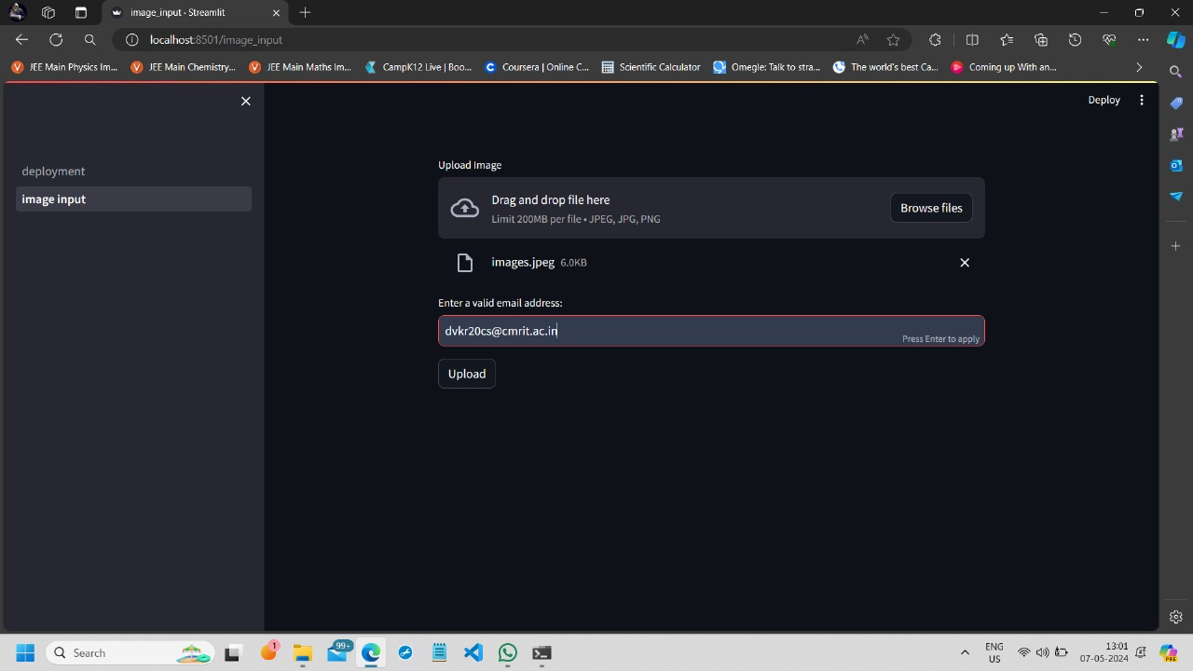
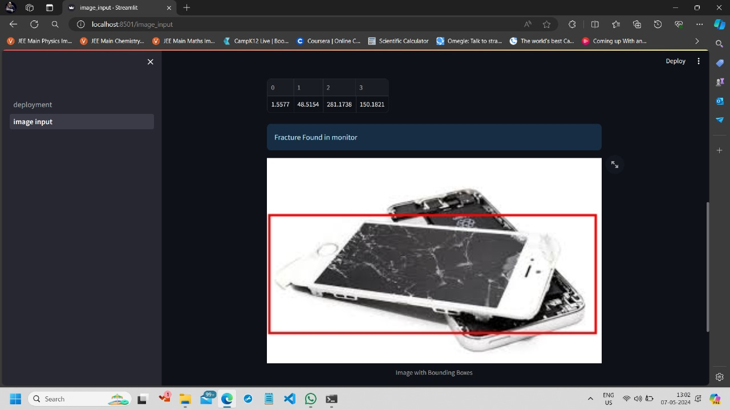
Results
15
The below figures depict how an image is scanned and if waste is identified, then a box is drawn around the object specifying that waste is identified.
*

Slide 16
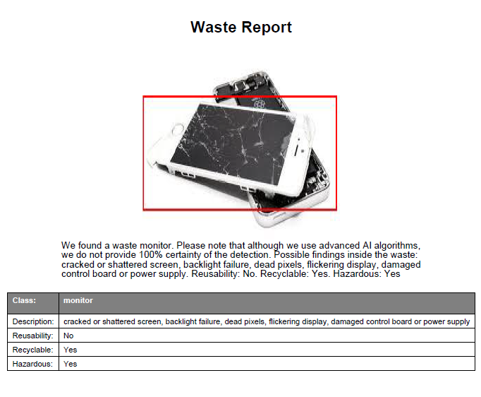
Contd…
16
This picture depicts the waste report that is being generated and the details about the waste identified. It also tells us if it is harmful waste, if it is reusable and if it is recyclable.
A box is drawn around the waste that is identified. This is based on CNN. The YOLOv8 model has been trained with images so that when an image is scanned it is compared with already trained dataset.
*

Slide 17
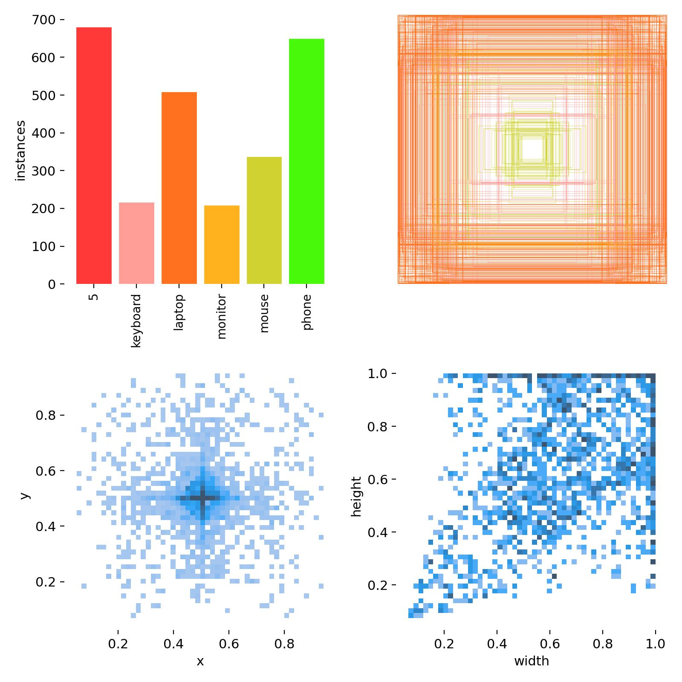
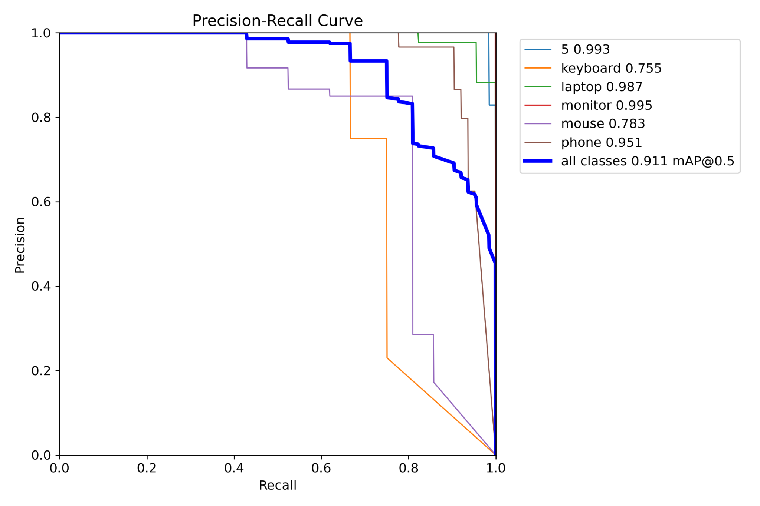
17
Graph
*

Slide 18
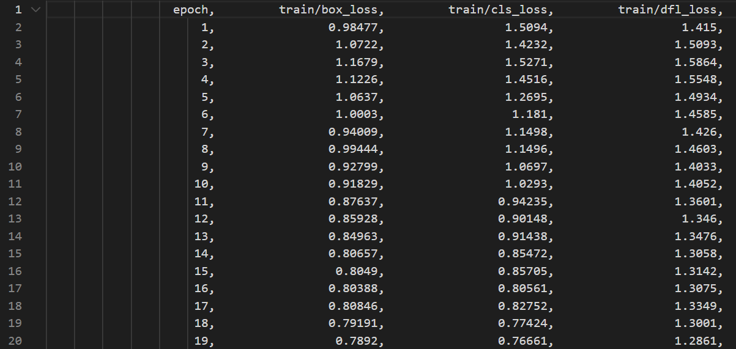
Contd…
18
*
Notes:
18

Slide 19
Conclusion
19
In conclusion, an efficient e-waste management system has been created which helps in the identification, the classification, the details about if it is reusable, recyclable, if it is hazardous to humans,etc. This information helps us in taking the further step about what to do next with the particular electronic item. To protect the environment and the health of workers, an automated method for sorting and separation of e-waste is urgently needed. Improved efficiency and accuracy in waste management system i.e. it compares images accurately with datasets and segregates.
*

Slide 20
Future Scope
20
Integration of Multi-Sensor Data Fusion: Explore the integration of multi-sensor data fusion techniques to enhance the capabilities of the e-waste detection system. By incorporating data from various sources such as thermal imaging, infrared sensors, and spectroscopy, the system can improve its accuracy in detecting and classifying e-waste items. Additionally, fusion algorithms can help mitigate challenges such as occlusion and varying lighting conditions, further enhancing the robustness of the detection system.
Development of Real-Time Monitoring and Tracking: Focus on the development of real-time monitoring and tracking functionalities to enable continuous surveillance of e-waste accumulation and movement. Implementing advanced tracking algorithms and incorporating IoT devices can facilitate the monitoring of e-waste throughout its lifecycle, from collection to recycling or disposal. Real-time alerts and notifications can also be integrated to notify stakeholders of critical events or anomalies, enabling timely intervention and decision-making in e-waste management processes.
*

Slide 21
References
21
[1] Forti V, Balde CP, Kuehr R, Bel G. “The global e-waste monitor 2020: Quantities, flows and the circular economy potential”. Available from: https://ewastemonitor.info/gem-2020/
[2] TensorFlow [Online tutorial]. Available from:https://www.tensorflow.org/tutorials/images/cnn
[3] Dias P, Bernardes AM, Huda N. “Ensuring best E-waste recycling practices in developed countries: An Australian example”. J Clean Prod. 2019 Feb 1; 209: 846-54.http://doi.org/ 10.1016/j.jclepro.2018.10.306.
[4] Song J, Gao S, Zhu Y, Ma C. “A survey of remote sensing image classification based on CNNs”. Big Earth Data. 2019,Sep 12; 3(3): 232-54, doi: 10.1080/20964471.2019.1657720.
[5] Wang C, Qin J, Qu C, Ran X, Liu C, Chen B. “A smart municipal waste management system based on deep-learning and Internet of Things”. Waste Management. 2021 Nov 1;135:20-9.
*

Slide 22
THANK YOU
22
*

