Slide 1

DESIGN AND DEVELOPMENT OF FULLY AUTONOMOUS CREWLESS PROTOTYPE MODEL SHIP
18ME801 FINAL YEAR PROJECT PHASE II PRESENTATION
Devis Vijith Karakada
4NM19ME409
Nisarga
4NM19423
Harsha P Shetty
4NM18ME052
Joshua Dsouza
4NM18ME052
Guide: Dr. Nithin Kumar
Dept of Mech. Engg. NMAMIT Nitte

Slide 2
1. INTRODUCTION
An Autonomous ship can sense its environment and operate by itself. Presence of crew or sailor not required in ship (onboard).
It uses a range of sensors to scan its surroundings and feed the information to the Controlling system, which processes the information and then relay the sailing instructions.
Indeed, supposing that no personal will be onboard no crew would get injured.
The project, miniature version of the vessel highlights how transportation is increasingly shifting toward automation, and sailor-less ship would be managed from land-based facilities focusing on specific task.
Dept. of Mechanical Eng. NMAMIT

Slide 3
2. LITERATURE REVIEW
Name of the author | Journal/ Paper/others | Details & Summary
Xiang-yu Zhou, Jin-jing Huang, Feng-wu Wang, Zhao-lin Wu and Zheng-jiang Liu | A Study of the Application Barriers to the Use of Autonomous Ships Posed by the Good Seamanship Requirement of COLREGs / THE JOURNAL OF NAVIGATION | This paper reviews the literature on autonomous ships from the perspective of the obligations of good seamanship imposed by COLREGs. The authors conclude that to facilitate the introduction of autonomous ships, the application barriers presented by COLREGs need to be analyzed.
Goran Vojković, Melita Milenković | Autonomous ships and legal authorities of the ship master / Elsevier | Today, the ship’s master authorities are divided into three segments: the public authorities, the duties of the ship's safety and navigation, and representation of the shipping companies. If the ship master is not physically on board - the powers change considerably, to the level of legal question: Who is the master of an autonomous ship?
Dept. of Mechanical Eng. NMAMIT

Slide 4
Name of the author | Journal/ Paper/others | Details & Summary
Timothy J. McCoy | Electric Ships: Past, Present, and Future / IEEE Electrification Magazine | This article attempts to provide both a look at the past and a glimpse into the future of shipboard power and propulsion systems, an arena that has dynamically changed and will continue to change in the coming decades.
Ziaul Haque Munim | Autonomous ships: a review, innovative applications and future maritime business models / SUPPLY CHAIN FORUM: AN INTERNATIONAL JOURNAL | This study contributes to the maritime literature by (1) providing a review of the AS development projects and the benefits of AS from an economic, environmental and social perspective, (2) suggesting innovative uses of AS in short-sea-shipping (SSS), arctic shipping, and conventional shipping, and finally (3) discussing potential business models from the perspective of AS manufacturers
Dept. of Mechanical Eng. NMAMIT

Slide 5
Name of the author | Journal/ Paper/others | Details & Summary
Shadman Fahim Ahmad, Abrar Hasin Kamal, Iftekharul Mobin | Ultrasonic Sensor Based 3D Mapping & Localization / International Journal on Computer Science and Engineering | This paper provides an introduction in 3D mapping using sonar sensors and localization. It describes the methods used to construct a low-cost autonomous robot along with the hardware and software used as well as an insight to the background of autonomous robotic 3D mapping and localization.
Kurt Schwehr | Vessel Tracking Using the Automatic Identification System (AIS) During Emergency Response: Lessons from the Deepwater Horizon Incident/Schwehr 2011: Presented at US Hydro, Tampa Fl | This paper discusses use of Real-time AIS and e-Navigation related technologies enable closer coordination between all involved parties. Recorded historical AIS data give insight into what occurred before, during, and after an incident.
Dept. of Mechanical Eng. NMAMIT

Slide 6
3.OBJECTIVES
To create fully autonomous prototype miniature model ship.
To fabricate a prototype miniature model of a ship.
To implement drone autopilot system to surface vessel.
To implement obstracle detection system.
To design a hull that can house all the components.
To fabricate the hull and fine tune its stability
To achieve highest gps accurancy as possible
Testing and tuning of the model ship.

Slide 7
4. METHODOLOGY
PROJECT LAYOUT:
Ground Station
Telemetry
Autonomous ship
Dept. of Mechanical Eng. NMAMIT

Slide 8
ENGINEERING SETUP:

Slide 9
SENSOR CIRCUIT:

Slide 10
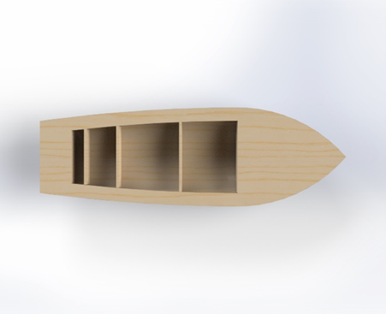
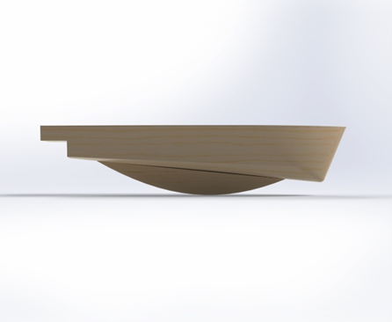
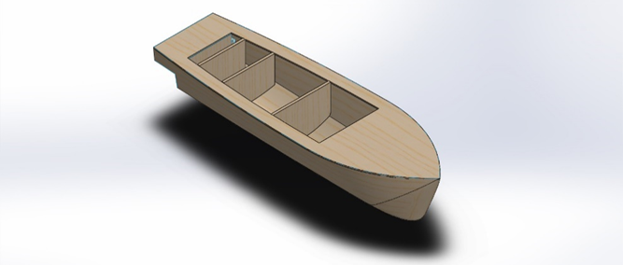
5.WORKDONE
CONCEPTUAL DESIGN:
Top view
Side view
Isometric view

Slide 11
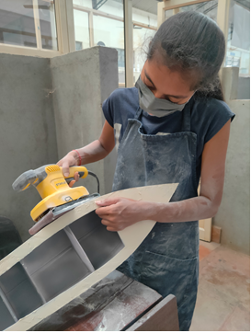
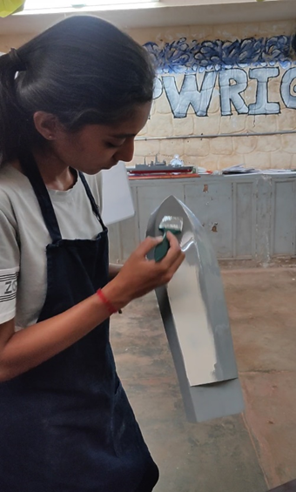
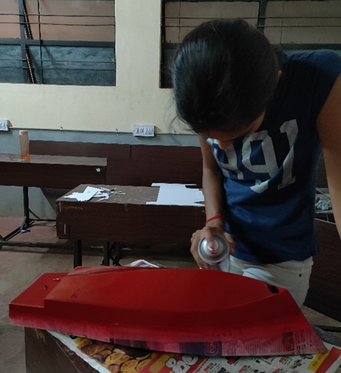
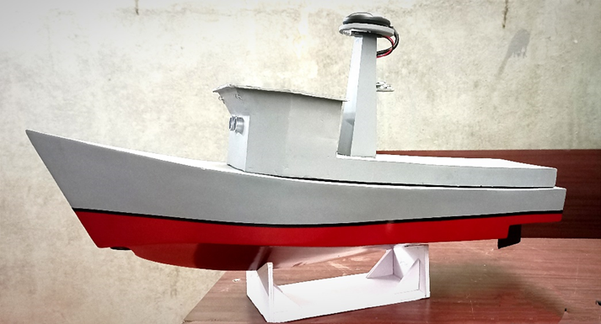
CONSTRUCTION OF PROTYPE SHIP:
Metal paste stage
Primer stage
Painting hull
Completed prototype model

Slide 12
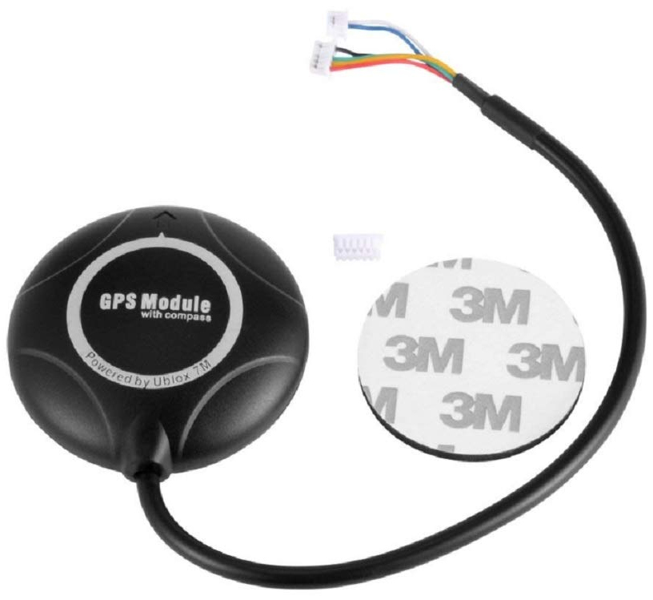
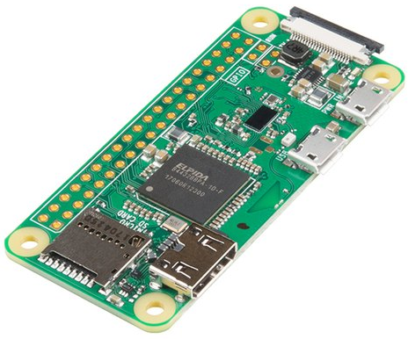
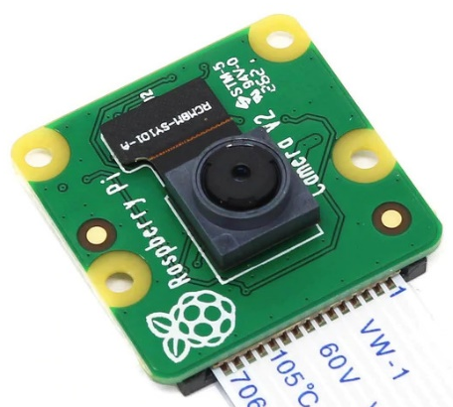
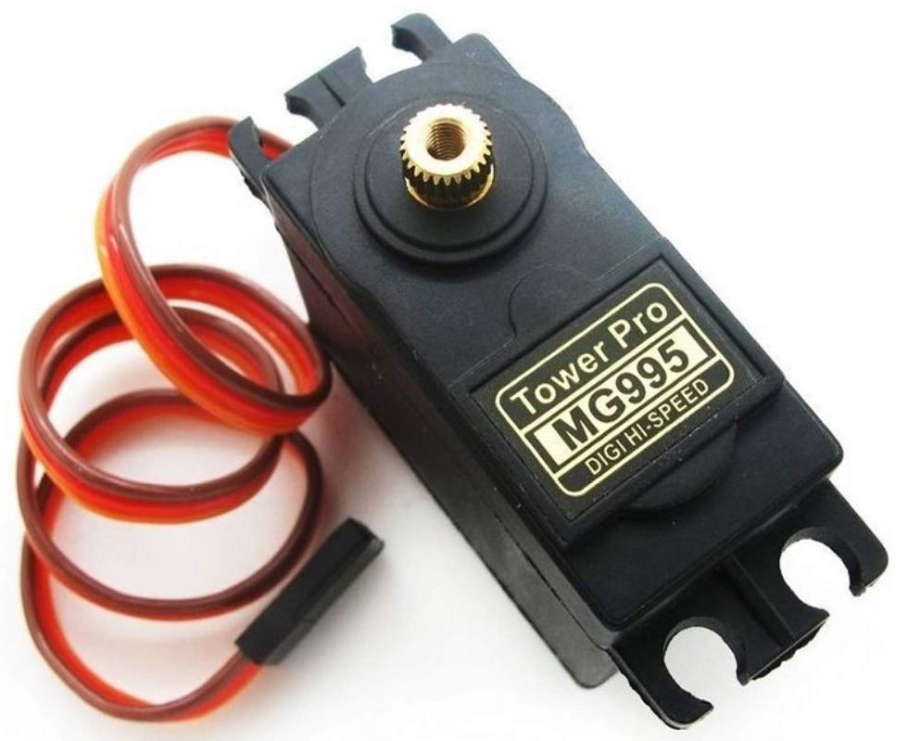
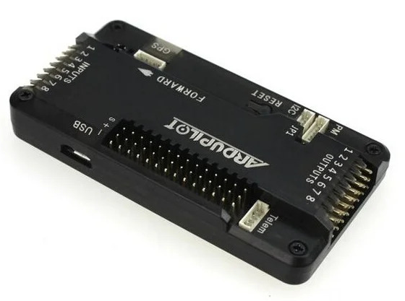
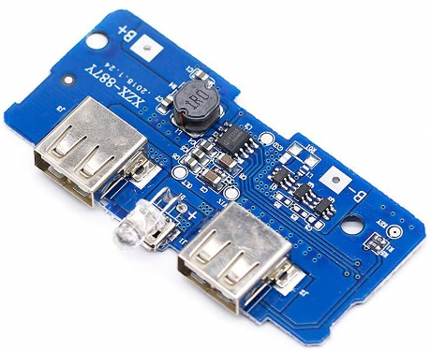
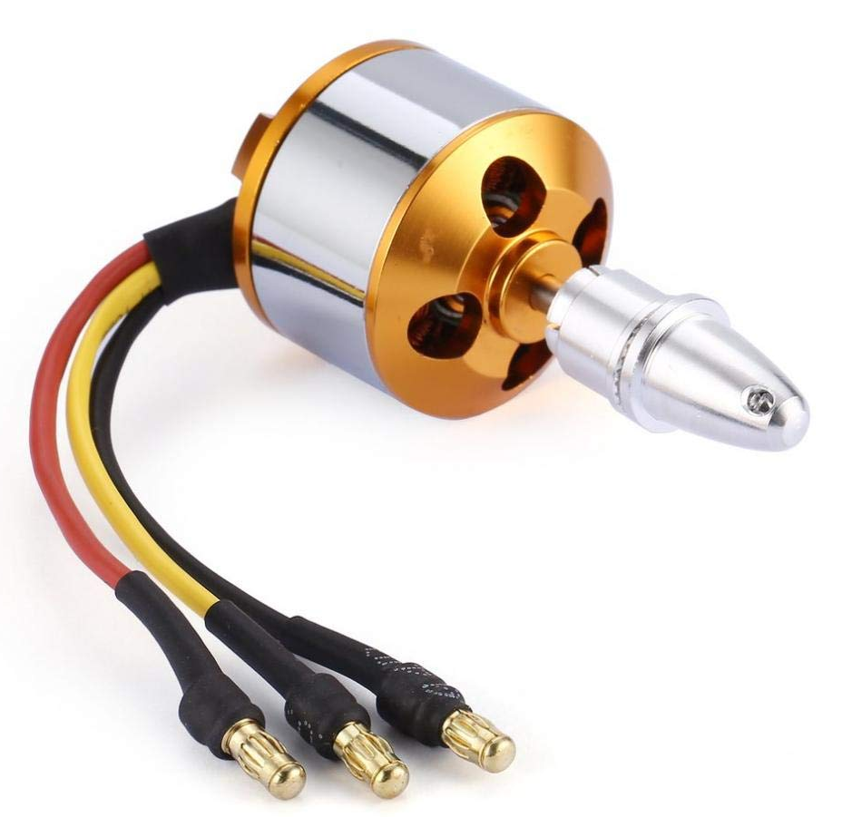
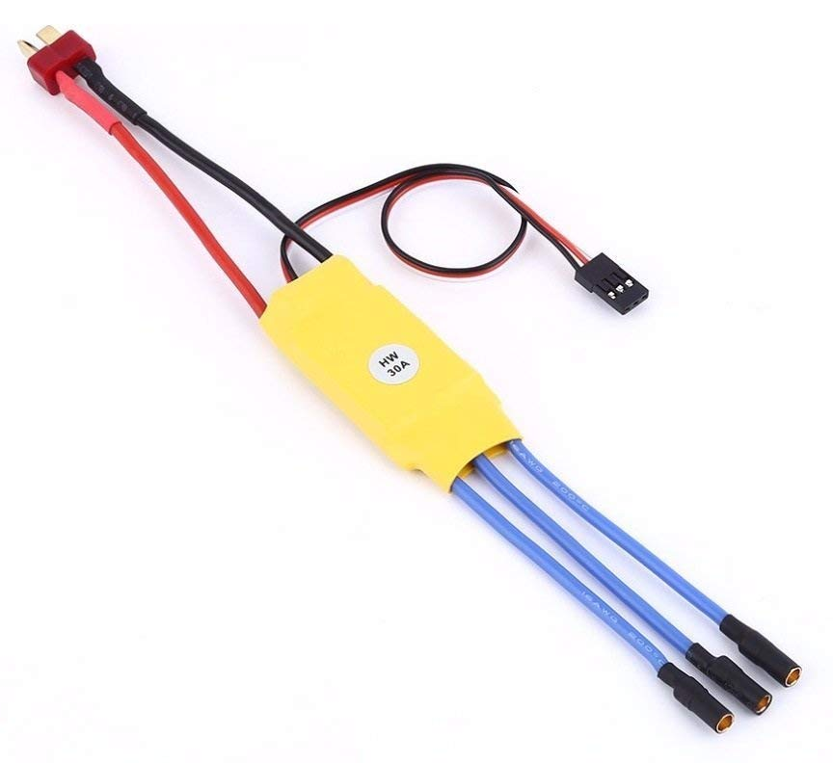
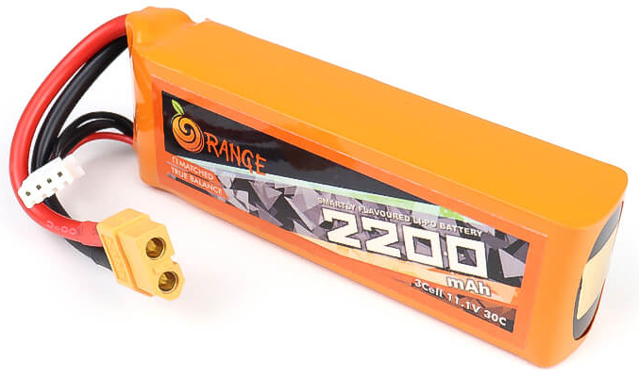

Setup and configuration:
Raspberry Pi Zero W
APM GPS
Pi Camera
Servo
Power bank
APM 2.8
4G Dongle
ESC
Brushless Motor
Lipo Battery
Dept. of Mechanical Eng. NMAMIT

Slide 13
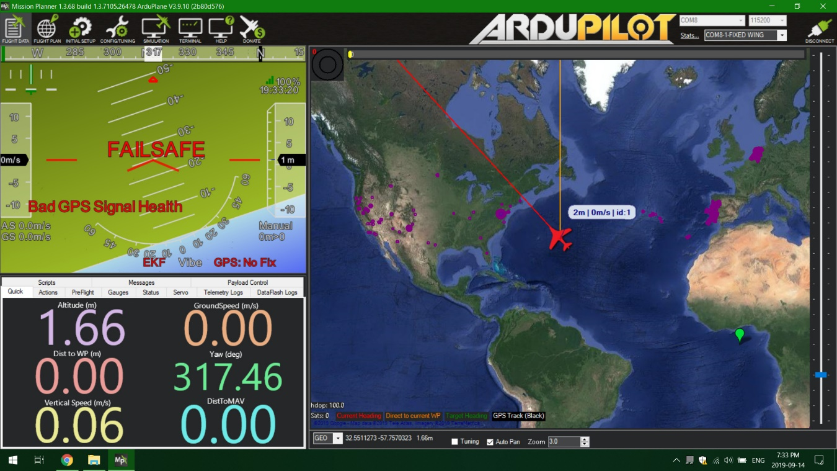

7. Telemetry
Raspberry Pi Zero W
MAVLINK
Ardupilot Mission planner
Dept. of Mechanical Eng. NMAMIT

Slide 14
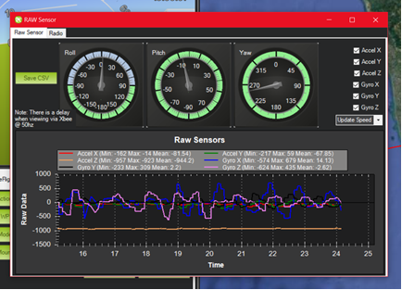
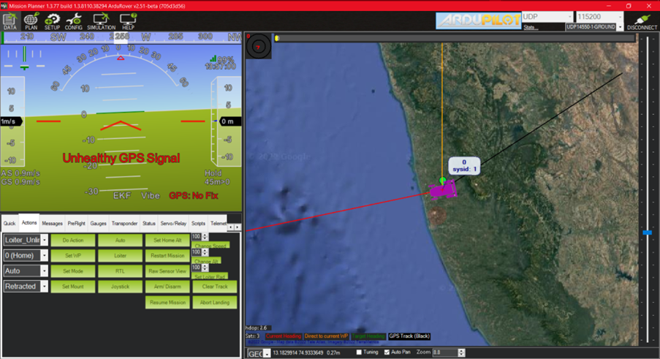
RESULT AND DISCUSSION:
Pitch, roll and yaw
GUI interface
The sample depth, distance, temperature, accelerometer and gyro data obtained from sensors are as follows:
Connected! 0
["b'22", '124.64', ' -2220', '-16092', ' -2164', '27', ' 57', ' 68', " -107'"]
Depth: b'22
Range: 124.64
Temperature: 27
Accelerometer: X -2220 Y-16092 Z -2164
Gyro: X 57 Y 68 Z -107

Slide 15
Conclusion
There are many hurdles when it comes to implementing autonomous ship in international waters.
Hurdles such as international maritime laws are not designed keeping in mind for autonomous ships.
The system is operational and capable to avoid obstacles and enable autonomous functions like collision avoidance and hold and change.
The system lacks in few drawbacks since ultrasonic sensors only measured distance upto about 250cm reliably, farer distance and problematic surfaces are not detected at all or with the necessary reliability.
Since ultrasonic sensors fail to detect all surfaces, other sensors are mandatory.
Dept. of Mechanical Eng. NMAMIT

Slide 16
Thank You.
Dept. of Mechanical Eng. NMAMIT

