Slide 1
Sales MIS Dashboard – Superstore Dataset
MIS Executive Project | Excel-based Reporting & Dashboard
By : Divyam Mahant

Slide 2
Business Objective
To create a Sales MIS system for management reporting
To track monthly sales, profit, and quantity
To analyze region, category, and segment performance
To support data-driven decision making

Slide 3
Dataset Overview
Dataset: Superstore Sales Data
Records: ~10,000 rows
Time Period: 2014 – 2017
Key fields:
Order Date, Sales, Profit, Quantity
Region, Category, Sub-Category, Segment

Slide 4
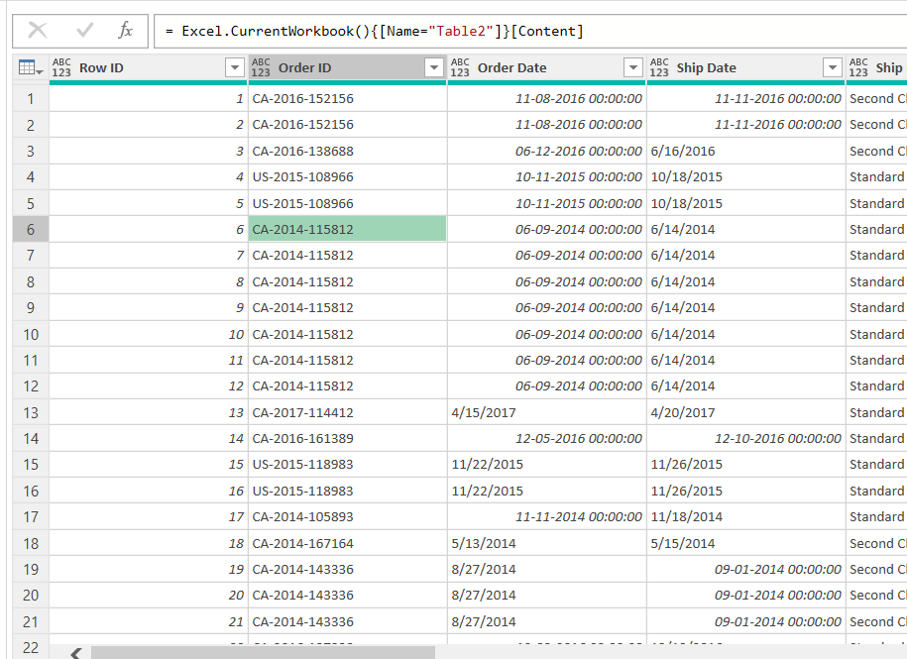
Data Cleaning & Preparation
Standardized Order Date and Ship Date using Power Query
Verified correct data types (Date, Number, Text)
Created helper columns:
        Order Month
        Order Year

Slide 5
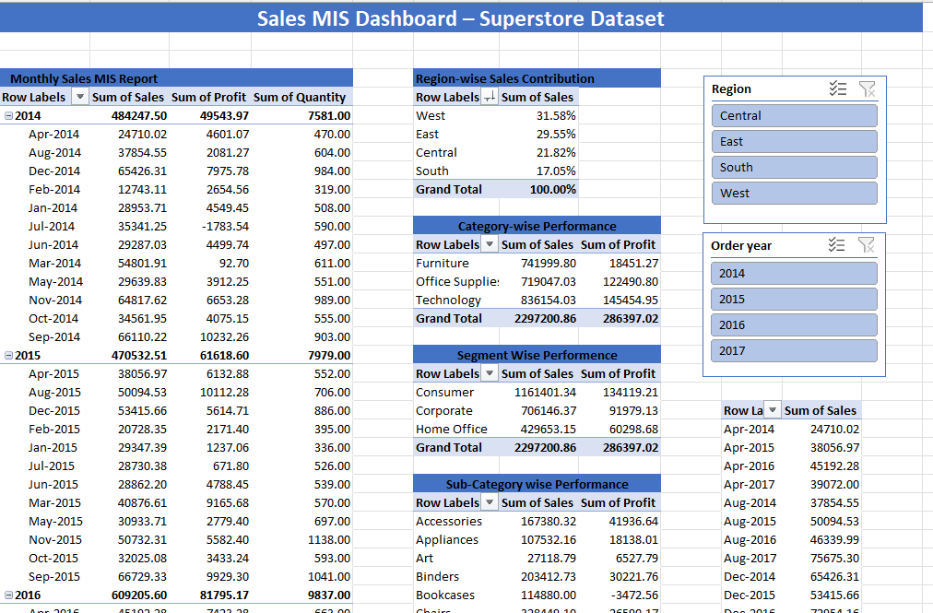
MIS Reports
Monthly Sales MIS (Sales, Profit, Quantity)
Region-wise Sales Contribution (%)
Category-wise Performance (Sales vs Profit)
Segment-wise Performance

Slide 6
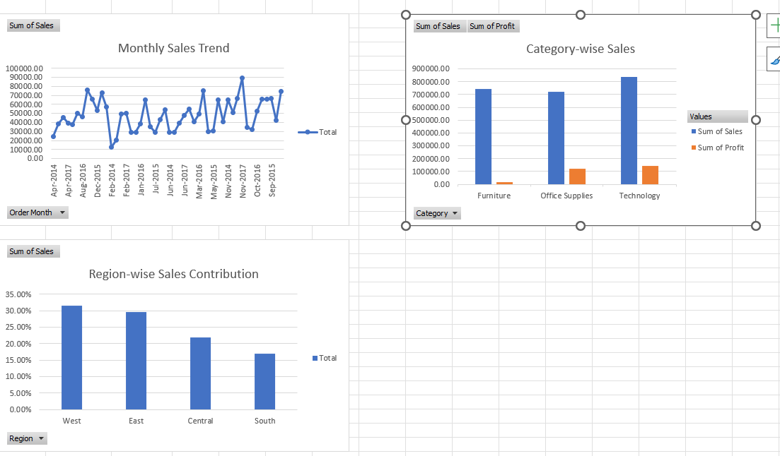
MIS Dashboard
KPI Cards: Total Sales, Total Profit, Total Quantity
Monthly Sales Trend (Line Chart)
Region-wise Sales Contribution (Column Chart)
Category-wise Sales & Profit
Interactive slicers (Year, Region)

Slide 7
Management Insights
West region contributes the highest share of sales
Sales show a steady trend with seasonal variations
Technology category generates highest revenue & profit
Furniture category shows lower profit margins
Consumer segment contributes the most to total sales

Slide 8
Conclusion
This MIS dashboard enables quick performance tracking
Supports management decision making
Can be refreshed and reused monthly
Demonstrates strong MIS Executive reporting skills

