Slide 1
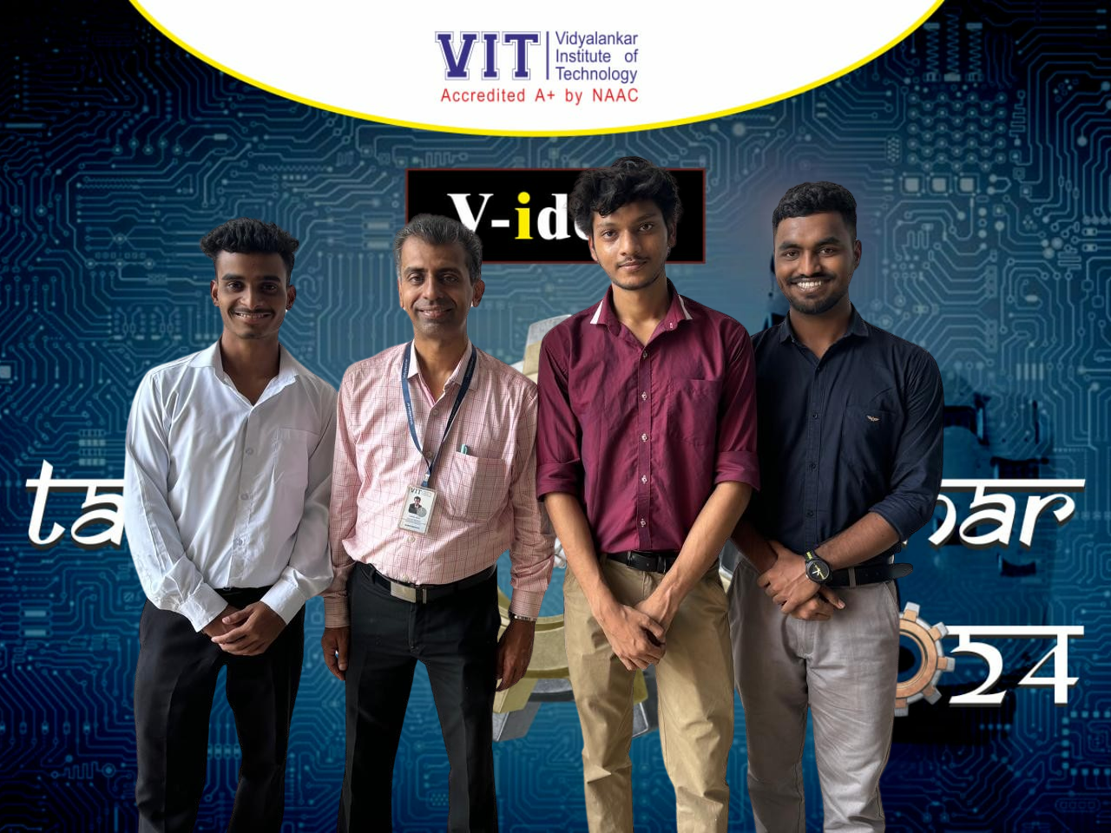
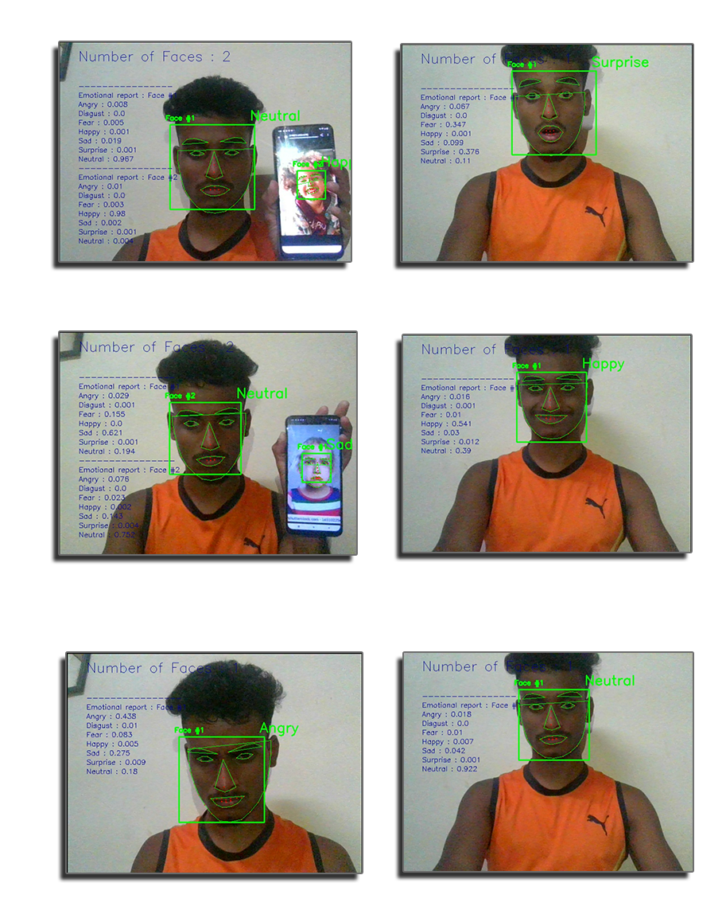
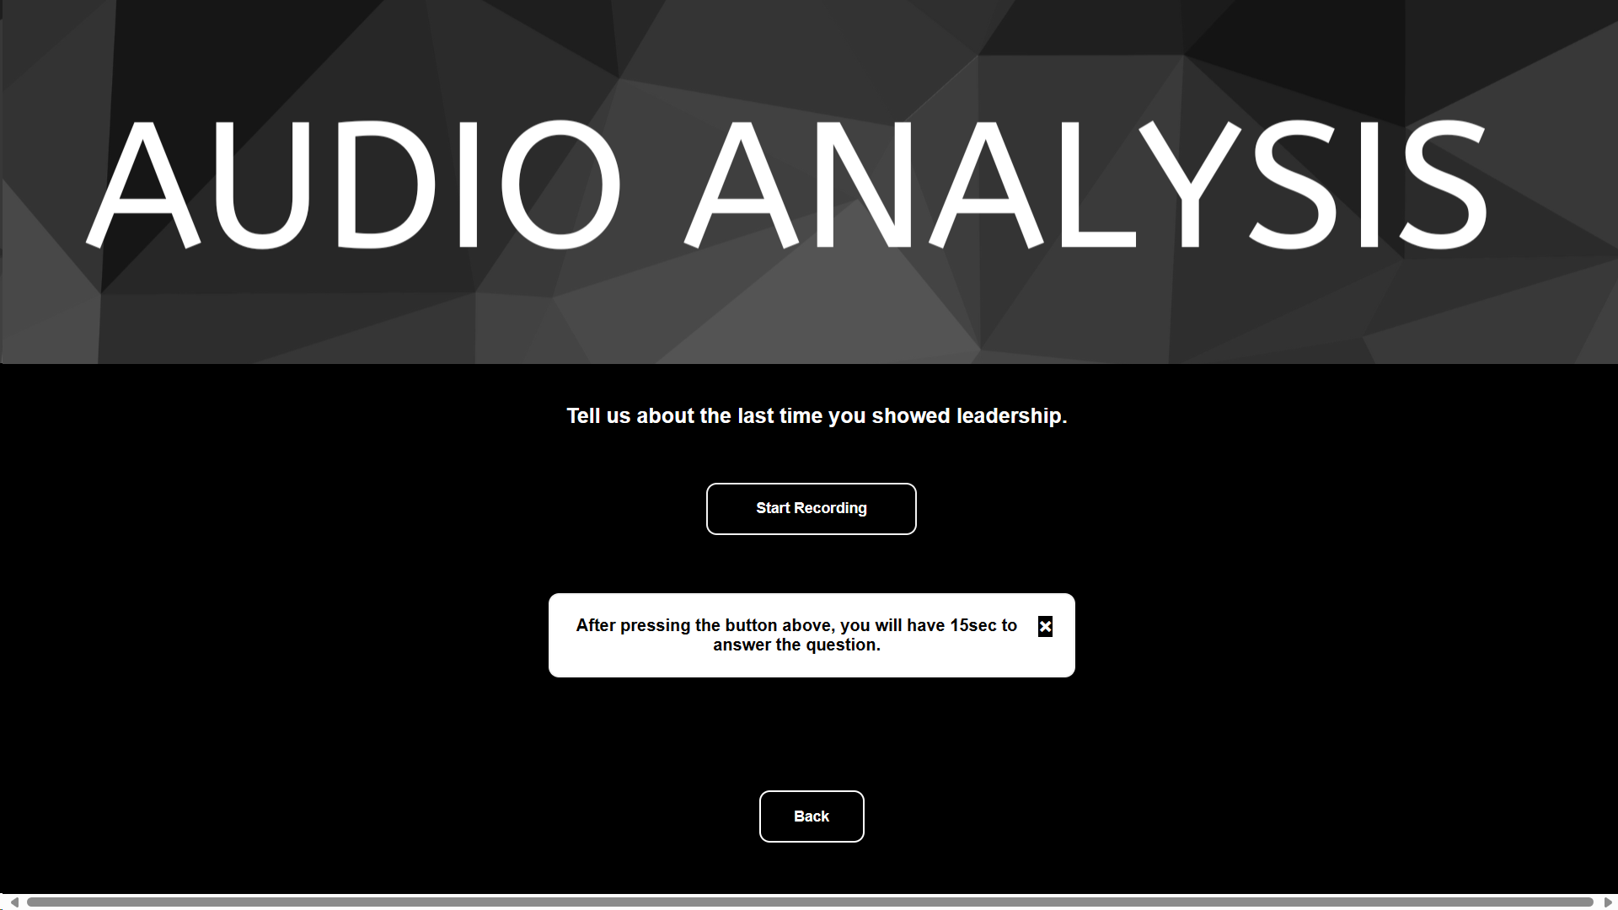
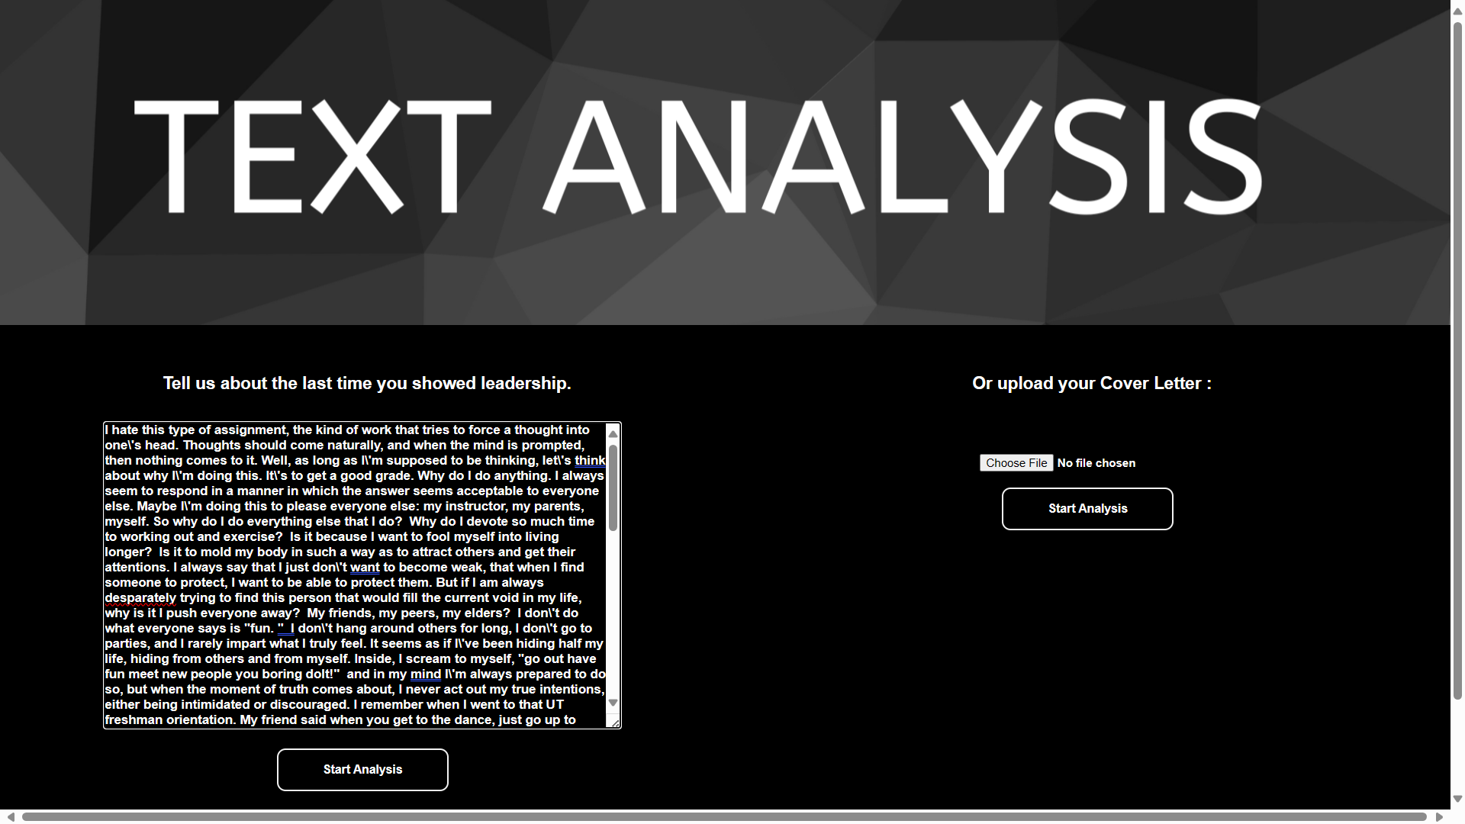
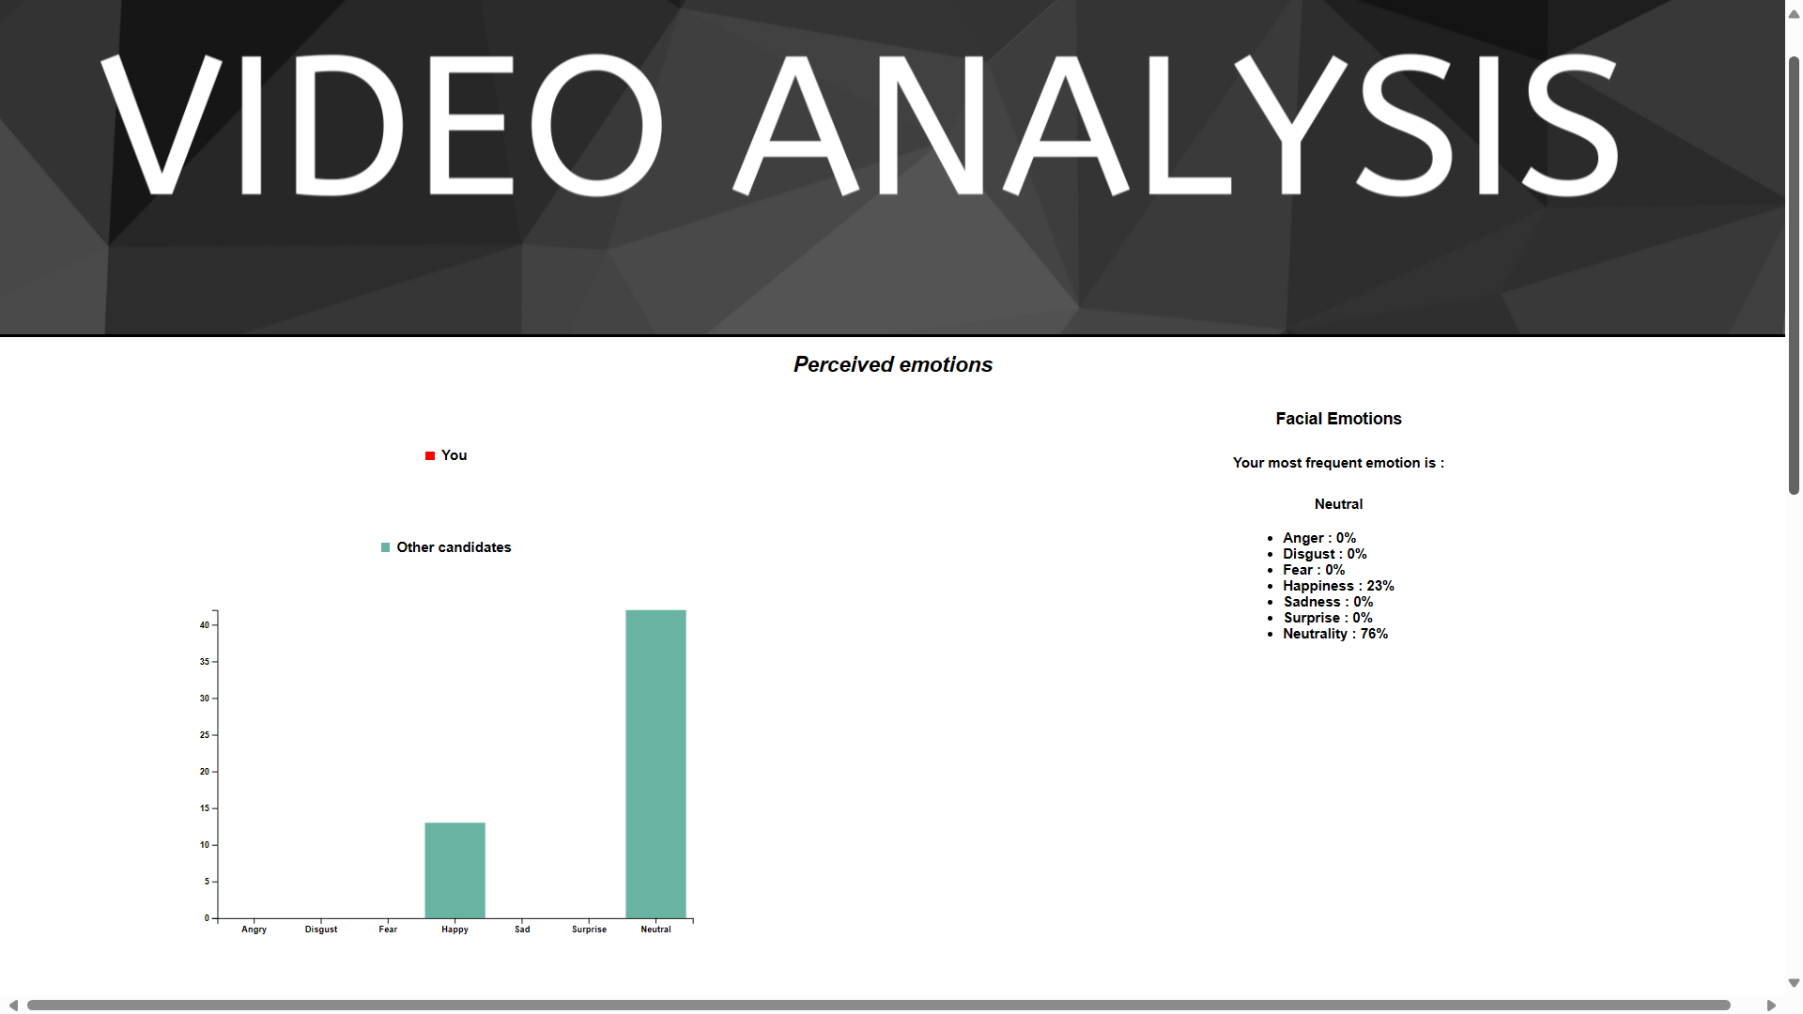
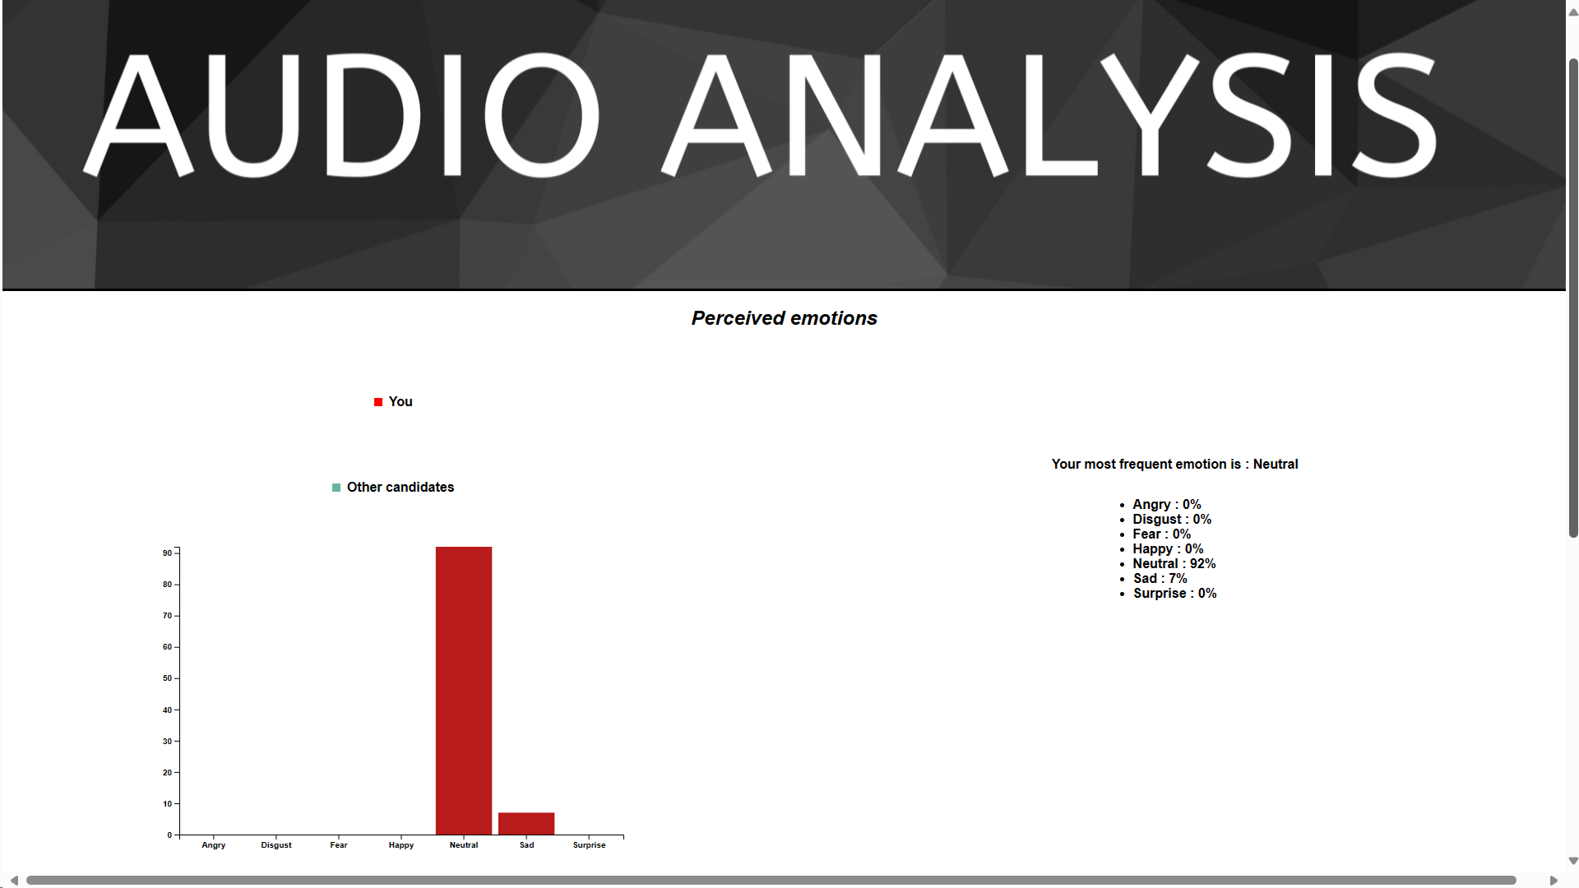
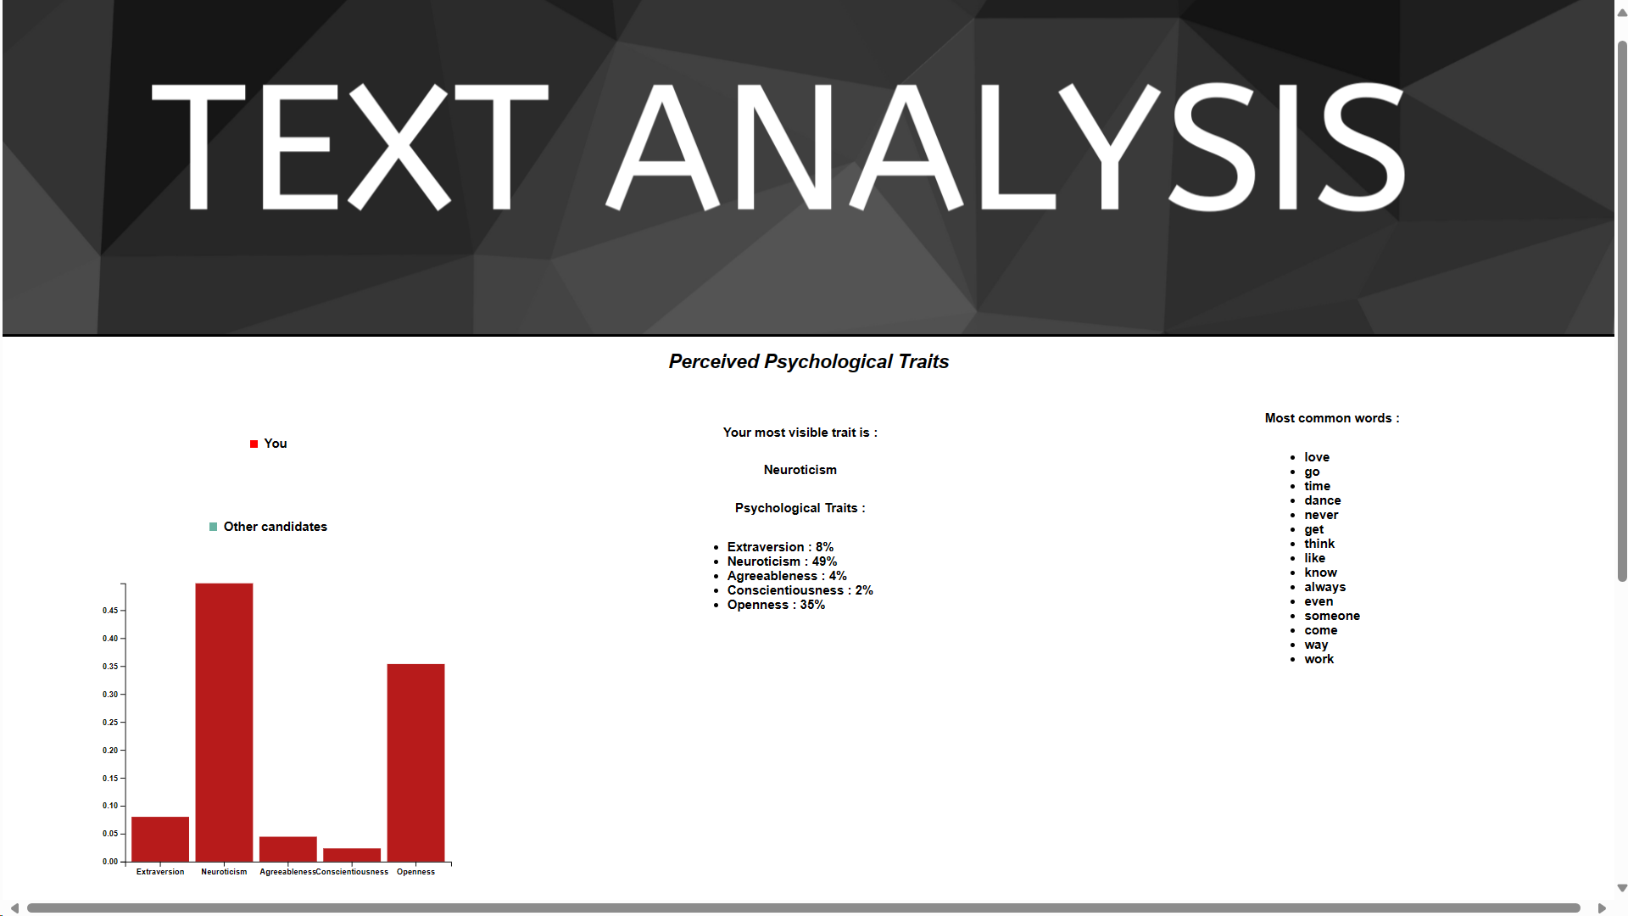
Department : Information Technology
Project Title : TalkSpace - Advanced Emotion Recognition and Personality Analysis Platform
Domain (Area of Project) : Machine learning , Web development
Name of Project Guide : Prof. Samuel Jacob (samuel.jacob@vit.edu.in)
Name of Students : Rohan Kadu (rohan.kadu@vit.edu.in)
Krishnakant Gangurde (akanksha.amdekar@vit.edu.in)
Vaishnav Rajput (vaishnav.rajput@vit.edu.in)
Brief idea of Project :
The proposed project aims to develop a multimodal emotion recognition system using deep learning techniques. Integrating text, audio, and image modalities, the system will recognize emotions expressed in various forms, such as written text, spoken language, and facial expressions. Leveraging convolutional neural networks (CNNs) and recurrent neural networks (RNNs), the system will provide accurate and real-time emotion analysis for applications in affective computing and human-computer interaction.
Screenshots of the Project / Photos of Working Model :
Applications: The application can be used in various domains,
including customer service, mental health monitoring, education, and entertainment,
to analyze emotions and personalize interactions based on users' emotional states.
Paper Publication/conference/project competition :
1 Participated in Atharva College Project Competition
2 Research paper published in IJSREM
ITA08

