Slide 1
(GID ITA08 – TalkSpace - Advanced Emotion Recognition and Personality Analysis Platform ​)
Department of Information Technology
BE Major Project
Semester: VIII
Group Members:
Krishnakant Gangurde 20101A0016
Rohan kadu 20101a0023
Vaishnav Rajput 20101A0063
Under the guidance of
Prof. Samuel jacob
AY 2023-24

Slide 2
Outline
Abstract
Introduction
Motivation
Objectives
Problem Statement
Literature Survey
Technology Stack (Hardware/Software)
Implementation
Results and Discussions
Conclusion and Future Scope
References
Project Achievements

Slide 3
Abstract
Multimodal Emotion Recognition System The proliferation of human-computer interaction applications necessitates robust emotion recognition systems. This project presents a Multimodal Emotion Recognition System that leverages video, audio, and text data to accurately identify human emotions. By integrating facial expression analysis, speech pattern recognition, and sentiment analysis, the system provides a comprehensive understanding of emotional states. The fusion of modalities ensures resilience against noisy data and improves recognition accuracy. The system employs advanced machine learning algorithms and deep neural networks to process and analyze multimodal inputs. The real-time processing capability of the system makes it suitable for various applications, including interactive gaming, mental health assessment, and customer service enhancement. The project’s goal is to bridge the gap between human emotions and machine interpretation, paving the way for more intuitive and empathetic human-computer interactions.

Slide 4
Introduction
Project Goal: Integrate emotional intelligence into AI.
Why It Matters :Emotions are crucial for human interaction and decision-making.
Impact: Enhance human-computer interaction.
Benefits: Create natural, personalized user experiences.
Potential: Improve user interface design and overall satisfaction.

Slide 5
Motivation
The pursuit of integrating emotional intelligence into artificial intelligence systems is the driving force behind the multimodal emotion recognition project.
The motivation stems from a fundamental understanding that emotions are central to human experience and communication.
They influence our decisions, shape our interactions, and affect our well-being
Enhancing Human-Computer Interaction: By imbuing machines with the capability to detect and interpret emotions, we can create more natural, intuitive, and efficient interactions

Slide 6

Objectives
Recognition: Develop deep learning models that accurately identify human emotions from multiple modalities (video, audio, and text).
Robustness: Create a system resilient to noisy data by fusing information from different sources.
Real-Time Processing: Enable real-time emotion analysis for applications like interactive gaming, mental health assessment, and customer service.
Empathetic Interactions: Bridge the gap between human emotions and machine interpretation, leading to more intuitive and empathetic human-computer interactions.

Slide 7
Problem Statement
Emotions and personality traits are complex, making accurate interpretation challenging.
Traditional methods are subjective and inefficient.
Current solutions focus on single modalities, ignoring holistic communication cues.
Fragmented approaches hinder accurate interpretation of complex emotions.
A unified framework leveraging multiple modalities is essential.
This framework would enhance understanding of emotions and enable better communication strategies.

Slide 8
Literature Survey
1) Paper Name: B.Kratzwalda, S.Ilie´, M.Kraus, S.Feuerriegel, H.Prendinger. Deep learning foraffective computing: text-based emotion recognition in decision support, Sep. 2018.
In this paper, Kratzwalda et al. likely discuss the utilization of deep learning models, such as recurrent neural networks (RNNs) or convolutional neural networks (CNNs), to automatically recognize emotions expressed in textual data. They may discuss the architecture and training methodology of the deep learning models used, as well as the preprocessing techniques for text data.
2) Paper Name: C.Pramerdorfer, and M.Kampel. Facial Expression Recognition usingConvolutional Neural Networks: State of the Art. Computer Vision Lab,TU Wien
The research aims to improve the accuracy, efficiency, and robustness of facial expression recognition systems, which have applications in fields such as human-computer interaction, emotion analysis, and facial recognition technology.

Slide 9
Technology Stack
HARDWARE:
A standard webcam captures face for recognition.
microphone interprets voice command to extract features.
SOFTWARE:
Google collab, Kaggle and jupyter notebook
Python 3.9
OpenCV

Slide 10
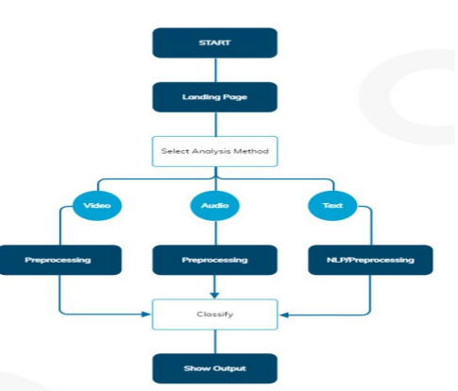
IMPLEMENTATION
Process Flow Chart

Slide 11
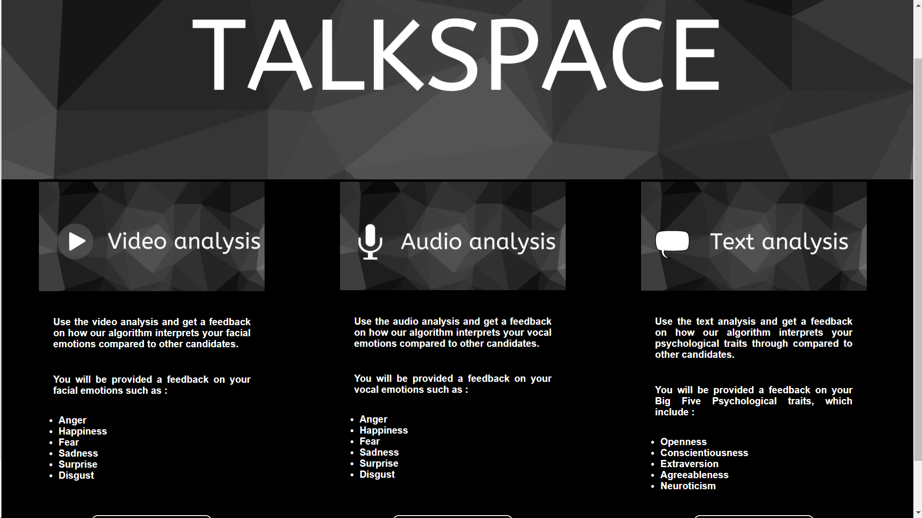
Results and Discussions

Slide 12
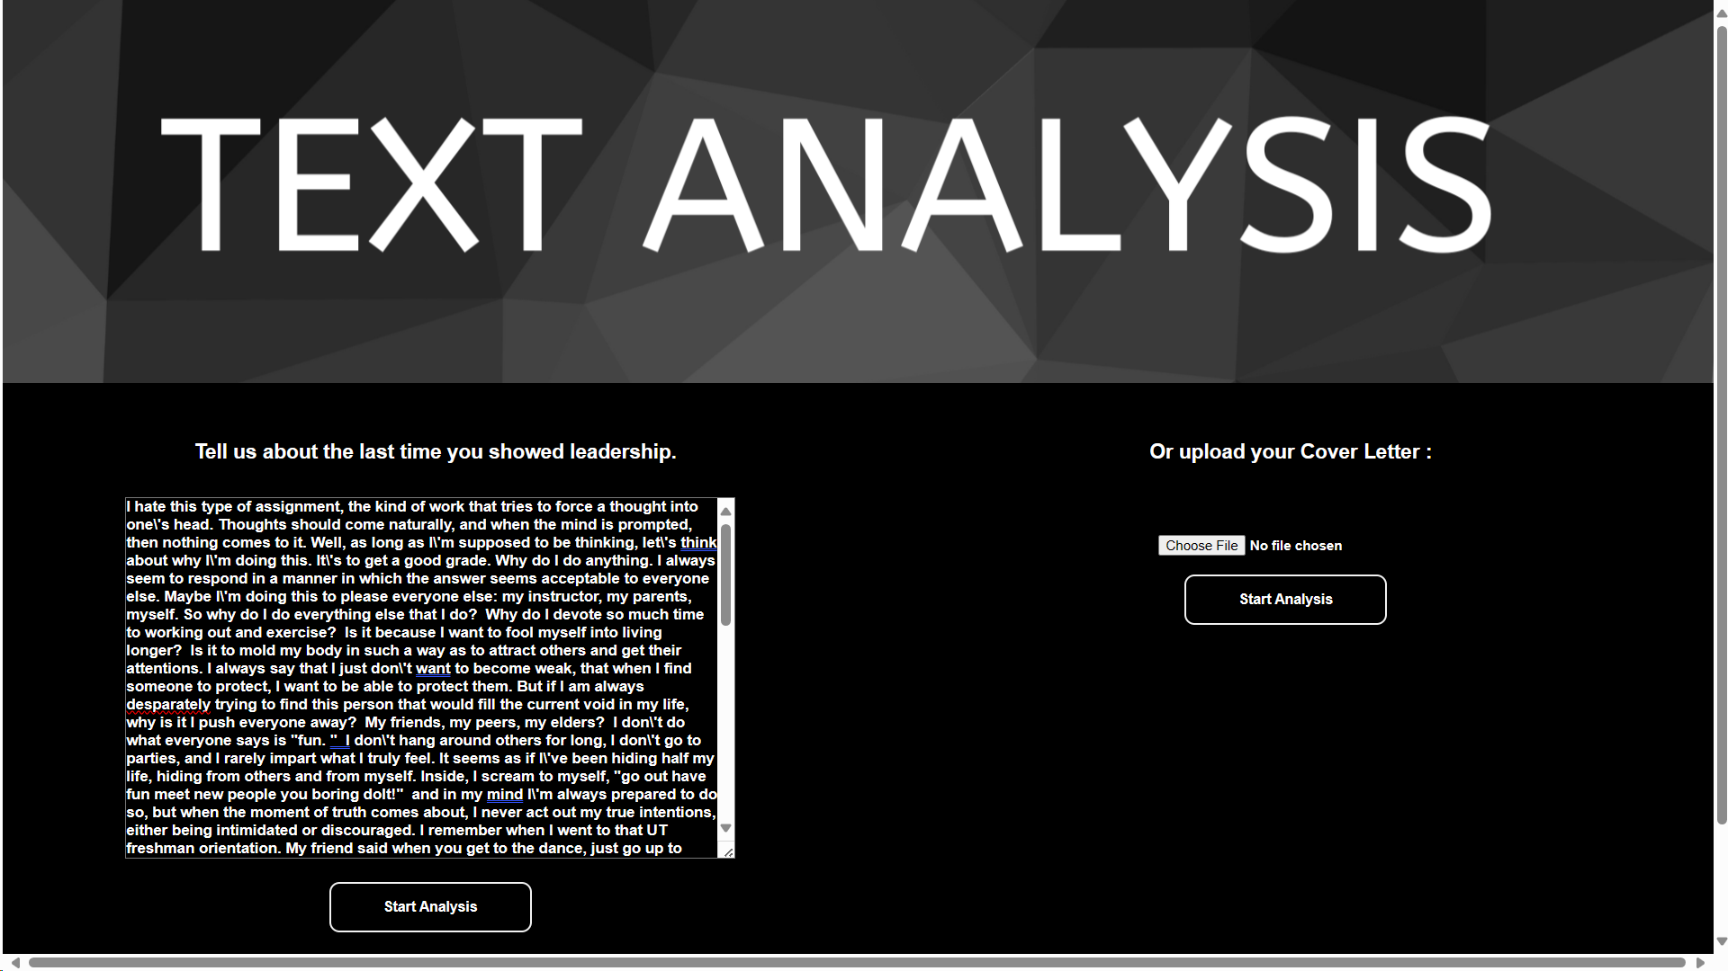
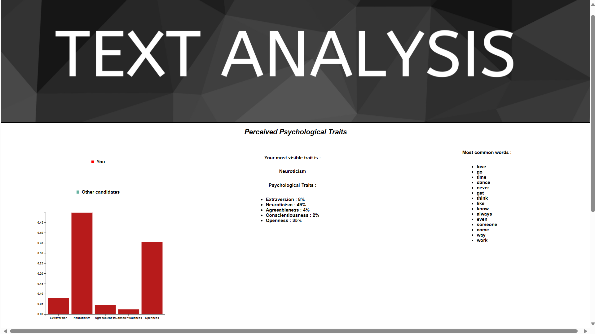

Slide 13

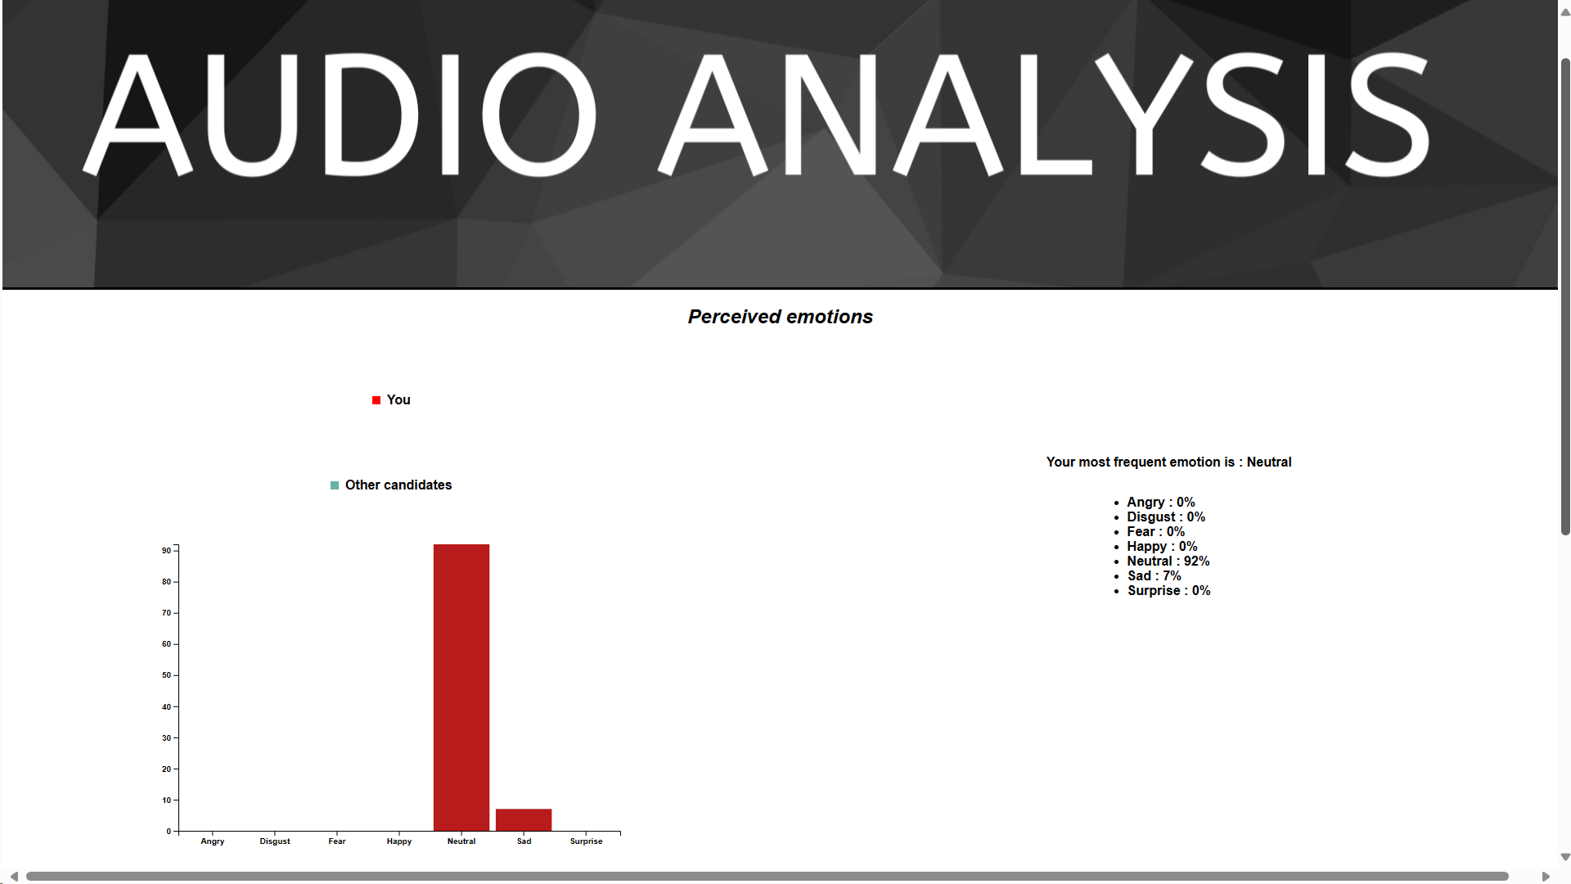

Slide 14
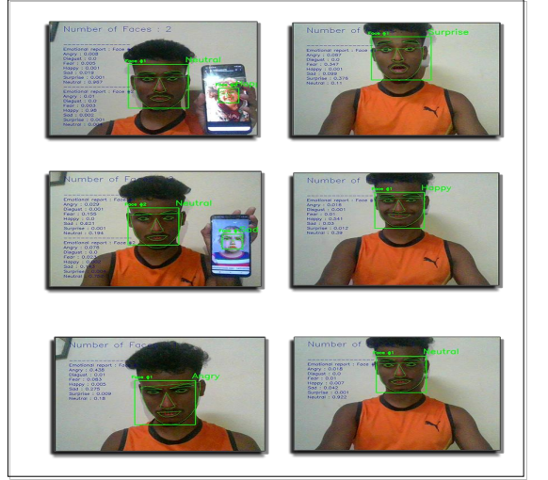
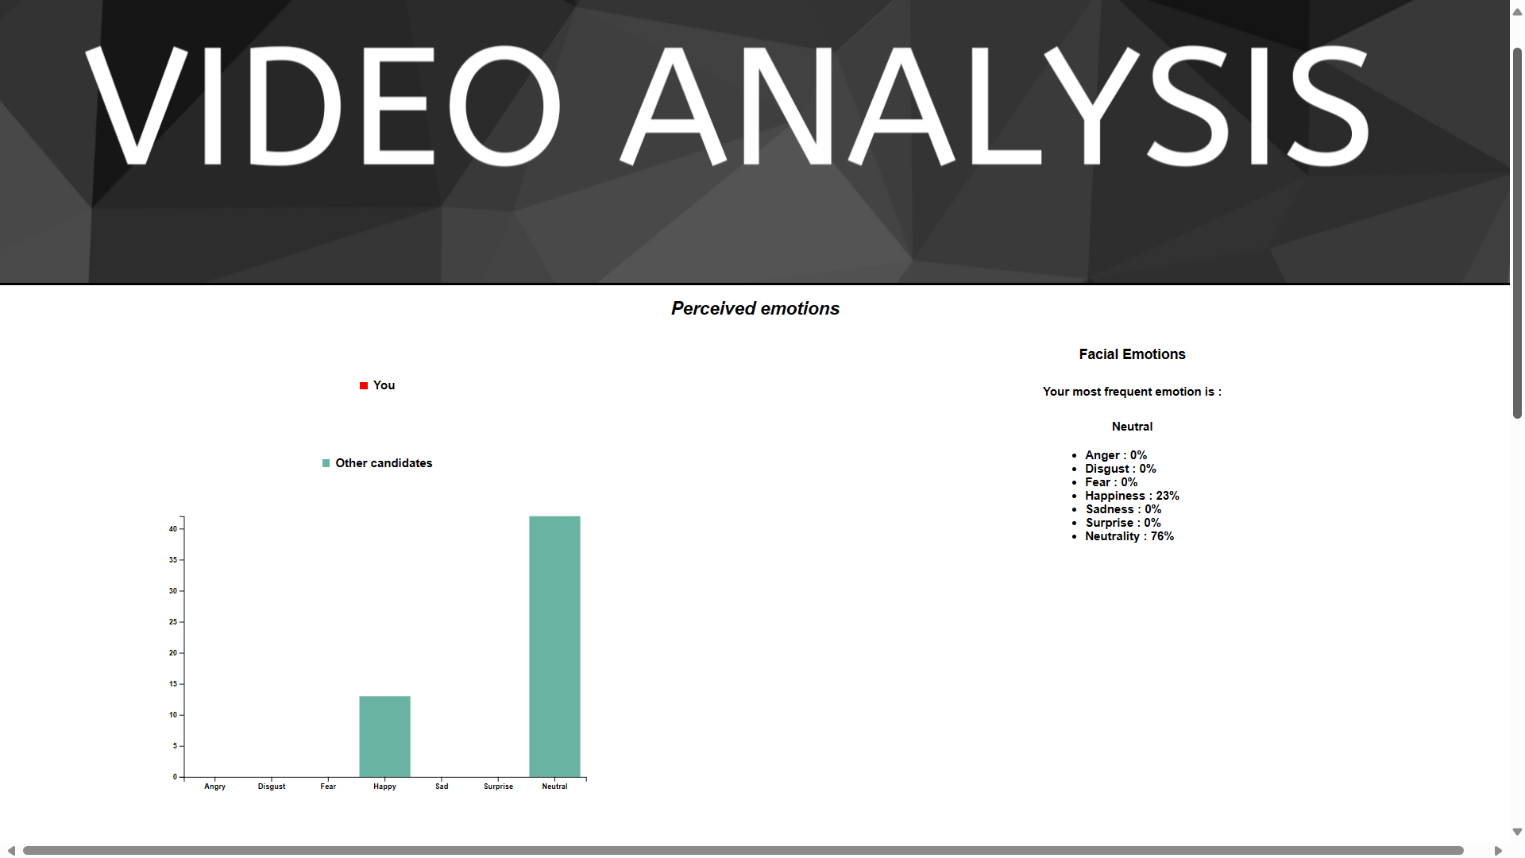

Slide 15
Conclusion
Nuanced Understanding: Captures subtle emotional expressions across various modalities.
Machine Learning Algorithms: Utilizes LSTM, CNNs, and pre-trained models like Xception for accurate emotion classification.
Fusion Mechanism: Combines outputs from different modules to enhance accuracy and reliability.
Applications: Enables effective communication, personalized services, and tailored interventions in mental health, customer service, and education domains.

Slide 16
Future Scope
ML Model Refinement: Enhance accuracy and efficiency through improved models.
Real-time Feedback: Provide instant responses for dynamic environments.
Cultural Adaptation: Recognize emotions across diverse contexts.
Multimodal Fusion: Combine data for richer results.
Expanded Applications: Utilize in VR and education for personalized experiences.
Innovation: Embrace interdisciplinary approaches for continuous improvement.

Slide 17
References
B.Kratzwalda, S.Ilie´, M.Kraus, S.Feuerriegel, H.Prendinger. Deep learning for affective computing: text-based emotion recognition in decision support, Sep. 2018. This paper explores deep learning techniques for text-based emotion recognition in decision support systems, presenting approaches and methodologies for affective computing
N.Majumder, S.Poria, A.Gelbukh, E.Cambria. Deep Learning-Based Document Modeling for Personality Detection from Text, 2107. This study investigates deep learning-based approaches for personality detection from textual documents, focusing on document modeling techniques.
OpenCV open source library for image feature extraction. OpenCV is a popular open-source library for computer vision tasks, including image feature extraction and processing

