Slide 1
Git Stash
1)What is meant by git stashing?
Git has an area called an stash where you can store temporarily a snapshot of your changes without commiting them to the repository. It is separate from the working directory, the staging area, or the repository.
This functionality is usefull when you have made changes to a branch that you aren’t ready to commit , but you need to switch to another branch.
The git stash command enables you to switch branches without committing the current branch.

Slide 2
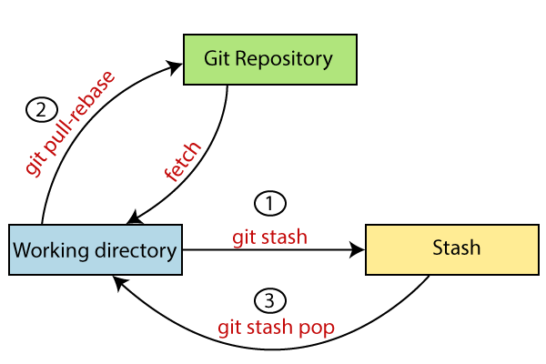
Stash Diagram

