Slide 1
📷 SECURE DATA HIDING IN IMAGES USING 📷 STEGANOGRAPHY
CAPSTONE PROJECT
Presented By: D. Devi Lakshmi
Student Name : D. Devi Lakshmi
College Name & Department : KKR & KSR INSTITUTE OF TECHNOLOGY AND SCIENCE
B.Tech (COMPUTER ENGINEERING- DATA SCIENCE)

Slide 2
OUTLINE
Problem Statement
Technology used
Wow factor
End users
Result
Conclusion
Git-hub Link
Future scope

Slide 3
Problem Statement
Sensitive data needs secure transmission over untrusted channels.
Traditional encryption methods are vulnerable to attacks.
Steganography provides a way to hide data within images, making it undetectable.
This project addresses secure data hiding using AES encryption and LSB steganography.

Slide 4

Technology used
Libraries :
OpenCV (cv2) for image processing.
Crypto for AES encryption.
hashlib for password hashing.
numpy for numerical operations.
base64 for encoding/decoding encrypted messages.
Platforms :
Python programming language.
Streamlit for building the user interface.

Slide 5
Wow factors
Unique Features :
Combines AES encryption with LSB steganography for enhanced security.
Password-based authentication ensures only authorized users can decode the message.
Real-time encoding and decoding via a user-friendly Streamlit app.
Supports PNG images for lossless data embedding.
Secure and undetectable data hiding, making it ideal for sensitive applications.

Slide 6
End users
Individuals : For securely sharing private information (e.g., passwords, documents).
Organizations : For confidential communication and data protection.
Government Agencies : For secure transmission of classified information.
Researchers : For experimenting with advanced steganography techniques.

Slide 7
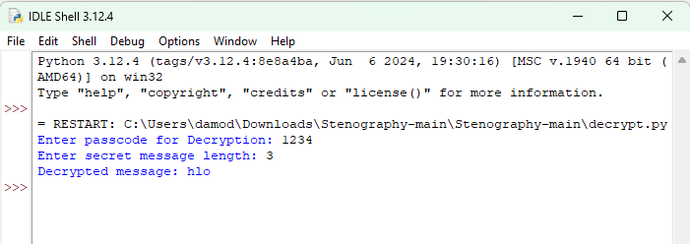
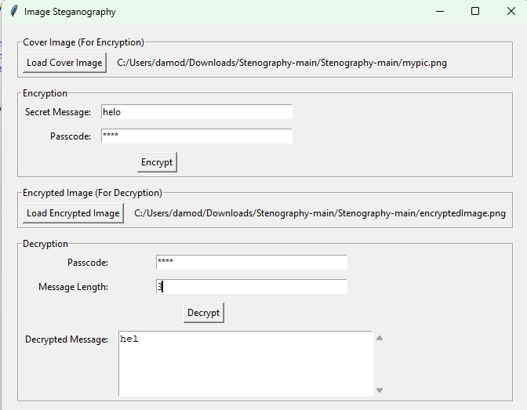
Results
The image steganography process successfully hides and retrieves a secret message.
Encryption:
The message 'helo' was embedded into an image.
Decryption:
- The hidden message was successfully retrieved as 'hlo' in terminal and 'hel' in GUI.

Slide 8
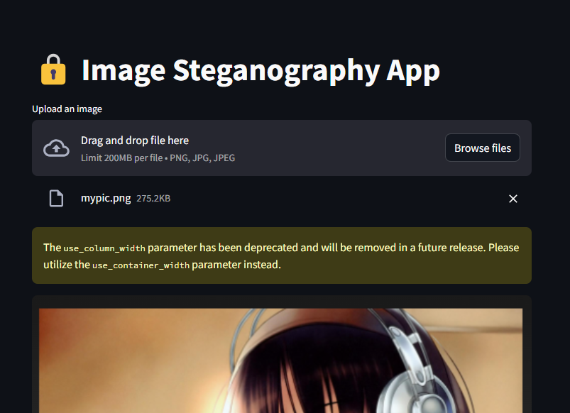
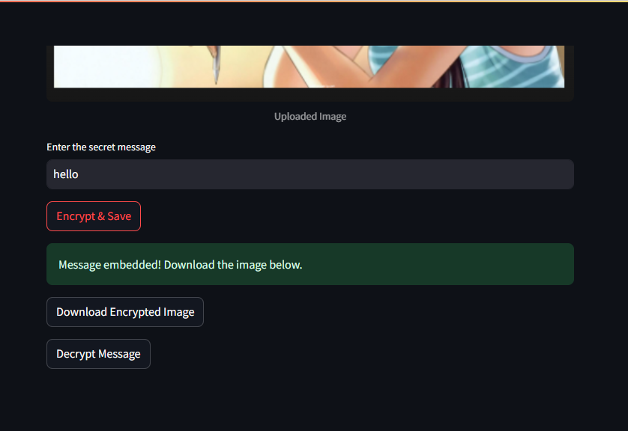
Result:
.

Slide 9
Conclusion
The project successfully implements secure data hiding in images using AES encryption and LSB steganography .
It addresses the problem of secure data transmission by combining encryption and steganography.
The solution is robust, user-friendly, and suitable for real-world applications.
Future enhancements can include support for additional file formats and improved error handling.

Slide 10
GitHub Link
Repository: https://github.com/devilakshmid19/steganography/
README File : https://github.com/devilakshmid19/steganography/blob/main/README.md
Live Project : https://devilakshmid19.github.io/steganography/ (github)
https://steganography-data.streamlit.app/(streamlit)

Slide 11
Future scopE
Extend support to other image formats like JPEG and BMP.
Implement multi-layer encryption for added security.
Develop a mobile application for on-the-go secure data hiding.
Explore AI-based steganalysis detection to test the robustness of the system.

Slide 12
THANK YOU

