Slide 1
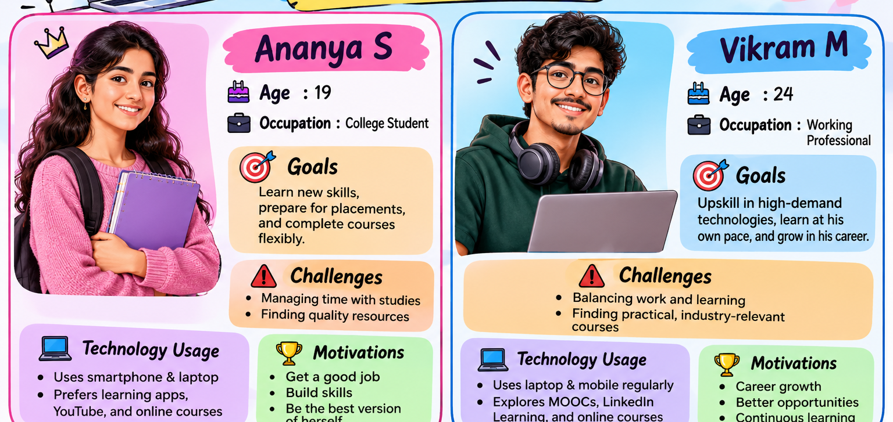
EXPERIMENT 4
USER PERSONA
DEVELOPMENT
Online Learning Platform
Creating realistic user profiles to guide design decisions and build user-centered learning experiences.
UI / UX DESIGN • PERSONA CARDS • USER-CENTERED DESIGN
EXPERIMENT 4 • USER PERSONA DEVELOPMENT 1 / 5

Slide 2
What is a User Persona?
A fictional profile representing a key type of user, based on research and user needs.
OBJECTIVE
PERSONA DETAILS
Create realistic user profiles for better design decision-making.
Name and age
Occupation
Goals
Personas help designers understand users’ goals, challenges, habits, and expectations before designing a product.
Challenges
Technology usage
Motivations
EXPERIMENT 4 • USER PERSONA DEVELOPMENT 2 / 5

Slide 3
Persona 1 — Ananya S
College student • 19 years old
GOALS
CHALLENGES
ANANYA
Learn new skills
Prepare for placements
Complete courses flexibly
Managing time with studies
Finding quality learning resources
“I want to learn useful skills and prepare for my future career.”
Profile
19 • College Student
Uses phone & laptop
TECHNOLOGY USAGE
MOTIVATIONS
Smartphone and laptop
Learning apps, YouTube, online courses
Get a good job
Build skills
Become more confident
EXPERIMENT 4 • USER PERSONA DEVELOPMENT 3 / 5

Slide 4
Persona 2 — Vikram M
Working professional • 24 years old
GOALS
CHALLENGES
VIKRAM
Upskill in high-demand technologies
Learn at his own pace
Grow in his career
Balancing work and learning
Finding practical, industry-relevant courses
“I need flexible, practical learning that helps me grow in my career.”
Profile
24 • Working Professional
Uses laptop & mobile
TECHNOLOGY USAGE
MOTIVATIONS
Laptop and mobile
MOOCs, LinkedIn Learning, online courses
Career growth
Better opportunities
Continuous learning
EXPERIMENT 4 • USER PERSONA DEVELOPMENT 4 / 5

Slide 5
Learning Outcome & Conclusion
Personas turn user needs into practical design direction.
LEARNING OUTCOME
CONCLUSION
Students will be able to:
• Define target users
• Identify user goals and expectations
• Recognize user challenges
• Make user-centered design decisions
Ananya and Vikram have different needs, but both benefit from:
• Clear course information
• Flexible learning options
• Easy-to-use navigation
• Relevant learning content
RIGHT USER → RIGHT EXPERIENCE
EXPERIMENT 4 • USER PERSONA DEVELOPMENT 5 / 5

