Slide 1
PHONESPOT
By: abhishek u & sharath sunil

Slide 2
introduction
PHONESPOT IS AN APPLICATION WHICH HELPS NAÏVE USERS TO FIND SMARTPHONES OF THEIR CHOICE.
IT HELPS TO REDUCE THE HASSLE OF FILTERING OUT SMARTPHONES FROM e-COMMERECE WEBSITE.
USERS HAVE THE OPTION TO INPUT THE BRAND NAME AND PRICE OF THE REQUIRED SMARTPHONE.
IT ALSO HAS AN OPTIONAL FEATURE TO SEARCH SMARTPHONES ON THE BASIS OF RAM AND INTERNAL STORAGE.
THE APPLICATION USES SQLite DATABASE TO STORE DATA AND PICASSO LIBRARY TO CACHE IMAGES.

Slide 3
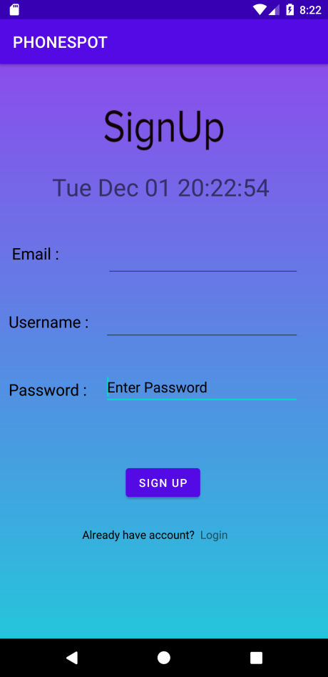
Signup activity
A NEW USER CAN REGISTER TO THE APPLICATION
USING THIS ACTIVITY.
WE FIRST OF ALL CHECK WHETHER THE USER
ALREADY EXIST IN THE APPLICATION.
AFTER THE REGISTRATION THE USER WILL BE
DIRECTED TO THE LOGIN ACTIVITY.

Slide 4
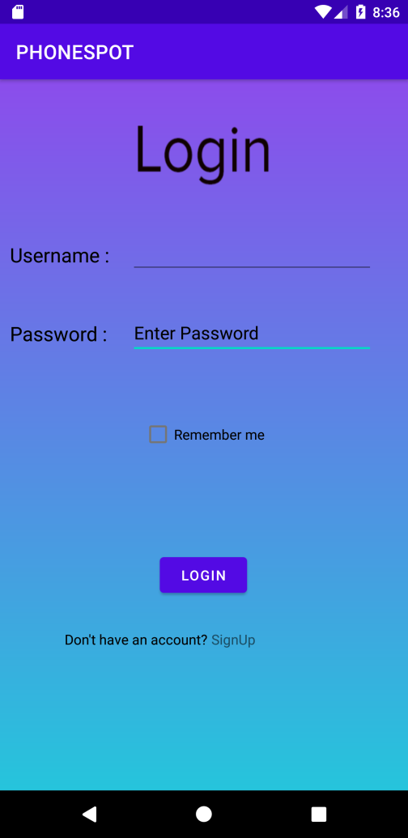
LOGIN activity
AFTER VALIDATING THE USER CREDENTIALS
THE USER WILL BE DIRECTED TO THE SEARCH
PAGE.
IN THIS ACTIVITY SHAREDPREFERENCE IS
USED TO STORE THE USER CREDENTIALS
FOR EASIER LOGIN.

Slide 5
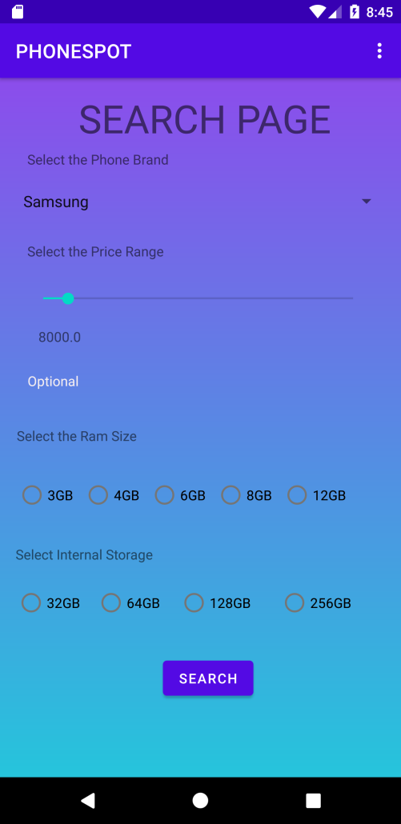
SEARCH ACTIVTY
THE USER CAN SEARCH THE SMARTPHONES
ON THE BASIS OF BRAND AND PRICE RANGE.
THE SEARCH PAGE ALSO OFFERS AN OPTIONAL
FEATURE TO SEARCH ON THE BASIS OF RAM
AND INTERANAL STORAGE.

Slide 6
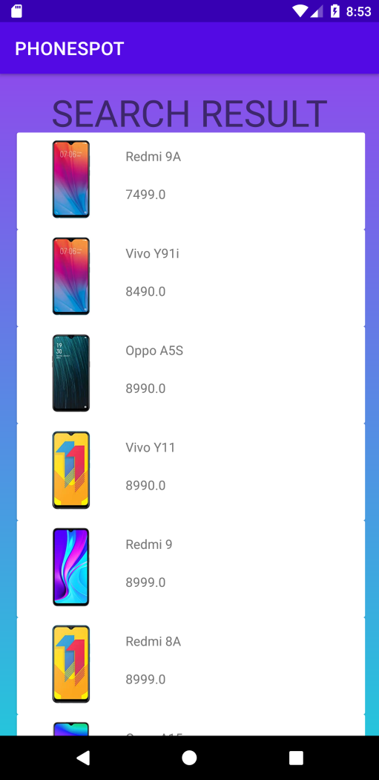
RESULT ACTIVITY
THE PHONES ARE FETCHED FROM THE
DATABASE ON THE BASIS OF THE SEARCH
QUERIES OF THE PREVIOUS ACTIVITY.
THE RECYCLER IS USED TO VIEW THE PHONE
DETAILS.

Slide 7
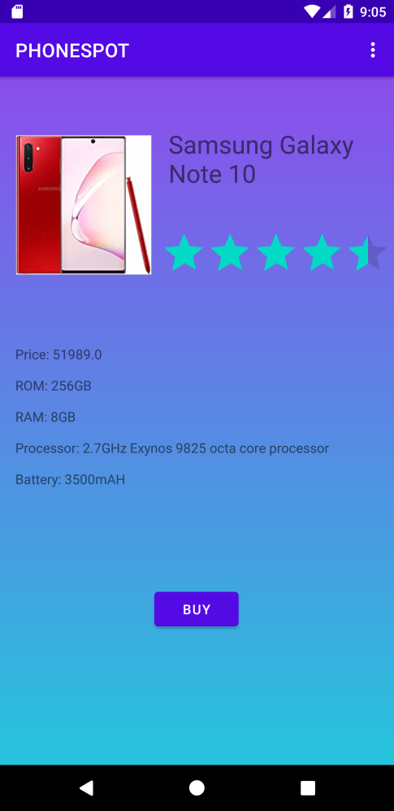
BUYING ACTIVITY
A BRIEF DEATLS OF THE CHOSEN SMARTPHONE
WILL BE SHOWN IN THIS CURRENT ACTIVIY.
BY PRESSING THE BUY BUTTON THE USER WILL
BE DIRECTED TO A BROWSER WHERE HE CAN
BUY THE PHONE.

Slide 8
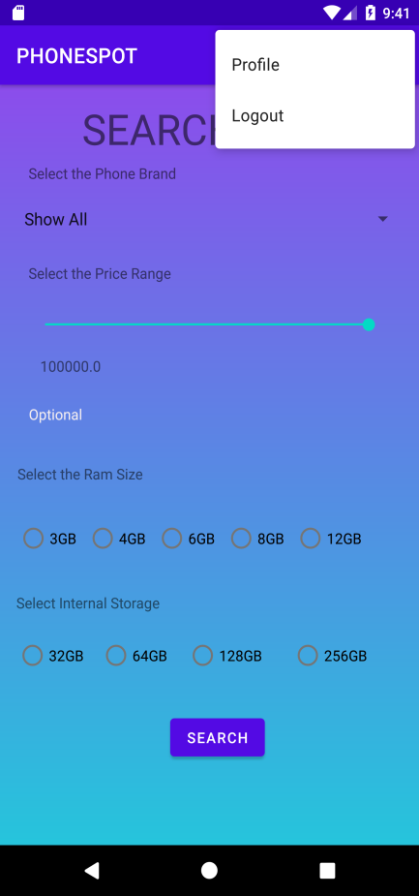
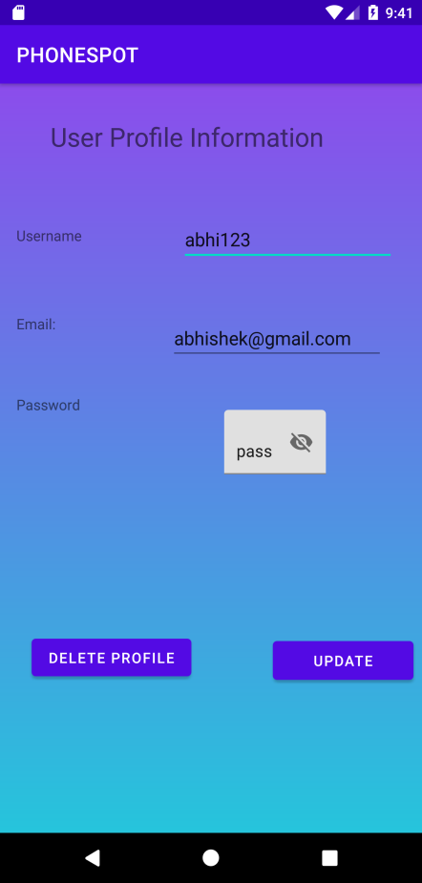
OPTIONS MENU
THERE IS AN OPTIONS MENU IN THE
SEARCH PAGE WHICH HAS TWO
OPTIONS PROFILE AND LOGOUT.
IN THE PROFILE ACTIVITY WE CAN
UPDATE THE CURRENTLY LOGGED
IN USER INFORMATION OR DELETE
THE ACCOUNT.
BY USING THE LOGOUT OPTION THE
THE USER WILL BE LOGGED OUT
FROM THE APPLICATION AND WILL
BE DIRECTED TO THE LOGIN ACTIVITY.

Slide 9
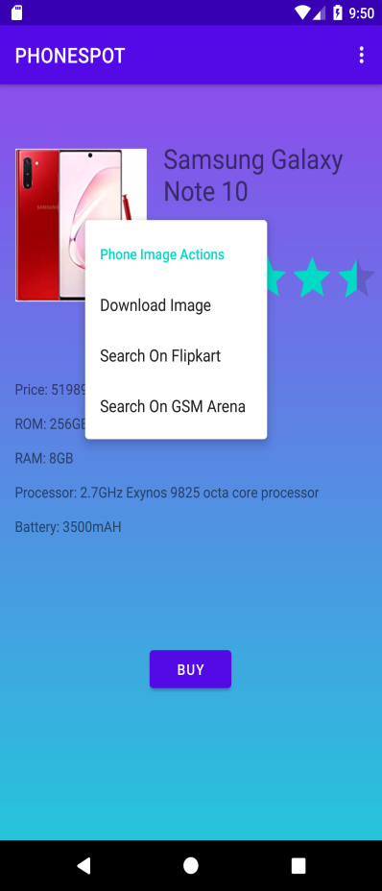
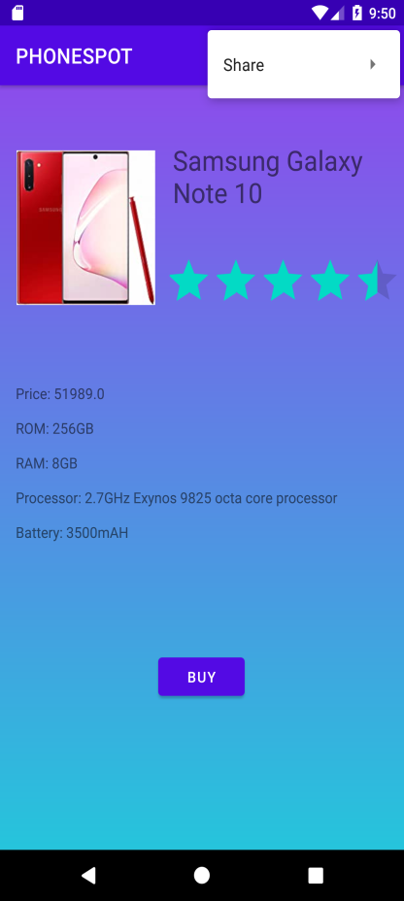
CONTEXT MENU
A CONTEXT MENU IS ASSOCIATED
WITH THE IMAGE VIEW.
THE CONTEXT MENU HAVE OPTIONS
WHICH WILL BE REDIRECTED TO THE
BROWSER FOR THEIR RESPECTIVE
ACTIONS.
A TOOLBAR MENU IS ALSO PROVIDED
WHICH IS ASSOCIATED WITH THE
SHAREACTION PROVIDER.

Slide 10
THANK YOU

