Slide 1
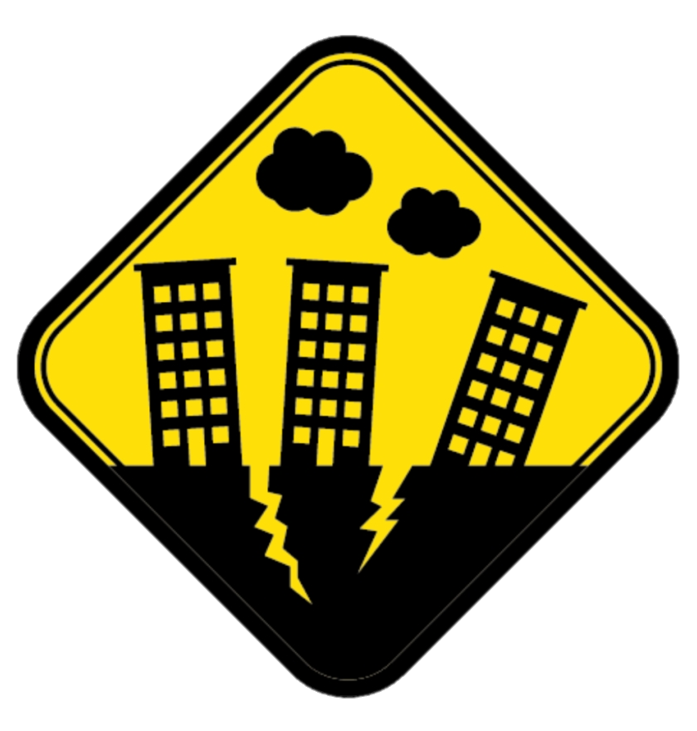
Earthquakes Investigational Report
By- Sameer Gupta
Summer Holiday Homework for I&S

Slide 2
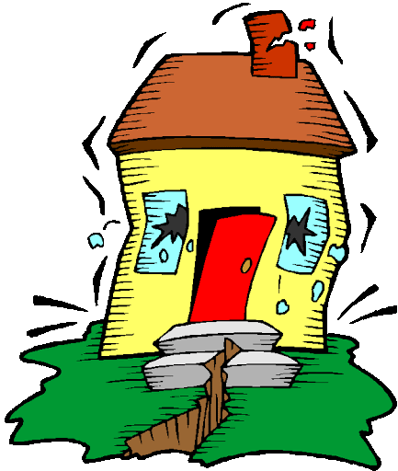
How can we define Earthquakes?
An earthquake is a natural occurring disaster in which the earth platform starts to move, and/or shake. This type of disaster can be very dangerous as well because the result of the earth shaking can cause severe damage to buildings and people.

Slide 3

How do earthquakes happen?
There are many ways in which earthquakes can occur and the scale of those ways decides the scale of the earthquake. Firstly some rocks underground break or fall, the sudden release of energy make the ground shake and cause seismic waves. Another cause of earthquakes is when the tectonic plates move because of energy or if they collide with other tectonic plates which results in very major earthquakes. If the tectonic plates overlap each other, then that could cause mountain building and volcanos also. The point where the collision, breaking/falling of rocks happens is the epicentre and that place is severely effected

Slide 4
FACT:
WE MEASURE THE EARTHQUAKE’S SCALE IN THE UNIT OF MAGNITUDE!

Slide 5
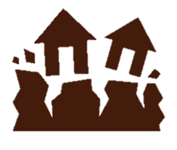
Consequences/effects of such hazards:
These hazards like earthquakes can have some severe effects/consequences depending on the scale of the earthquake. If the earthquake is not that big (maybe a scale of 2 to 3 magnitude) which happen every now and then, there wont be much damage but we will be able to feel the earth shaking, the occasional pencil will fall of the table but that’s it but if the magnitude exceeds 3 to maybe 3 – 6 then it will have more severe consequences like maybe someone falling, some parts of a building coming down (rarely happens at this magnitude), a lot of shaking etc., in this instance we should try to be safe at take cover. But if the magnitude is very high, then that is a major problem and you should probably evacuate your house and be protected because there will be some serious seismic activity.

Slide 6
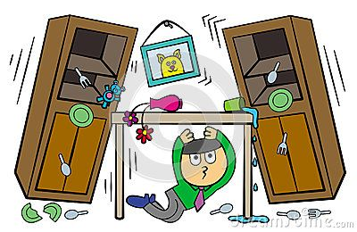
What should we do in these kind of situations?
In these kind of situations, just to be safe we should evacuate the house or apartment and if you don’t have time to do that, you need to hide under tables or be in a safe position where all your important body parts are safe. If you are in a high rise building, you should take the fire exit to evacuate.

Slide 7
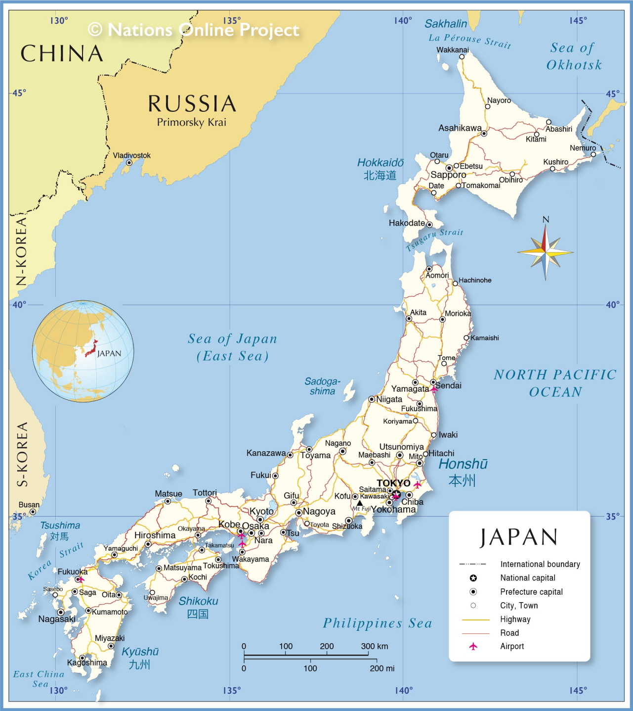
Which county is highly effected by earthquakes?
According to research Japan is the most effected by earthquakes because of its history with earthquakes and where it is located. Since Japan is situated in the Pacific Ocean’s ring of fire, it receives a lot of earthquakes. Japan stands on the Philippines sea tectonic plate which is know to have a lot o f seismic activity.

Slide 8
Thank You

