Slide 1
Number system
Ch-3-Real numbers and ratio

Slide 2
Learning objectives
I will be able to
understand the number system.
Distinguish between various forms of numbers
Formulate the definition of rational numbers

Slide 3
Discussion time
What do you know about numbers ?
Why do we need numbers?
Do you think Animals use number ?
Why do we need negative answers?
Padlet : https://padlet.com/kanikas/t7br96inzthx4gwa

Slide 4
What are natural numbers?
What are integers ?

Slide 5
The set of natural numbers is the set of all positive numbers (and zero) that are neither fraction nor decimal. It is denoted by ℕ.
ℕ = {0, 1, 2, …}
The set of integers is the set of all positive and negative numbers (and zero) that are neither fraction nor decimal. It is denoted by ℤ.

Slide 6
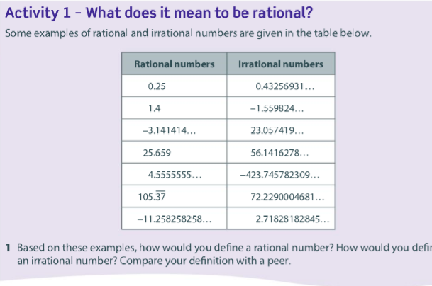

Slide 7
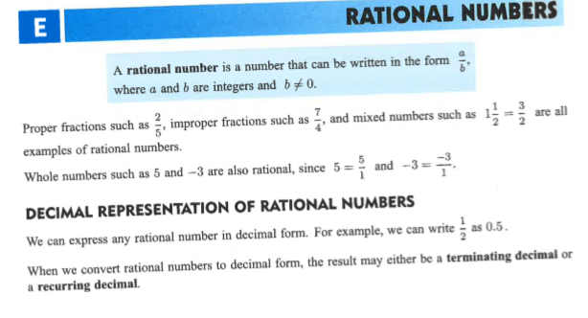

Slide 8
What are terminating decimals?
Answer in the chat

Slide 9
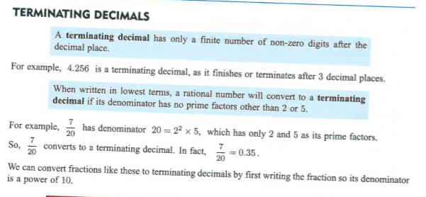

Slide 10
What are recurring decimals?
Answer in chat

Slide 11
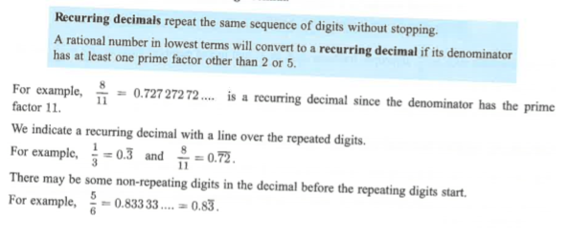

Slide 12
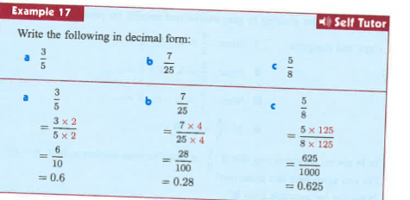

Slide 13
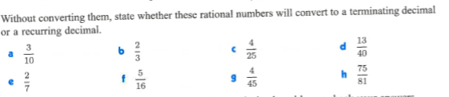
Let’s practice

Slide 14

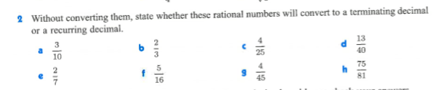

Home Work

Slide 15
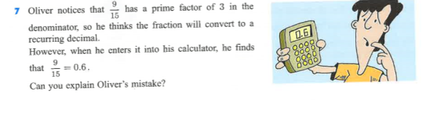

Slide 16
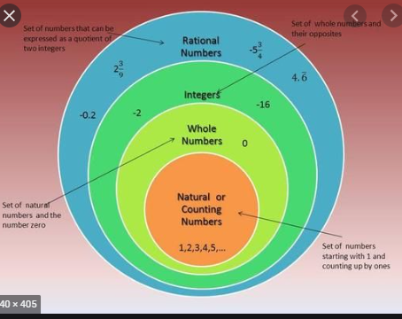

Slide 17
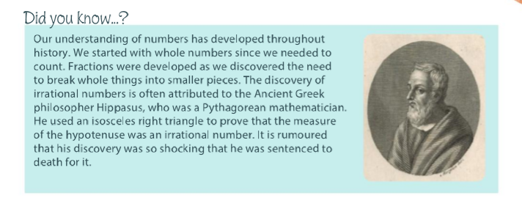

Slide 18
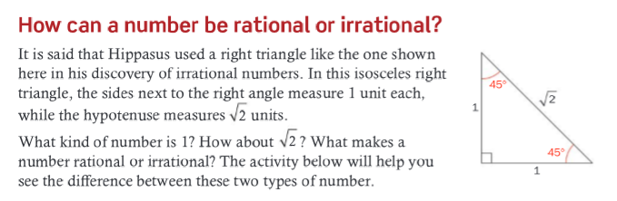

Slide 19
