Slide 1
Design of Chilled Water Type Conditioning and Ventilation System of Proposed Three Storey Hospital in Batangas
Prepared by: Abu, Mark Kervin N.
Azucena, Roniel A.
Castillo, Adrian M.

Slide 2

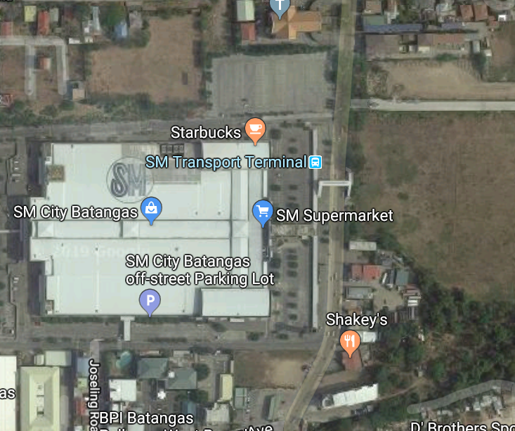


Location of the Building
N
N
E
W
E
W
S
S

Slide 3
Details of Location
13°45'21" North Latitude, 121°04'419" East Longitude
Area= 1819 m²
Outdoor Design:
Dry-Bulb Temperature = 34.5 °C
Wet-Bulb Temperature = 26.1°C
Daily Range= 8.1 °C
Design Month= May

Slide 4
Indoor Design at 50% Relative Humidity
Dry bulb Temperature= 24 °C
Dry bulb Temperature= 22.5 °C
Dry bulb Temperature= 22 °C
Reference: Hvac Design Manual for Hospitals and Clinics, 2013 Ashrae

Slide 5
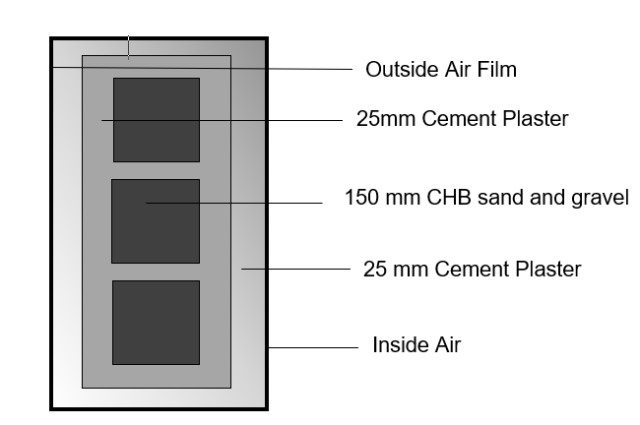
Construction of Wall
 | R, m² ⁰K/Watt | ρ_{S}, Kg/m²
outside air film | 0.0440 | ---
25 cement plaster | 0.0347 | 39.95
150mm CHB sand and gravel | 0.1350 | 147
25 cement plaster | 0.0347 | 39.95
inside air film | 0.12 | ---
 | R_{T} = 1.2695 | ρ_{ST} = 226 Kg/m²
 | U_{W} = 2.7144 W/m²K | TYPE F

Slide 6
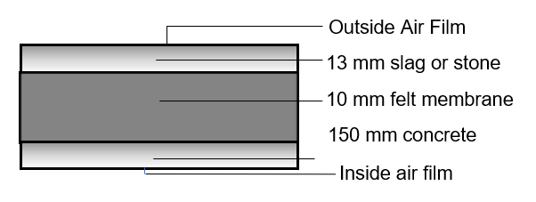
Construction of Roof
 | R, m²K/W | ρ_{S}, Kg/m²
outside air film | 0.044 | ---
25 mm granite | 0.01375 | 42.5
200 mm concrete block, sand and gravel | 0.18 | 196
25 mm cement plaster | 0.02919 | 39.95
inside air film | 0.12 | ---
 | R_{T} = 1.104 m²K/W | ρ_{ST} = 278.45 kg/m²
 | U_{W} = 2.58438 W/m²K | TYPE 6 roof with suspended ceiling

Slide 7
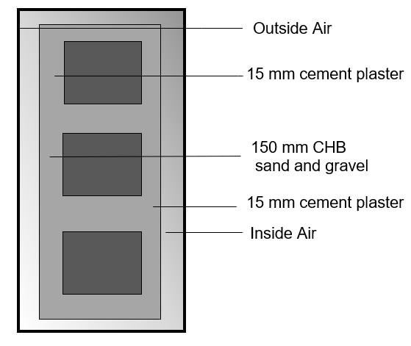
Construction of Wall Partition
 | R, m² ⁰K/Watt | ρ_{S}, Kg/m²
inside air film | 0.12 | ---
15 mm cement plaster | 0.0208 | 23.97
120 mm CHB sand and gravel | 0.1350 | 117.6
15 mm cement plaster | 0.0208 | 23.97
inside air film | 0.12 | ---
 | R_{T} = 0.3896 m²K/W | ρ_{ST} = 165.54 Kg/m²
 | U_{W} = 2.5667 W/m²K | TYPE F

Slide 8
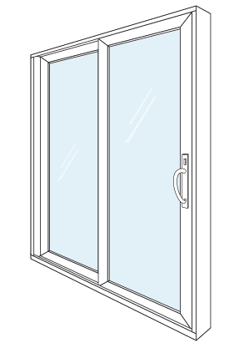
Construction of Glass
Single glass, regular sheet with venitian blinds and light color
U= 2.8211 W/m2K (fixed)
U= 2.8722 W/m2K (awning, sliding)

Slide 9
Load Calculation
External Wall Load
Glass Load
Roof Load
Infiltration Load
Ventilation Load
Lighting Load
Occupant Load
Partition Load
Miscellaneous Load

Slide 10
External Wall Load Calculation
External Wall Load
𝐐_{𝐰} = 𝐔𝐀 𝐂𝐋𝐓𝐃_{𝐚𝐝𝐣}
For 22⁰C, Minor Operating Room
For Area (m²)
N: 13.6 m²
For Cooling Load Temperature Difference
CLTD_{ADJ} = (CLTD_{SEL} + LM)k + (25 – t_{i}) + (t_{AV}-29)
Where tav = 30.45⁰C
N: (13 – 0.55)(0.65) + (25-22) + (30.45-29)
N= 20.3425
ForHeat transfer coefficient:
U= 2.7144 W/ m²K
For Thermal Heat Load, Q_{W} (W)
Q_{W}= 2.7144 W/ m²K (13.6)(20.3425)
Q_{W}= 479.9059 W

Slide 11
Glass Load Calculation
Glass Load
Q_{G}= Q_{SG} + Q_{TH}
Q_{SG}= (SHGF)(SC)(A)(CLF)
Q_{TH}= (U)(A)( ΔT)
For 22⁰C, Minor Operating Room
Area (m²)
N: 1.6 m²
Solar Heat Gain, Q_{SG} (W)
N: (120)(0.91)(1.6 m²)(0.55)
Q_{SG}= 96.096 W
Conduction Heat Load, Q_{TH}
N: (2.8211 W/ m²K)(1.6 m²)( 34.5 – 22) ⁰C
Q_{TH}= 56.422 W
Q_{G}= 96.096 W + 56.422 W
Q_{G}= 152.518 W

Slide 12
Roof Load Calculation
Roof Load
Q_{S}= (U)(A)(CLTD_{ADJ})
For 22.5⁰C, 5-Bed Ward 1
Area (m²)
34.2769 m²
Cooling Load Temperature Difference
CLTD_{ADJ} = [(CLTD_{MAX} + LM)k + (25 – t_{i}) + (t_{AV}-29)]f
Where tav = 30.45⁰C
CLTD_{MAX}= 18
k= 0.75, medium color
f= 0.75, positive ventilation

Slide 13
CLTD_{ADJ} = [(18 + 0)0.75 + (25 – 22.5) + (30.45-29)]0.75
CLTD_{ADJ}= 13.0875
Q_{S}= 2.58438(34.2769 m²)(13.0875)
Q_{S}= 1159.35 W

Slide 14
Infiltration Load Calculation
Infiltration Load
Q_{S} = 1.232 (L/s) (t_{o}- t_{i})
Q_{L} = 3000 (L/s) (ω_{o}- ω_{i})
For 22°C, Minor Operating Room
Infiltration Rate, L/s
L/s = NV / 3.6
*wind speed from ASHRAE Meteo, v = 3 m/s
number of air changes, N = a +bv+ c(to – ti)
N = 0.15+(0.01)(3)+0.007(34.5-22)
N = 0.2675
volume of conditioned space, V = (floor area)(building height)
V = 23.389 m2 (4m)
V = 93.544 m3
L/s = (0.2675) (31.27) / 3.6
L/s = 6.9516

Slide 15
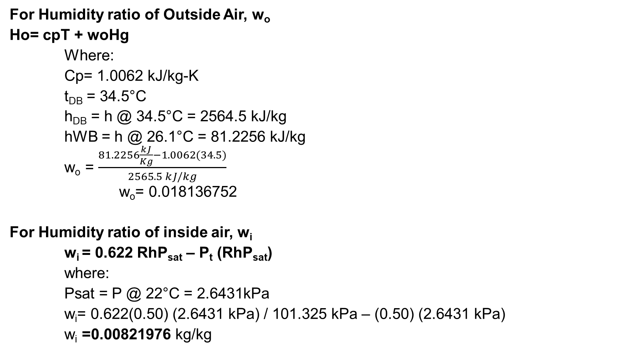
For Humidity ratio of Outside Air, w_{o}
Ho= cpT + woHg
Where:
Cp= 1.0062 kJ/kg-K
t_{DB} = 34.5°C
h_{DB} = h @ 34.5°C = 2564.5 kJ/kg
hWB = h @ 26.1°C = 81.2256 kJ/kg
w_{o} = $\frac{81.2256\frac{kJ}{Kg}−1.0062(34.5)}{2565.5 kJ/kg}$
w_{o}= 0.018136752
For Humidity ratio of inside air, w_{i}
w_{i} = 0.622 RhP_{sat} – P_{t} (RhP_{sat})
where:
Psat = P @ 22°C = 2.6431kPa
w_{i}= 0.622(0.50) (2.6431 kPa) / 101.325 kPa – (0.50) (2.6431 kPa)
w_{i} =0.00821976 kg/kg

Slide 16
Sensible Heat Load (Q_{S})
Q_{s}= 1.232(2.2019) (34.5°C - 24 °C)
Q_{s}= 28.4841 W
Latent Heat Load (Q_{L})
Q_{L}= 3000 (2.2019) (0.018136752 - 0.00821976)
Q_{L}= 58.4183 W

Slide 17
Ventilation Load
VENTILATION LOAD
Q_{S}= 1.232 (L/s) (t_{o}- t_{i})
Q_{L} = 3000 (L/s) (ω_{o}- ω_{i})
For 24°C, Canteen
L/s = N (L/s per person)
Where L/s per person= 8
Number of occupants= 20 persons
L/s= 8(20)= 160
Q_{S}= 1.232 (160 L/s) ( 34.5 – 24)°C
Qs= 2069.76 W
Q_{L}= 3000 (160 L/s) (34.5 – 24)°C
Q_{L}= 4244.8882 W

Slide 18
Lighting Load
Lighting Load
Q_{S} = (lamp rating)(F_{u})(F_{sa})(CLF)
For 24 °C, Canteen
Where:
Lamp rating= 2362.09 W
F_{u}=0.5
F_{sa}=1.2
CLF= 0.94
Q_{S}= (2362.09 W)( 0.5)( 1.2)( 0.94)
Q_{S}= 1332.219 W

Slide 19
Occupant Load
Occupant Load
Q_{S} = (gain per person)(sensible heat gain)(no.of people)(CLF)
Q_{L} = (gain per person)(latent heat gain)(CLF)
For 24 °C, Canteen
Where:
Gain per person= 100
Sensible heat gain= 0.6
Latent heat gain= 0.4
No. of people= 20
CLF= 0.92
Q_{S}= (100)(0.6)(20)(0.92)
Q_{S}= 1104 W
Q_{L}= (100)(0.4)(0.92)
Q_{L}= 36.8 W

Slide 20
Partition Load for Wall
Wall Partition: Q_{S} = U A ΔT
For 24 °C, Canteen
Where: Wall Partition of Canteen and Hallway
Area= 10.2 m²
ΔT= (28 - 24) °C= 4°C
Q_{S}= (2.7144)(10.2 m²) (4)
Q_{S}= 41.53032 W

Slide 21
Partition Load for Door
For 22 °C, Minor Operating Room
Where: Door Partition of Minor Operating Room and Emergency Room
Area= 3.2 m²
ΔT= (22.5 - 22) °C= 0.5
Q_{S}= (2.3576)(3.2 m²)(0.5)
Q_{S}=37.7216 W

Slide 22
Miscellaneous Load
Minor Operating Room Equipment
Smoke Detector = 0.4 W
Cardiopulmonary Bypass Machine = 150 W
Surgical Lights= 25 W
Autoclave= 2000 W
Electrosurgery= 109 W
For 22.5 °C, Emergency Room
Where:
W= 300.8 W
Sensible Heat Gain= 0.33
CLF= 0.96
Latent Heat Gain= 0.16
Q_{S}=(300.8 W)(0.33)(0.96)
Q_{S}= 95.29344 W
Q_{L}=(300.8 W)(0.16)(1)
Q_{L}= 48.128 W

Slide 23
Summary of Load Calculation
SUMMARY OF HEAT LOAD CALCULATION FOR GROUND FLOOR AT 22 °C
HEAT SOURCES | Qs (W) | Ql (W)
External Wall | 1945.68192 | 0
Glass Load | 962.044 | 0
Infiltration Load | 257.4623 | 497.3868
Ventilation Load | 1309 | 2528.83296
Lighting Load | 532.87948 | 0
Occupant Load | 483 | 138
Wall Partition Load | 796.78502 | 0
Door Partition Load | 5.894 | 0
Miscellaneous Load | 723.6979 | 365.504
TOTAL | 7016.44462 | 3529.72376
OVERALL TOTAL | 10546.16838
SUMMARY OF HEAT LOAD CALCULATION FOR GROUND FLOOR AT 22.5°C
HEAT SOURCES | Qs (W) | Ql (W)
External Wall | 16186.72723 | 0
Glass Load | 6662.64419 | 0
Infiltration Load | 3885.6216 | 7455.7825
Ventilation Load | 5884.032 | 11457.01248
Lighting Load | 7216.6545 | 0
Occupant Load | 4845.18 | 1713.96
Wall Partition Load | 14155.41998 | 0
Door Partition Load | 1130.043 | 0
Miscellaneous Load | 380.204326 | 1920.224
TOTAL | 60346.52683 | 22546.97898
OVERALL TOTAL | 82893.50581
SUMMARY OF HEAT LOAD CALCULATION FOR GROUND FLOOR AT 24°C
HEAT SOURCES | Qs (W) | Ql (W)
External Wall | 16630.03447 | 0
Glass Load | 5175.5414 | 0
Infiltration Load | 1180.8 | 2558.912
Ventilation Load | 2069.76 | 4244.88816
Lighting Load | 2511.867 | 0
Occupant Load | 1104 | 36.8
Wall Partition Load | 3602.335 | 0
Door Partition Load | 11.986 | 0
Miscellaneous Load | 901.9296 | 455.52
TOTAL | 33188.25347 | 7296.12016
OVERALL TOTAL | 40484.37363

Slide 24
Summary of Load Calculation
SUMMARY OF HEAT LOAD CALCULATION FOR SECOND FLOOR AT 22 °C
HEAT SOURCES | Qs (W) | Ql (W)
External Wall | 2286.793008 | ___
Glass Load | 0 | ___
Infiltration Load | 406.8458102 | 787.2557721
Ventilation Load | 3757.6 | 7259.237
Lighting Load | 641.7098 | 0
Occupant Load | 3867 | 1500
Wall Partition Load | 1935.096 | 0
Door Partition Load | 110 | 0
Miscellaneous Load | 1474.13372 | 744.512
TOTAL | 14479.17834 | 10291.00477
OVERALL TOTAL | 24770.18311
SUMMARY OF HEAT LOAD CALCULATION FOR SECOND FLOOR AT 22.5°C
HEAT SOURCES | Qs (W) | Ql (W)
External Wall | 18499.32996 | 0
Glass Load | 11264.605 | 0
Infiltration Load | 3339.8875 | 6560.8163
Ventilation Load | 15796.7 | 30952.7564
Lighting Load | 8698.5097 | 0
Occupant Load | 3959.9 | 4052.5
Wall Partition | 15295 | 0
Door Partition | 1021.74384 | 0
Miscellaneous Load | 1927.94243 | 973.6448
TOTAL | 79803.61843 | 42539.7175
OVERALL TOTAL | 122343.3359
SUMMARY OF HEAT LOAD CALCULATION FOR SECOND FLOOR AT 24°C
HEAT SOURCES | Qs (W) | Ql (W)
External Wall | 4579.752496 | 0
Glass Load | 2949.2208 | 0
Infiltration Load | 577.8417 | 1187.028
Ventilation Load | 614.46 | 1260.2016
Lighting Load | 524.0859 | 0
Occupant Load | 938.4 | 880
Wall Partition Load | 2660.49202 | 0
Door Partition Load | 98.07616 | 0
Miscellaneous Load | 68.36544 | 34.528
TOTAL | 13010.69452 | 3361.7576
OVERALL TOTAL | 16372.45212

Slide 25
Summary of Load Calculation
SUMMARY OF HEAT LOAD CALCULATION FOR THIRD FLOOR AT 22.5°C
HEAT SOURCES | Qs (W) | Ql (W)
External Wall | 24827.88391 | 0
Roof Load | 27420.0353 | 0
Glass Load | 11472.723 | 0
Infiltration Load | 2478.26972 | 5099.36068
Ventilation Load | 13106.018 | 26381.30264
Lighting Load | 6378.502 | 0
Occupant Load | 4519.5 | 2132.1
Wall Partition Load | 11615.785 | 0
Door Partition Load | 1000.65112 | 0
Miscellaneous Load | 2157.17387 | 1089.4816
TOTAL | 104976.5419 | 34702.24492
OVERALL TOTAL | 139678.7868
SUMMARY OF HEAT LOAD CALCULATION FOR THIRD FLOOR AT 24°C
HEAT SOURCES | Qs (W) | Ql (W)
External Wall | 11065.52304 | 0
Roof Load | 5910.72485 | 0
Glass Load | 436.0549 | 0
Infiltration Load | 1170.876 | 2401.36
Ventilation Load | 620.928 | 1273.4662
Lighting Load | 2460.248 | 0
Occupant Load | 0 | 0
Wall Partition Load | 3266.075 | 0
Door Partition Load | 67.89888 | 0
Miscellaneous Load | 0 | 0
TOTAL | 24998.32867 | 3674.8262
OVERALL TOTAL | 28673.15487

Slide 26
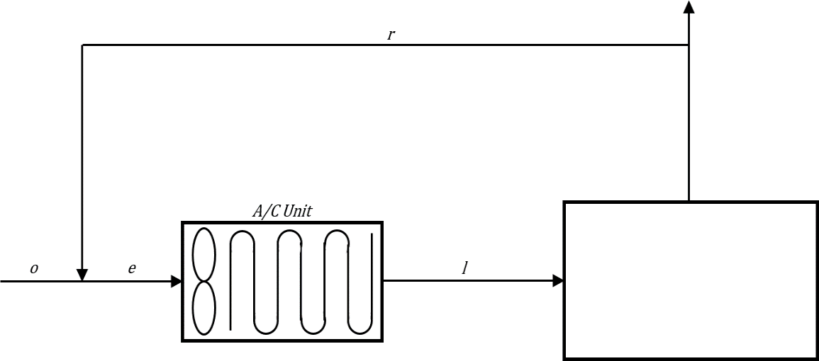
Psychrometric Method
GROUND FLOOR at 24°C initial condition;
Q_{s} = 33188.2535 W
Q_{L} = 7296.1202 W
Q_{T} = 40484.3736 W
34.5 °CDB & 26.1 °CWB
24 °CDB & 50% RH QS = 33188.2535 QT = 40484.3736

Slide 27
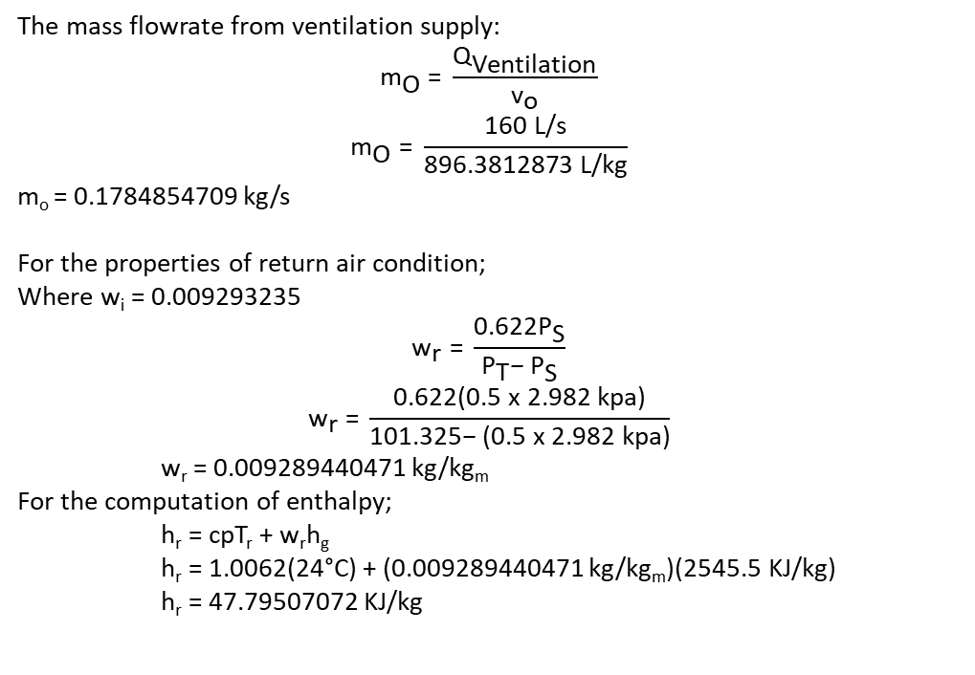
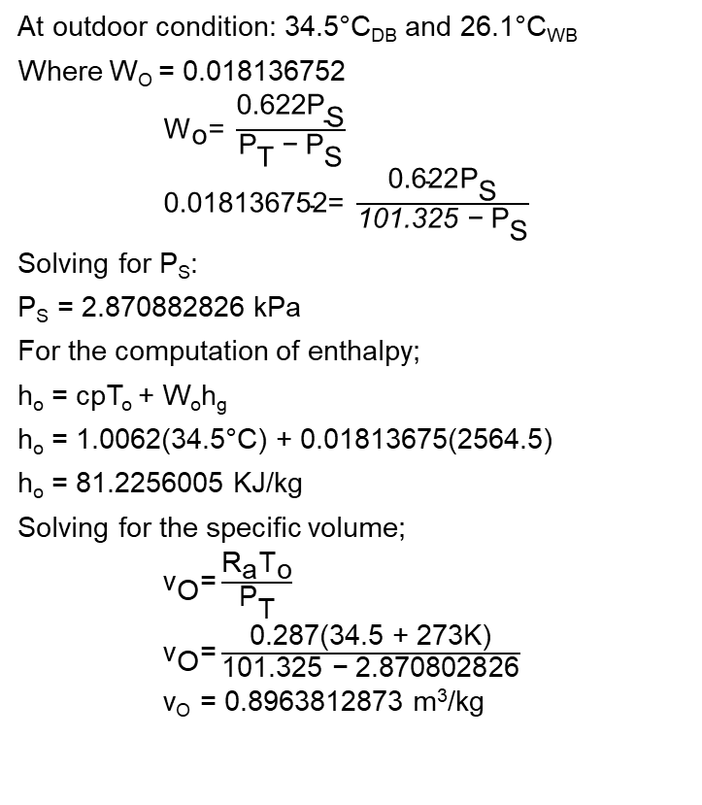
Psychrometric Method
At outdoor condition: 34.5°C_{DB} and 26.1°C_{WB}
Where W_{O} = 0.018136752
${\text{W}}_{\text{o}}\text{= }\frac{\text{0.622}{\text{P}}_{\text{S}}}{{\text{P}}_{\text{T}} \text{−}{ \text{P}}_{\text{S}}}$
$\text{0.018136752= }\frac{\text{0.622}{\text{P}}_{\text{S}}}{\text{101.325 −}{ \text{P}}_{\text{S}}}$
Solving for P_{S}:
P­_{S} = 2.870882826 kPa
For the computation of enthalpy;
h_{o} = cpT_{o} + W_{o}h_{g}
h_{o} = 1.0062(34.5°C) + 0.01813675(2564.5)
h_{o} = 81.2256005 KJ/kg
Solving for the specific volume;
${\text{v}}_{\text{O}}\text{=}\frac{{\text{R}}_{\text{a}}{\text{T}}_{\text{o}}}{{\text{P}}_{\text{T}}}$
${\text{v}}_{\text{O}}\text{=}\frac{\text{0.287(34.5 + 273}\text{K}\text{)}}{\text{101.325 }\text{−}\text{ 2.870802826}}$
v_{O} = 0.8963812873 m³/kg
The mass flowrate from ventilation supply:
$${\text{m}}_{\text{O}}\text{ = }\frac{{\text{Q}}_{\text{Ventilation}}}{{\text{v}}_{\text{o}}}$$
$${\text{m}}_{\text{O}}\text{ = }\frac{\text{160 }\text{L}\text{/}\text{s}}{\text{896.3812873 }\text{L}\text{/}\text{kg}}$$
m_{o} = 0.1784854709 kg/s
For the properties of return air condition;
Where w_{i} = 0.009293235
$${\text{w}}_{\text{r}}\text{ = }\frac{{\text{0.622}\text{P}}_{\text{S}}}{{\text{P}}_{\text{T}}\text{−} {\text{P}}_{\text{S}}}$$
$${\text{w}}_{\text{r}}\text{ = }\frac{\text{0.622(0.5 }\text{x}\text{ 2.982 }\text{kpa}\text{)}}{\text{101.325}\text{−}\text{ (0.5 }\text{x}\text{ 2.982 }\text{kpa}\text{)}}$$
w_{r} = 0.009289440471 kg/kg_{m}
For the computation of enthalpy;
h_{r} = cpT_{r} + w_{r}h_{g}
h_{r} = 1.0062(24°C) + (0.009289440471 kg/kg_{m})(2545.5 KJ/kg)
h_{r} = 47.79507072 KJ/kg

Slide 28
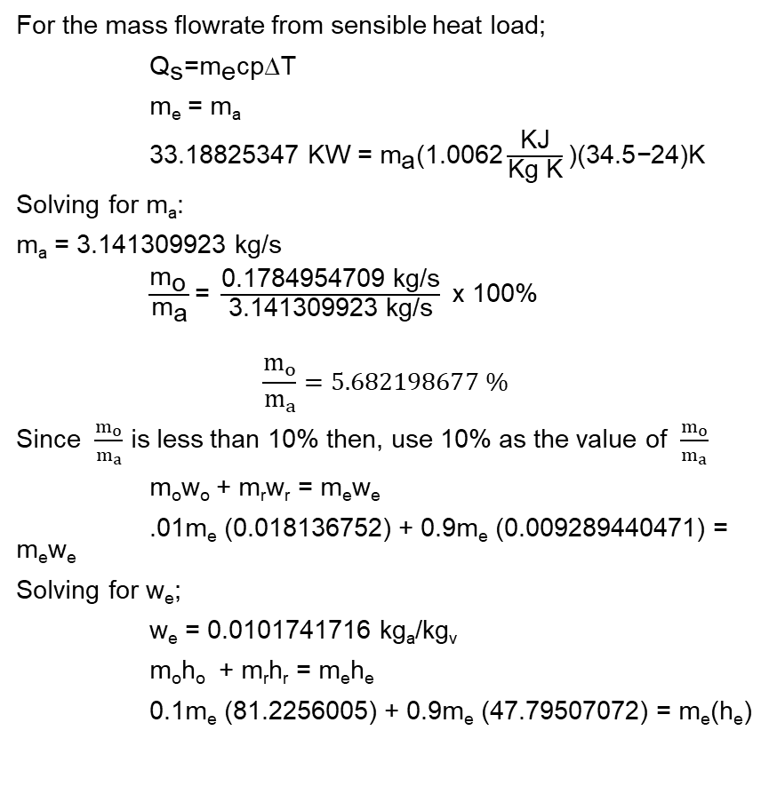
Psychrometric Method
For the mass flowrate from sensible heat load;
${\text{Q}}_{\text{s}}\text{=}{\text{m}}_{\text{e}}\text{cp}\text{∆}\text{T}$
m_{e} = m_{a}
$\text{33.18825347 }\text{KW}\text{ =}{ \text{m}}_{\text{a}}\text{(1.0062}\frac{\text{KJ}}{\text{Kg} \text{K}}\text{)(34.5}\text{−}\text{24)}\text{K}$
Solving for m_{a}:
m_{a} = 3.141309923 kg/s
$\frac{{\text{m}}_{\text{o}} }{{\text{m}}_{\text{a}}}\text{= }\frac{\text{0.1784954709 }\text{kg}\text{/}\text{s}}{\text{3.141309923 }\text{kg}\text{/}\text{s}} \text{x}\text{ 100\%}$
$$\frac{m_{o}}{m_{a}}=5.682198677 \%$$
Since $\frac{m_{o}}{m_{a}}$ is less than 10% then, use 10% as the value of $\frac{m_{o}}{m_{a}}$
m_{o}w_{o} + m_{r}w_{r} = m_{e}w_{e}
.01m_{e} (0.018136752) + 0.9m_{e} (0.009289440471) = m_{e}w_{e}
Solving for w_{e};
w_{e} = 0.0101741716 kg_{a}/kg_{v}
m_{o}h_{o} + m_{r}h_{r} = m_{e}h_{e}
0.1m_{e} (81.2256005) + 0.9m_{e} (47.79507072) = m_{e}(h_{e})
Solving for h_{e};
h_{e} = 51.1381237 KJ/kg
m_{o}t_{o} + m_{r}t_{r} = m_{e}t_{e}
0.1m_{e} (34.5) + 0.9m_{e} (24) = m_{e}(t_{e})
Solving for t_{e};
T_{e} = 25.06°C
From psychometric chart:
T_{L} = 11.4°C
For capacity of cooling coil;
Capacity = m_{e} (h_{e} – h_{L})
Capacity = 3.141309923 kg/s (51.1381237 – 32.32978727 KJ/kg)
Capacity = 59.08281386 KW

Slide 29
Summary of A/C capacity of each Floor
Table 46 SUMMARY of A/C Capacity for each floor
FLOOR | DESIGN TEMPERATURE
 | 24°C | 22.5°C | 22°C
GROUND FLOOR | 59.0828 kW | 92.4161 kW | 17.8804 kW
 | 16.0086 TOR | 25.9472 TOR | 5.0844 TOR
SECOND FLOOR | 33.1554 kW | 160.153 kW | 38.1973 kW
 | 9.3089 TOR | 45.5408 TOR | 10.8617 TOR
THIRD FLOOR | 47.4593 kW | 159.5619 kW | -----
 | 13.4954 TOR | 45.3726 TOR
 |  | TOTAL : | 607.9062 kW
 |  |  | 172.8627 TOR

Slide 30
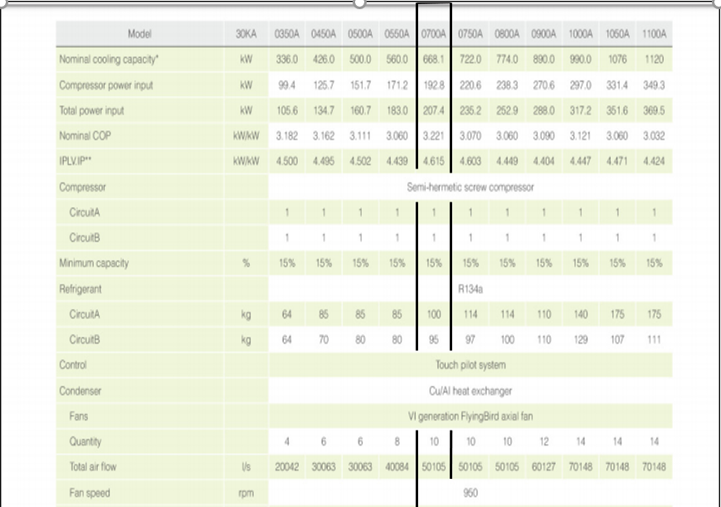
Equipment Selection
CHILLER CATALOGUE (CARRIER)

Slide 31
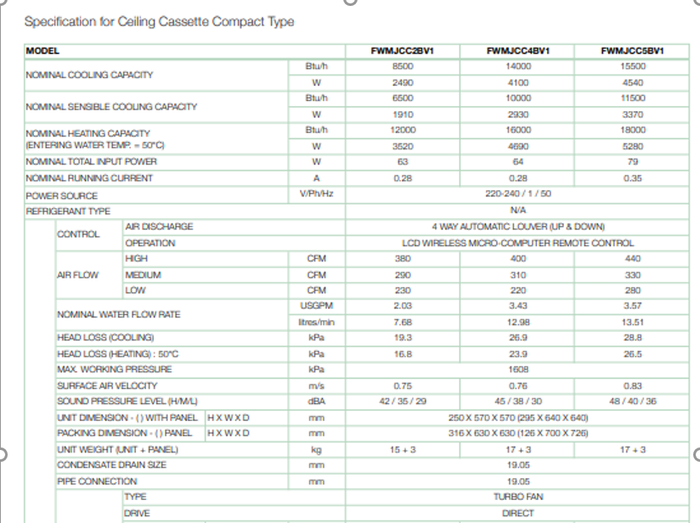
Fan Coil Unit Catalogue (Daikin)

Slide 32
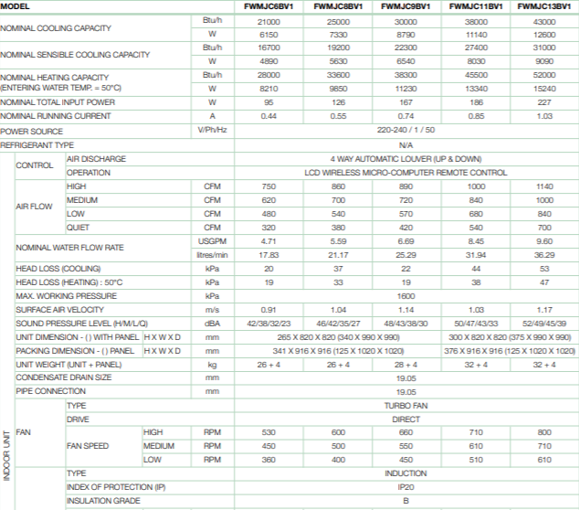
Fan Coil Unit Catalogue (Daikin)

Slide 33
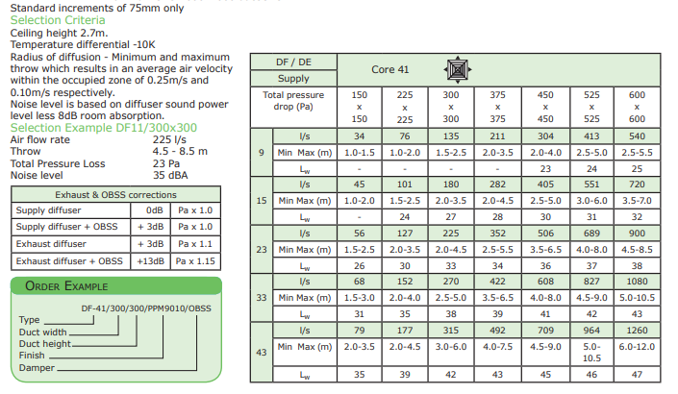
Diffuser Catalogue (OC Water Loo)

Slide 34
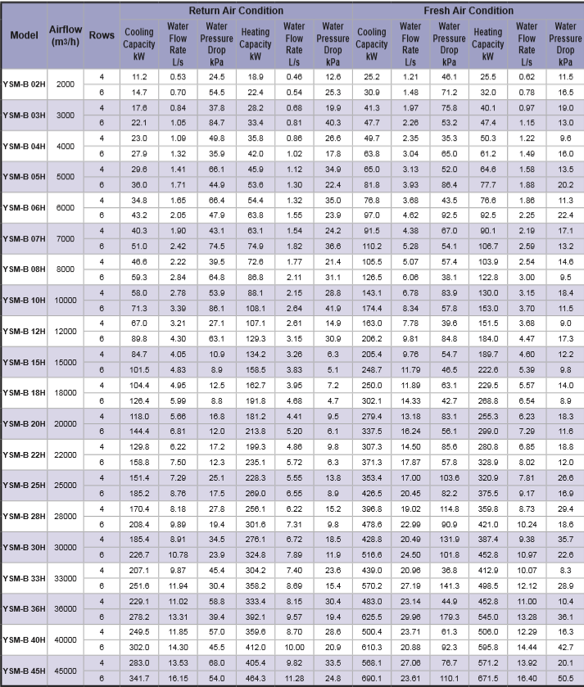
Air Handling Unit Catalogue (carrier)

Slide 35
Ground Floor ACU Layout

Slide 36
Second Floor ACU Layout

Slide 37
Third Floor ACU layout

Slide 38

Piping Calculations
Computing for L/s (Cleanup Room)
L/s= $\frac{Cooling Capacity (V@11.4C)}{Cp(Tl−Te)}$
Where cooling capacity= 3.5167 kW
V at 11.4°C = 0.001002915 m³/kg
Cp_{Water}= 4.187 kJ/kg
Tl= 25.05 °C
Te= 11.4 °C
L/s= $\frac{3.5167 kW(0.001002915)}{4.187\frac{kJ}{kg}\left(25.05−9.92\right)°C}$
L/s = 0.082649003 L/s

Slide 39
Piping Calculations
From Chiller to pump
Where Q= 19.1489 L/s
Pressure Gradient= 160.9349787 Pa/m
Length of pipe= 2m
Pressure drop= Pressure gradient x total length of pipe
Pressure drop= 321.8699574 Pa

Slide 40
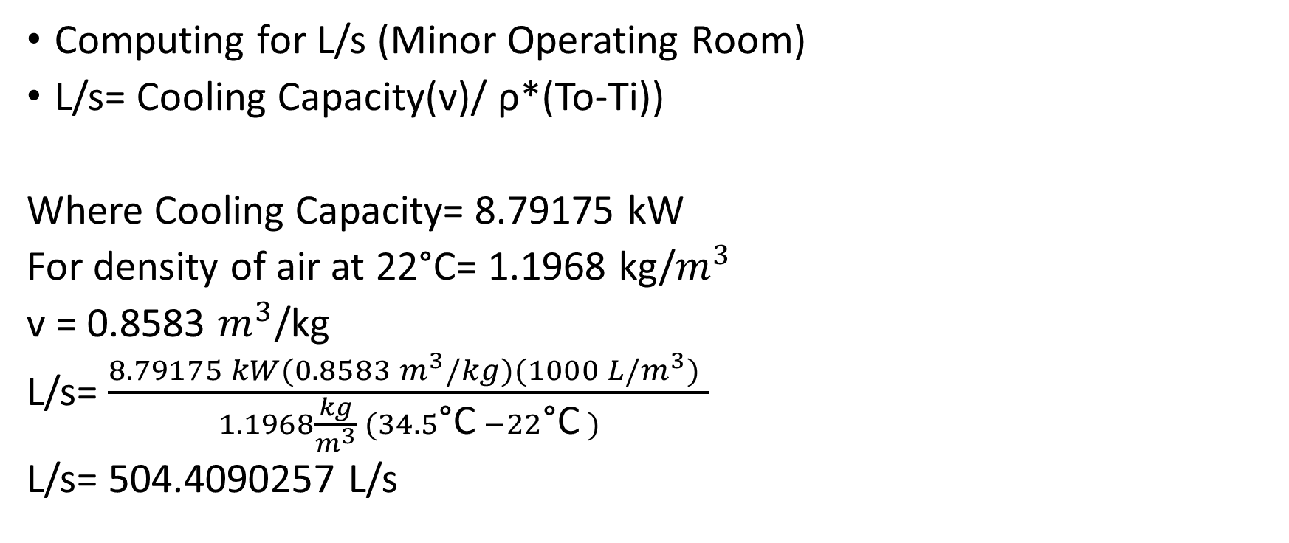
Ducting Calculations
Computing for L/s (Minor Operating Room)
L/s= Cooling Capacity(v)/ ρ*(To-Ti))
Where Cooling Capacity= 8.79175 kW
For density of air at 22°C= 1.1968 kg/$m^{3}$
v = 0.8583 $m^{3}$/kg
L/s= $\frac{8.79175 kW(0.8583 m^{3}/kg)(1000 L/m^{3}) }{1.1968\frac{kg}{m^{3}} (34.5\text{°}\text{C} −22\text{°}\text{C} )}$
L/s= 504.4090257 L/s

Slide 41
Ducting Calculations
For Examination or treatment area:
Nominal Diameter= 600 mm
Velocity= 4.282 m/s
Pressure gradient= 0.324Pa/m
Equivalent Length=38.82 m
Pressure drop= 38.82m * 0.324 Pa/m
Pressure drop= 30.1537 Pa

Slide 42
Equipment Schedule
TAG no. | Quantity | Description | Brand/Model | Capacity | No. of Indoor units connected | Electrical Data
 |  |  |  |  |  | V | ϕ | Hz
CH-1 | 1 | Air Cooled Chiller | Carrier/0700A | 668.1 kW | 96 | --- | --- | ---
TAG no. | Quantity | Description | Brand/Model | Capacity | No. of Indoor units connected | Electrical Data
 |  |  |  |  |  | V | ϕ | Hz
AHU | 1 | 39G Air Handling Unit | Carrier/Y SM-B | 668.1 kW | 15 | --- | --- | ---

