Slide 1
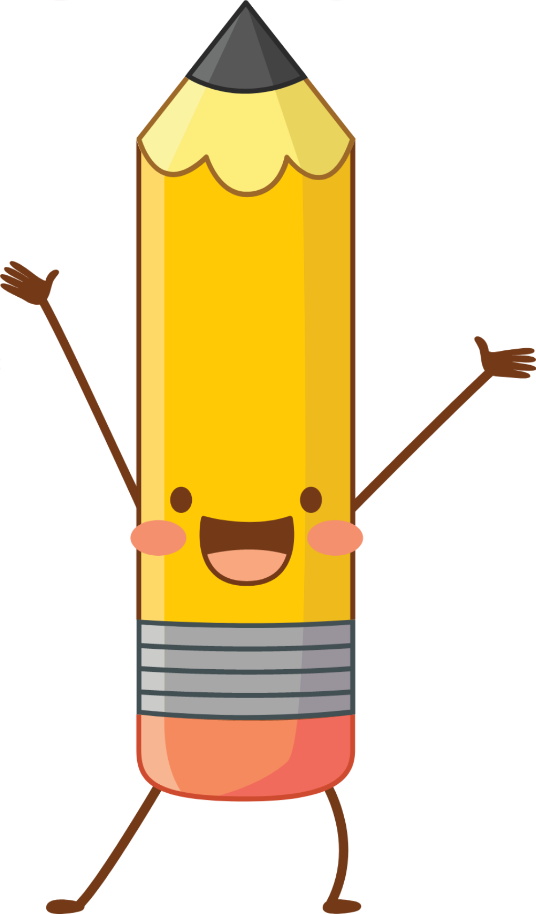
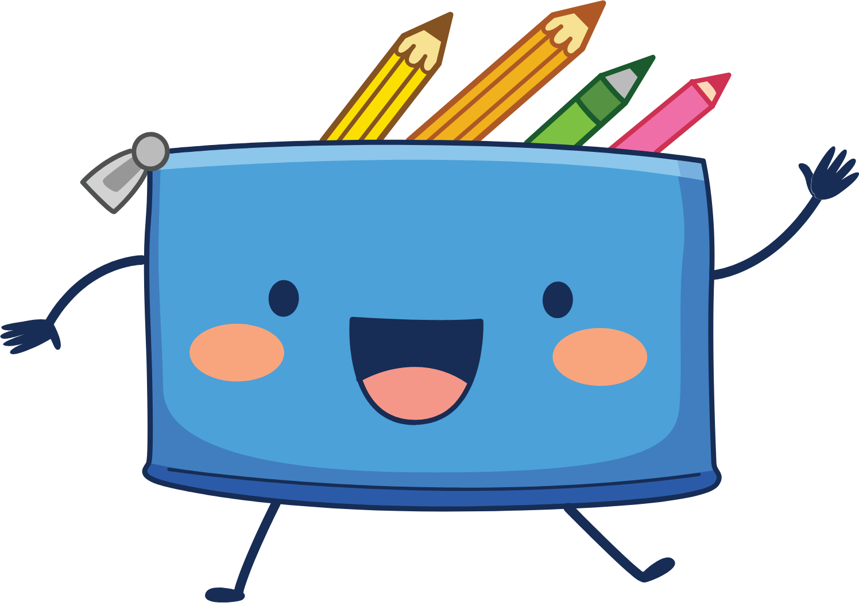


For government students
Let’s develop mindset

Slide 2
Problems faced by Government school students:
Poverty
Lack of knowledge
Poor quality of education
Competition with higher boards
Lethargic faculties
Down categorized

Slide 3
Impact of the problems
Making students believe that they are not to ready compete.
Students will accept failure before even trying for anything.
Focus is only made on academics.
Students are getting addicted to harmful stuff like alcohol, drugs and etc.
Less awareness about general topics like puberty, good touch & bad touch, career opportunities and etc.

Slide 4
Goals
Create mindset
General awareness about teenager life

Slide 5
Why is building mindset important?
Good mindset helps us to grow more. Positivity and proper information give us right direction. Sometimes, just due to demotivation we give up. Sometimes, some wrong thoughts get embedded in our mind that can lead us to problems. We might have heard the life challenges of successful people. And only thing we notice is that they had a attitude of never give up even after all troubles in their life. But everyone is not similar. Some people need more time or proper direction. And we can show them direction of light. Motivation is not enough. Physical aids are also important. But in this era, mental health impacts more. So, why not create awareness and mindset even though these are small efforts?

Slide 6
Idea 1 : (all age group till 12th standard)
We are going to give motivation to students in a unique way. Yes!
Who doesn't like stories ?
But if these stories are real and based on similar problems like us, we can relate more. We get inspired or either demotivated. But what if we get inspired ?
We think that things are possible. Right ?
So, we are going to record stories of successful people from different career background. But the twist is that rather telling it in the form of general knowledge, we will tell those stories as considering a story of a person. Afterwards, we will reveal the name of a person. We will play voice records these stories in government schools.

Slide 7

Idea 2 : (for 7th to 12th std)
More knowledge = More awareness
let’s make students aware about puberty, bad addictions, mental health, career opportunities, physical health, life, love and etc.
Yes! This is not bold discussion or awful topics but necessity.
We are going to record these almost topics and play voice note in a government school to make so called awful things casual.

Slide 8
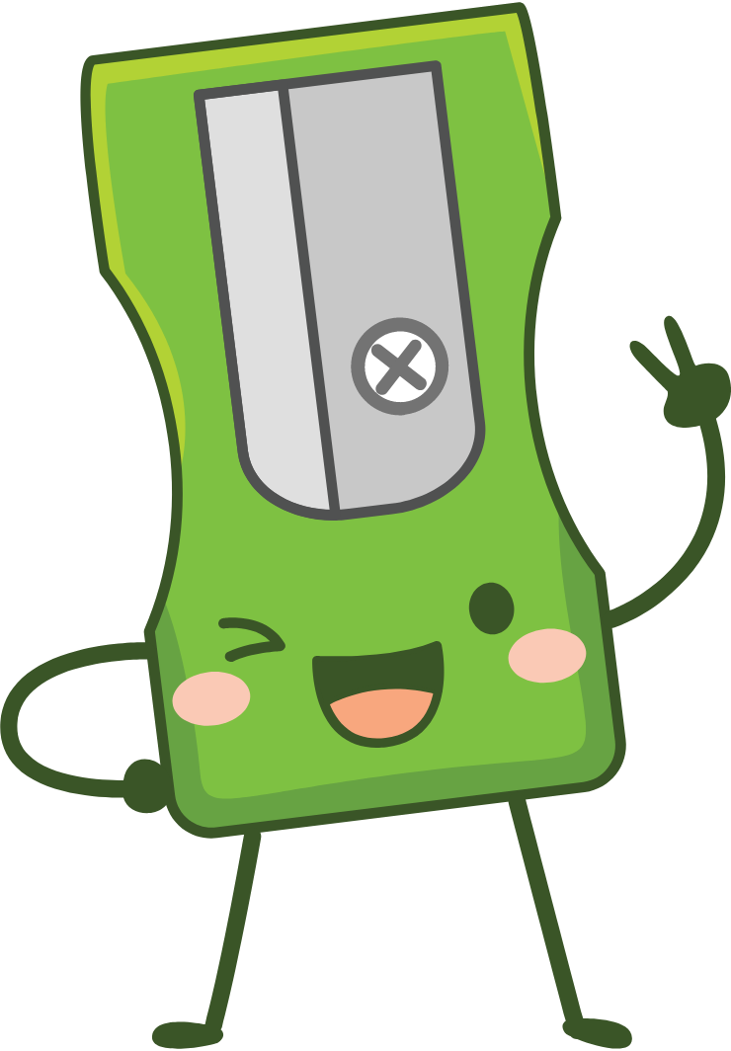
Let’s become a community:
A community for providing the equipments with our small savings. Like,
Colours, story books, drawing books, sport equipment, board games, diaries and etc.

Slide 9
let’s show them world more than they know and make them believe in themselves !
Thank you!

