Slide 1

GURU GHASIDAS VISWAVIDYALAYA,BILASPUR (CSIT)
How to Earn Money Online Through Article Writing
Turning writing skills into an online income:-
Ankit Chaudhary (Leader)
Keshari Nandan Mallik
Dhananjay Thakur
Sachin Kumar
Yajjala Vijay Chandan
(BCA 5th Sem)

Slide 2

What Is Article Writing?
Article writing means creating useful, informative content that helps readers understand a topic.
Topics: education, technology, health, travel, finance, entertainment
Writers research a topic and explain it clearly
Work can be for clients, websites, companies, or your own platform
Simple process: Topic → Research → Write → Publish → Earn

Slide 3

How Article Writing Generates Income
People and companies need useful written content online
Writers provide that content and get paid
Payment models: per word, per article, or per project
Start small — grow skills & portfolio for higher-paying work

Slide 4

Way 1 — Freelance Article Writing
Freelance writers work independently for different clients.
Clients give topics, requirements, and deadlines
Writers research and deliver articles
Payment: per article / per word / per project
Find work on legitimate platforms like Upwork, Fiverr, Freelancer
Do not expect guaranteed earnings — results depend on skill, consistency, and client demand.

Slide 5

Way 2 — Writing for Websites & Online Publications
Many websites publish articles from contributors and pay for accepted work.
Follow each site's submission guidelines
Pitch topics or write to open calls
Some pay per accepted article; others offer regular assignments
Build long-term relationships for repeat work

Slide 6
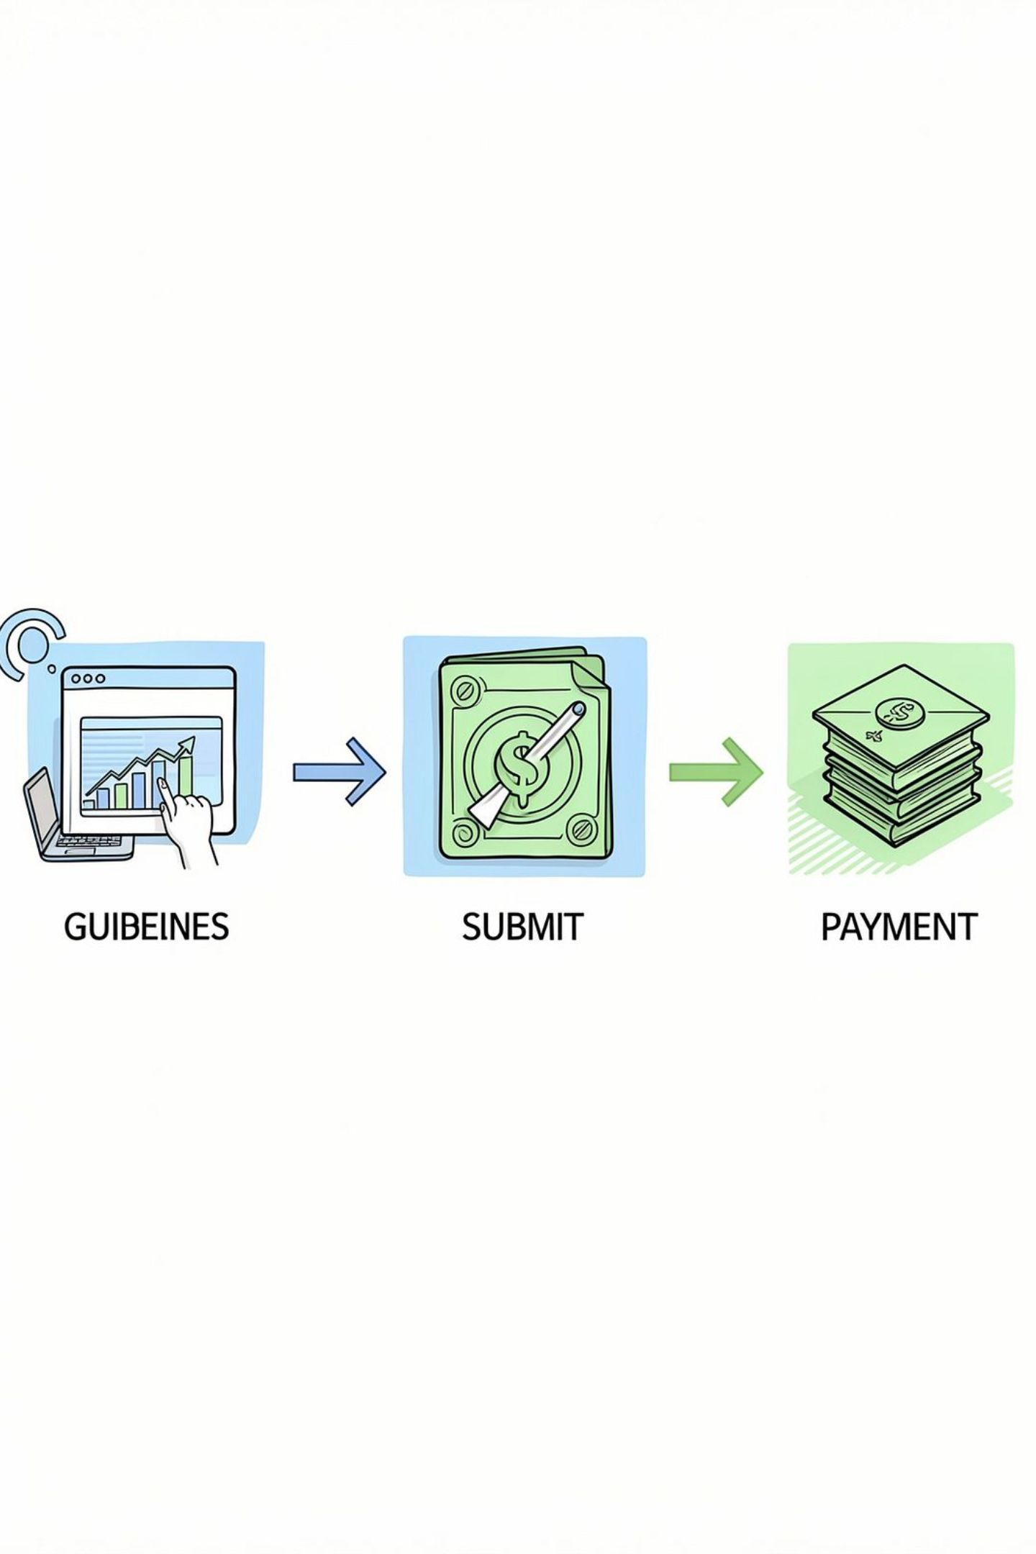
How This Method Works
Find a suitable website or publication
Check writing guidelines
Choose or pitch a topic
Write and submit the article
Receive payment if accepted

Slide 7

Starting Your Own Online Article Platform
Publish original articles regularly and grow an audience.
Pick a clear topic or niche
Publish useful, original content consistently
Monetize later with ads, sponsorships, or affiliate links
Earning takes time and depends on traffic & content quality

Slide 8

What Is Niche Writing?
Niche writing means focusing on one specific topic or area to build expertise.
Examples: Technology, Fitness, Education, Travel, Gaming, Finance
Specializing helps you learn faster and stand out to clients
Build a strong portfolio in one area to attract targeted work
Path: General Writing → Choose a Niche → Build Expertise → Find Target Clients

Slide 9
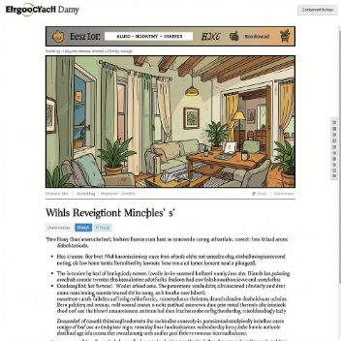



Ways to Earn from Your Own Articles
Advertisement
Sponsorships
Affiliate Marketing
Audience
Earn when ads display on your site (depends on traffic).
Companies pay for promotional or sponsored content.
Useful content + consistency → more readers → more monetization options.
Recommend products with special links and earn commissions on sales.

Slide 10
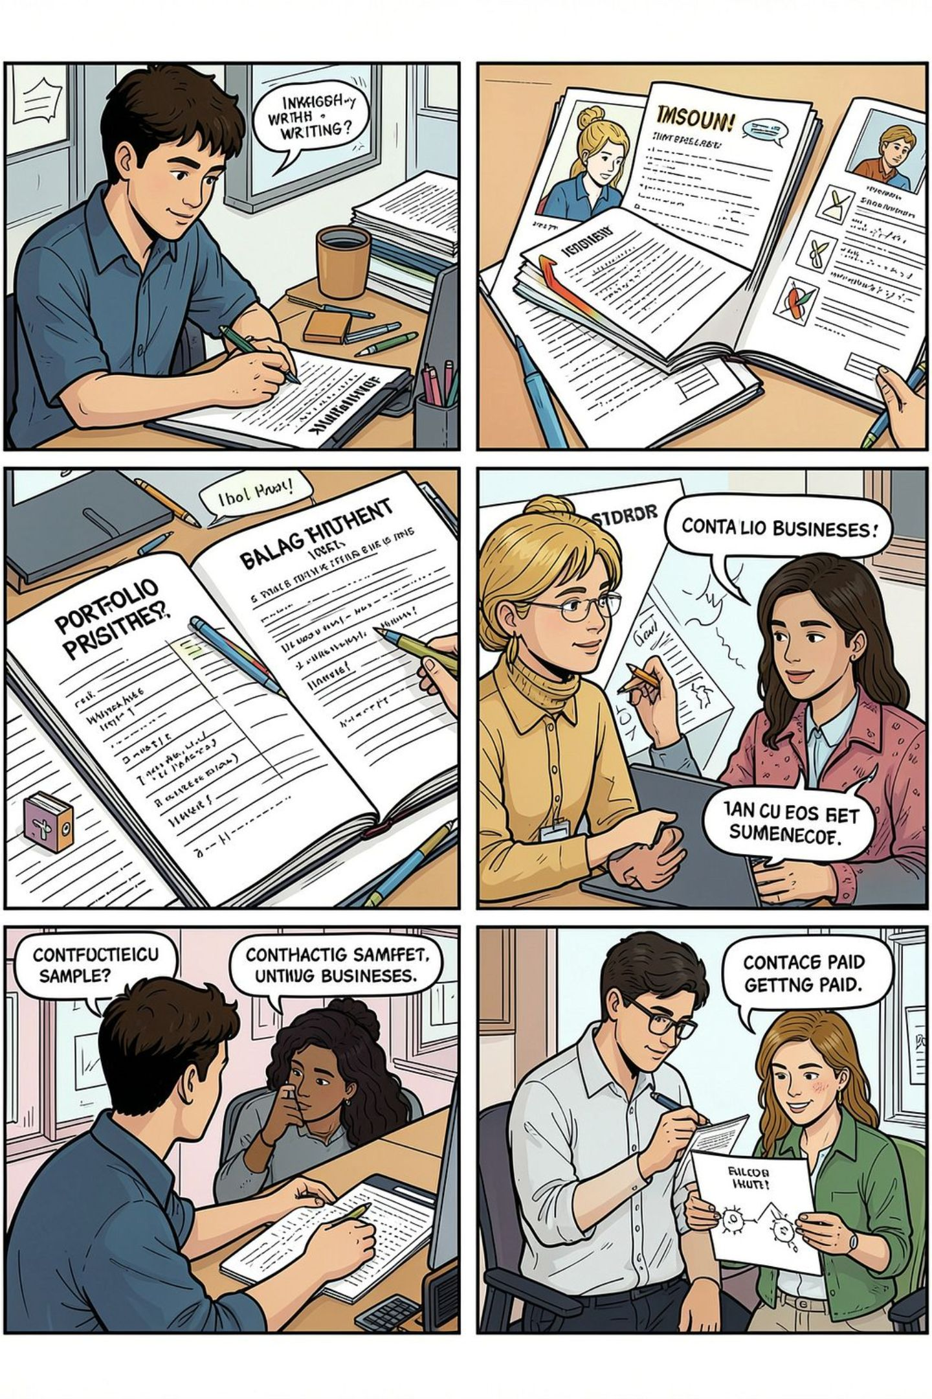

Tips, Mistakes & Final Takeaway
Top Tips
Common Mistakes
Working with Businesses
- Improve grammar, research, and clarity
- Choose a niche you enjoy
- Create 3–5 strong samples
- Build a simple portfolio
- Copying others or using unedited AI content
- Ignoring client instructions or deadlines
- Paying to get jobs or accepting suspicious offers
- Contact businesses, show samples, agree terms, deliver work professionally
Final Message
Article writing can become an online income source when you combine good writing, useful knowledge, consistency, and genuine opportunities. Start small and grow step by step.
Questions? Thank you! Any questions?

