Slide 1

Animation Through Freelancing in Java
PRESENTED BY:
SUBMITTED TO:
Mr.Ratnesh Shrivastav
Tanu Rathore
Arth Sharma
Ansuman Mistry
Tuleshwar Kumar Yadav
1

Slide 2
1. What is Animation?
Member 1
Animation makes pictures or objects look like they are moving.
It is made by showing many frames quickly.
2D has height and width.
3D also has depth.
Examples
Games, cartoons, advertisements and educational videos
Why use it?
It makes learning and applications more interesting.
2

Slide 3
2. Java and Animation
Member 1
Java is a programming language.
It can draw shapes, images and text.
We can change an object's position to create movement.
Java is useful for games, desktop apps and simulations.
Main idea
Draw → Move → Repaint → Repeat
Java gives us the tools to create simple animation.
3

Slide 4
3. Tools Used in Java
Member 1
AWT
Swing
JavaFX
Basic graphics and components
Used for desktop windows and buttons
Used for modern interfaces and graphics
Graphics2D
Timer
Helps us draw shapes and make changes
Updates the animation again and again
For our demo, we will use Swing, JPanel and Timer.
4

Slide 5


Slide 6
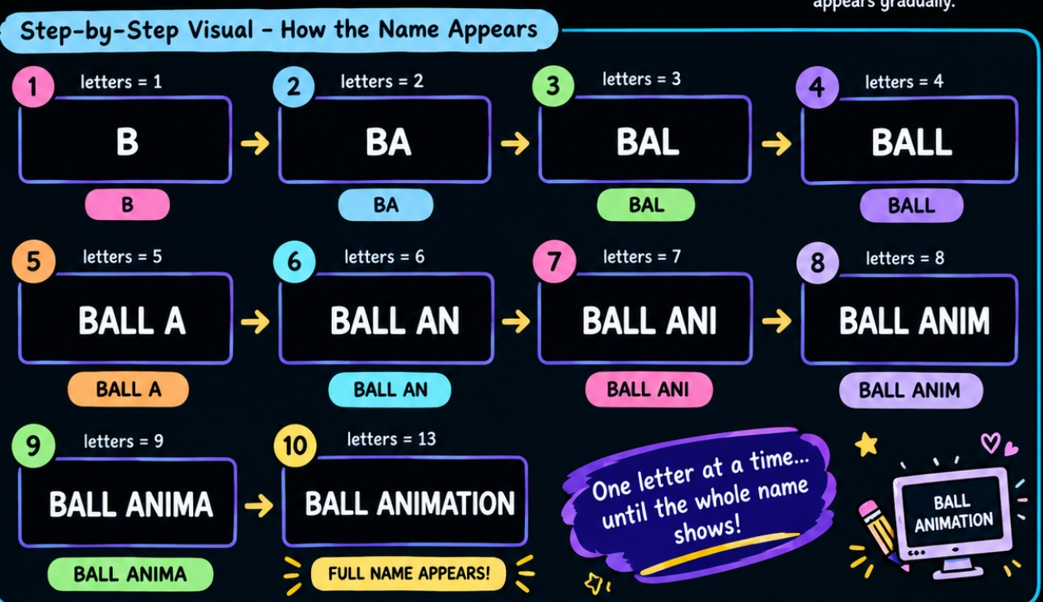
BALL ANIMATION
File name: BallAnimation.java
import javax.swing.*;
import java.awt.*;
import java.awt.event.*;
public class BallAnimation
extends JPanel
implements
ActionListener {
Timer timer = new Timer(40, this);
String name = "BALL ANIMATION";
int letters = 0;
int x = 80;
int size = 40;
int step = 0;
Color ballColor = Color.BLUE;
// Name appears letter by letter
void showName(Graphics g) {
g.setColor(Color.WHITE);
g.setFont(new Font("Arial", Font.BOLD, 60));
g.drawString(name.substring(0, letters), 250, 100);

Slide 7
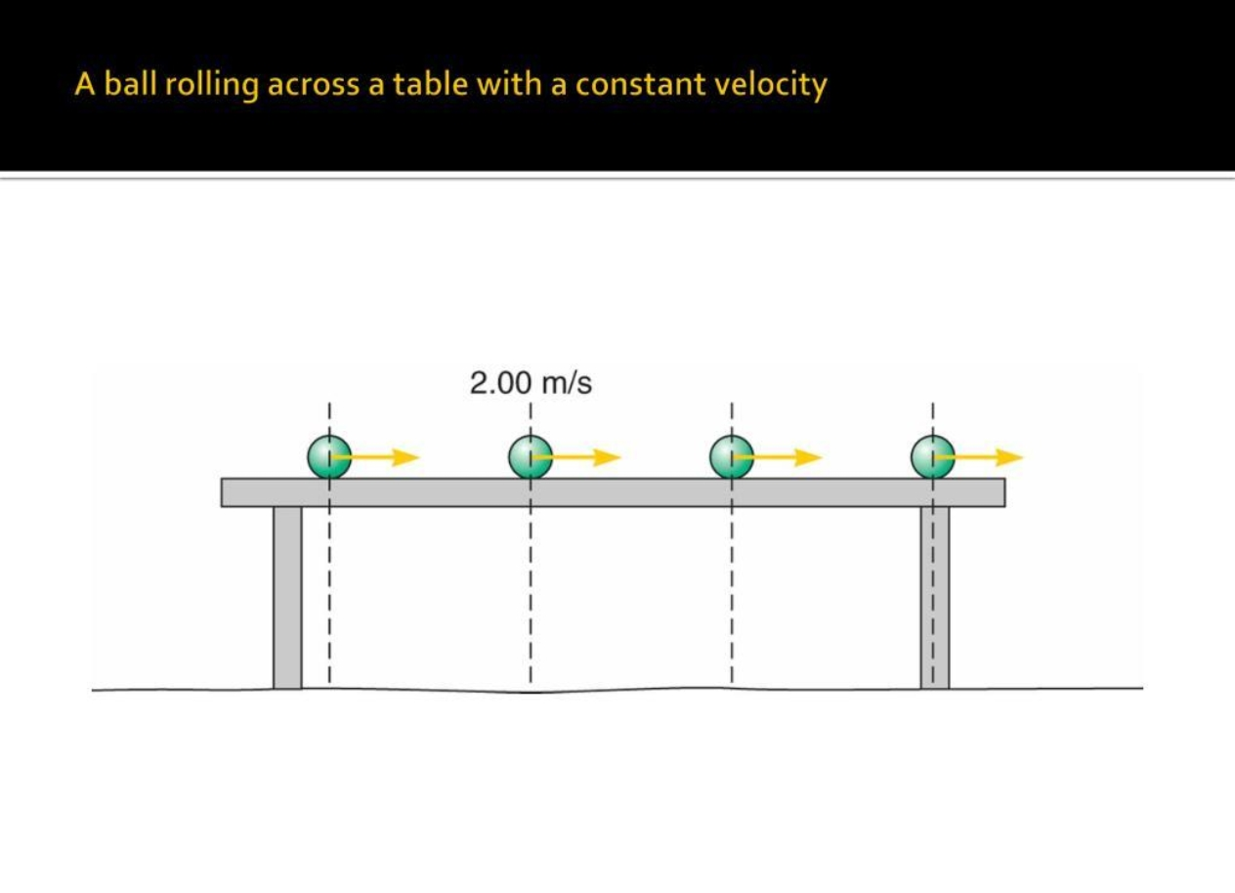
BALL ANIMATION
File name: BallAnimation.java
// Ball moves from A to B
void moveBall()
{
x = x + 5;
if (x >= 550) {
x = 550;
step = 2;
}
}

Slide 8
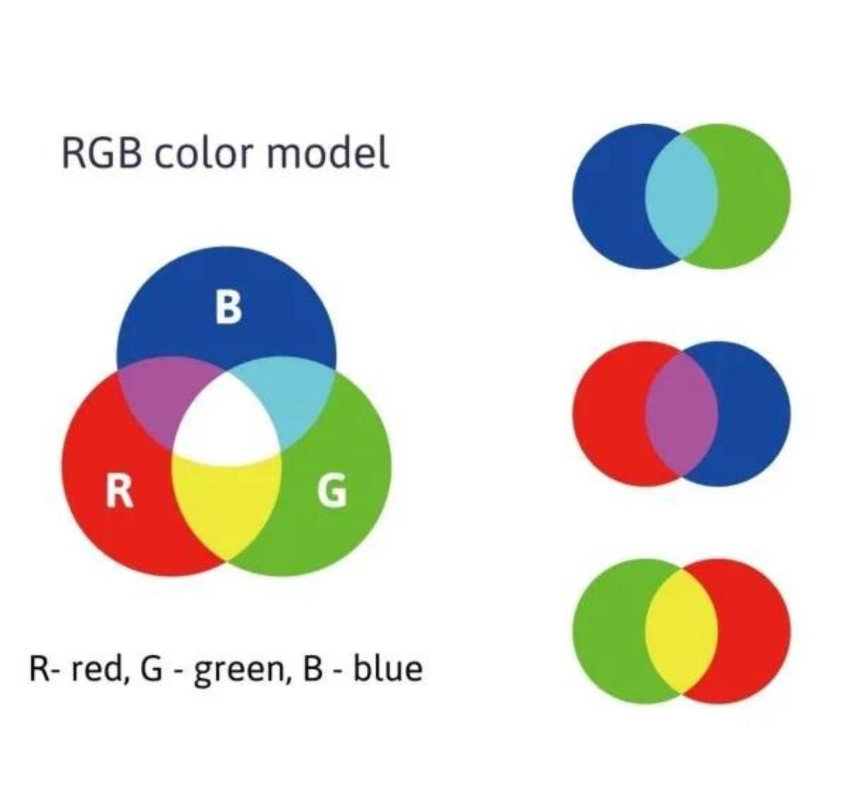
BALL ANIMATION
File name: BallAnimation.java
// Ball changes from blue to red
void changeColor()
{
int red = ballColor.getRed() + 5;
if (red >= 255)
{
red = 255;
step = 3;
}
ballColor = new Color(red, 0, 255 - red);
}

Slide 9
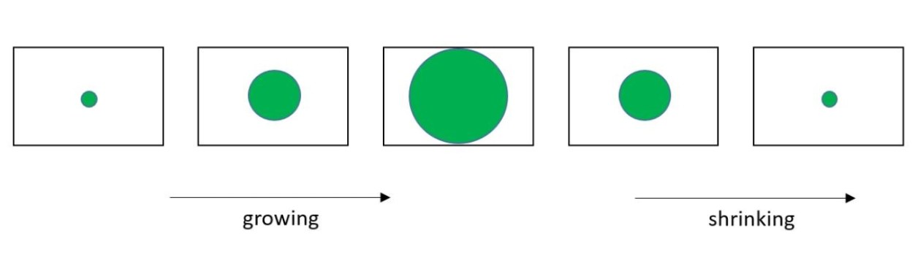
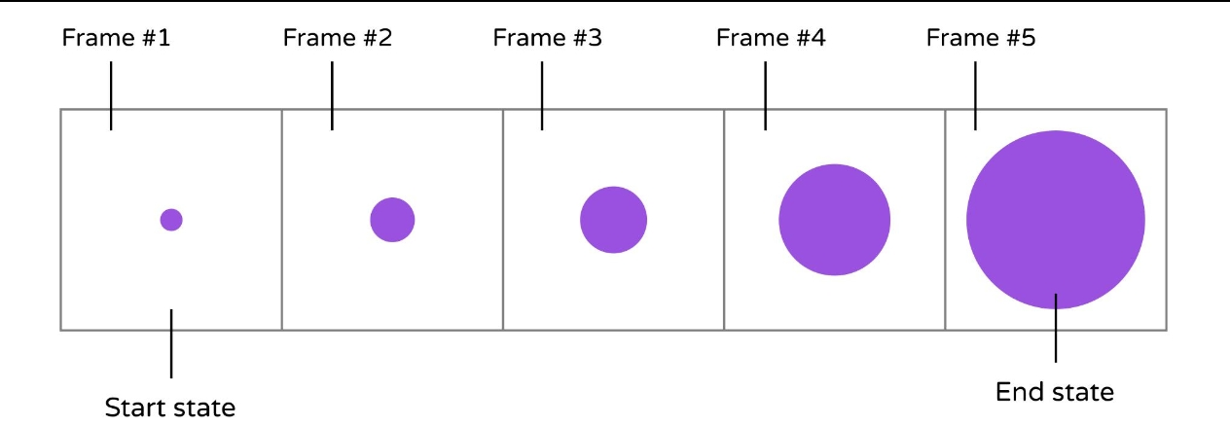
BALL ANIMATION
File name: BallAnimation.java
// Ball grows bigger
void changeSize()
{
size = size + 2;
if (size >= 120)
{
timer.stop();
}
}

Slide 10
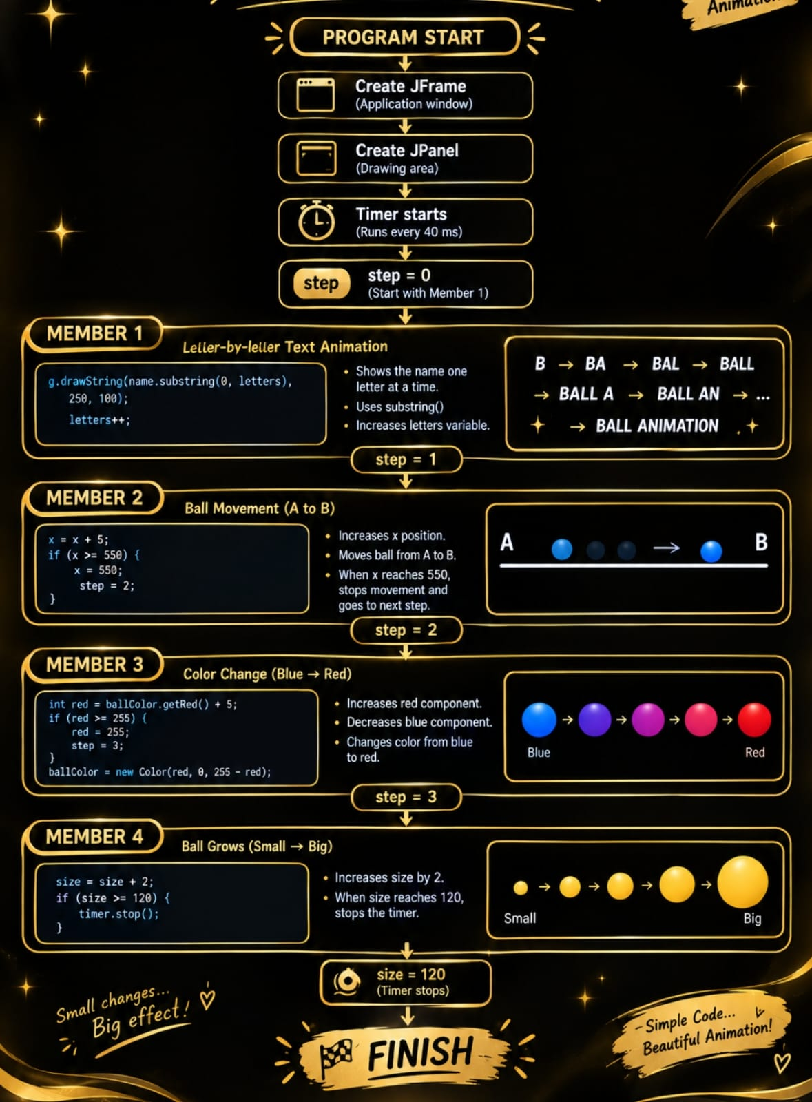
BALL ANIMATION
File name: BallAnimation.java
public BallAnimation()
{ setBackground(Color.BLACK);
timer.start();
} public void actionPerformed(ActionEvent e) {
if (step == 0) {
letters++;
if (letters > name.length())
{
letters = name.length();
step = 1;
}
}
else if (step == 1) {
moveBall();
}
else if (step == 2) {
changeColor();
} else if (step == 3) {
changeSize();
}
repaint();
}

Slide 11
BALL ANIMATION
File name: BallAnimation.java
protected void
paintComponent(Graphics g) {
super.paintComponent(g);
showName(g);
g.setColor(Color.WHITE);
g.setFont(new Font("Arial", Font.BOLD, 25));
g.drawString("A", 40, 260);
g.drawString("B", 620, 260);
g.drawLine(60, 270, 630, 270);
g.setColor(ballColor);
g.fillOval(x, 270 - size / 2, size, size);
}

Slide 12
BALL ANIMATION
File name: BallAnimation.java
public static void main(String[] args) {
JFrame frame = new JFrame("Java Animation Project");
frame.add(new BallAnimation());
frame.setSize(700, 450);
frame.setDefaultCloseOperation(JFrame.EXIT_ON_CLOSE);
frame.setLocationRelativeTo(null);
frame.setVisible(true);
}
}

Slide 13
4. How Animation Works
Member 2
1
2
3
4
5
→
→
→
→
Make a ball
Draw it
Change x
Repaint
Repeat
Result
The ball looks like it is moving because its position changes very fast.
5

Slide 14
5. Graphics Used
Member 2
Graphics draws the ball.
Color makes the ball blue.
x and y show the ball's position.
Timer updates the movement.
repaint() asks Java to draw again.
Our example
A blue ball moving from left to right
Simple idea, but it teaches the base of animation.
6

Slide 15
8. What is Freelancing?
Member 3
Freelancing means working independently for clients.
A freelancer works on projects instead of one permanent job.
Payment can be hourly or project-based.
Good communication is important.
Example
A client asks us to make a small Java educational animation.
9

Slide 16
9. Java Freelancing Opportunities
Member 3
Simple Java games
Educational applications
Desktop GUI software
Simulations and visualizations
JavaFX applications
Remember
Clients usually want a complete project, not only an animation.
10

Slide 17
10. Finding Clients
Member 3
Platforms
Upwork • Fiverr • Freelancer • LinkedIn
A portfolio helps clients see our work.
Other ways
Start with small projects and improve step by step.
Local businesses, college contacts and direct clients
11

Slide 18
11. Freelancing Steps
Member 3
Learn
Make projects
Create portfolio
Find client
Discuss work
Build + test
Deliver
→
→
→
→
→
→
Clear requirements + regular updates = better client experience
12

Slide 19
12. Skills We Need
Member 4
Technical
Creative
Freelancing
Core Java, OOP, graphics, JavaFX, debugging and Git
Timing, colors, simple design and storyboarding
Communication, time management and requirement understanding
We do not need to know everything on day one.
We can learn, practise and improve with every project.
13

Slide 20
13. Advantages and Challenges
Member 4
Advantages
Challenges
Future scope
Flexible work • New projects • Portfolio • Work from home
Competition • Deadlines • Revisions • Finding clients
Games • Educational apps • Software • Simulations
Freelancing needs patience, practice and continuous learning.
14

Slide 21

CONCLUSION
Learn → Practise → Build → Find Clients
Animation in Java combines programming and creativity to create interactive and engaging applications. In our project, we demonstrated this through letter-by-letter text, ball movement, color change, and size increase using Java graphics, timers, and repainting. These skills can be useful in freelance projects such as games, educational applications, simulations, and interactive software. Overall, Java provides a practical way to understand animation while developing both technical and creative skills.
15

