Slide 1
RURALCONNECT
🌾
From villages
to greater markets.
A digital B2B marketplace connecting rural producers
with retailers, restaurants and urban buyers.
Presented By
Saumil Kurre • Ayush Kumar • Vasudev Choudhary
Shivam Sharma
Project Topic / RuralConnect
Course: BCA – 5th Semester
Department: CSIT
Subject: Advanced Java Programming
Submitted To
Dr. Ratnesh Shrivastava Sir
CONNECT • TRADE • BID • GROW

Slide 2
01 • THE OPPORTUNITY
The rural supply chain has a discovery problem
RuralConnect focuses on the gap between producers who have supply and buyers who need reliable access.
TODAY
THE SHIFT
1
Fragmented access
Small producers often depend on local or intermediary channels to reach larger buyers.
From fragmented
transactions →
one connected market.
2
Limited price discovery
A producer may not know which buyer, quantity or price is available beyond the local market.
A marketplace layer for discovery, bulk ordering, order visibility and price discovery through auctions.
3
Manual coordination
Product discovery, ordering, quantities and follow-up can happen across calls and messages.
4
Trust & visibility
Buyers need product, stock, location and order information in one place.
B2B
BULK
BID
RURALCONNECT • ADVANCED JAVA PROGRAMMING
02

Slide 3
02 • THE SOLUTION
One platform. Two sides. One connected marketplace.
RuralConnect is designed around the real journeys of producers and buyers.
🌾
↗
🛒
🔨
📦
RURAL
PRODUCER
LIST
& MANAGE
DISCOVER
& ORDER
BID &
PRICE DISCOVER
TRACK &
DELIVER
Producer
Buyer
Auction
Platform
Visibility beyond the local buyer network
Faster discovery + bulk purchasing
Competitive price discovery
A repeatable transaction layer
RURALCONNECT • ADVANCED JAVA PROGRAMMING
03

Slide 4
03 • CUSTOMER JOURNEY
Designed for convenience, not complexity
The product experience turns a multi-step buying process into a clear digital flow.
BUYER JOURNEY
PRODUCER JOURNEY
01
Browse
Search by product, category, location
01
Create profile
Become discoverable to buyers
02
Compare
See price, unit, stock and producer
02
List supply
Product + price + unit + stock
03
Order
Add quantities and place a bulk order
03
Receive demand
Orders arrive through the dashboard
04
Track
Follow: Placed → Confirmed → Packed → Shipped → Delivered
04
Auction
Choose a starting bid and let buyers compete
RURALCONNECT • ADVANCED JAVA PROGRAMMING
04

Slide 5
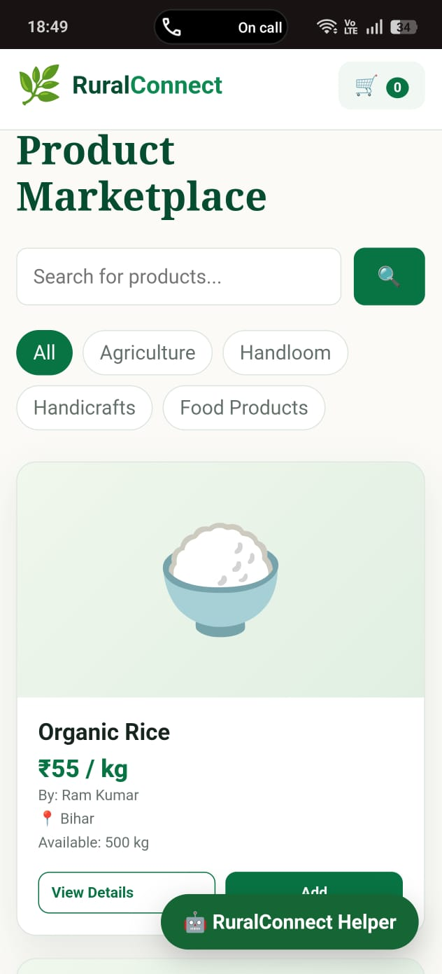
04 • MARKETPLACE
A digital storefront for rural supply
The demo supports product discovery, cart-based purchasing, producer dashboards and order tracking.
PRODUCT DISCOVERY
TRANSPARENCY
Search + category filters
Price, unit, stock & location
BULK BUYING
PRODUCER CONTROL
Quantities built for B2B orders
List products & view sales
ORDER VISIBILITY
HELPER
Basic order tracking flow
Guidance inside the experience
What the demo already proves
A complete buyer → product → cart → order journey can be demonstrated end-to-end.
RURALCONNECT • ADVANCED JAVA PROGRAMMING
05

Slide 6
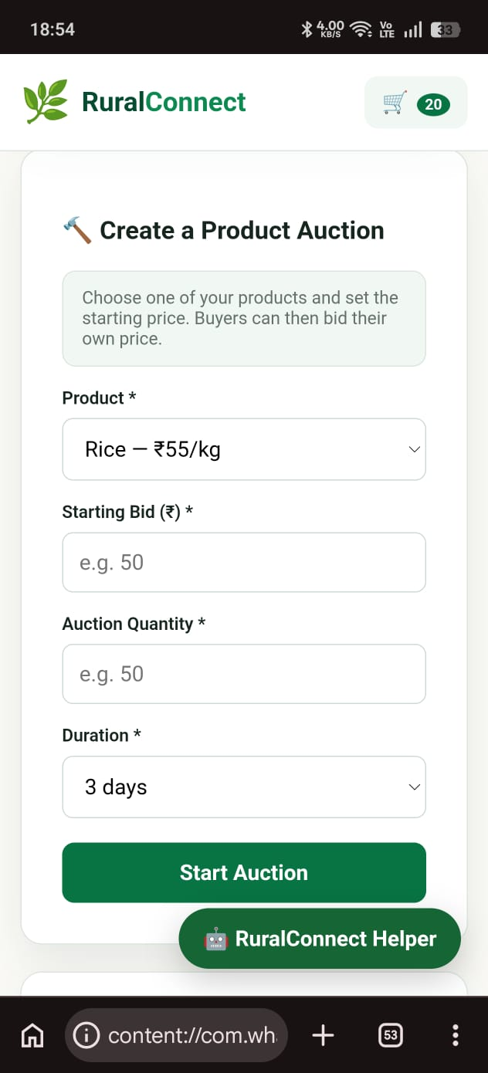
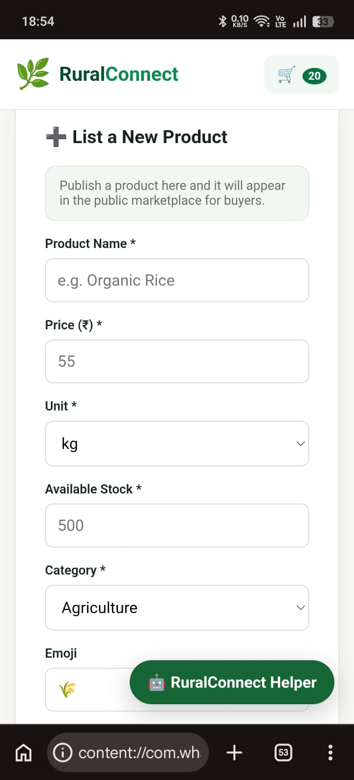
05 • AUCTION ENGINE
Let the market discover the price
Instead of only publishing a fixed price, producers can create an auction and invite buyers to bid.
SET → BID → COMPETE → WIN
STARTING BID • QUANTITY • DURATION
HIGHER BID = BETTER PRICE DISCOVERY
RURALCONNECT • ADVANCED JAVA PROGRAMMING
06

Slide 7
06 • WHO PAYS?
Build around recurring B2B use cases
RuralConnect can serve multiple customer groups without changing the core marketplace.
1
FARMERS
2
WEAVERS
Rice • wheat • vegetables • honey
Sarees • textiles • fabric
Buyer side • Restaurants • retailers • distributors
Buyer side • Boutiques • resellers • stores
3
ARTISANS
4
URBAN BUYERS
Handicrafts • local products
Bulk sourcing • repeat orders
Buyer side • Retailers • gifting businesses
Buyer side • Lower search & coordination effort
THE CORE VALUE: reduce discovery friction and make rural supply easier to buy at scale.
RURALCONNECT • ADVANCED JAVA PROGRAMMING
07

Slide 8
07 • BUSINESS MODEL
How RuralConnect can make money
The following is an illustrative model for a future production version—not current project revenue.
01
02
03
TRANSACTION FEE
PRODUCER PRO
AUCTION FEE
3% of completed marketplace GMV
₹199 / month
1% of winning auction value
Earn when a trade happens.
Premium visibility, analytics and tools.
Monetize competitive price discovery.
ILLUSTRATIVE MONTHLY SCENARIO
₹50L
× 3%
₹1.50L
+
300
× ₹199
= ₹59.7k
+ auction fees → ≈ ₹2.15L / month
monthly GMV
transaction revenue
Pro producers
subscription revenue
Assumption: ₹5L auction GMV/month × 1% = ₹5k. Scenario is illustrative and should be validated with real customer data.
RURALCONNECT • ADVANCED JAVA PROGRAMMING
08

Slide 9
08 • SCALE STORY
A simple growth equation
The business grows when more producers list, more buyers transact, and repeat purchasing increases.
1,000
5,000
₹50L
₹2.15L
TARGET PRODUCERS
TARGET BUYERS
MONTHLY GMV
MONTHLY PLATFORM REVENUE
More supply & geographic coverage
More demand & repeat orders
Illustrative transaction volume
Illustrative revenue at the model above
THE 4 LEVERS
Supply density
Buyer acquisition
Repeat rate
Trust layer
More producers per region
Retailers + restaurants + resellers
Re-orders create recurring GMV
Verification, reviews, payments & logistics
GMV = active buyers × orders per buyer × average order value
RURALCONNECT • ADVANCED JAVA PROGRAMMING
09

Slide 10
09 • ROADMAP & CLOSE
From college prototype to scalable rural commerce
The current project demonstrates the concept; the next step is turning the demo into a production-ready platform.
1
2
3
NOW
NEXT
SCALE
Marketplace
Producer + Buyer dashboards
Cart + demo orders
Real authentication
Payments
Notifications
Reviews & ratings
Cloud deployment
Real-time auctions
Logistics integration
Analytics
RuralConnect
Connect → Trade → Bid → Grow
A practical business concept powered by Java, web technologies and database-driven commerce.
THANK YOU • QUESTIONS?
Dr. Ratnesh Shrivastava Sir
RURALCONNECT • ADVANCED JAVA PROGRAMMING
10

