Slide 1

PyKafkaStream
by: YUKTA PIYUSH SHAH

Slide 2
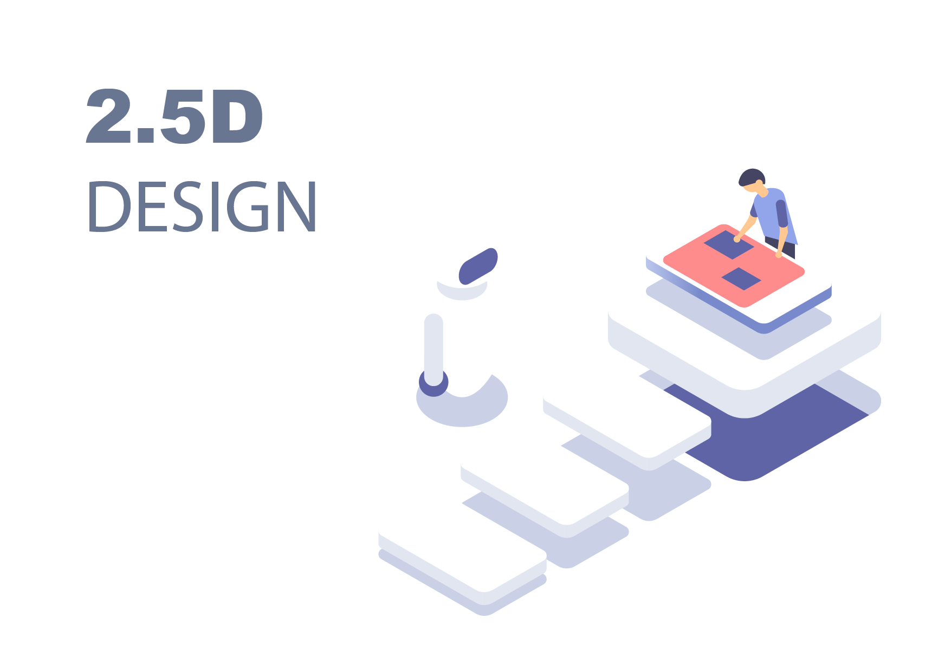
Full Stack Real-Time Web Application with Kafka & Docker
A containerized full-stack system integrating real-time data flow with a modern web architecture.
Features:
User authentication (register/login)
Real-time stock data endpoint
Scalable containerized microservice setup

Slide 3





Technology Stack
REACT
FLASK
KAFKA
DOCKER
SQLITE

Slide 4
System Architecture
React Frontend – Sends API requests to Flask backend.
Flask Backend – Handles user auth, queries DB, and integrates Kafka for real-time data.
SQLite Database – Stores user credentials & stock information.
Kafka + Zookeeper – Manages message streaming for stock price updates.
Docker Compose – Orchestrates all containers into a single deployable unit.

Slide 5



System Architecture Visualisation
REACT -> FLASK -> SQLITE
DOCKER
KAFKA PRODUCERS -> KAFKA TOPICS -> CONSUMERS

Slide 6
Backend: Flask + SQLite + Kafka Integration
Flask API Endpoints:
/register → Secure user signup with password hashing
/login → Authentication via stored hashed passwords
/data → Fetch stock details from SQLite
Database Layer:
SQLite ORM using SQLAlchemy models (User, Stock)
Kafka Integration:
Broker set via env var → KAFKA_BROKER: kafka:9092
Implements producer-consumer flow for real-time stock updates
Security & Connectivity:
Password hashing with werkzeug.security
CORS enabled for seamless frontend-backend communication

Slide 7
Frontend: React + REST Integration
Framework:
Built with React and React Router for dynamic navigation
Core Pages:
Login → Authenticates with Flask backend
Register → Adds new users to the database
Dashboard → Fetches /data from Flask and displays real-time stock info
Integration & Design:
API communication via Axios / Fetch
Responsive, minimal, and intuitive UI layout
Focus:
⚡ Simple, fast, and interactive interface with seamless backend connectivity

Slide 8
Dockerization and Deployment
Docker Compose creates
Containerized services
Kafka
(Port :9092)
Flask App Service
(Port : 5000)
React App Service
(Port : 5173)
Producer
Zookeeper
(Port : 2181)
`
Key Benefits:
🔁 Reproducible development environment
⚙️ Simplified, one-command deployment
🧪 Isolated service testing for easier debugging
Compose Configuration:
Each service runs in its own container.
docker-compose.yml defines dependencies & startup order.
depends_on ensures sequence: Zookeeper → Kafka → Backend → Frontend

Slide 9

Impact, Learnings & Future Scope
Impact
Demonstrated end-to-end understanding of modern web architecture.
Hands-on with microservices, containerization, and data streaming.
01
Learning
02
Integrated multiple technologies across the stack.
Debugged container networking & service dependencies.
Gained DevOps exposure through Docker Compose.
03
Future Enhancements
Deploy on AWS/GCP using container registries
Implement Kafka producer for live stock updates
Upgrade SQLite database

Slide 10
Demonstration

Slide 11

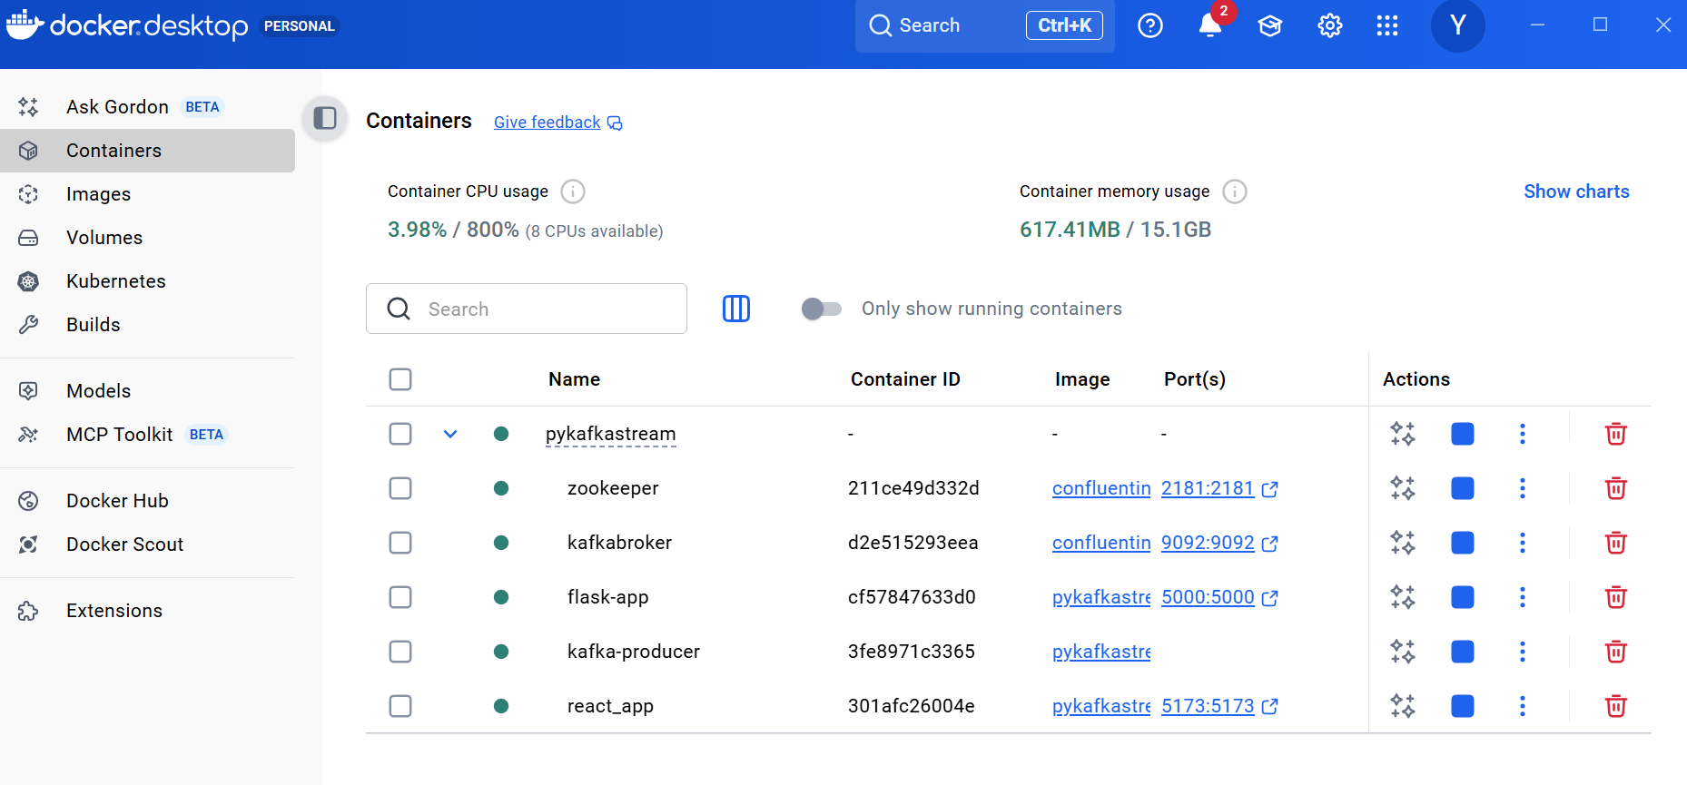
Docker starts all the Services

Slide 12
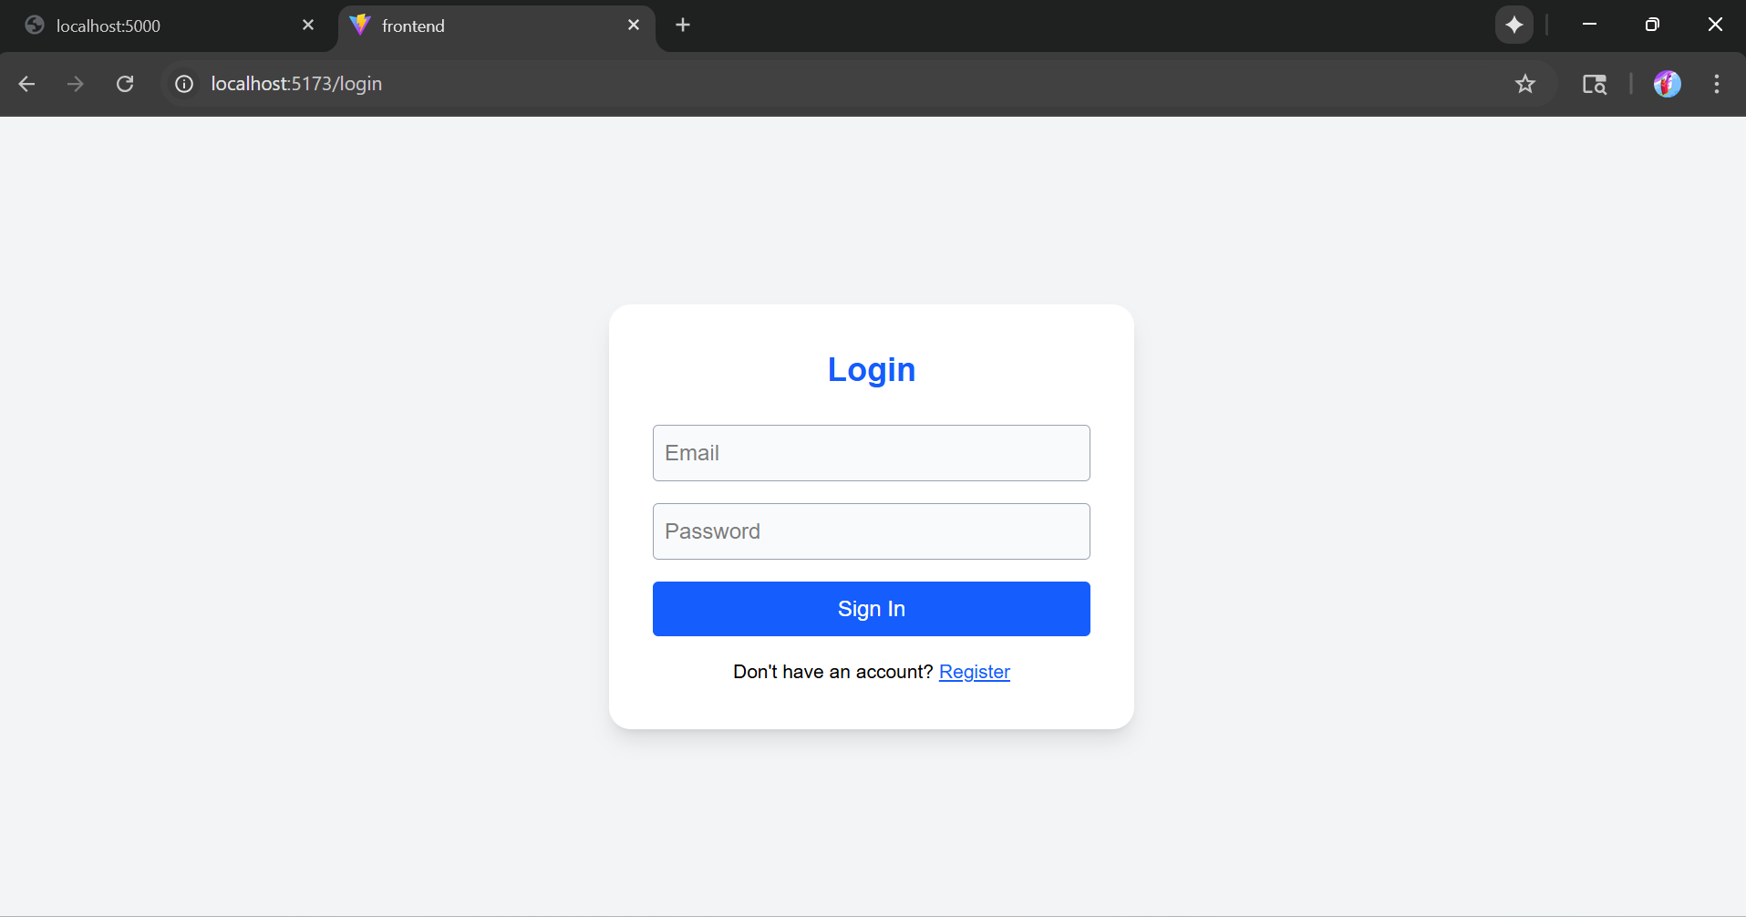
HomePage

Slide 13
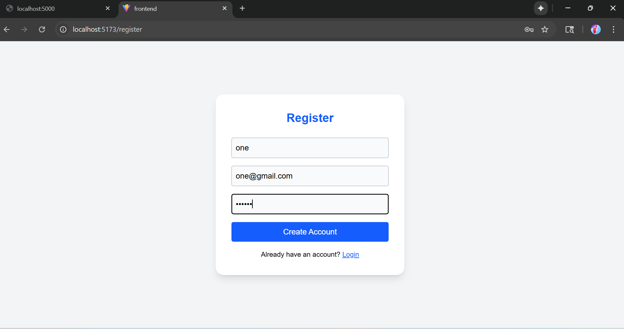
Registration

Slide 14
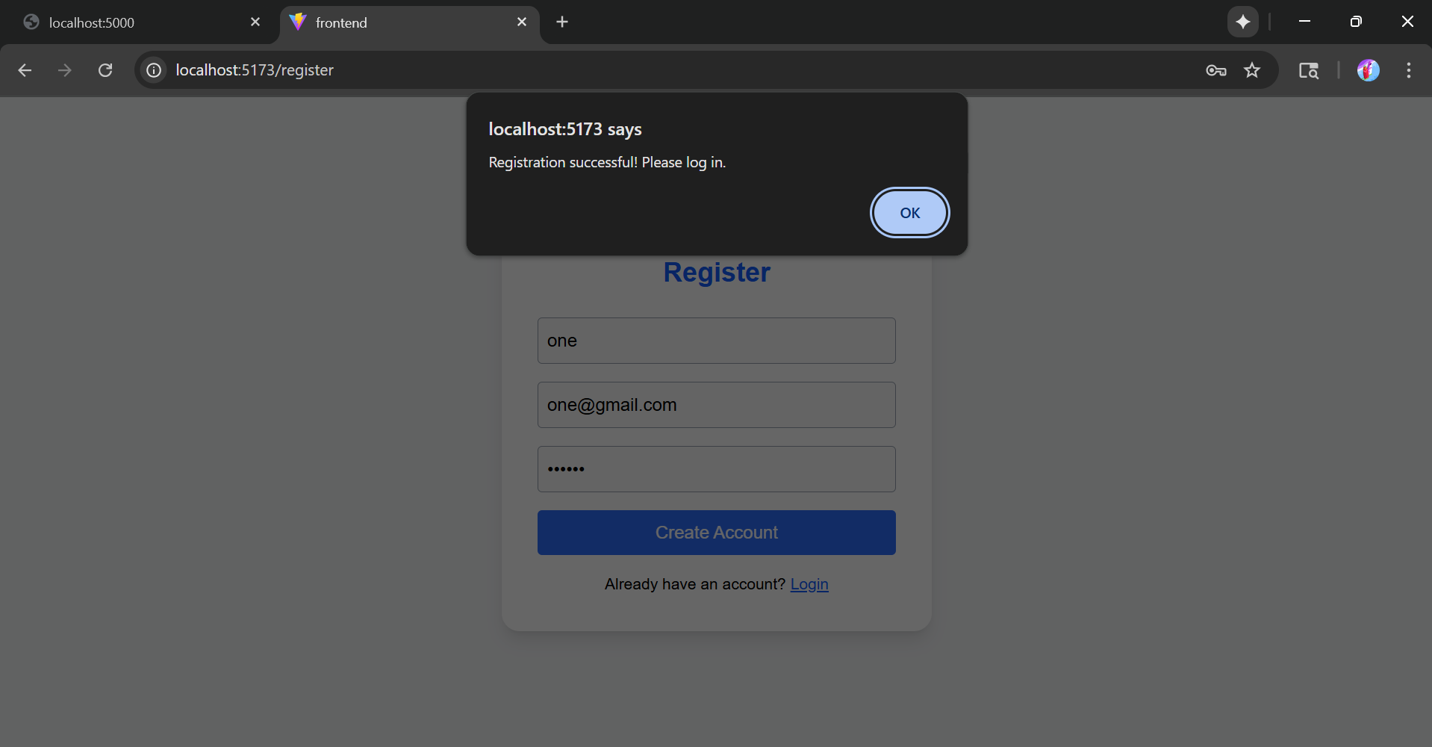
Registration Successful

Slide 15
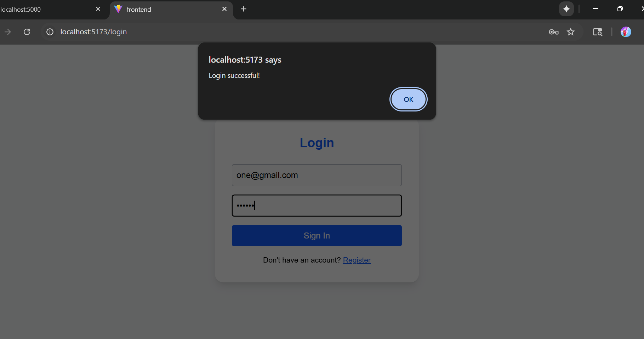
Login Successful

Slide 16
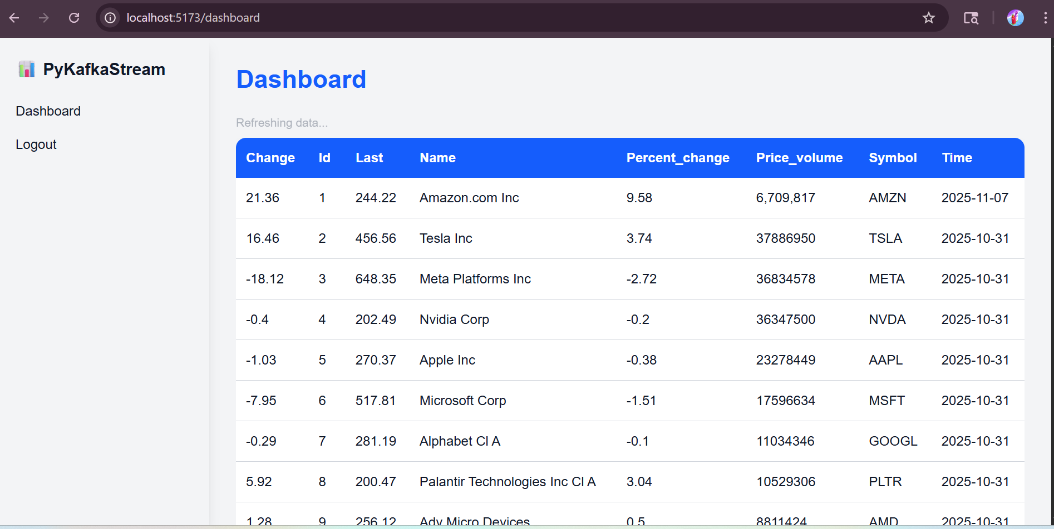
Dashboard

Slide 17
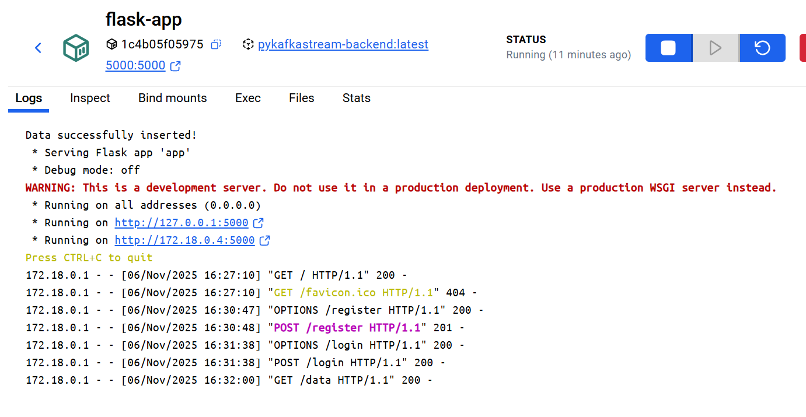
Successful Hits to the backend

Slide 18
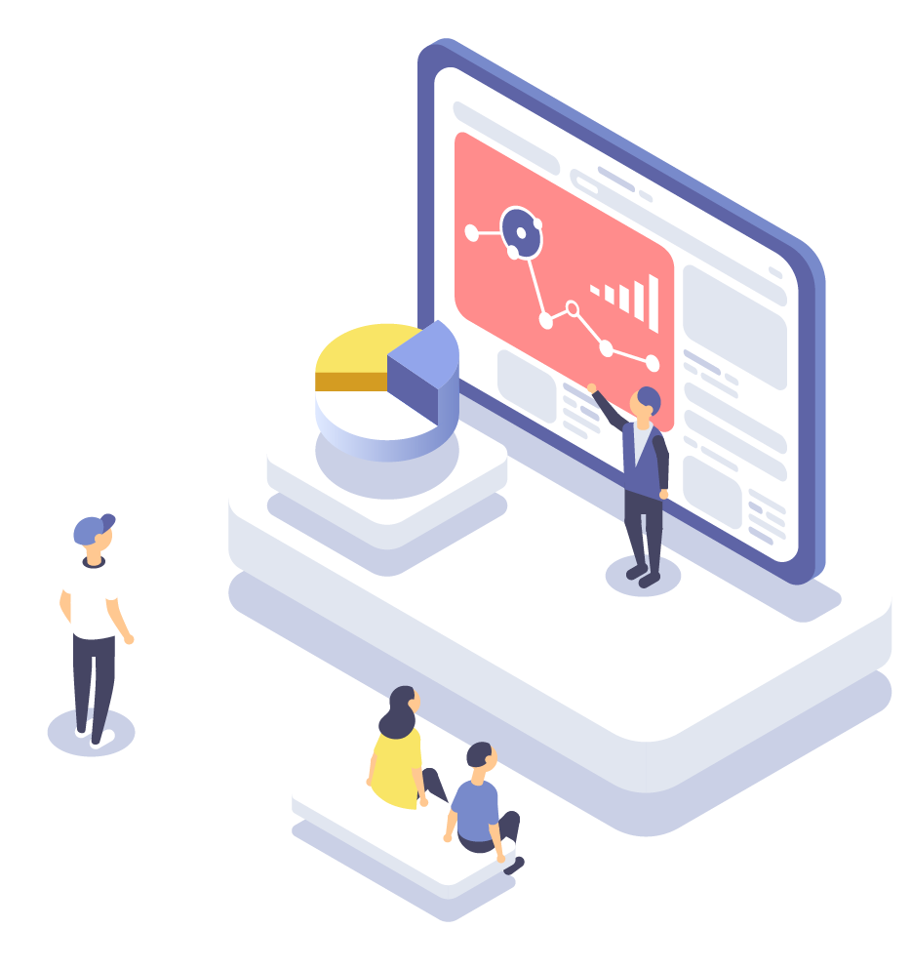
Thank you
https://github.com/devils-angel/pykafkastream

