Slide 1
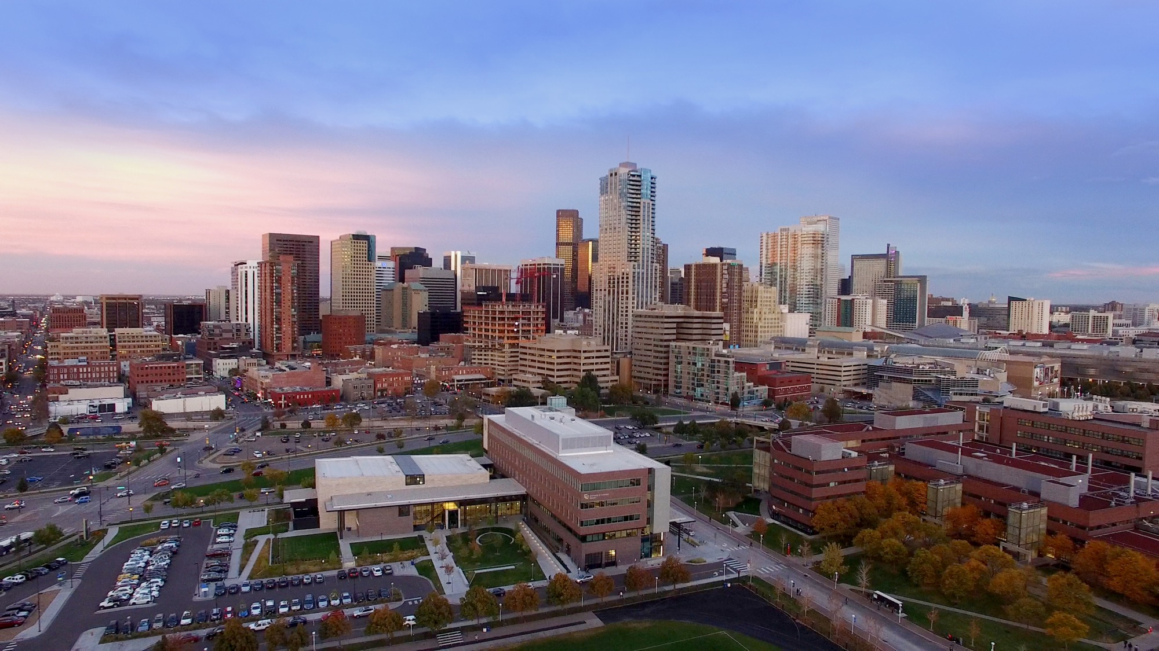

Presented by:
Erfan Jafari Khadem Zavareh
Supriya Ramachandra
Swayanshu Shanti Pragnya
Sleep Stage Classification
Notes:
TITLE SLIDE:
Change background as needed; more images available at http://ucdenver.webdamdb.com
Change Title and Subtitle as needed
Date updates automatically

Slide 2
PROBLEM STATEMENT
The idea is to develop an algorithm of sleep staging classification, which is able to differentiate between Wake, N1, N2, N3 and REM on windows of 30 seconds of raw data.
Source: https://www.physionet.org/content/sleep-edfx/1.0.0/
The source database contains 197 whole-night Polysomnographic sleep recordings, containing EEG, EOG, chin EMG, and event markers. Some records also contain respiration and body temperature.

Slide 3
MOTIVATION
Sleep is a necessary part in every human’s life
Automatic and accurate classification of sleep stages from EEG signals are critical due to the following reasons:
First, to identify sleep-related conditions that include fatigue, drowsiness, or sleep disorders, such as apnea, insomnia or narcolepsy
Second, manual sleep scoring is a time-consuming and prone to human error
Finally, smart EEG machines reduce dependence on expert personnel, who may not be readily available at all times.

Slide 4
QUALITY METRICS
The informal success measure that we planned to use are:
Confusion Matrix to calculate accuracy
Classification Report
Log loss

Slide 5
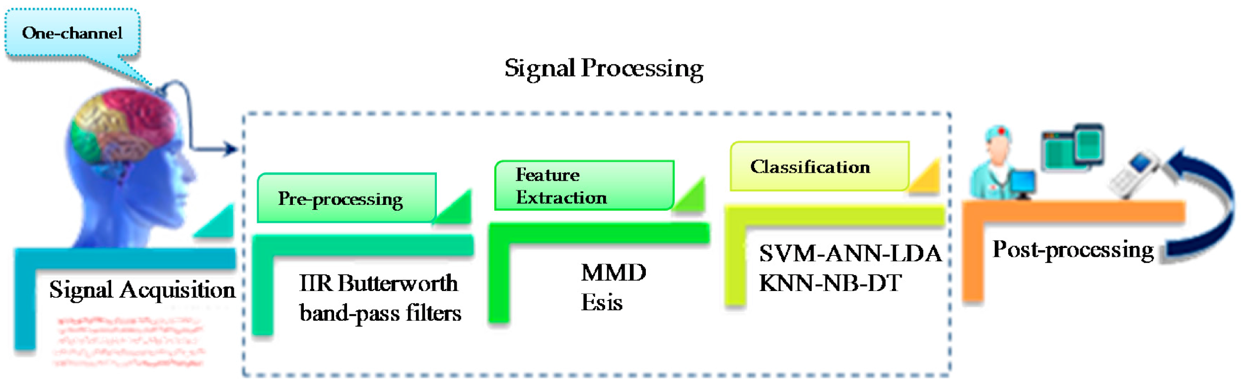
METHODS
Sleep Data in terms of EEG → Data Preprocessing based on 30 sec Time frame→ Feature Extraction → 5 stage classification

Slide 6
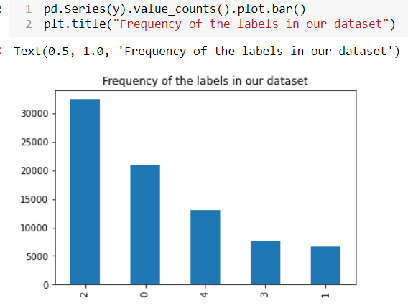
EXPLORATORY DATA ANALYSIS
Data Exploration
Plot
Feature Explanation:
EEG Fpz-Cz and EEG Fpz-Cz both are vertical splitting of brain
EOG horizontal: Eye movement
Resp oro-nasal: Oral respiratory
EMG submental: ElectroMyoGraphy
Temp rectal: upward movement while sleeping

Slide 7
WHY WE COULD NOT DO EDA?
Reason:
Data Preprocessing
Since our data is a 3000 dimension vector we cannot do any exploratory analysis.
At this stage we could perform dimensionality reduction in order to filter out the noise in our dataset.
Normalizing the data by using StandardScaler()
X.squeeze() as data in multiple dimensional vector
Before splitting
We can normalize our variables to have zero mean and variance one, by doing this we void many numerical instabilities that could happen during the training process.

Slide 8
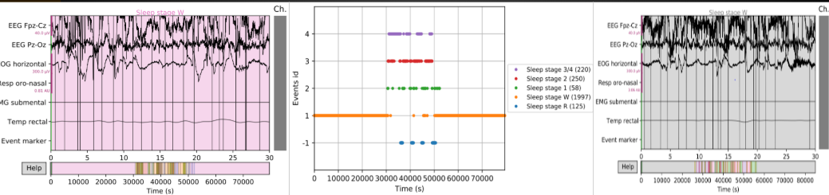
METHODS
Data Preprocessing
Feature Extraction: Power spectral density (PSD)

Slide 9
MODELS
LSTM (Long short-term memory)
Support Vector Machine (SVM)
Random Forest (RF)
K nearest neighbor (KNN)

Slide 10

TOOLS USED
Python
Numpy
NiLearn
Tensorflow
Libraries:
mne
pyEDFlib
urllib
dhedfreader
matplotlib, seaborn (visualization)

Slide 11
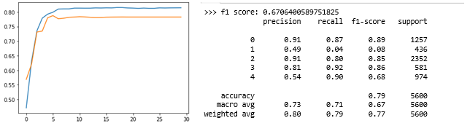
RESULTS
LSTM (Long short term memory): The model was run on 50 subjects for 30 epochs

Slide 12
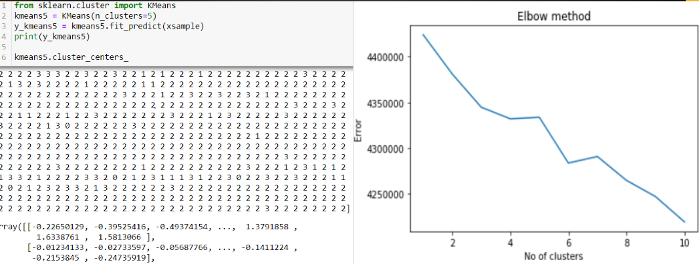
RESULTS
These graphs represents K means Implication and the Elbow method is exactly opposite from what we expected as the error is increasing due to non linear and inconsistent data.

Slide 13
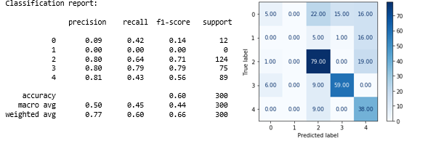
RESULTS
Support Vector Machine (SVM):
accuracy calculation:
Initially we got only 30% accuracy.
What's the problem?
When you specify a linear kernel on SVM you imply that you are expecting that a line will separate the data, but generally we have a highly non-linear dataset. Hence the low accuracy score. Below are the results for the first 2000 samples of the dataset.

Slide 14
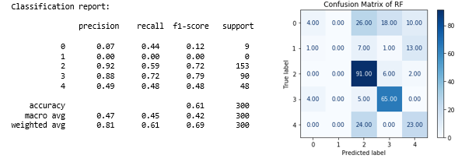
RESULTS
Random forest: An accuracy of 59% was achieved.

Slide 15
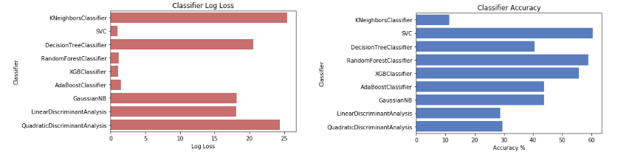
BASELINE/NAÏVE MODEL
KNN was used as baseline model which achieved a low accuracy score of below 20%
Primary model used was SVM in which an accuracy of 60% was achieved
accuracy and log loss plot

Slide 16
LESSONS LEARNED
Understanding EDF files-
As the file type was in different format i.e EDF, so it took sometime to understand and analyze this type of data file. Here Numpy helped a lot and we implemented few methods like squeeze, butter bandpass filter.
Small dataset-
Due to 50 person’s data, it’s not easy to generalize any pattern and getting accuracy was the toughest part
And one important lesson we learned is that understanding the characteristics of data and the initial preprocessing of data and feature extraction plays an important role in achieving a good performance of the model. Though we were able to achieve an accuracy of 78%, 60%, 59% for LSTM, SVM and RF, we believe that a better performance could have been achieved by better feature extraction and filtering of the data.

Slide 17
Questions ??
Thank you

