Slide 1
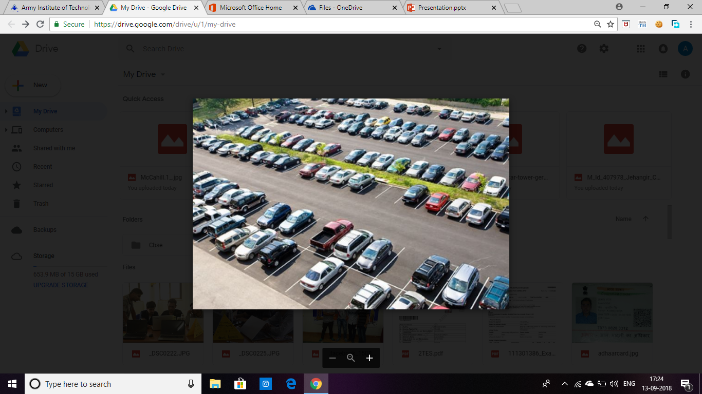

PARKING MANAGEMENT SYSTEM
BY-
Akash Mall 3208
Gaurav Kumar Singh 3240

Slide 2
ABSTRACT
Today is the age of technology where every corner of the world is accessible with just one click. In this age of advancement we cannot afford to lose even a single second of our precious time.
Our mini project is for saving the precious time of people by making the parking accessible in digitalised form. In the formed application the person can directly see if the parking is full or not and he won’t have to search for empty places. The user can choose his/her space well before hand and can directly go to spot to park and hence save his/her valuable time.

Slide 3
FEATURES
Parking layout showing the occupied and unoccupied places.
Location of chosen spot
Sqlite database.
Software used- Qt Creator

Slide 4
SQLITE
Relational database management system
Serverless
Stable Cross-Platform Database File
Compact

Slide 5
APP RUN

Slide 6
THANK YOU

