Slide 1


INDIAN INSTITUTE OF TECHNOLOGY PATNA DEPARTMENT OF MECHANICAL ENGINEERING
ME395 (ENGINEERING PRACTICUM) PRESENTATION

Slide 2
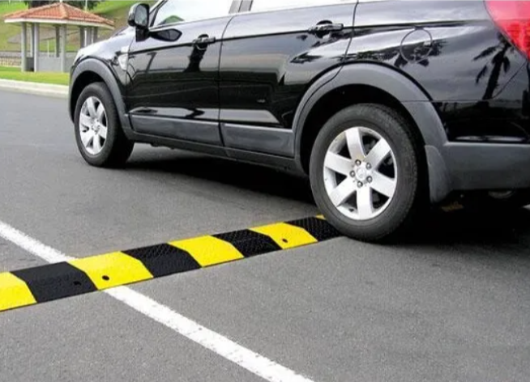
POWER GENERATION USING SPEED BREAKERS
GUIDED BY :
Dr. Somnath Sarangi AND Dr. Chiranjit Sarkar

Slide 3
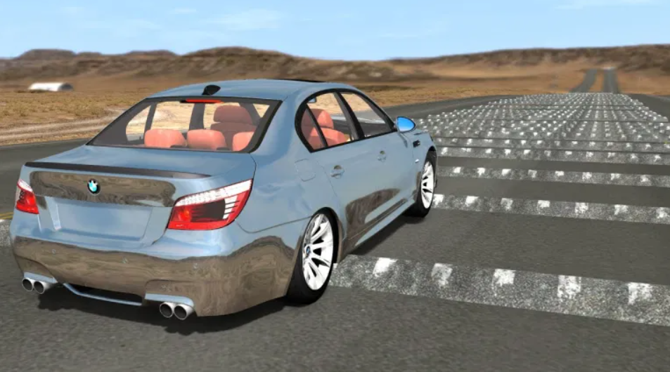
AIM OF THE PROJECT :
This Project Aims to Prevent the loss of Energy which is generated when a vehicle passes over a speed bump.

Slide 4

HOW MUCH POWER CAN BE GENERATED ??
A vehicle weighing 1000 kg going up a height of 10 cm on a speed bump produces approximately 1 kilowatt power.
1 speed breaker 1 vehicle….1KW
1 speed breaker 100 vehicles …. 100 KW

Slide 5

Low budget electricity production
2. No obstruction to traffic
3. Easy maintenance
4. Suitable at parking of multiplexes, malls, toll booths, signals, etc.
5. Uses: Charging batteries and using them to light up the streets, etc.

Slide 6
ROAD MAP
PROGRESS TILL MIDSEM
Accumulation of Data related to topic
3-4th of website completed
Review presentation
Started working on solid works
Progress Expected Till Endsem
Website completion
Handling problems related to storage and transmission of power generated
Completion of solid works

Slide 7
Introduction
Through This project, we intend to harvest energy from speed breaker by making gear arrangement and using electronics gadgets. Large amount of electricity can be generated saving lot of money.
When vehicle is in motion it produces various forms of energy like, due to friction between vehicle’s wheel and road i.e. rough surface HEAT Energy is produced, also when vehicle traveling at high speed strikes the wind. then also energy is produced which is always lost in environment and of which we can’t make use.

Slide 8
this energy that we can’t make use of is just the WASTAGE OF ENERGY that is abundantly available around us. In this project we are just trying to make use of such energy in order to generate an ELECTRICAL ENERGY. This project will work on the principle of “POTENTIAL ENERGY TO ELECTRICAL ENERGY CONVERSION” Potential energy can be thought of as energy stored within a physical system. This energy can be released or converted into other forms of energy, including kinetic energy. It is called potential energy because it has the potential to change the states of objects in the system when the energy is released If h is the height above an arbitrarily assigned reference point, then Kinetic energy of an object is the extra energy which it possesses due to its motion. It is defined as the work needed to accelerate a body of a given mass from rest to its current velocity.

Slide 9
Principle
The principle involved is Convert POTENTIAL ENERGY TO ELECTRICAL ENERGY CONVERSION.
There is a system to generate power by converting the potential energy generated by a vehicle going up on a speed breaker into kinetic energy.
When the vehicle moves over the inclined plates, it gains height resulting in increase in potential energy , which is wasted in a conventional rumble strip.

Slide 10
Rack and Pinion mechanism:

Slide 11
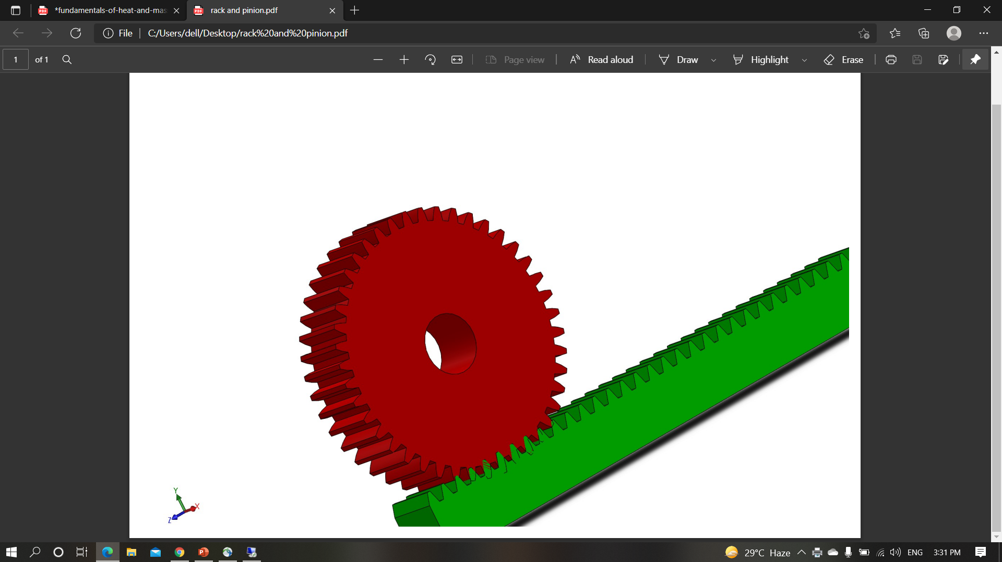
Rack and pinion made on solidworks
Pinion
Rack

Slide 12
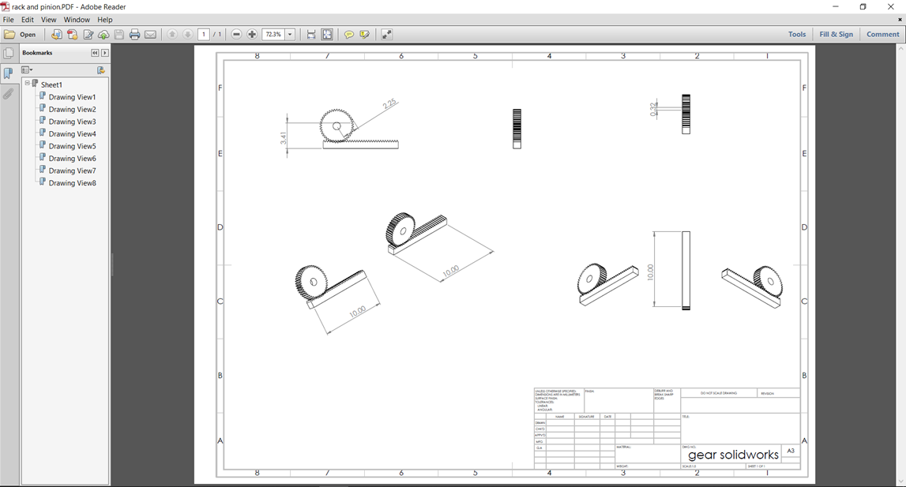

Slide 13
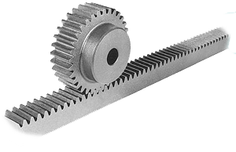
Rack and pinion gears normally change rotary motion into linear motion, but sometimes we use them to change linear motion into rotary motion. They transform a rotary movement (that of the pinion) into a linear movement (that of the rack) or vice versa. We use them for sliding doors moved by an electric motor.The rack is attached to the door and the pinion is attached to the motor. The motor moves the pinion which moves the rack and the door moves.

Slide 14
ELECTRICITY GENERATION FROM RACK AND PINION MECHANISM:(POWER HUMP):
The Kinetic energy of moving vehicles can be converted into mechanical energy of the shaft through rack and pinion mechanism. This shaft is connected to the electric dynamo and it produces electrical energy proportional to traffic density. This generated power can be regulated by using zener diode for continuous supply .All this mechanism can be housed under the dome like speed breaker, which is called hump.
The generated power can be used for general purpose like streetlights, traffic signals. The electrical output can be improved by arranging these power humps in series this generated power can be amplified and stored by using different electric devices. The maintenance cost of hump is almost nullified. By adopting this arrangement, we can satisfy the future demands to some extent.

Slide 15
Setup description
A dome is mounted on four springs and in the bottom, a rack is clamped. The rack consists contact teeth on both the faces. It is connected to two gear wheels to rotate the gear wheels only in one direction. We have inserted a free wheel in each gear. The free wheel and the gear assembly are mounted centrally. The flywheel is also mounted on the same shaft and the shaft is simply supported at the both ends by means of ball bearings. Now a dynamo is connected to each shaft by belt drive. The output terminal of dynamo is connected to an electrical storing device. The total assembly is arranged in concrete pit.

Slide 16
WORKING PRINCIPLE:
While moving, the vehicles possess some kinetic energy and it is being wasted. This kinetic energy can be utilized to produce power by using a special arrangement called POWER HUMP. It is an Electro-Mechanical unit. It utilizes both mechanical technologies and electrical techniques for the power generation and its storage. POWER HUMP is a dome like device likely to be speed breaker.
Whenever the vehicle is allowed to pass over the dome it gets pressed downwards then the springs are attached to the dome are compressed and the rack which is attached to the bottom of the dome moves downward in reciprocating motion. Since the rack has teeth connected to gears, there exists conversion of reciprocating motion of rack into rotary motion of gears but the two gears rotate in opposite direction. A flywheel is mounted on the shaft whose function is to regulate the fluctuation in the energy and to make the energy uniform. So that the shafts will rotate with certain R.P.M. these shafts are connected through a belt drive to the dynamos, which converts the mechanical energy into electrical energy. The conversion will be proportional to traffic density.

Slide 17
Whenever an armature rotates between the magnetic fields of south and north poles, an E.M.F (electro motive force) is induced in it. So, for inducing the E.M.F armature coil has to rotate, for rotating this armature it is connected to a long shaft. By rotating same e.m.f. , is induced, for this rotation kinetic energy of moving vehicles is utilized. The power is generated in both the directions; to convert this power into one way a special component is used called zener diode for continuous supply. All this mechanism can be housed under the dome, like speed breaker, which is called HUMP. The electrical output can be improved by arranging these POWER HUMPS in series. This generated power can be amplified and stored by using different electrical devices.

Slide 18
COMPONENTS
The various machine elements used in the construction of power hump are
RACK
SPUR GEAR
FLY WHEEL
BEARINGS
SHAFT
SPRINGS
ELECTRIC DYNAMO

Slide 19
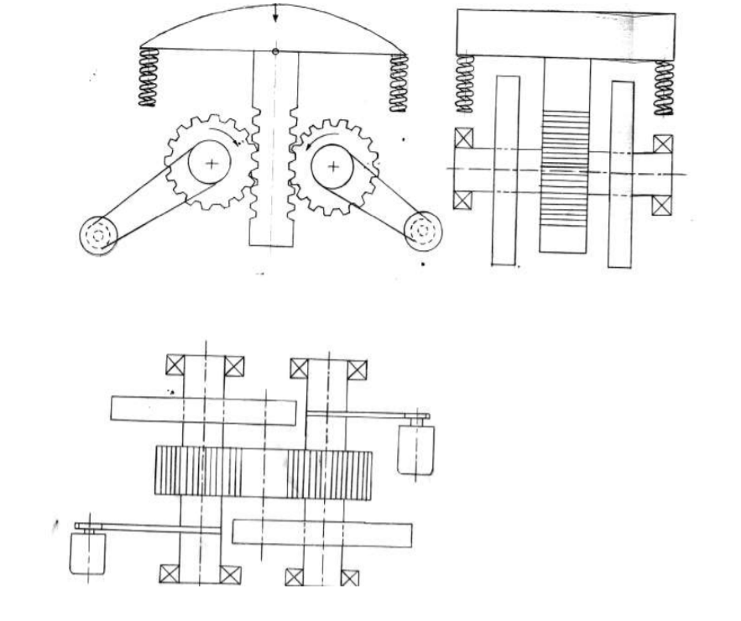
MECHANICSM DIAGRAM

Slide 20
Conclusion
With the help of this project we can produce surplus electricity and thus reducing the consumption of electricity from non-renewable sources like-coal.
Instead of wasting potential of vehicles at speed breakers the minor needs can be met by converting potential energy to electrical energy.
So the minor needs of electricity such as street lights and traffic signals can be generated from speed breakers.

