Slide 1

SleekFlow TODO List
Name : DAIWEI Ong

Slide 2
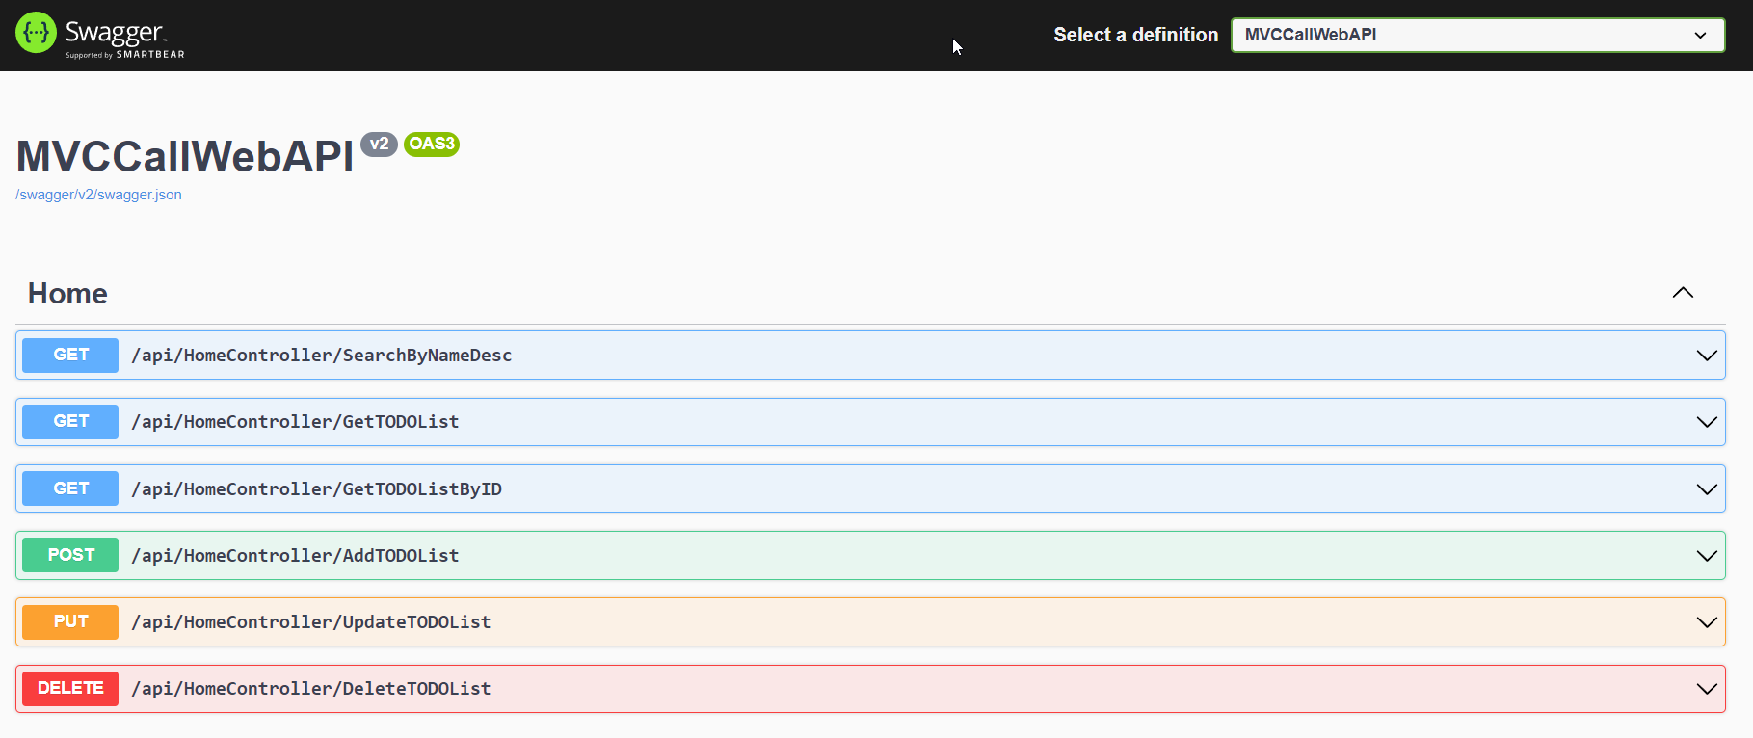
Access to swagger UI
Access to https://localhost<portnumber>/swagger/index.html
TODOs CRUD
Filtering & Sorting features at “api/HomeController/SearchByNameDesc”

Slide 3

Thank You
odw3258@hotmail.com

