Slide 1

Gpay - Junior
Innovative Business Solutions with Large Language Models (LLMs)
Confidential – GPay Junior
Confidential – GPay Junior - Devi Murugesan

Slide 2
GPay
Google Pay is a dominant player in India's digital payments landscape, with a significant market share in UPI transactions.It is specifically designed for the Indian market and requires an Indian bank account and phone number. Google Pay is a Third Party Application Provider (TPAP) authorized by the National Payments Corporation of India (NPCI) to facilitate payments via UPI. This enables instant, inter-bank fund transfers using a virtual payment address (VPA), phone number, or QR codes.The service emphasizes security, protecting payment information with multiple layers of encryption, fraud protection, and built-in authentication methods like PINs or fingerprints.The app also offers features like a platform to apply for credit cards from partner institutions, check CIBIL credit scores, access loan facilities from third-party lenders, and invest in a Gold Accumulation Plan (GAP) through MMTC-PAMP.
Google Pay is available for teens (ages 13-18) in India, but it's a specific, supervised experience designed with safety and legal compliance in mind. The app is not completely unavailable; rather, the features are limited and often require parental involvement due to legal age restrictions for financial contracts in India.
Confidential – GPay Junior
Confidential – GPay Junior - Devi Murugesan

Slide 3
Gpay - Junior
Fewer teens use Google Pay due to age restrictions requiring parental consent, limited features for underage users, and a lack of independent bank accounts. While some platforms offer a "supervised" experience, many teens still rely on cash because they don't have a bank account or prefer other digital wallets designed for them.
Our new app Gpay – Junior, a neobank for teenagers, enabling cashless transactions via UPI and prepaid cards without requiring a traditional bank account. It promotes financial literacy, safe digital payments, and parental oversight for users aged 11–18 years.
The objective of this app is
        Empower teens to make secure digital payments.
        Provide parents with control and visibility over spending.
        Ensure compliance with RBI guidelines for minors and PPIs.
        Enhance user experience with gamified financial education.
Confidential – GPay Junior
Confidential – GPay Junior - Devi Murugesan

Slide 4
Target Users
Primary: Teenagers (11–18 years) seeking independence in digital payments.
Secondary: Parents/guardians who fund and monitor transactions.
Confidential – GPay Junior
Confidential – GPay Junior - Devi Murugesan

Slide 5
The Problem
Teenagers in India not having access to the Unified Payments Interface (UPI) face significant effects, primarily related to delayed financial literacy and inclusion, depending on cash or parents, and limited exposure in managing their own expenses.
What is the user trying to do? | What are the biggest problems with the current approach?
Daily essential petty transaction. | Parents Availability and risk of carrying cash and rendering appropriate amount.
Handling cash | Risk of loosing or misusing.
Tracking the spends | Difficult for the teens as well the parents to track and monitor.
Financial literacy. | No holistic approach and friendly guidance.
Confidential – GPay Junior
Confidential – GPay Junior - Devi Murugesan

Slide 6
MVP Epic 1 - RBI Guidelines & Compliance
Usecase 1-1 – Full-KYC PPIs only can enable UPI payments
  Full-KYC PPIs only can enable UPI payments. - RBI mandates UPI only for Full-KYC wallets to prevent fraud and ensure identity verification.
  A 16-year-old user wants to pay for a book using UPI through Gpay Junior
  The teen’s wallet must be Full-KYC verified (Aadhaar + Parent’s/Guardian's PAN).
  User initiates UPI payment. → System checks KYC status. → If Full-KYC → allow payment; else → show message: “Complete KYC to use UPI.”
Usecase 1-2 – No co-branded UPI arrangements
  No co-branded UPI arrangements; issuer must onboard its own customers
  The app creates its own UPI handle eg - @gjunior
  Users register under gpay system, not via a third-party bank
Usecase 1-3 – Prepaid wallets for minors must have parental control and spending limits
  Protects minors from overspending and ensures parental oversight.
  Parent sets a daily limit of ₹500.
  User tries to pay ₹2,000 → System blocks transaction and notifies parent.
Confidential – GPay Junior
Confidential – GPay Junior - Devi Murugesan

Slide 7
MVP Epic 1 - RBI Guidelines & Compliance
Usecase 1-4 – Cash withdrawal not allowed for minors
  Prevents misuse and keeps transactions digital-only.
  Transaction request detected as withdrawal from a junior account, System blocks and shows: “Cash withdrawal not permitted for minors.”
Usecase 1-5 – Transaction authentication must use wallet credentials
  RBI requires wallet-level authentication for security.
  Teen initiates a UPI payment of ₹100, System prompts for PIN or biometric.
  No external bank PIN allowed.
Confidential – GPay Junior
Confidential – GPay Junior - Devi Murugesan

Slide 8
MVP Epic 2 – Basic Features – (Must haves)
Usecase 2-1 – Scan & Pay, personalized UPI ID.
  Wallet has sufficient balance and UPI ID is active.
  User opens app → selects “Scan & Pay.” → Scans merchant QR code. → Enters amount → authenticates with PIN/biometric. → Payment completes → confirmation shown.
  Wallet balance updated.
Usecase 2-2 – Dashboard for Parental Controls
  Parent configures limit in app. → Teen tries to spend ₹700 → system blocks transaction. → Parent gets instant notification of attempt.
  Controlled spending, parental oversight maintained.
  View Spending Summary
  View Issue/Resolution
Usecase 2-3 – Security – PIN, Fingerprint, Face Unlock, Instant account Block
  Teen loses phone or system encounters multiple wrong pins, account blocked instantly to avoid misuse.
  Parents can enable the access with help of multi factor authentication.
Confidential – GPay Junior
Confidential – GPay Junior - Devi Murugesan

Slide 9
MVP Epic 2 – Basic Features – (Must haves) Contd
Usecase 2-4 – Restrict payments – Strictly no bypass.
  Payments allowed only to authorized businesses.
  Payments to individuals are blocked.
  Block gaming, betting, gambling merchants.
Usecase 2-5 – 24x7 Support .
  User encounters an issue , User navigates to “Help & Support.”
  Parents gets notified about the issue.
  If issue persists, communication happens with linked parents account towards resolution.
Confidential – GPay Junior
Confidential – GPay Junior - Devi Murugesan

Slide 10
MVP Epic 3 – Nice to haves
Usecase 3-1 – Financial Literacy - “Learn & Earn” section
  Basics of UPI and digital payments , How to budget and save,, Understanding RBI rules for minors, Avoiding fraud and scams
  Short videos, quizzes, and scenario-based questions.
  Parent can view teen’s progress in the parental dashboard and app encourages Parents to add money to parent-Approved Term Deposit via Partner Bank
Usecase 3-2 – Saving buckets.
  Convert Wallet Balance into a Savings Goal bucket with upper limit of Rs. 1000
  No interest on wallet balance (only banks can offer interest).
  No overdraft or negative balance.
  Funds remain in credit balance and cannot be withdrawn as cash
  Parents move leftover wallet balance into a minor’s deposit account.
Confidential – GPay Junior
Confidential – GPay Junior - Devi Murugesan

Slide 11
Pain points the MVP addressing for the user’s
Parents worry about overspending or spending on risky categories (gaming, betting).
Teens are vulnerable to scams, phishing, and unauthorized transactions.
Existing apps may not fully comply with RBI rules for minors.
Teens often lack budgeting and saving habits.
Parents find it hard to track spending and transfer funds easily.
Teens lose interest in traditional banking apps.
Encouraging the habit of goal-oriented savings.
Confidential – GPay Junior
Confidential – GPay Junior - Devi Murugesan

Slide 12
Risks
Risk | Mitigation
Failure to adhere to RBI guidelines (KYC, spending limits, parental controls) could lead to penalties or app suspension. | Regular audit and update based on RBI circulars. Implement automated compliance checks for every transaction and feature.
Teens may fall victim to phishing, scams, or unauthorized wallet/card use. | AI-based fraud detection for unusual patterns. Mandatory PIN/biometric authentication for all transactions.
Sensitive teen and parent data could be exposed. | End-to-end encryption , Regular penetration testing and security audits.
Payment failures during peak hours → loss of trust. | 99.9% uptime SLA. 24x7 support escalation for critical issues.
AI may incorrectly flag transactions or give misleading financial advice. | Continuous model monitoring and retraining. Human-in-the-loop for critical fraud decisions.
Teens unaware of budgeting or safe payment practices → higher fraud risk. | Mandatory learning goals before enabling advanced features.
Confidential – GPay Junior
Confidential – GPay Junior - Devi Murugesan

Slide 13
Primary - System Attributes
Security - End-to-end encryption , MFA, AI-driven fraud detection.
Compliance – 100% with RBI guidelines.
Parental Control - Spending limits, Real-time notifications
Teen-Friendly Experience – Gamified experience, Fun customization.
AI-Powered Features - Personalized saving suggestions, financial education content.
Reliability - 99.9% uptime SLA, Scalable architecture, Fast transaction (<3 seconds).
Confidential – GPay Junior
Confidential – GPay Junior - Devi Murugesan

Slide 14
Secondary - System Attributes
Analytics & Insights - Reports for compliance and audits.
Scalability - Modular architecture for easy feature expansion.
Performance - Optimized for low-bandwidth and mid-range devices.
Accessibility - Voice-assisted navigation for ease of use.
Confidential – GPay Junior
Confidential – GPay Junior - Devi Murugesan

Slide 15
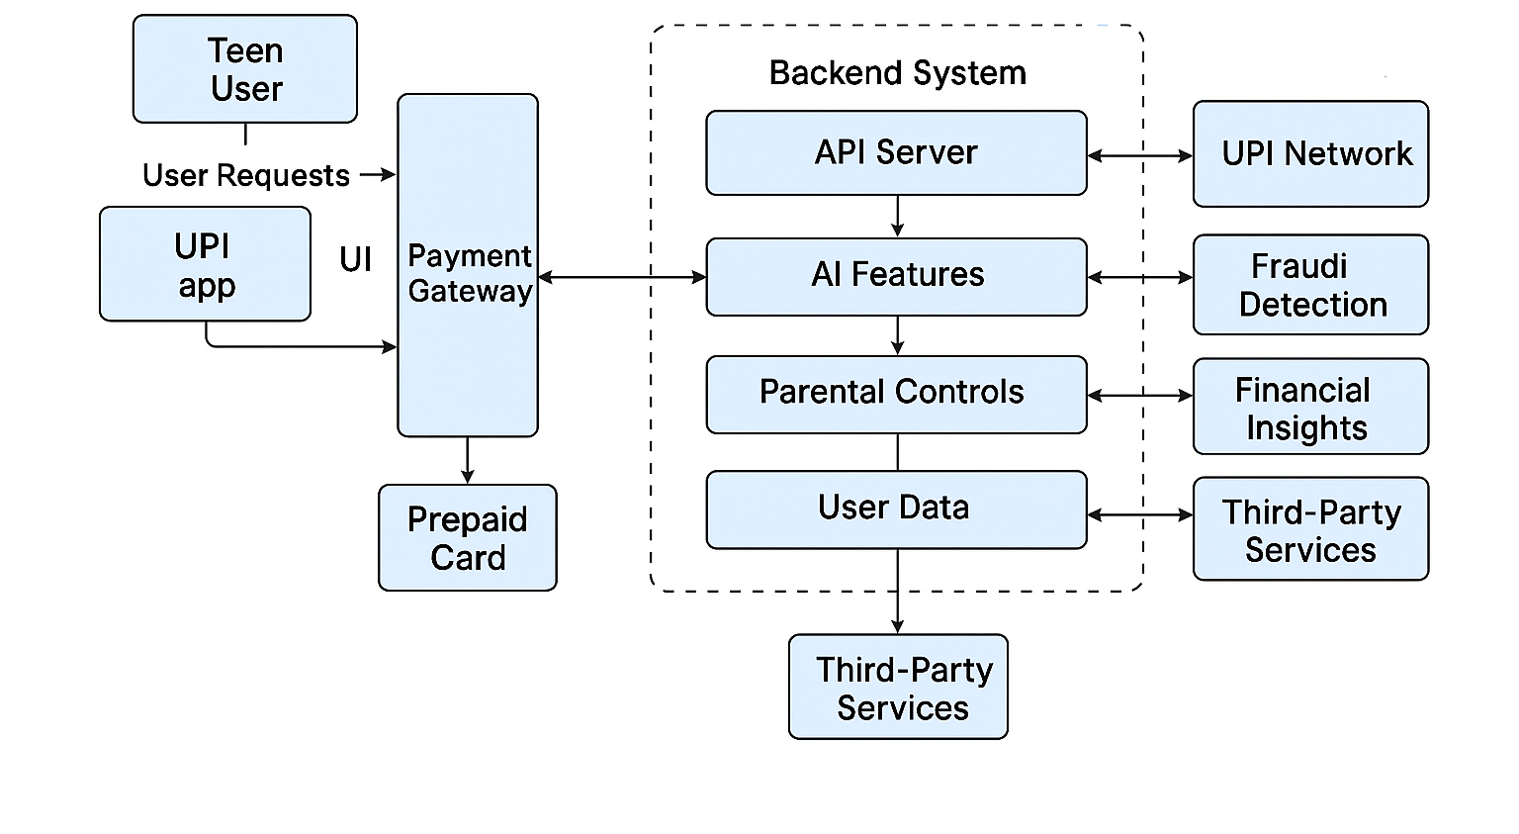
System Architecture
Confidential – GPay Junior
Confidential – GPay Junior - Devi Murugesan

Slide 16
LLM Configuration
Property | Value | Rationale
License - Google Gemini | Compliance & Safety Integration with Google Ecosystem Scalability Cost & Performance Google offers Vertex AI for fine-tuning Gemini on domain-specific data. | Google prioritizes responsible AI with strong safety filters. Gemini is deeply integrated with Google Cloud, Android, and Play Store services. Google can leverage its own infrastructure for cost-efficient deployment.
Deployment Type – On-device Cloud Deployment | Cloud-based inference (high accuracy, needs internet). Edge/on-device inference (low latency, privacy). Hybrid approach for sensitive teen data. | Reduces memory footprint for mobile deployment.
Confidential – GPay Junior
Confidential – GPay Junior - Devi Murugesan

Slide 17
LLM Configuration
Property | Value | Rationale
Temperature | Low (0.2) → deterministic, factual responses. High (0.8) → creative, varied responses. | Controls randomness in output
Top K | Low (10–20) for emergency instructions (consistent, safe). Higher (40–50) for daily conversation, | Limits sampling to top-k probable tokens.
Fine-tuning | Custom training on domain-specific data. | Fine-tune on RBI guidelines, UPI workflows, parental control scenarios.
Top-p (nucleus sampling) | 0.9 | Ensures diversity in output while maintaining relevance.
Safety Filters | Content moderation layers. | Enable strict filters for financial and teen-related queries.
Latency Threshold | < 500ms | Ensures real-time responsiveness for voice and emergency interactions.
Confidential – GPay Junior
Confidential – GPay Junior - Devi Murugesan

Slide 18
Metrics
Metric for Business | Ideal Value | Purpose
User Adoption Rate | 15–20% month-over-month | Measures market acceptance and effectiveness of onboarding..
Transaction Volume | 5–8 Transactions per User per Month: | Total UPI and wallet transaction value per month.
Revenue | 0.1–0.2% Commission | Commission from merchant transactions.
Churn Rate | <5% per month | % of users leaving the app monthly.
Compliance | KYC Completion Rate: >90% Fraud Detection Accuracy (AI): >95% | % of users with Full-KYC completed.
Confidential – GPay Junior
Confidential – GPay Junior - Devi Murugesan

Slide 19
Metrics
Metric for Product | Ideal Value | Purpose
Security | Fraud Detection Accuracy: >95% | Number of fraud attempts detected and prevented.
Transaction Success Rate | >=99% | % of successful UPI and wallet transactions.
Average Transaction Time | Time to Complete Transaction: <3 seconds | Time taken to complete a payment
Engagement | Average Session Duration: 3–5 minutes | Average sessions per user per week.
Retention | Day 30 Retention Rate:40–50% | Customer satisfaction, loyalty,
Confidential – GPay Junior
Confidential – GPay Junior - Devi Murugesan

Slide 20
Prepared by Devi Murugesan – Nov 2025
Confidential – GPay Junior - Devi Murugesan

