Slide 1

Deep Learning Content Summarization Model
Odai Athamneh
Devin Cline
Feng Zheng
Michael Nweke

Slide 2
Abstract
Can we train a language model to summarize news articles?

Slide 3



Phase 1
Phase 2
Phase 3
Data acquisition and refinement
Model Architecture Selection
Model Training and Evaluation

Slide 4
Phase 1
Phase 2
Phase 3
Model Architecture Selection
Model Training and Evaluation
Dataset
Dataset of news articles from Kaggle
Total of 870,521 articles
Collection of news articles from 3 separate datasets (XSum, CNN/Daily Mail, Multi-News)
Only 580,013 unique articles (about 1/3 of the articles are duplicates)
We lemmatized the dataset to extract meaning

Slide 5
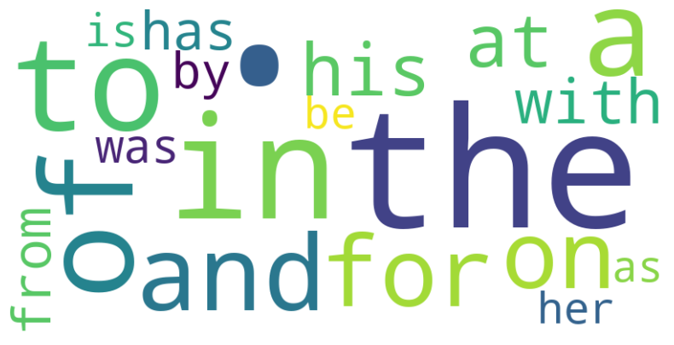
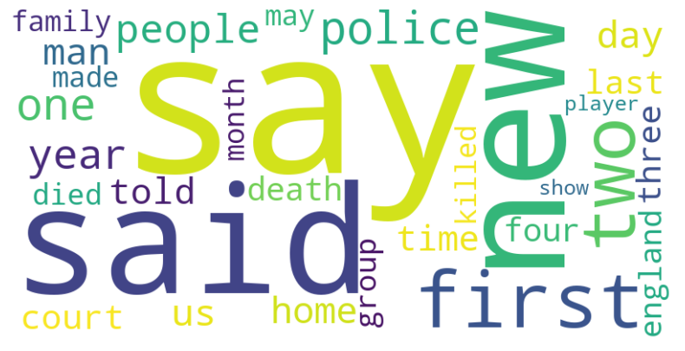

Phase 1
Phase 2
Phase 3
Word Map
Model Architecture Selection
Model Training and Evaluation
raw data
stop words removed

Slide 6
Phase 2
Phase 1
Phase 3
Model Architecture Selection
Initial Models
Data acquisition and refinement
Model Training and Evaluation
Model | Type | Key Features
BERT | Transformer-based model | Pre-trained, fine-tunable, attention-based, bidirectional
T5 | Transformer-based model | Pre-trained, fine-tunable, text-to-text transfer learning, flexible architecture
GPT-J | Transformer-based model | Pre-trained, large scale, high-quality generation
GPT-Neo | Transformer-based model | Pre-trained, smaller than GPT-J, high-quality generation
Sequence-to-Sequence with Attention (Seq2Seq) | Encoder-Decoder model | Attention-based, flexible architecture, proven success for text summarization
Transformer-Based Encoder-Decoder Models (BART, MASS, XLM) | Encoder-Decoder model | Transformer-based, pre-trained, fine-tunable, bidirectional, flexible architecture, proven success for text summarization
Pointer-Generator Network for Abstractive Summarization | Pointer-Generator model | Hybrid approach (extraction and abstraction), proven success for text summarization
Reinforcement Learning-Based Pointer-Generator Network | Pointer-Generator model | Trained using reinforcement learning, state-of-the-art performance, proven success for text summarization

Slide 7
Phase 2
Phase 1
Phase 3
Model Architecture Selection
Smaller Models
Data acquisition and refinement
Model Training and Evaluation
DistilBERT
MobileBERT
ALBERT
TinyBERT
ELECTRA

Slide 8
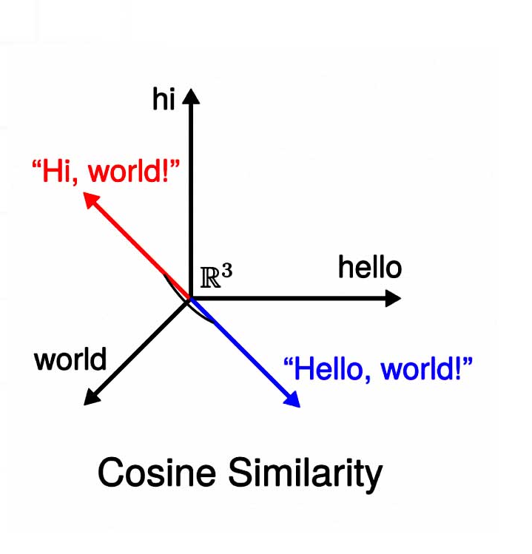
Phase 3
Phase 1
Phase 2
Model Training and Evaluation
Data acquisition and refinement
Model Architecture Selection
Scoring Metrics
Cosine Similarity captures semantic similarity
We chose Word Man’s Distance and Smooth Inverse Frequency
image credit: https://www.engati.com/glossary/cosine-similarity

Slide 9

Phase 3
Phase 1
Phase 2
Data acquisition and refinement
Model Architecture Selection
Model Training and Evaluation
higher is better
lower is better
Scoring
 | WMD Mean | SIF Mean
DistilBERT | 4.4856 | 0.8400
MobileBERT | 2204752.00 | 0.9992
ALBERT | 15.5492 | 0.8180
ELECTRA | 8.3385 | 0.3745
MobileBERT performed significantly better by WMD score than the other models, while ELECTRA performed the best by SIF score.
This suggests that MobileBERT is better at capturing the semantic similarities between the text inputs, while ELECTRA is better at capturing the overall meaning of the text.

Slide 10
Future Improvements
Larger models – need more hardware power for this
Enhance domain-specific features in dataset
More data to train on
Different evaluation metrics – ROUGE or BLEU?

