Slide 1
MOTIF FINDER IN DNA SEQUENCES USING EXPECTATION MAXIMIZATION (EM) ALGORITHM
CS 412 SPRING 2020 PROJECT TEAM:
DEVIN VINCENT TARK - devinvt2
GOWTHAM KUNTUMALLA - gowtham4
XIAOWEI LYU- lv7

Slide 2
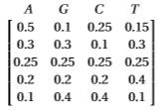
Introduction to Problem
A ‘motif’ is a pattern in a sequence, which is often in the form of ‘position weight matrix’ (PWM). The project involves developing a “motif finding” program and testing it. The three major components of the implementation are:
Building a benchmark
Implementing the “motif finder”
Evaluating the motif finder on the benchmark and making intelligent inferences.
We'll use Expectation-Maximization (EM) as our “motif finder”.
Example of PWM

Slide 3
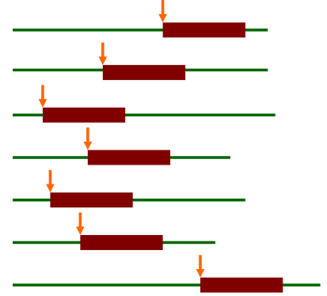
Description of EM Algorithm
The Expectation-Maximization (EM) is a family of algorithms for learning probabilistic models in problems that involve latent variables. The algorithm has four parts:
Initialization
Expectation Step
Maximization Step
Exit condition
Bailey and Elkan uses EM algorithm for discovering motifs in a group of DNA sequences.
Latent variables in motif finding: where the motif starts in each training sequence (sites)

Slide 4
EM Algorithm (at a high level) Pseudocode
EM (dataset, W) {
Initialization: Find the most common subsequences as starting points;
Generate an initial PWM;
While (iterations < n_iter): {
Estimate motif positions Z_ij from motif matrix (E-Step);
Update the PWM from all positions Z_ij (M-Step);
}
}

Slide 5
Code Structure

Slide 6
Experiments

Slide 7
Conclusion

Slide 8

Thank You
United Imaging
BIOE 575 Instructors
Resources provided by the Department of Bioengineering

