Slide 1


SPARK TO SNOWPARK CONVERSION
Liquidity POV

Slide 2
Artifacts CREATED in POV
15 Source snowflake tables [TEST_DB ] and Synthetic data Loaded . One Target Snowflake table generated as output
10 Scala classes [Demo Project]
Around 25 Scala functions [Demo Project]
4 Scala UDF [TEST_DB SnowSight]
PSV reference file [Resources folder in Demo Project]

Slide 3
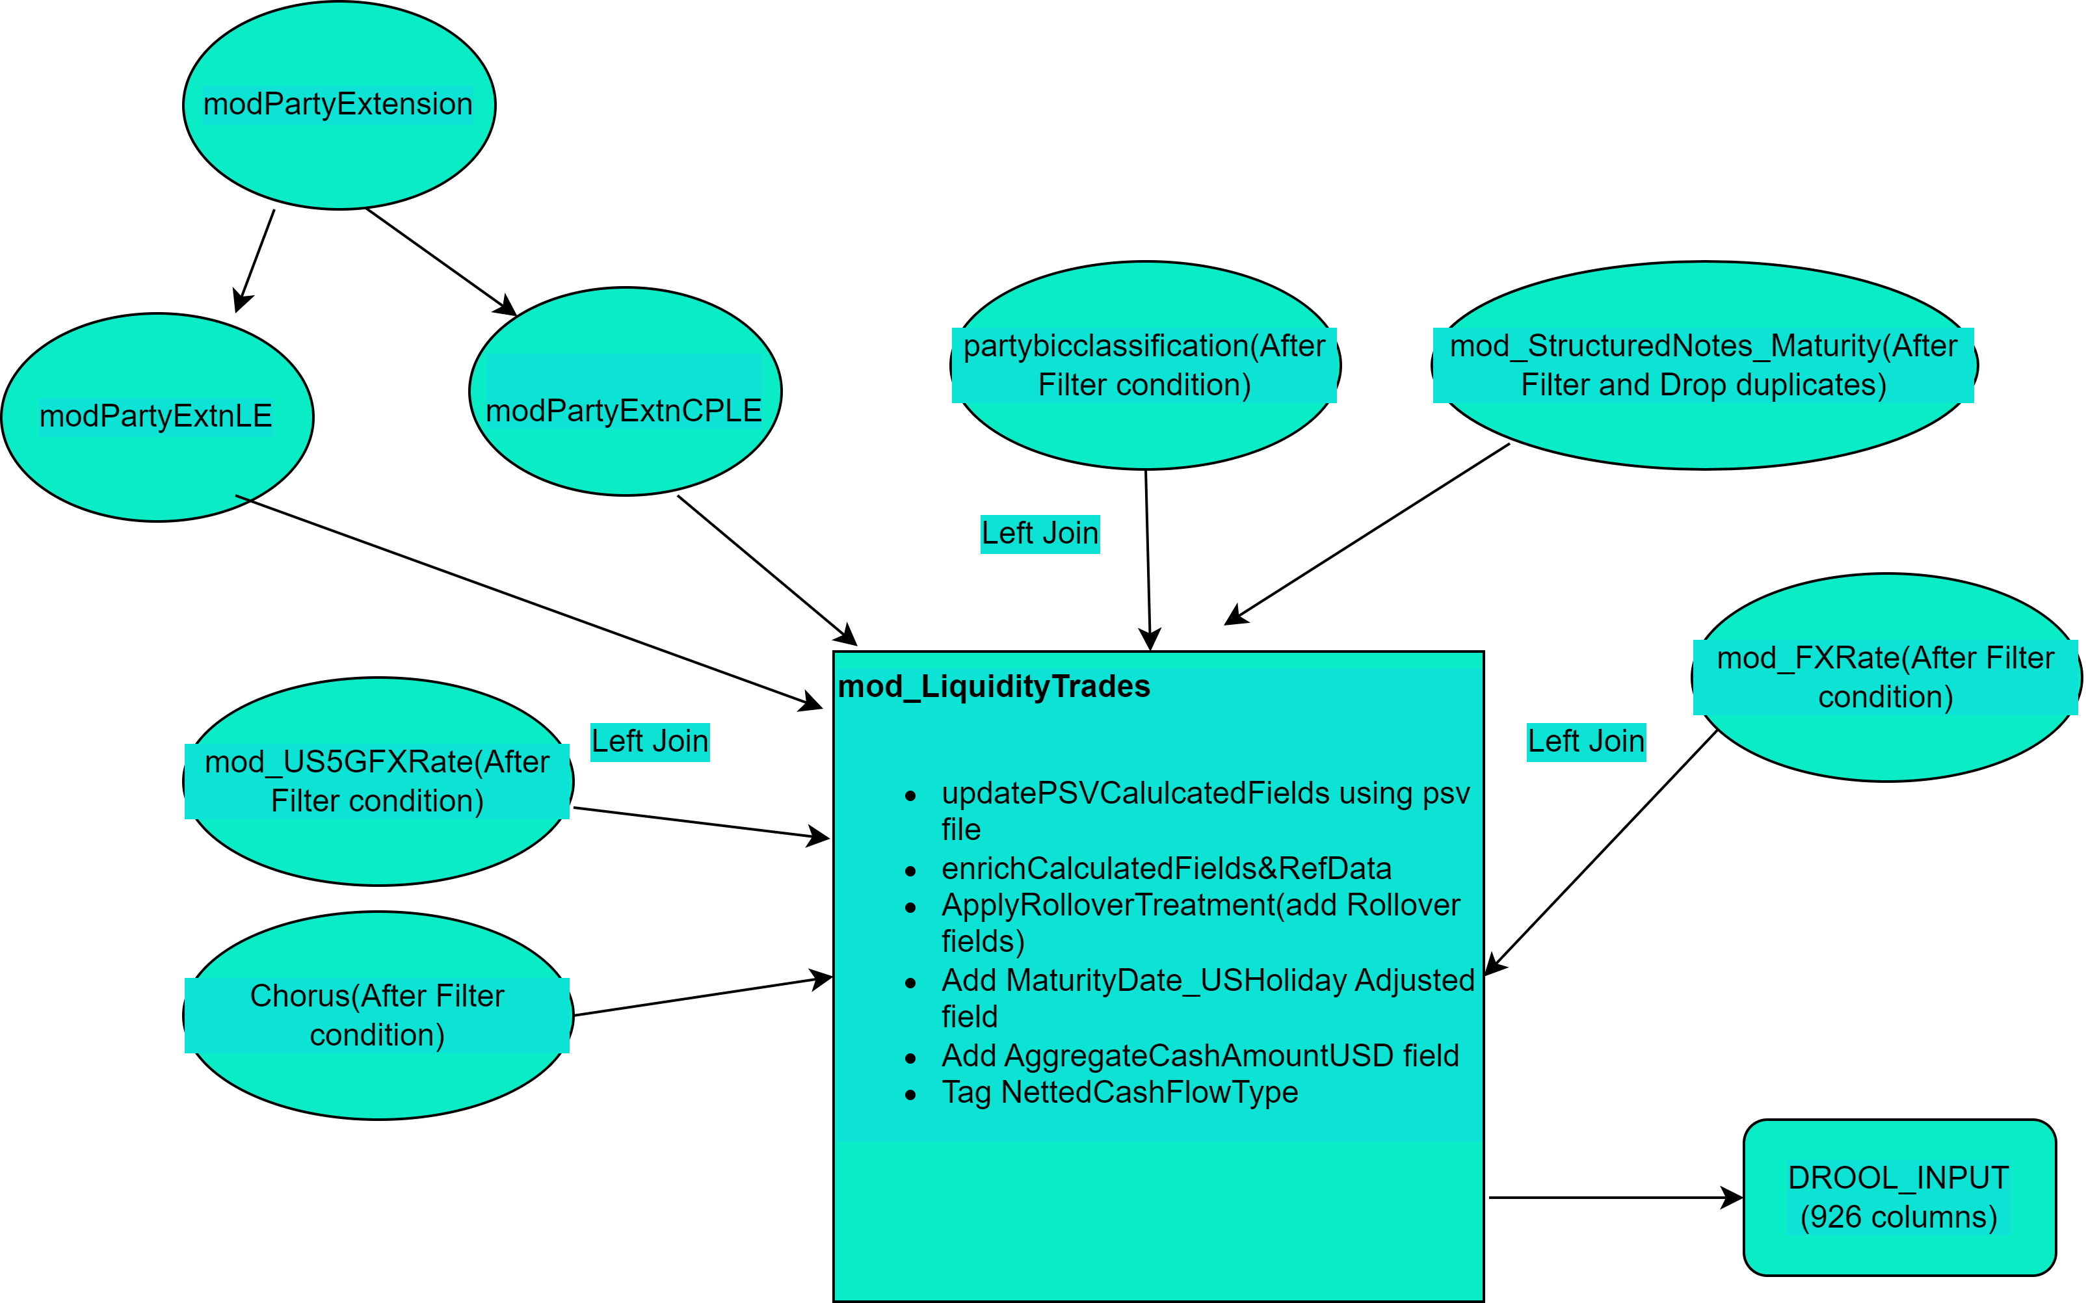
SNOWPARK Code Flow

Slide 4
Function and API Changes Done for SNOWPARK
Broadcast function not required .
AsNonDeterminstic() for UDFs not available in SnowPark
OrderBy,Window.partitionBy and sort can take col as only input( but not string as in Spark)
Coalesce function is used for different purpose in snowpark
queryAsNonDeterminstic() for UDFs not available in SnowPark
Cache_result in place of cache()
AsNonDeterminstic() for UDFs not available in SnowPark
df.na.fill needs Map as input in snowpark
withColumnRenamed is available in snowpark_extensions library. RDD use has been removed as not supported in SnowPark
Created two Temp tables to resolve Compilation memory exhausted due to long
collect() needed after session.sql
equal_to is repalcement for isequal in spark
lit() needs to be used if we are using constant/variables of any type which are not columns

Slide 5
References
Confluence Page updated with Snowconvert installation, setup and migration details
POV Code has been checked in CTO stash
Artifacts available in TEST_DB [SFPLAY environment]
Calculated and Enriched data may come blank and will require changes in Source tables Synthetic data to generate required output

