Slide 1
WHY WE NEED ARRAY IN PROGRAMMING ?
WHAT IS ARRAY?
TYPES OF ARRAY
HOW TO DECLARAE AN ARRAY IN C
INITIALIZATION OF AN ARRAY

Slide 2
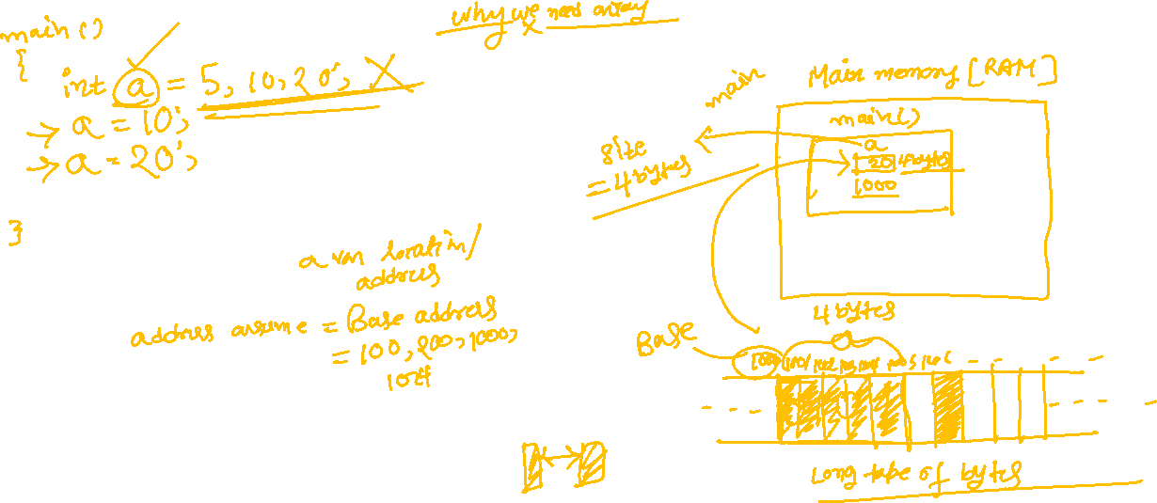

Slide 3
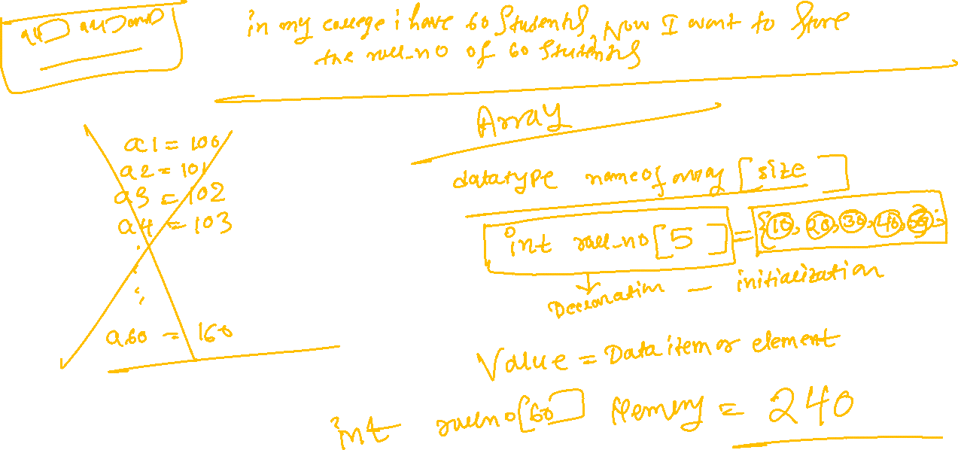

Slide 4
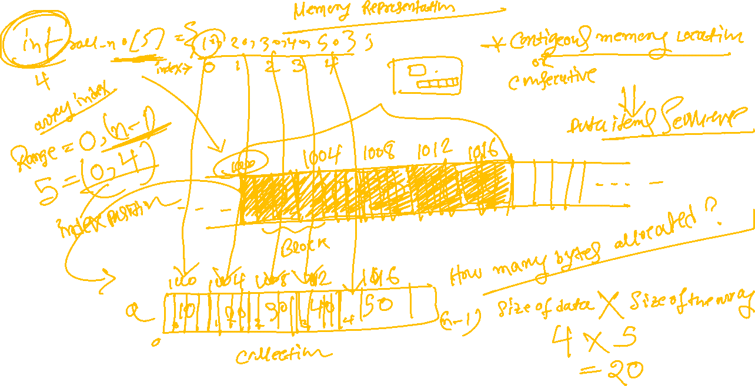

Slide 5


Slide 6
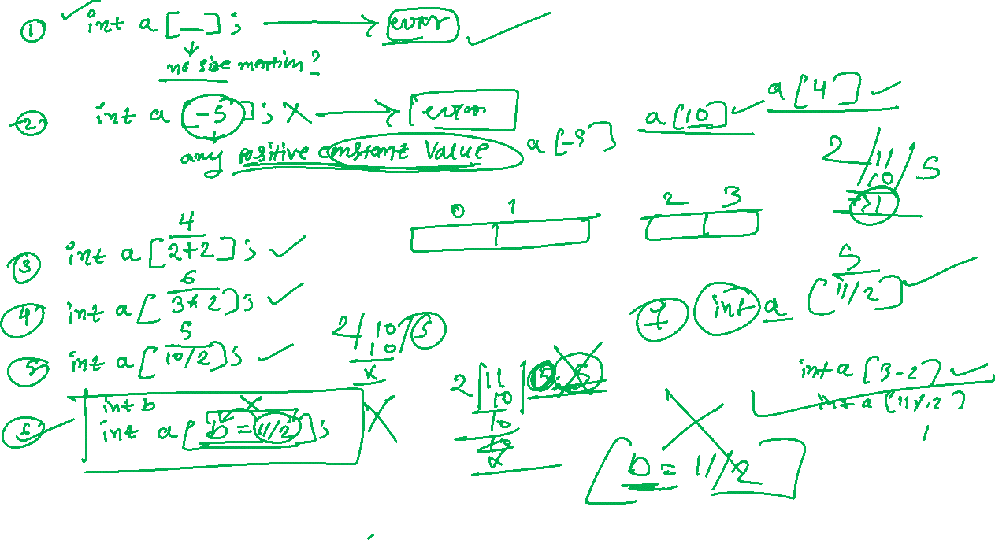

Slide 7


Slide 8
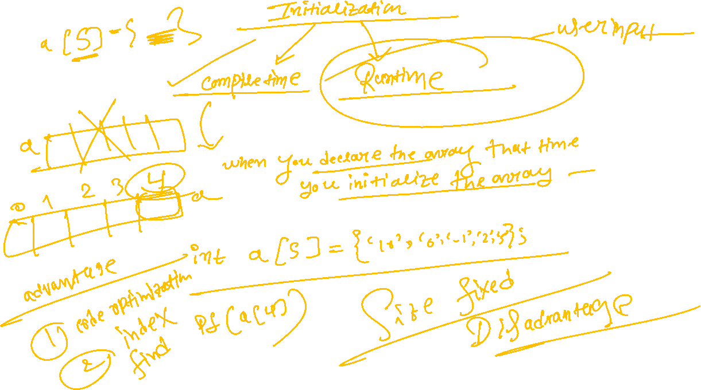


Slide 9


Slide 10



Slide 11
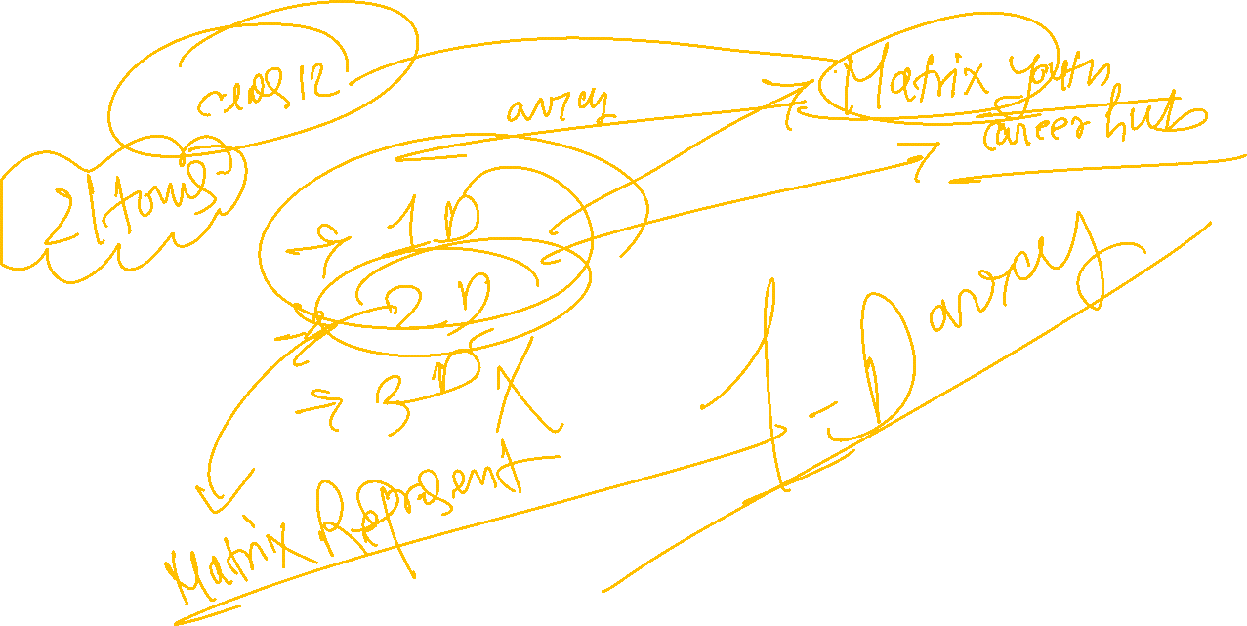

Slide 12
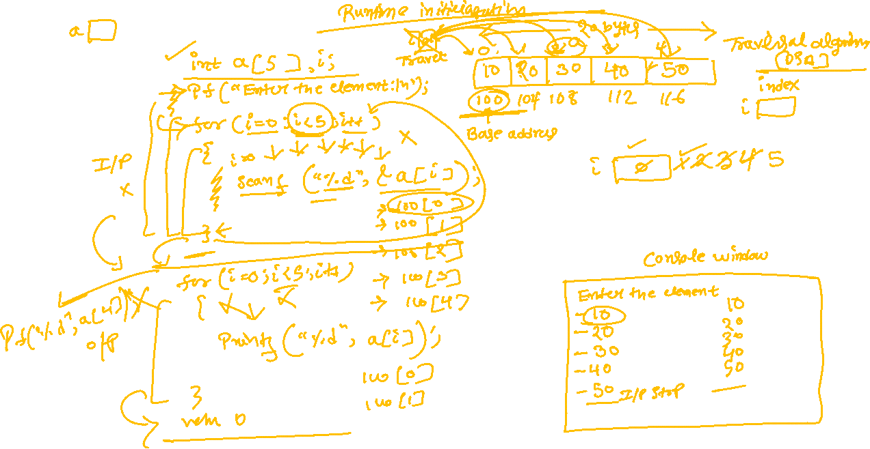

Slide 13


Slide 14





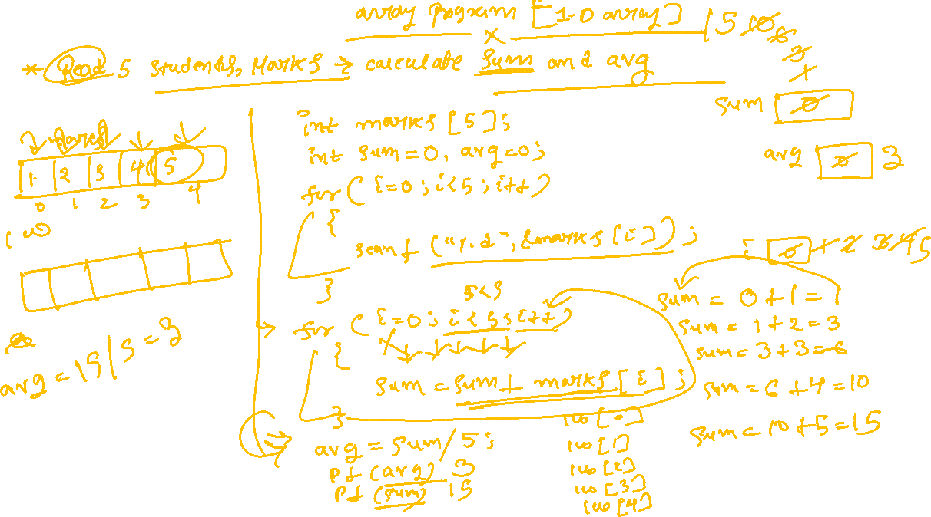



Slide 15



























Slide 16


















































Slide 17









































Slide 18













































