Slide 1
STORAGE CLASS IN C

Slide 2
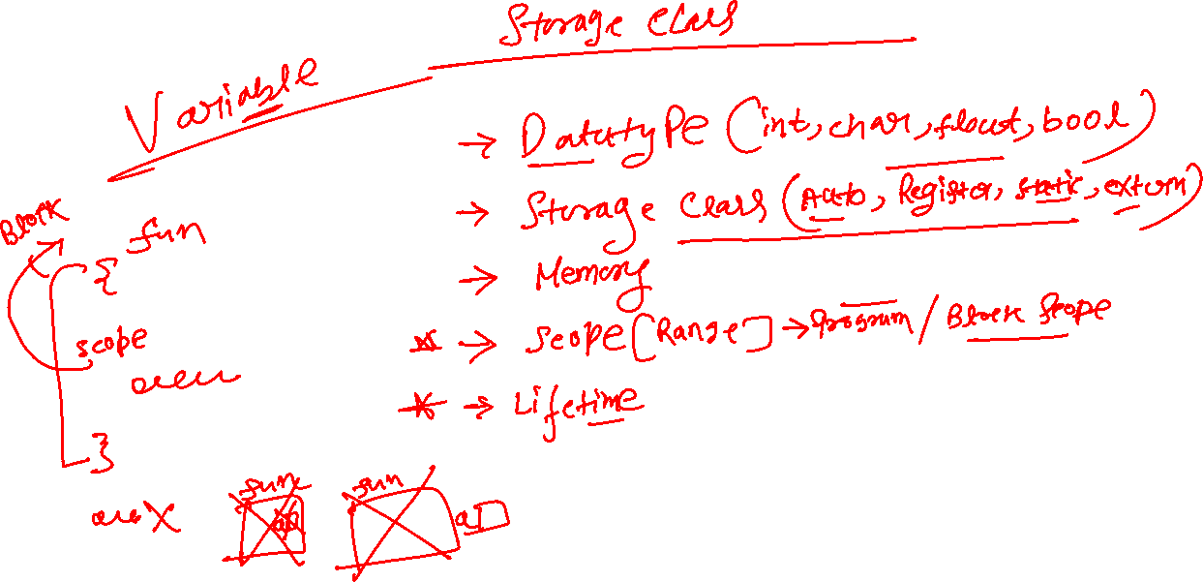

Slide 3
AUTO STORAGE CLASS IN C
#include <stdio.h>
int main()
{
auto int x = 10;
{
auto int x;
printf("%d\n", x);
}
printf("%d",x);
}
OUTPUT
2588672
10

Slide 4
AUTO STORAGE CLASS IN C
Syntax
Example-1
Example-2
#include <stdio.h>
void fun()
{
auto int a=10;
++a;
printf("%d\n",a);
}
int main()
{
fun();
fun();
fun();
}
#include <stdio.h>
void main()
{
int a = 10, b = 20;
{
int a = 15, c = 18;
printf("%d%d%d", a, b, c);
{
int b = 25, d = 30;
printf("%d%d%d%d", a, b, c, d);
}
printf("%d%d%d%d", a, b, c, d);
}
printf("%d%d%d%d", a, b, c, d);
}
Syntax:- auto int a;
Default Value:- garbage
Location:- RAM
Lifetime:- End of Block
Scope:- Block Scope
OUTPUT
11
11
11

Slide 5
STATIC STORAGE CLASS IN C
#include <stdio.h>
void display();
void main()
{
display();
display();
}
void display()
{
static int x;
x+=10;
printf("x=%d\n",x);
}
OUTPUT
x=10
x=20

Slide 6
STATIC STORAGE CLASS IN C
Syntax
Example-1
Syntax:- static int a;
Default Value:- Zero
Location:- RAM
Lifetime:- Till the end of the program
Scope:- with in Block Scope
#include <stdio.h>
void fun()
{
static int a = 10;
++a;
printf("%d\n", a);
}
int main()
{
fun();
fun();
fun();
}
OUTPUT
11
12
13

Slide 7
STATIC STORAGE CLASS IN C
Example-2
Pseudo-Code
c-Code
int f(int n)
{
static int i = 1;
if n>=5
return n
n = n+i
i++
return f(n)
}
#include <stdio.h>
int f(int);
void main()
{
int r;
r=f(1);
printf("%d",r);
}
int f(int n)
{
static int i = 1;
if (n >= 5)
{
return n;
}
n = n + i;
i++;
return f(n);
}

