Slide 1
DSC 4310 Project One
The Effects of Normalization on Clustering Algorithms
Authors: Tyler Frankowiak, Josh Foster, Devin Duran

Slide 2
Objectives
Run multiple normalization and clustering methods on several datasets and compare their metrics
For this, we will use the following datasets:
Iris dataset
Cybersecurity Malware dataset
Wisconsin Breast Tumor dataset
Later on we will visualize these datasets and a few additional ones using Yellowbrick

Slide 3
Normalization Overview
For this analysis we will use the following normalization methods to preprocess the data before clustering:
StandardScaler: transforms data to have a mean of 0 and standard deviation of 1
MinMax: puts data in a range of 0 and 1 where the minimum value of the pre-scaled data is 0 and the maximum pre-scaled value is 1
MaxAbs: divides each data point by the maximum absolute value of its respective feature
Robust Scaler: subtracts the median and divides by the interquartile range

Slide 4
Methods Overview
After normalizing each dataset we run the following clustering algorithms on them:
K-Means: groups points to clusters based on its nearest center, which updates until convergence
DBSCAN: density based algorithm that partitions points as core, reachable, or outliers
Bisecting K-Means: picks largest cluster and bisects with K-means, before adding the two clusters with the lowest SSE to the others
HDBSCAN: extends DBSCAN by converting it into a hierarchical clustering algorithm, computes mutual reachability distance between points
OPTICS: finds core sample of high density and expands clusters from them

Slide 5
Metrics Overview
We calculate the accuracy of each method with each normalization method using these metrics:
Silhouette Coefficient: how well individual points fit into their assigned clusters; used when true labels are unknown
V-measure: the harmonic mean of homogeneity and completeness
Adjusted Random Index (ARI): compares all pairs of points in the dataset and counts the number of pairs assigned to the same cluster in both the true and predicted sets of labels before dividing this number by the total number of pairs of points in the dataset
Normalized Mutual Info (NMI): measures the mutual information between the true class labels and the predicted labels
Adjusted Mutual Info Score (AMI): quantifies information shared between the two sets of labels

Slide 6
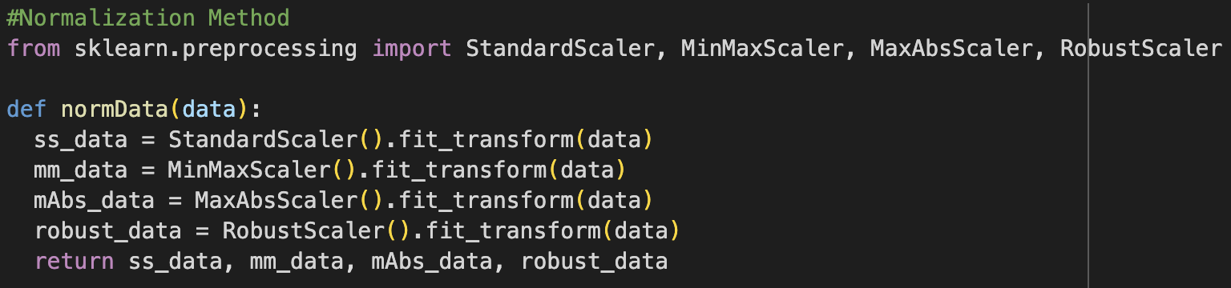
Step 1: Normalization Function
We create a function that does all four normalization methods using the ‘fit_transform’ command and returns updated data for each method

Slide 7
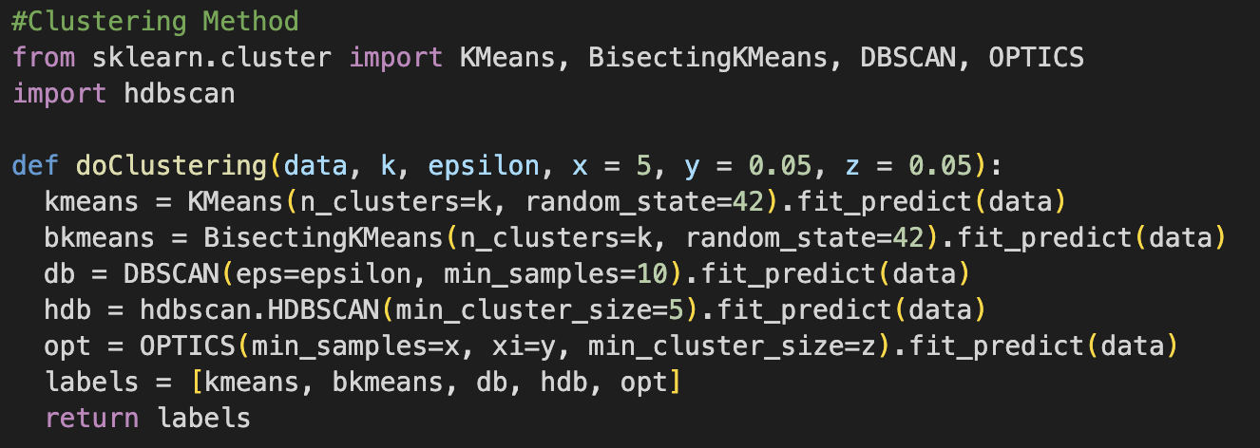
Step 2: Clustering Function
Creating a function called “doClustering”, we perform each of the clustering methods on the datasets, while computing and returning the labels of each method
Some of the methods required much parameter testing, hence the parameters of the method as a way to control the parameters of the methods

Slide 8
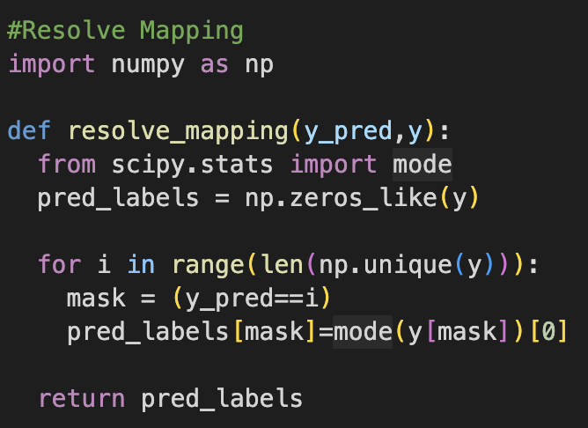
Step 3: Resolve Mapping
Before calculating the metrics of each method on each dataset, we run a resolve mapping function
This allows for each predicted label to be matched with its respective true label

Slide 9
Step 4: Metrics Methods Function
To calculate our metrics, we run a very long function that returns each metric for every clustering algorithm for each normalization type
It loops through all inputted labels and also iterates off of normalization type

Slide 10
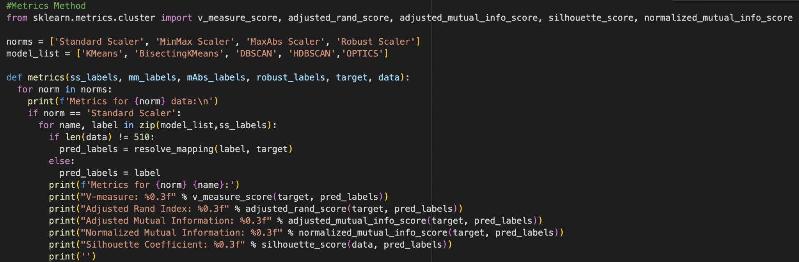
Step 4: Metrics Method Function

Slide 11
Results on Iris Data
For the iris data, these are notable patterns we observed:
The clustering method with the worst overall metrics appears to be OPTICS by a wide margin
For each normalization method, K-Means and Bisecting have identical metrics to each other and appear to have the highest overall metrics as well
DBSCAN and HDBSCAN also have very similar metrics although not identical for every normalization; with higher metrics than OPTICS but not as high as K-Means and Bisecting
HDBSCAN has consistently slightly better performance than DBSCAN for each normalization
MaxAbs normalization generally leads to the best metrics for the iris dataset, while Standard and Robust Scaler generally have the lowest metrics for most of the clustering methods
However for OPTICS, Robust Scaler yields the highest metrics

Slide 12
Results on Cybersecurity Data
We notice these patterns on the metrics for the cybersecurity data:
The metrics here are all very low and significantly lower than those of the iris data
Bisecting K-Means and K-Means are not identical, but very similar, same with HDBSCAN and DBSCAN
OPTICS still returns the lowest score of all clustering methods but is much closer to the others this time, actually having the best metrics for RobustScaler normalization
HDBSCAN generally has best scores of the methods and K-Means generally has the worst
Standard Scaler appears to be the best normalization method for this dataset, returning the best scores of all the methods
A reason for this low performance is potentially due to the fact that there is a large imbalance between the classes, very few data points had the class value of 1.

Slide 13
Results on Wisconsin Breast Tumor Data
In the Wisconsin data, we notice:
The scores here are much better than the cybersecurity data, similar to that of iris data
Like the iris data, OPTICS once again is generally the worst clustering method, having the lowest metrics
DBSCAN is slightly better than HDBSCAN, unlike the other two datasets; the pair’s metrics are much lower than that of K-Means and Bisecting, closer to that of OPTICS
K-Means and Bisecting have similar metrics, with Bisecting having the best of the clustering methods
All the normalization methods are pretty balanced here, with MinMax having the slight edge in metrics scores

Slide 14
Conclusions and Insights
Some conclusions our analysis gave us:
OPTICS was typically the least successful clustering method, by a decent margin; works best with RobustScaler normalization
The iris dataset had the highest scores overall, followed by the Wisconsin data, then the cybersecurity data
This is likely due to the number of features in each dataset; pattern we see is data with less features appear to be more accurate with all clustering and normalization methods
Bisecting K-Means and K-Means, along with DBSCAN and HDBSCAN had similar scores across datasets and normalization methods
The K-Means duo had the highest scores for the iris and wisconsin datasets, while DBSCAN/HBSCAN duo had the highest scores for the cybersecurity dataset, the one with the greatest amount of features and noise
Each dataset had different normalization methods that worked best

Slide 15

Yellowbrick Overview
Yellowbrick is a powerful machine learning tool used for visualization
We will use it to visualize the data and their feature importances

Slide 16
Yellowbrick Methods
We use these visualization methods in Yellowbrick
Parallel Coordinates: plots all values for each feature on a line graph
Principal Component Plot: explains relationships between variables in dataset with principal components
K-Means Intercluster Distance Map: visualizes distance between clusters and how distinct/dense they are
Lasso Importance: measures feature importance
Shapiro Ranking: measures the normality on a 0 to 1 coefficient
Covariance Ranking: measures the correlation of each variable with one another using a heatmap like visualization
RadViz: measures correlation of each variable with each other using a scatterplot in the middle of a circle

Slide 17
Datasets For Yellowbrick Visualization
For the Yellowbrick visualization, we will be performing on the same datasets used for the clustering and normalization method analysis
In addition we will also use the following two datasets:
HFT AAPL data
Heart dataset, containing characteristics of various hearts to predict heart attacks

Slide 18
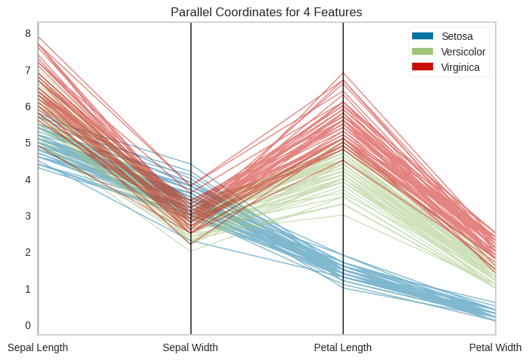
Parallel Coordinates (Iris)
The parallel for the coordinates was
very simple as there were very few
observations
We split the data into features and
classes based on the type of data
The values of each numerical variable are all above 0 for the most part and are greater than zero
Setosa’s petals are smaller than the other two

Slide 19
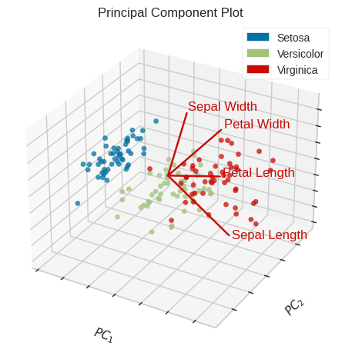
Principal Component Plot (Iris)
Looking at the PCP, we observe that the points
from each category are all in their own little clusters
There is slight overlap with the Versicolor and
Virginia species and none of the flowers appear
to have any significant outliers

Slide 20
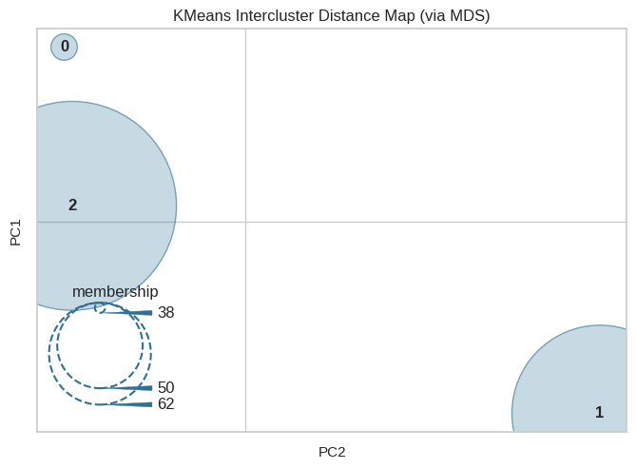
K-Means Intercluster Distance Map (Iris)
Using 3 clusters for our intercluster distance
map, we see the clusters are very distinct here
as they each occupy a corner of the plot with no
overlap
Clusters 1 and 2 are of similar size and contain
a similar amount of points; cluster 0 is much smaller, but is very dense and still contains a good amount of points

Slide 21
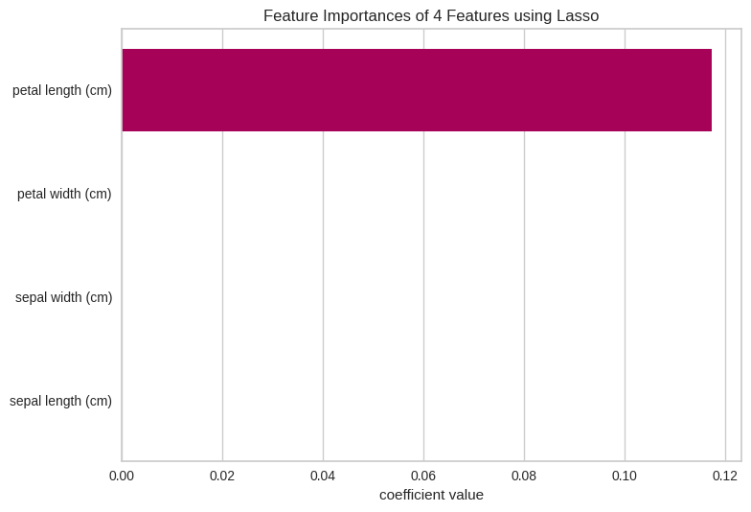
Lasso Feature Importance (Iris)
The lasso feature importance only shows
only one variable with a coefficient large
enough to even see on the visualization
That is petal length, which the lasso
feature importance measures as the most important numerical feature of the dataset

Slide 22
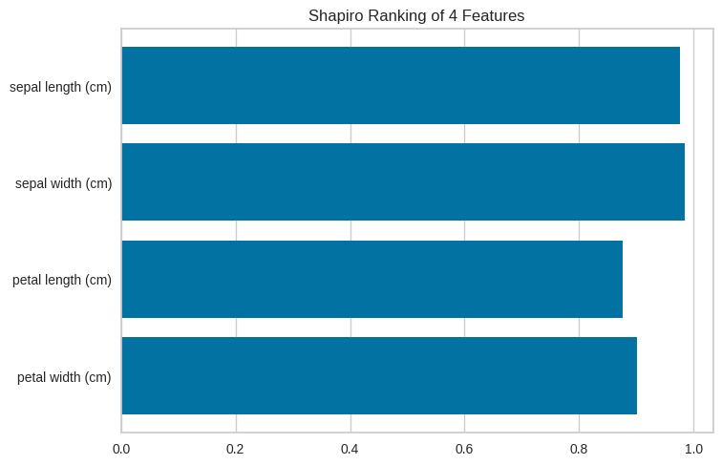
Shapiro Ranking (Iris)
The Shapiro Ranking measures the normality
of each of the features
It shows that all of them are very normal,
with the sepal length and width being the most

Slide 23
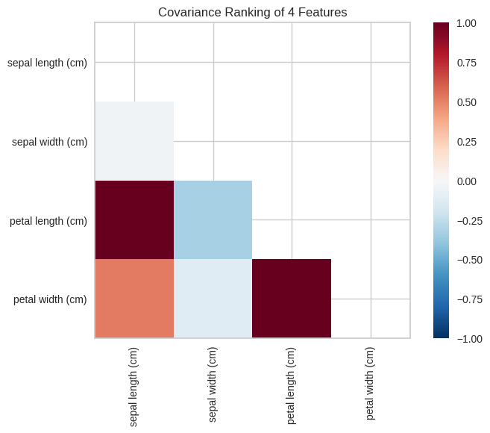
Covariance Ranking (Iris)
The covariance ranking shows that petal length has
two very strong positive correlations with petal width and
sepal width, further solidifying it as the most
important feature
Surprisingly sepal width and sepal length have a
coefficient of nearly zero and appear to be the least
correlated pair

Slide 24
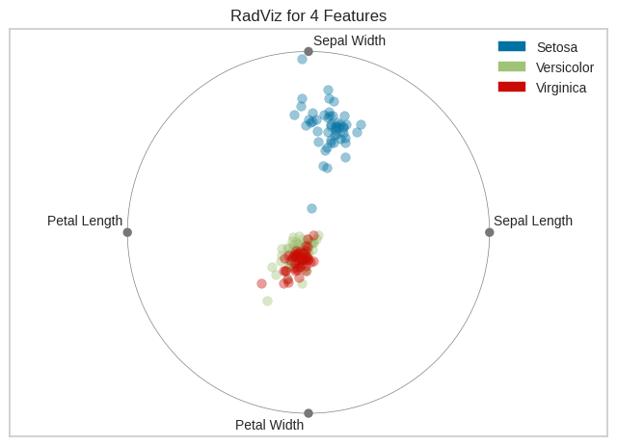
RadViz (Iris)
Similar to the PCP, the Versicolor and Virginia points are clustered together, with Setosa being on its own
There is only one Setosa point remotely close to the
points of the other 2 species, and they all settle
around the sepal width feature implying that for the
Setosa species, sepal width is a very prominent
feature

Slide 25
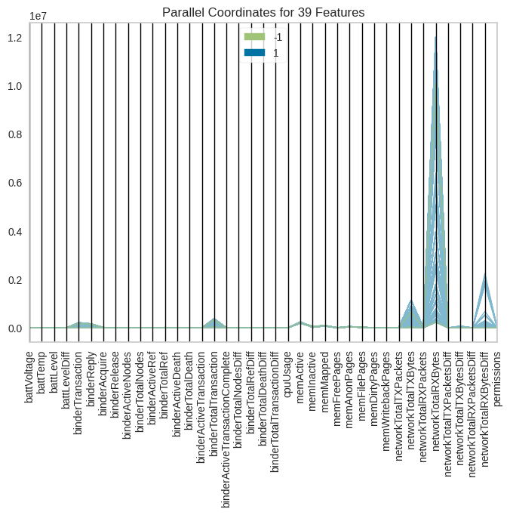
Parallel Coordinates (Cybersecurity)
For this dataset we categorize into
class with values -1 or 1
The parallel coordinates for this
dataset is much different than that
of the iris, due to much more features
being present
All of the features have values very
close to zero except that of
networkTotalRXBytes

Slide 26
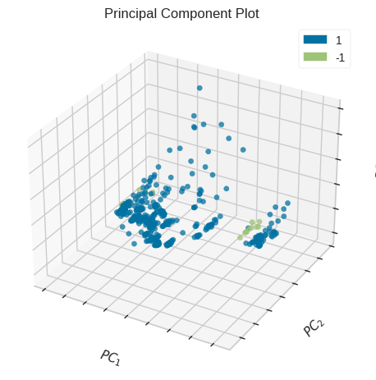
Principal Component Plot (Cybersecurity)
The points of the two clusters do not appear to relate
to each other at all with many variables and
separations among the features’ own points
There appears to be many outliers in both groups of
points, likely do to the high amount of features in this
dataset

Slide 27
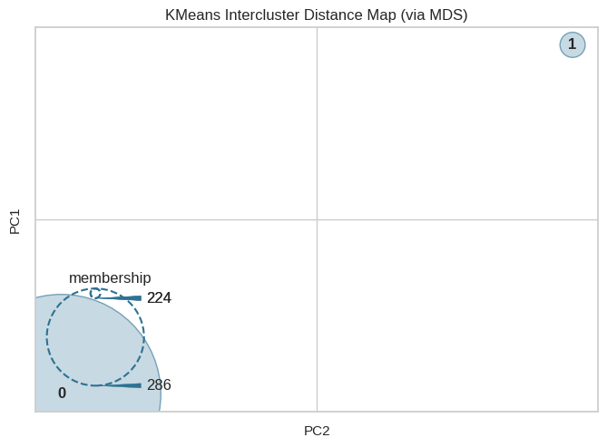
K-Means Intercluster Distance Map (Cybersecurity)
The two clusters for this dataset are very distinct,
each occupying opposite corners of the map
Cluster 0 has a much greater radius than that of
1, but cluster 1 is very dense and
doesn’t have much less points

Slide 28
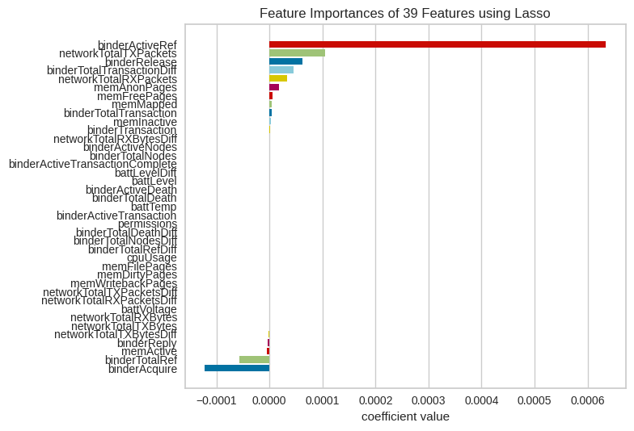
Lasso Feature Importance (Cybersecurity)
The coefficient values for the
features are small with it being high
dimensions
Notable features include
binderAquire, the most prominent
negative feature and binderActiveRef
which appears to be the most feature important overall

Slide 29
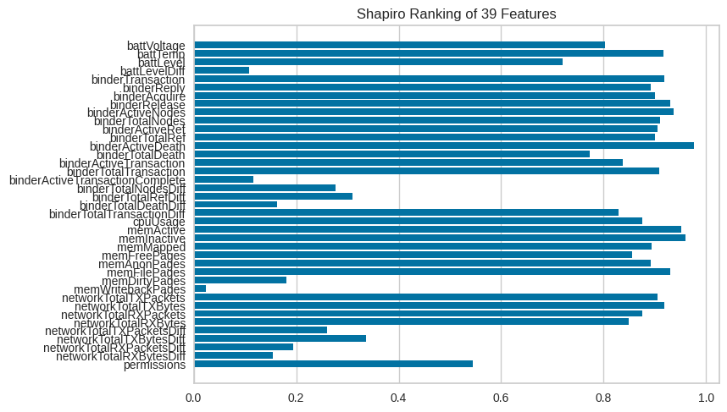
Shapiro Ranking (Cybersecurity)
The majority of the 39
Features appear to have
Good normality
However, the
memWritebackPages
variable has a very
low coefficient

Slide 30
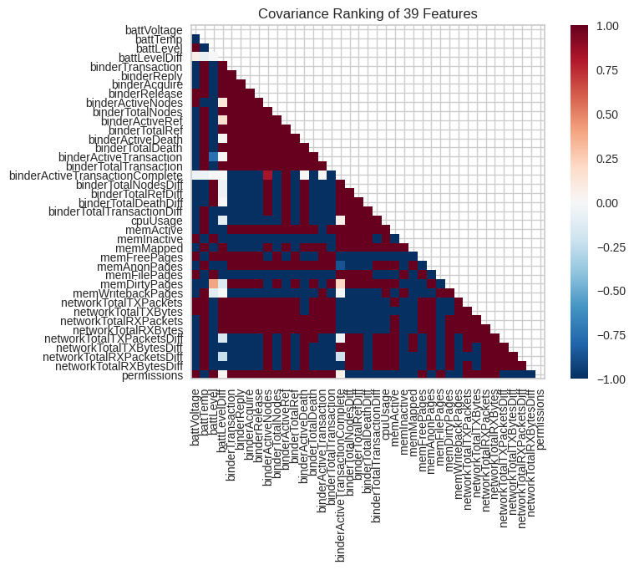
Covariance Ranking (Cybersecurity)
The features are very correlated to
each other here as seen by the dark
vibrant colors all over the
visualization

Slide 31
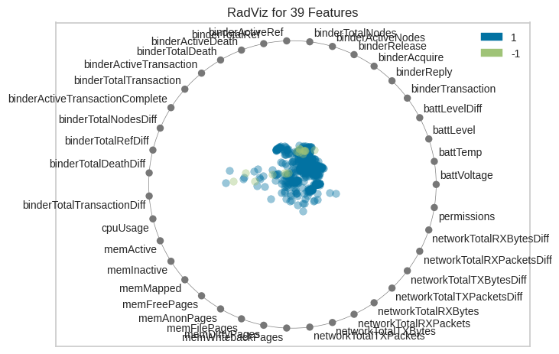
RadViz (Cybersecurity)
The RadViz map further illustrates the strong correlation of variables, with all of the points being a cluster in the center with very few deviating from it

Slide 32
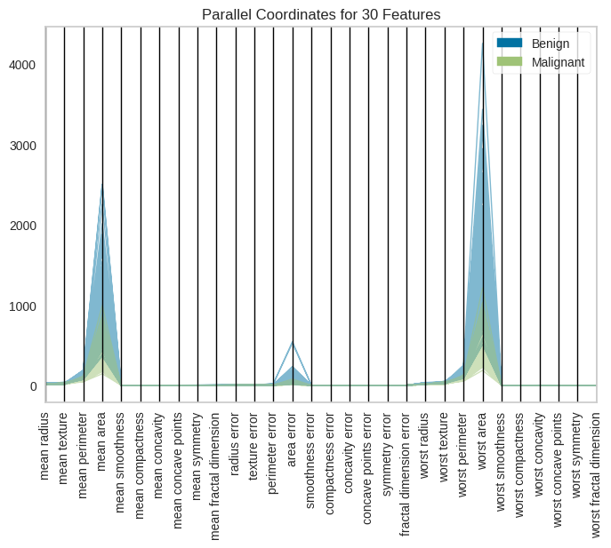
Parallel Coordinates (Wisconsin)
The parallel coordinates for the Wisconsin
breast cancer data classifies observations
as tumors being benign or malignant
The majority of variables have values close
to zero aside from the variables dealing with
the area of the breasts

Slide 33
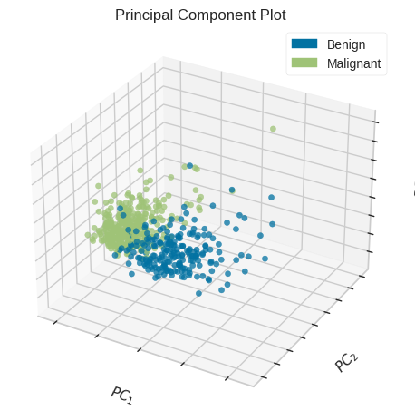
Principal Component Plot (Wisconsin)
The points here are divided into clusters with a large radius with few outliers in each
There is very little overlap

Slide 34
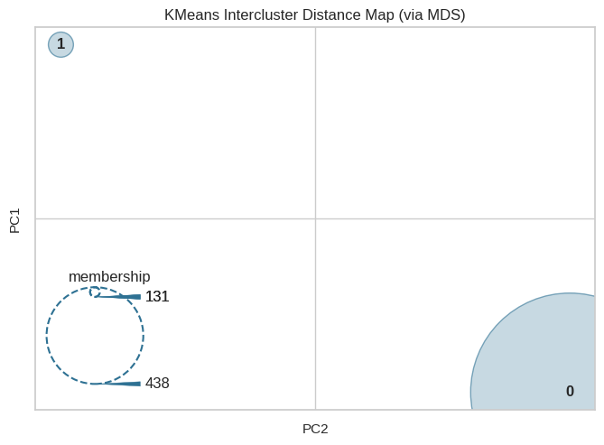
K-Means Intercluster Distance Map (Wisconsin)
The two clusters here once again are very far apart, occupying opposite corners of the map
Cluster 0 not only has a much larger radius but also has much more points, having about 3.5 times as many as cluster 1

Slide 35
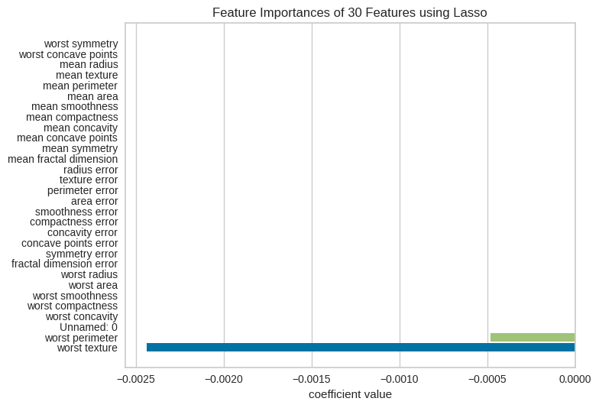
Lasso Feature Importance (Wisconsin)
The lasso feature importance illustrates
that the two most notable features of
worst perimeter and worst texture
have negative coefficient values
The coefficient values of each are very
close to zero

Slide 36
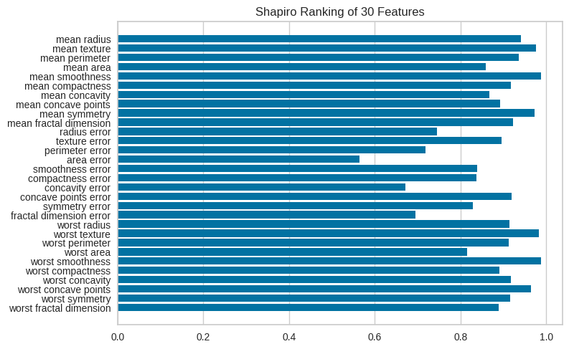
Shapiro Ranking (Wisconsin)
The Shapiro Ranking visualization
illustrates that the features all
appear to be somewhat normal with them
all having coefficients above 0.5

Slide 37
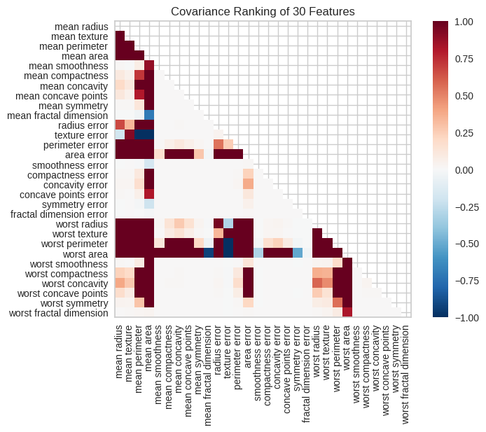
Covariance Ranking (Wisconsin)
The covariance ranking heatmap contains
much more pale squares than dark and
vibrant, illustrating that these variables
are not particularly too correlated with
each other
However, the variables involving measurements
such as ‘mean area’ or ‘worst perimeter’ are very strongly correlated with one another

Slide 38
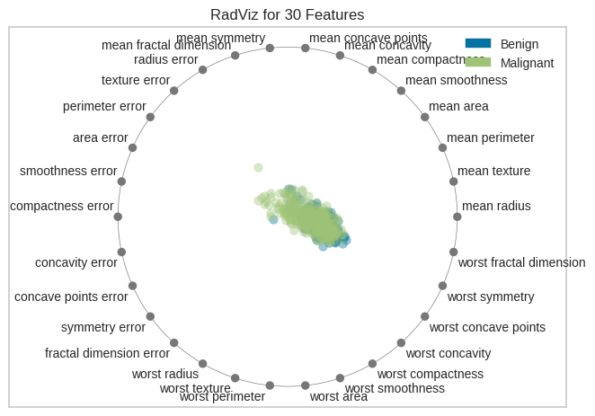
RadViz (Wisconsin)
The points of both benign and malignant tumor labels are both in compact clusters, very similar to each other here
There points start at the center and tend to deviate a little towards the ‘worst’ features
However this time, it is the worst features that
Have to do with shape rather than measurement

Slide 39
HFT Wrangling
Before starting our visualizations on the HFT dataset, we set the marketChangeOverTime as our target variable
We do this by categorizing the observation as increase, decrease, or no change based on its value being greater than, less than, or equal to zero

Slide 40
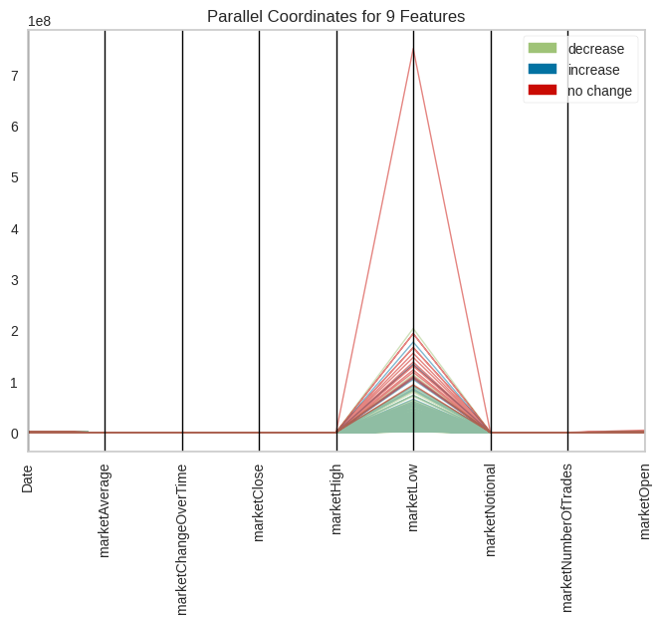
Parallel Coordinates (HFT)
All of the features here have values very
close to zero except for MarketLow, which
contains some values from 0 up to 2, with a
singular outlier of 7 in the no change class

Slide 41
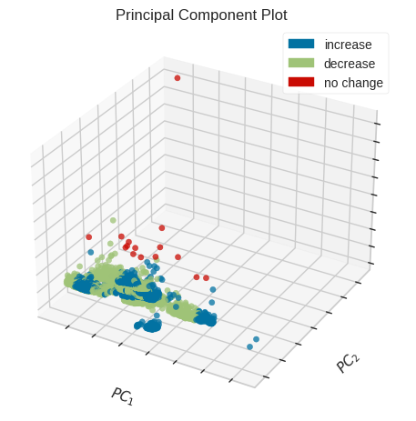
Principal Component Plot (HFT)
The increase and decrease classes have long and
overlapping clusters, with the increase class having 2
visible outliers
The no change class has much less points
with a cluster that isn’t very compact and has the
most visible outlier, like the same one seen in the parallel coordinates

Slide 42
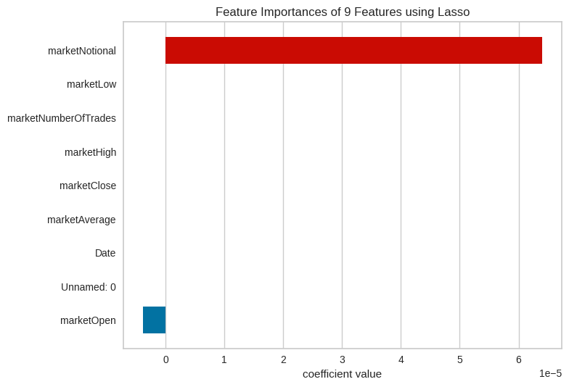
Lasso Feature Importance (HFT)
Only two variables are visible on the lasso
Visualization; marketNational and
marketOpen
MarketOpen has a decently sized negative
coefficient, but marketNational has an
abnormally large coefficient, by far the largest we’ve seen in our analysis

Slide 43
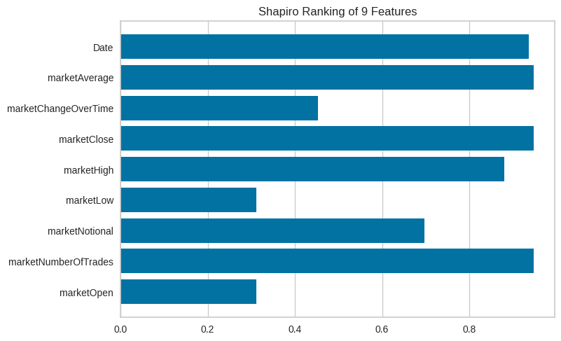
Shapiro Ranking (HFT)
Most of the features are relatively normal according to the Shapiro ranking
This is aside from marketLow and marketOpen
marketLow’s low coefficient is likely due to its very visible outlier seen in the parallel coordinates

Slide 44
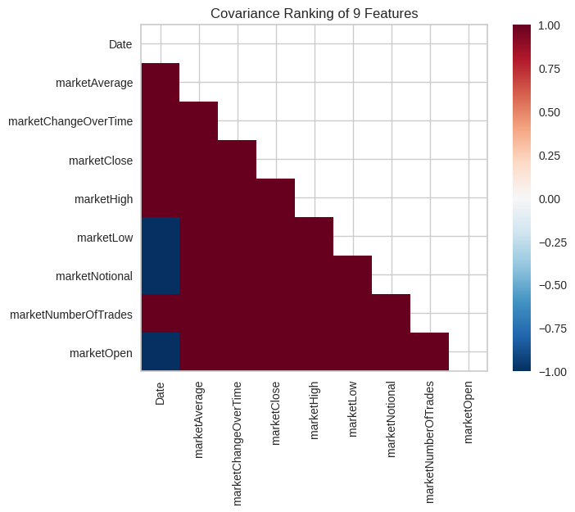
Covariance Ranking (HFT)
Every single square on the heatmap is dark and vibrant, all but 3 of them being dark red, implying strong positive correlation among features
The Date feature is strongly negatively correlated with the marketLow, marketNational, and marketOpen variables

Slide 45
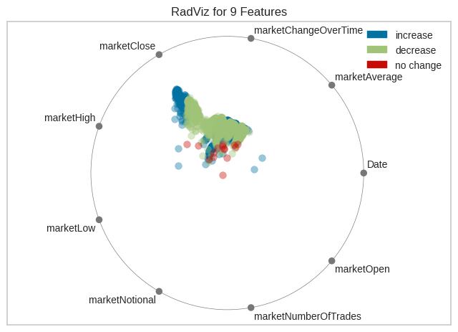
RadViz (HFT)
The few no change points are clustered near the center
The increase and decrease are both clustered on top of each other right near the marketHigh and marketClose variables, likely the two most correlated with each other

Slide 46
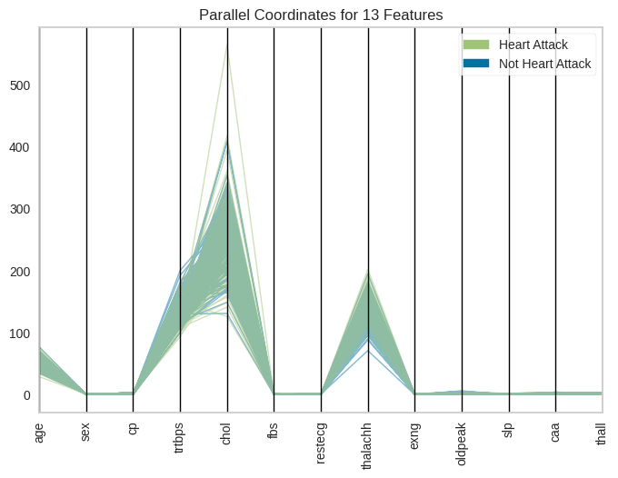
Parallel Coordinates (Heart)
Separating into classes Heart Attack
not Heart Attack, the parallel coordinates
here have several different values above zero
These are age, trtbps, chol, and thalchh, which
all make sense, given the context of the dataset
There is a visible outlier with a coordinate of a person in the heart attack class having a very high cholesterol above 500

Slide 47
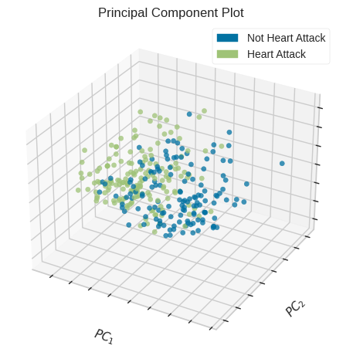
Principal Component Plot (Heart)
As we’ve seen from most of the other PCPs, there is once again visible overlap within the clusters
However, here they are not as clumped together and more of the points are visible
All the points themselves appear to form one big cluster with few outliers

Slide 48
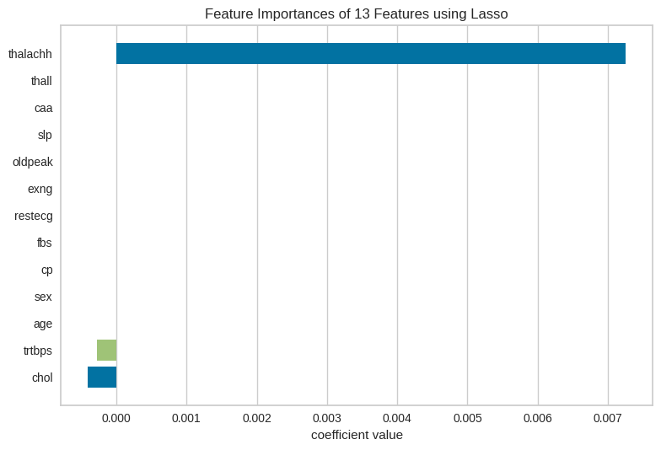
Lasso Feature Importance (Heart)
The most important variable with the largest coefficient is thalachh, which is the maximum heart rate achieved
Trtbps, the resting blood pressure and cholesterol are the other two appearing visible here with negative coefficients

Slide 49
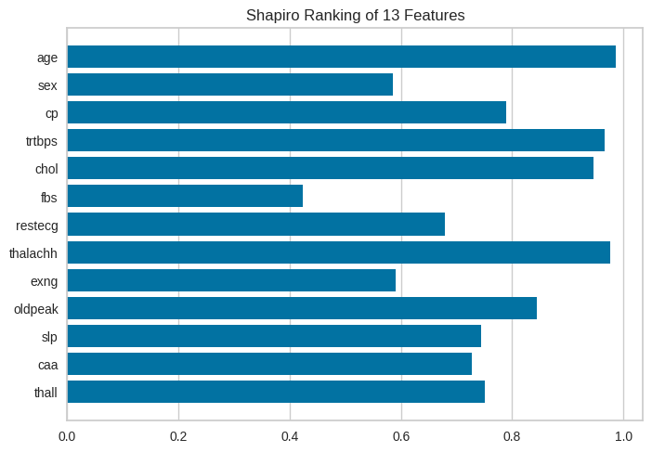
Shapiro Ranking (Heart)
Nearly all of the features appear to have good normality here, even cholesterol despite having a noticeable outlier
Fbs is an outlier (fasting blood sugar variable) that has the lowest coefficient of normality according to the Shapiro Ranking

Slide 50
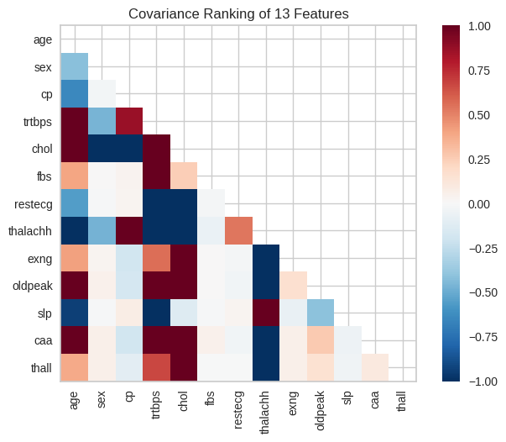
Covariance Ranking (Heart)
The features for the most part appear to be strongly correlated with one another
Cholesterol, trtbps, and thalachh are very correlated with each other and also relatively strongly correlated with the other variables as well as suggested by the lasso importance
thalachh has strong negative correlation with
the others aside from slp or slope

Slide 51
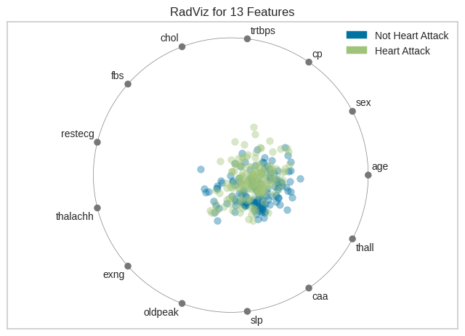
RadViz (Heart)
The points here are clustered together for the most part similar to the principal component plot
The distribution is pretty centered with a few of the Non Heart Attack points settling around the bottom right features, caa and thall which are the number of major vessels and thalium stress test result respectively

Slide 52
Yellowbrick Conclusions
The cybersecurity and HFT datasets appear to have the most correlation among their independent variables, whether positive or negative
All of the datasets had mostly normal features generally
The clusters in the intercluster distance maps showed that the clusters were very far apart, with clusters of varying radius and density
The iris and cybersecurity data both had a small cluster with a great density
The clusters on the principal component plots had some overlap and outliers

Slide 53
Conclusion
Using Yellowbrick we were able to visualize a multitude of different datasets
These visualizations help to explain and back up our clustering results from all the various normalization types

Slide 54
Thank You!

