Slide 1
Exploring Classification and Parameters
By: Devin Duran

Slide 2
Objectives
Part 1: Compare and observe classification methods of SVM and Random Forests under different normalization methods and parameters for the credit simulate dataset
Part 2: Implement several models such as DNN, kNN, random forests, gradient boosting, and extra tree to predict implied volatilities for Yahoo Finance data. I will then compute the MSE for the test data of each model.
The goal is to see which kinds of models are best at classifying financial data, which is what both analyses will be on

Slide 3

Part 1 - Credit Risk Analytics via Machine learning

Slide 4
Overview
I have a dataset called 'credit_data_simulate' which contains credit ranking for 12 different industry sectors.
The credit is classified as either good credit (AAA, AA, or AA) or bad credit (CCC). The good credit is labeled as 1 in the dataset while the bad credit is labeled as 1.
There are 1540 observations of this data labeled as good credit and 130 labeled as bad credit along with 7 total features.
I will run SVM with different kernels, including a custom kernel and random forests with different estimator counts
I will visualize a confusion matrix and calculate metrics and d-index of each method.

Slide 5
Data Import, Cleansing and Training
I start by importing the dataset and any packages needed for the analysis
I set the data and target variables, X and y with ‘Credit Status’ being the target
I drop all missing values and split our data into 80% training and 20% testing data

Slide 6
Normalizers
I use four different normalization methods on the data and observe how each method affects each model
I use:
StandardScaler: transforms data to have a mean of 0 and standard deviation of 1
MinMax: puts data in a range of 0 and 1 where the minimum value of the pre-scaled data is 0 and the maximum pre-scaled value is 1
Robust Scaler: subtracts the median and divides by the interquartile range
MaxAbs: divides each data point by the maximum absolute value of its respective feature
I create a dictionary with all of these methods that will be iterated over to get our metrics and matrix

Slide 7
Models and Parameters
Two different models with various parameters are ran in this analysis:
SVM - separates observations by constructing a hyperplane in high dimensional space
Random Forests - generates a ‘forest’ of decision trees and combines them to avoid overfitting and get better results
For our SVM the following kernels are used:
Linear: creates a straight line decision boundary to separate classes; default kernel, best to use when data is linear
RBF: places a radial basis function centered at each point, then perform linear manipulations to map points to higher-dimensional spaces that are easier to separate
Poly: represents the similarity of vectors in a feature space over polynomials of the original variables, allowing learning of non-linear models
Cosine: a similarity measure that can compare vectors in high dimensional space
Sigmoid: controls the influence of each individual training sample on the decision boundary and is the bias term shifting the data up or down
A custom kernel that I create
For random forests, the parameter of the amount of estimators is changed either using 10, 50, or 100 estimators
A dictionary is created with each model for each parameter, to be iterated

Slide 8
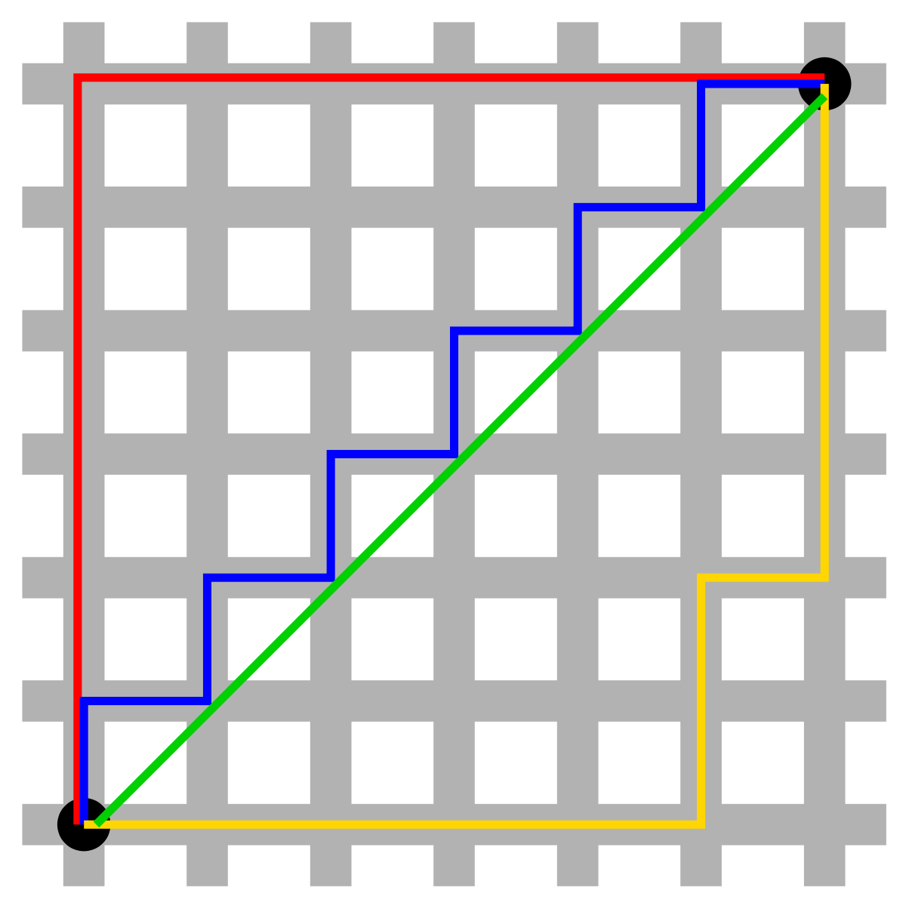
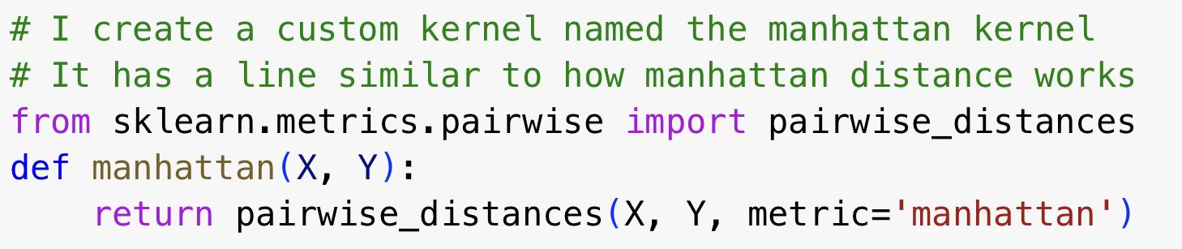
Custom Kernel - Manhattan Kernel
Using this function with pairwise distance, I create a function that will serve as the customized Manhattan kernel

Slide 9
Models and Metrics
For each of the models, I compute and visualize a confusion matrix of the predicted data compared to the testing data
I also calculate the accuracy, precision, recall, f1-score, and d-index of each model under each normalization

Slide 10
Diagnostic Index
The diagnostic index or d-index is a measure of classification performance combining sensitivity (true positive rate) and specificity (true negative rate)
d_index is convenient for comparing ML results, and is also an effective measure to reflect the true ML status in imbalanced learning
Its formula is given by d = log₂(1 + accuracy) + log₂(1 + (sensitivity + specificity)/2)
The value of d-index can be anywhere between 1.33 and 2; if it reaches 1.8, then it is a good score
A d-index less than 1.8 generally means “chance level” classification
A d-index can sometimes be less than 1 in special cases; this means that classification is very poor

Slide 11
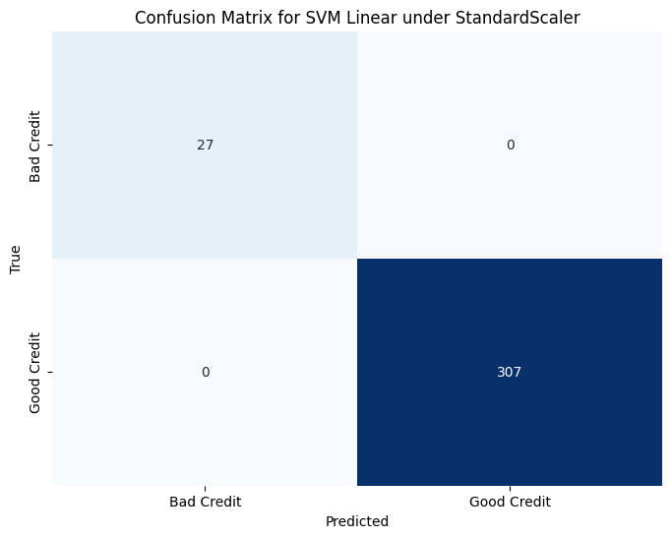

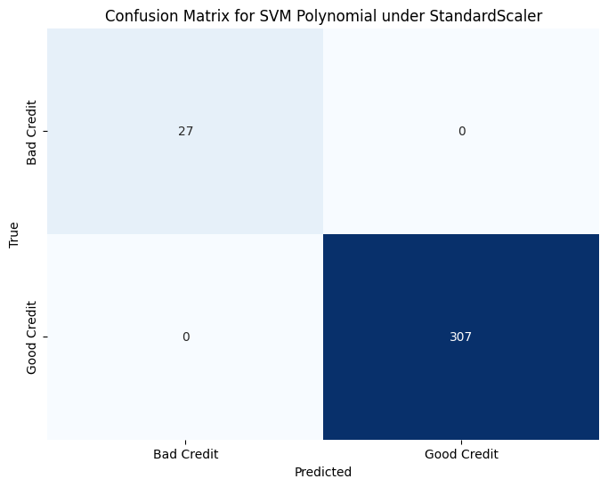
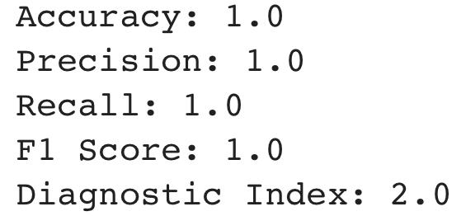
SVM Kernels - Standard Scaler

Slide 12
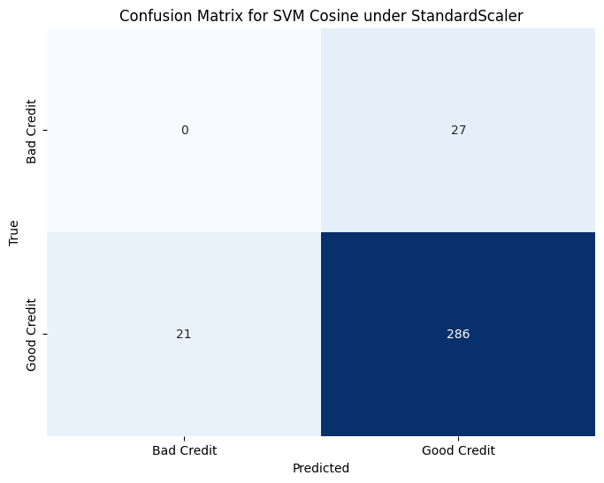
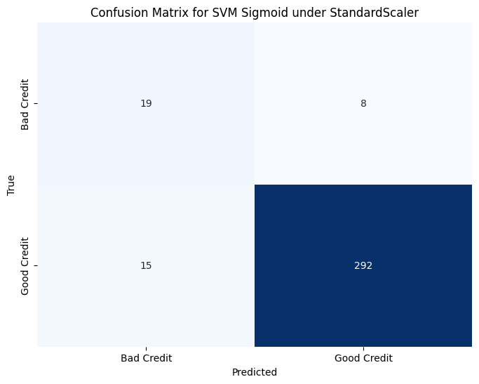
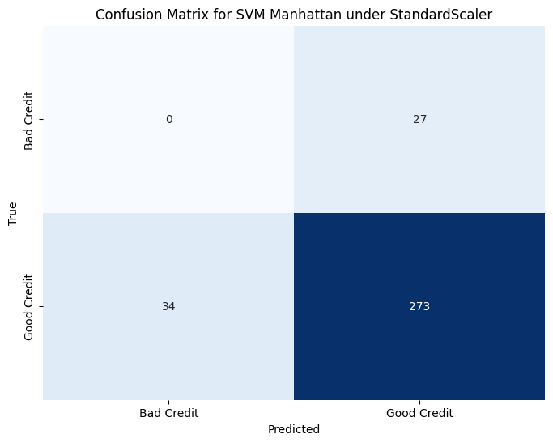
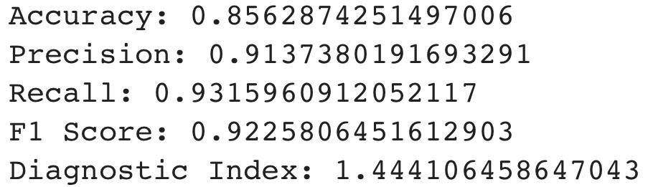
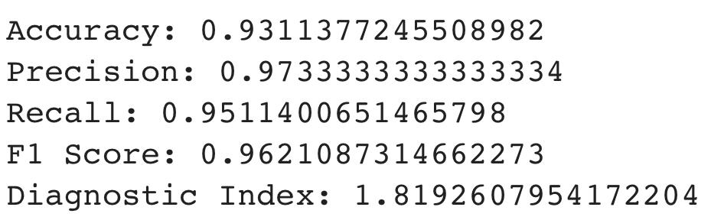
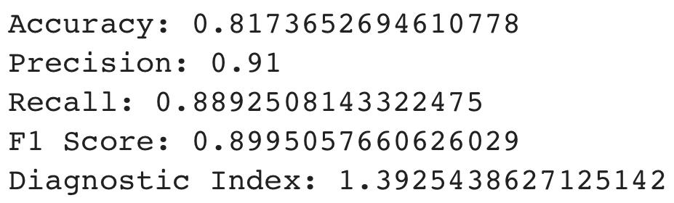
SVM Kernels - Standard Scaler

Slide 13



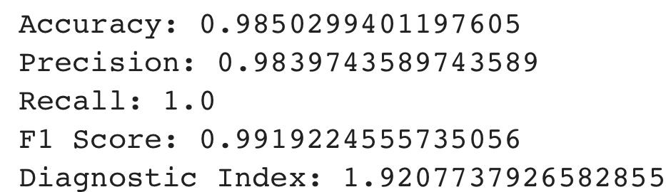
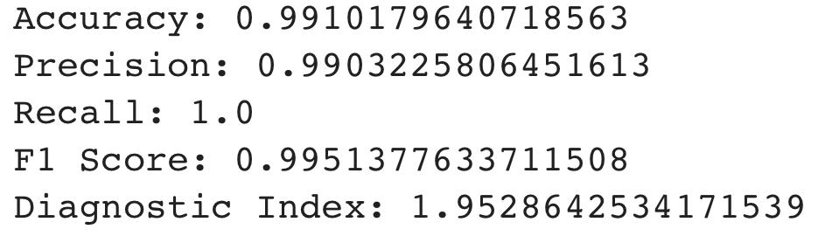
SVM Kernels - MinMax Scaler

Slide 14



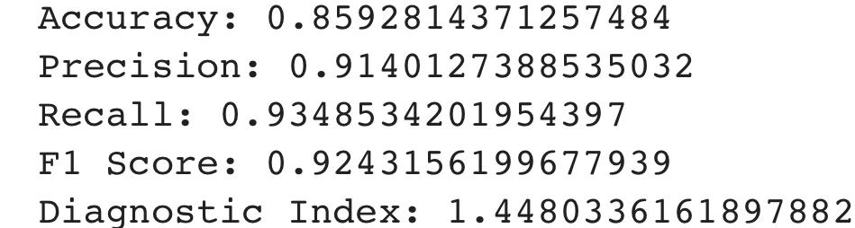
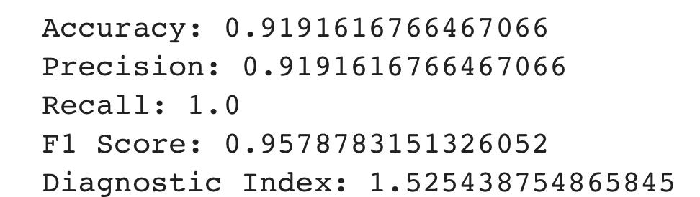
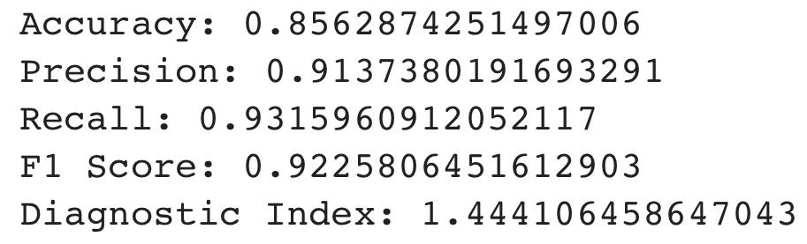
SVM Kernels - MinMax Scaler

Slide 15



SVM Kernels - Robust Scaler

Slide 16
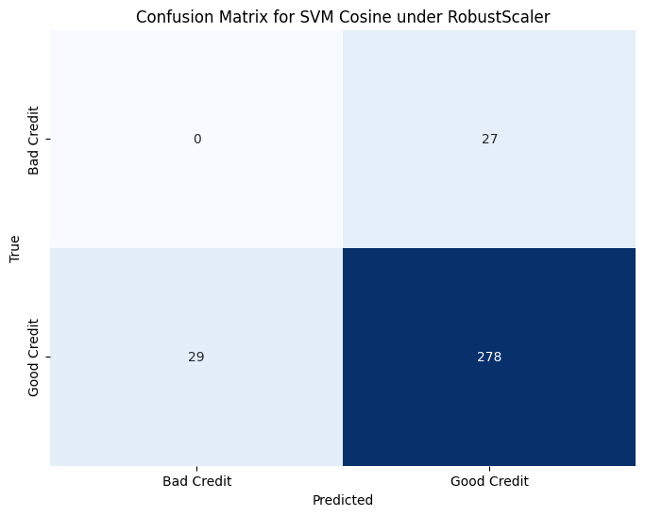


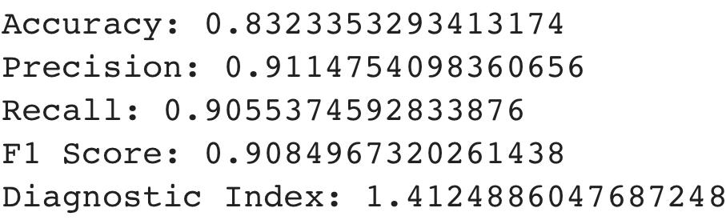
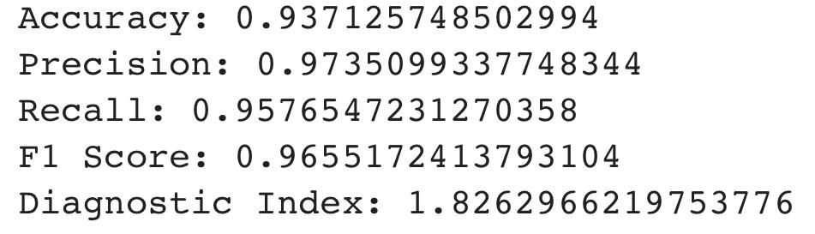
SVM Kernels - Robust Scaler

Slide 17


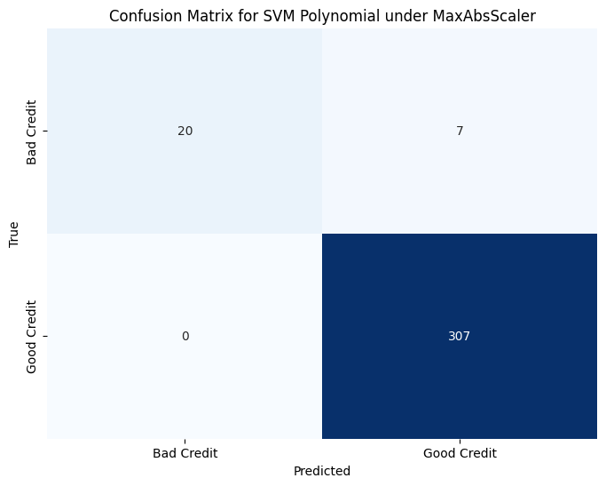
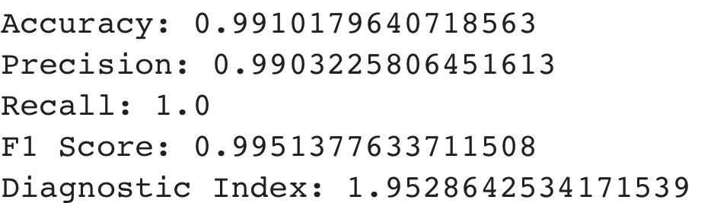
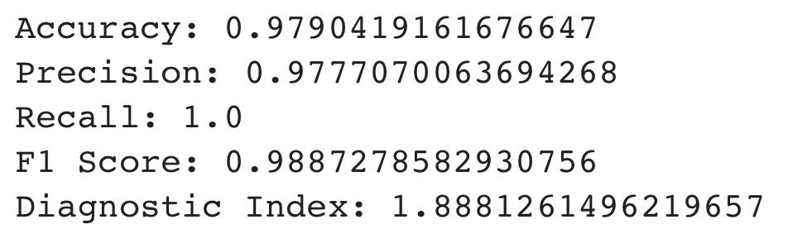
SVM Kernels - MaxAbs Scaler

Slide 18



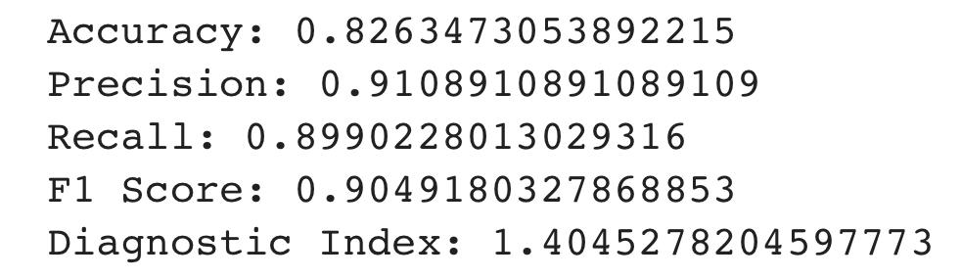
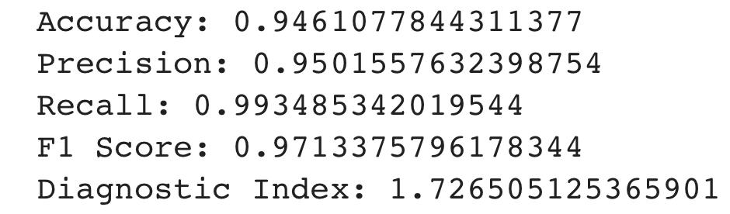
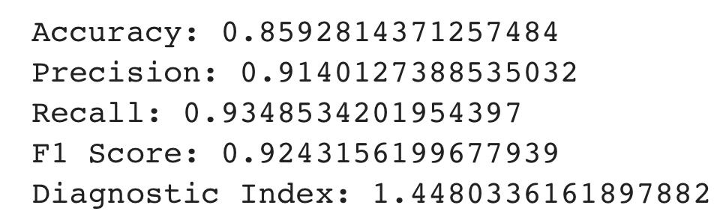
SVM Kernels - MaxAbs Scaler

Slide 19



Random Forests - Standard Scaler

Slide 20



Random Forests - MinMax Scaler

Slide 21



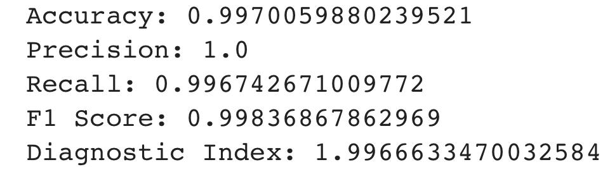
Random Forests - Robust Scaler

Slide 22



Random Forests - MaxAbs Scaler

Slide 23
Observations
The cosine, sigmoid, and manhattan kernels returned the worst D-index and metrics for all of the normalization methods
These models were especially bad when it came to predicting bad credit
Some of them had 0 correct bad credit predictions, but actually predicted that people with good credit had bad credit
This is not good at all, as falsely telling someone they have bad credit can lead to them panicking and even can result in a lawsuit
The other three kernels for SVM, linear, rbf and poly all performed relatively well, with them having perfect metrics for the majority of the normalizations, especially the RBF and Polynomial kernels

Slide 24
Observations and Conclusions
For the SVMs, RobustScaler appeared to be the overall best normalization method to use
The Random Forest models however, performed VERY well in this analysis
The only misclassification made by a random forest model was a false negative using RobustScaler and 10 estimators
From the analysis, it is safe to assume that random forests is the better technique, regardless of normalization method
The model with 50 estimators would be the one to choose, as it is less complex than the one with 100 estimators, but still returns perfect classification metrics

Slide 25

Part 2 - Option Data

Slide 26
Overview
For the next analysis, a dataset with 12110 options retrieved from Yahoo Finance in June of 2017 will be used
The option to call or put are denoted as 0 and 1 respectively in the 'option_type' variable
Several models such as DNN, kNN, random forests, gradient boosting, and extra tree will be implemented to predict implied volatilities for the data. I will then compute the MSE for the test data of each model and compare them

Slide 27
Data Import and Cleansing
I start by importing the packages needed for the analysis and loading the dataset
Then, I extract features and target variable which is implied volatility
Since it is numerical, we do not need to use LabelEncoder
The data and target are set to X and y, before being split into 80% training and 20% testing
The data is then normalized using StandardScaler

Slide 28
Models
The models used for this analysis were:
DNN - processes, clusters, and classifies unstructured data; very deep-learning model
KNN - classifies the data point on how its neighbor is classified
Random Forests - generates a ‘forest’ of decision trees and combines them to avoid overfitting and get better results
Gradient Boosting - relies on prior weaker models to produce a stronger one to reduce error
Extra Tree - creates many decision trees, but the sampling for each tree is random, without replacement
A dictionary of these models will be created which will be iterated over to calculate MSE and visualize scatterplots for each

Slide 29
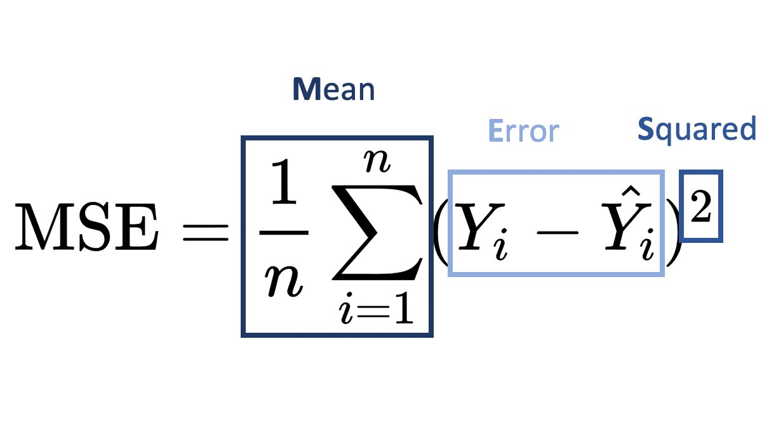
Mean Squared Error (MSE)
Mean Squared Error or MSE is the average squared difference between the estimated values and the actual value
MSE is a risk function, corresponding to the expected value of the squared error loss

Slide 30
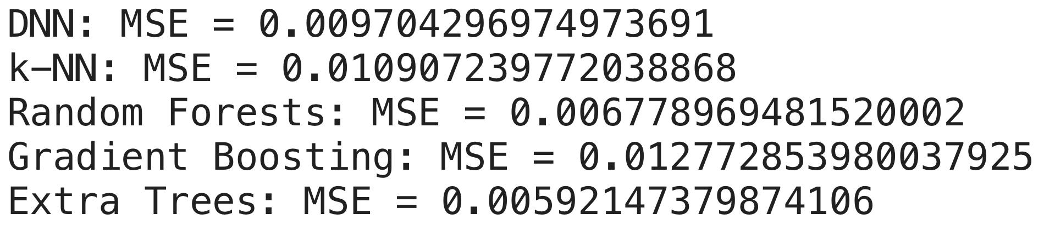
MSE Results

Slide 31
Scatterplots
After seeing the numerical values of our metrics, I wanted to plot scatterplots to visualize the relationship between the predicted points and the actual points for each model
A perfect model will have the points in a thin diagonal line from the origin with a slope of 1
The more the visualizations look correlated, the smaller the MSE likely is

Slide 32
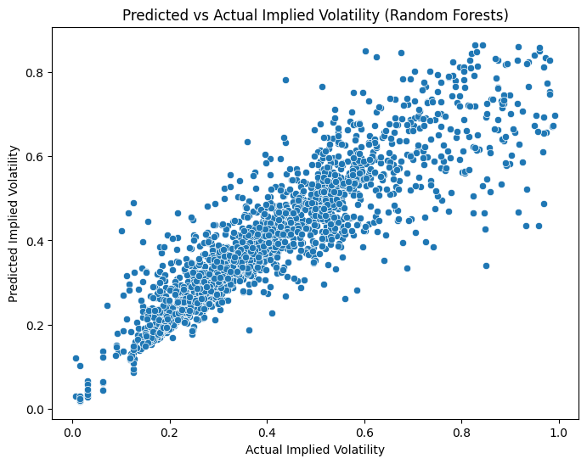
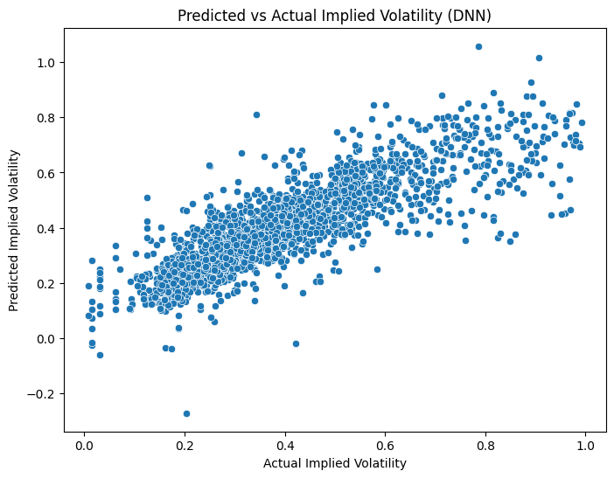
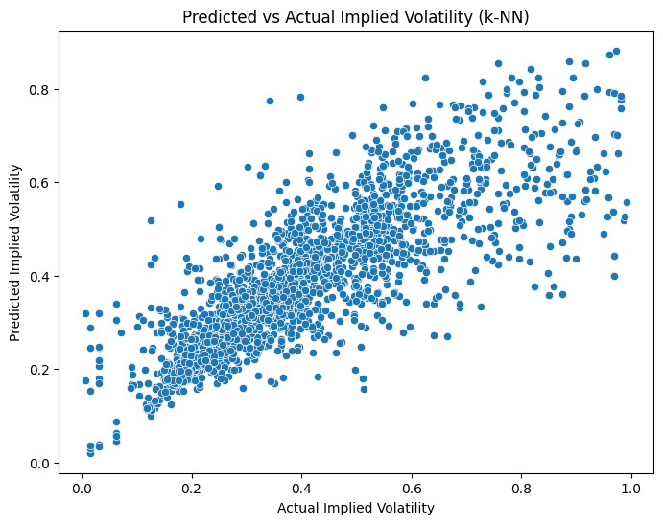
Scatterplots

Slide 33
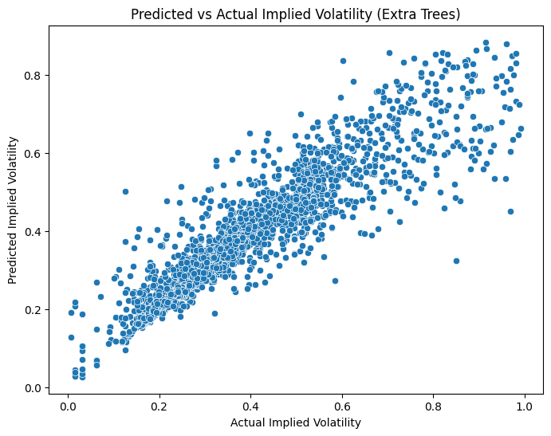
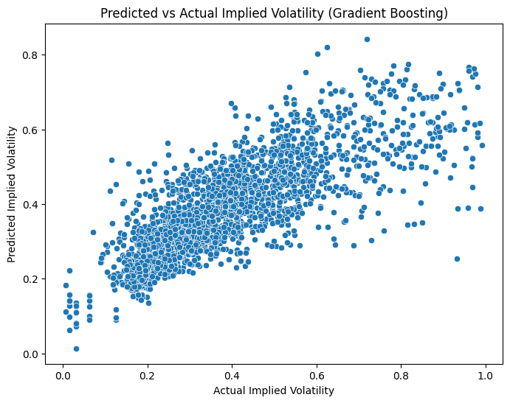
Scatterplots

Slide 34
Observations
Because the implied volatility has a range of 0 and 1, our MSE values are obviously going to be very small
That is why I made the scatterplots, to essentially show a ratio of how the points relate and how correlated they are
All of the models had an MSE below 0.02 with DNN, Random Forests, and Extra Trees having one below 0.01, Extra Trees having the lowest
The scatterplots illustrate that the models are pretty solid, with most of the points following the diagonal line with slope 1 and y-intercept 0
It is still possible for a model to be poor despite having small MSE; for example if all the values of the target are very small, but that does not appear to be the case here

Slide 35
Final Conclusions
The normalizations did not play as much of a role on classification results as the models themselves did
For our first analysis, the RBF and Polynomial kernels performed the best, illustrating the fact that the data was not perfectly linear but still continuous rather than categorical as it is finance data
The custom manhattan kernel did not work at all, returning too many false negatives, which is not good for a credit company when trying to predict credit scores
The models for the option data all seemed to predict implied volatility relatively well with miniscule MSE, even for data in a 0-1 range
Random Forests performed great in both analyses, returning perfect metrics aside from a SINGULAR misclassification in the first analysis and having a very small MSE in the option data analysis
It can be concluded that it was the best model all around here, with 50 being an ideal estimator count, and that Random Forests will typically perform well for financial data

