Slide 1
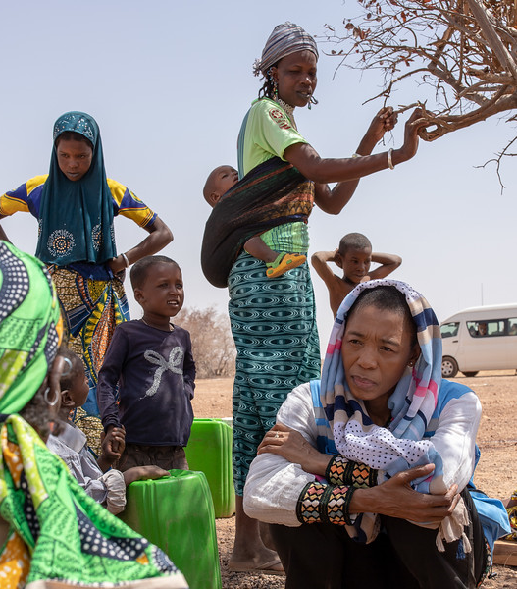
Breaking the financing silos to leave no one behind
Metsi Makhetha United Nations Resident Coordinator, Burkina Faso

Slide 2

Context
Population of 19.6 m: 70% in rural areas; 70% below 35 yrs; 52% women
Persistent poverty (40%) & geographic inequalities, despite steady economic growth (average 5%) the last decade
Land degradation, loss of biodiversity, burden on women and girls
Fragile zones with food & nutrition insecurity, and exposure to climate hazards
Limited institutional capacities
… and growing insecurity, vulnerability & risks
Violent attacks & radicalisation (initially Sahel region & expanded to new regions)
Cross-border challenges (Mali/Niger) and recently Togo, Ghana and Benin
Vision statement
« Building, with the people, a Burkina Faso of democracy, social and economic progress, freedom and justice »
Translated into
National Economic Social Development Plan 2016–2020

Slide 3

The Prevention Imperative & Sustainable Development
Guiding Frameworks
SDG-aligned National Plan (2016–2020)
SDGs & 2030 Agenda - “Reach the furthest behind” & “leave no one behind”.
Sustaining Peace – Prevent relapse, reduce risk, consolidate gains & sustain engagement towards the SDGs.
End humanitarian needs and strengthen preparedness to natural hazards (WHS and Sendai Frameworks)

Slide 4
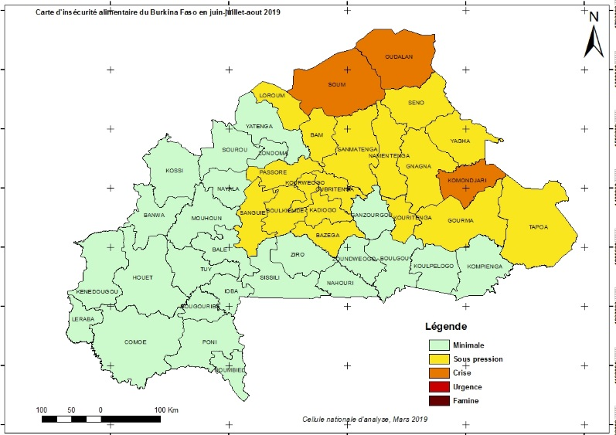
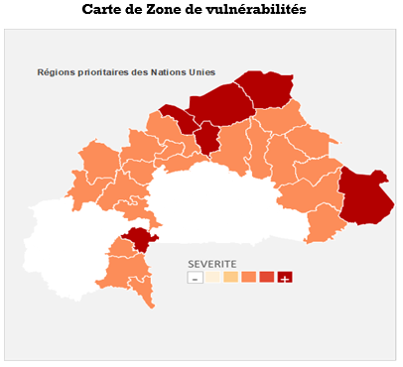
Operationalising Coherence: Case of Sahel Band Burkina Faso
Continued deterioration of the security situation in Sahel Band of Burkina (150k displaced populations)
Growing inter-community tensions
Deterioration of the food & nutrition security situation (Low rainfall and insecurity in the Sahel) – 687,000 people in emergency including 25,539 in IPC4 – March 2019
Weak institutional and community coping capacities – Burkina ranks 5.1 out of 10 in fragility according to risk INFORM.
Social Cohesion & Sustaining Peace → fundamental to advance towards SDGs – SDG 2 cannot be achieved on its own. Requires multisector response
CCA, September 2017

Slide 5
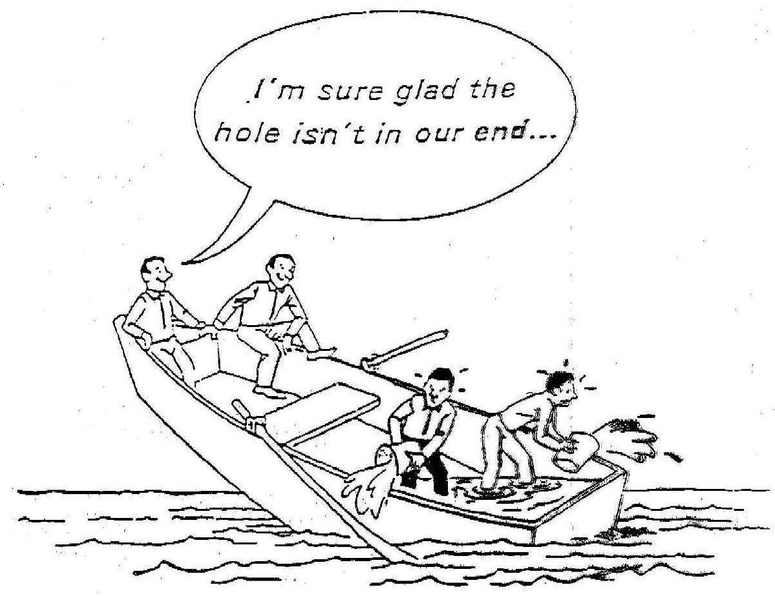

Slide 6
Approach to coherence financing

Slide 7


Collective outcomes stemming from the joint analyses
Food security: By 2020, to reduce by 50% the number of people in phase 3 of food insecurity and reach 0% of people in phase 4 and 5 of food insecurity
Peace and security: By 2020, a 50% reduction of perception of risk and conflicts by general population
Nutrition: By 2020, to reduce by 30% the rate of chronic malnutrition among children 0–5 years
Climate induced hazards: By 2020, to reduce to less than 1% the number of households vulnerable to climate shocks and increase by 50% the number of institutions with capacities for disaster risk reduction
By 2020, reduce the prevalence of multidimensional poverty to less than 35%

Slide 8
Burkina Faso, encouraging examples in food security & nutrition sectors
ECHO/DEVCO
USAID
UN (CERF)
World Bank – IDA18
Govt
Joint financing for lean season
Encouraging results
Notes:
Zones non accessibles, zone pauvre en grand besoin d’aide

Slide 9
We cannot solve our problems with the same thinking (& structures) we used when we created them.
Albert Einstein
Notes:
New mindset, new way of interacting/working - shared understanding and collective responsibilities.

