Slide 1
What do emerging trends in development finance mean for crisis actors?
May 2019

Slide 2
Rob Tew and Cecilia Caio
Development Initiatives
Notes:
Hi everyone, this is Cecilia.
For those of you who are not familiar with the development financing landscape, I’ll take you through the key policy processes and stakeholders, skimming the surface of the background document that was shared ahead of the webinar. You can find a link to this in the email you should have received an hour ago, so please do refer to that for more detail.
For those of you who are familiar with all of this, please bear with us, as we’ll quickly be moving on to the findings from our analysis.

Slide 3
Development finance policy
Key global policy frameworks
The 2030 Agenda for Sustainable Development
The High-level Political Forum (HLPF) on Sustainable Development
The Addis Ababa Action Agenda
Forum on Financing for Development (FfD)
The Global Partnership for Effective Development Cooperation (GPEDC)
Stockholm Declaration
Notes:
There are three overarching frameworks around which development financing policies are organised.
(On the slide, you can also see some of the follow-up processes related to these).
So, the first framework is the goal framework, which provides overall guidance related to what all actors involved in development finance are seeking to achieve.
This is the 2030 Agenda for Sustainable Development, which was agreed in September 2015 and which highlights the role and responsibility of all actors – public and private, domestic and international – to deliver on the 17 Sustainable Development Goals and the underlying principle to Leave No One Behind.
The second framework is the financing framework which sets out the means to achieve the collective goals set out in the 2030 Agenda.
The Addis Ababa Action Agenda is the guiding document for this. Agreed in July 2015 at the Third International Conference on Financing for Development, it highlights the role of different sources of finance, as well as systemic issues that need to be addressed.
The third framework is the effectiveness framework. This relates to how all actors can best work together to deliver on collective goals.
It was formally established in 2011 when the Global Partnership for Effective Development Cooperation was set up to boost the international community’s efforts toward development.
The work of the GPEDC includes, among other things, monitoring progress against four key effectiveness principles and adapting them to new forms of development cooperation, such as private sector engagement.
Lastly, the fourth framework is the Stockholm Declaration. This renews the commitment of the international community to the New Deal for Engagement in Fragile States, which represents an action plan and guide for how to prioritise investment in peacebuilding and state-building in fragile environments.
The Stockholm Declaration outlines what signatories must do to revive commitment to the New Deal and take it to the next level to Leave No One Behind and achieve the SDGs, particularly in fragile and conflict-affected settings.

Slide 4
Key stakeholders
Stakeholder category | Examples
Bilateral donors | DFID, SIDA
Civil society – international and national/local NGOs and CSOs | Oxfam, Conservation International
Development Finance Institutions and Multilateral Development Banks | African Development Bank, CDC, PROPARCO, WB
Foundations | Bill and Melinda Gates Foundation
Multilateral Institutions | IMF, UN
Partner country governments | Burkina Faso
Platforms and networks | Convergence (blended finance knowledge platform), Southern Voice (think tank network)
Private sector – both financial (commercial banks and investors) and non-financial (businesses such as SMEs and MNCs) | Financial: Aviva, Standard Chartered Bank Non-financial: Danone
Standard setting organisations | OECD, UN
Think tanks | Centre for Global Development, ODI
Notes:
Key stakeholders in development financing can be grouped into three broad categories.
Firstly, providers of assistance; secondly, implementers; and finally, and influencers and/or providers of evidence and policy advice.
Stakeholders are not always easily assigned to these categories, particularly as there are overlaps between the three.
For illustration purposes, this slide lists actors by narrower categories.
Examples of providers of development assistance include bilateral donors, foundations, DFIs and multilateral institutions.
These actors can also act as implementers, alongside others such as governments in partner countries and NGOs.
Examples of influencers and/or providers of evidence include think tanks and platforms.
In addition, there are standard setting institutions such as the UN and the OECD.
And recently, the private sector has been playing a more substantial role in development financing, acting across the categories of providers and implementers.
Now, on to the findings from our analysis.

Slide 5
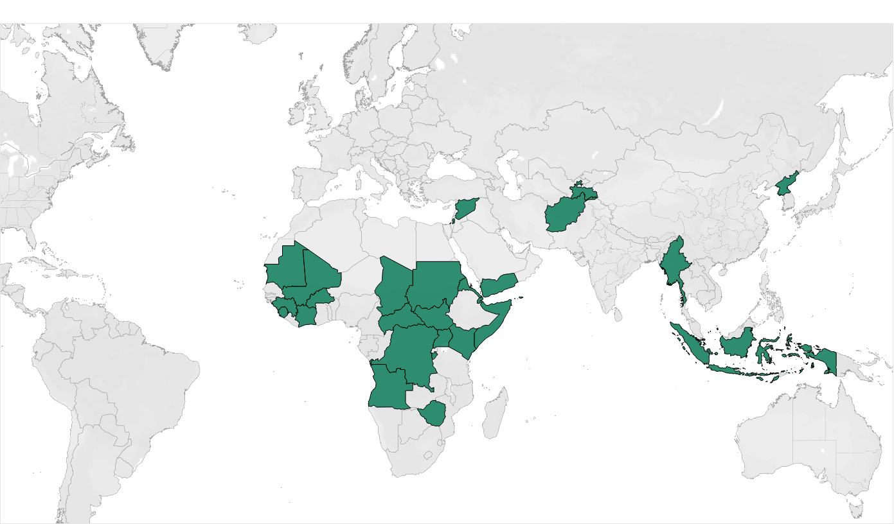
Countries in protracted crisis
Source: Development Initiatives based on OECD and UN-OCHA data
Notes:
Our analysis focused on a group of ‘countries in protracted crisis’ - which we’ve termed ‘protracted crisis countries’ or ‘PCCs’ for short.
These are countries which have had at least 5 consecutive years of humanitarian response plans at any point between the years 2000 and 2017 (with 2017 being the latest year for which we have country-level development finance data).
We are focusing on protracted crises in particular as it’s in these contexts that humanitarian, development and peace actors are most likely to interconnect in practice.
There are 27 protracted crisis countries – some of which have not been the subject of humanitarian response plans for a number of years, and others which have had humanitarian response plans for almost every year since 2000.

Slide 6
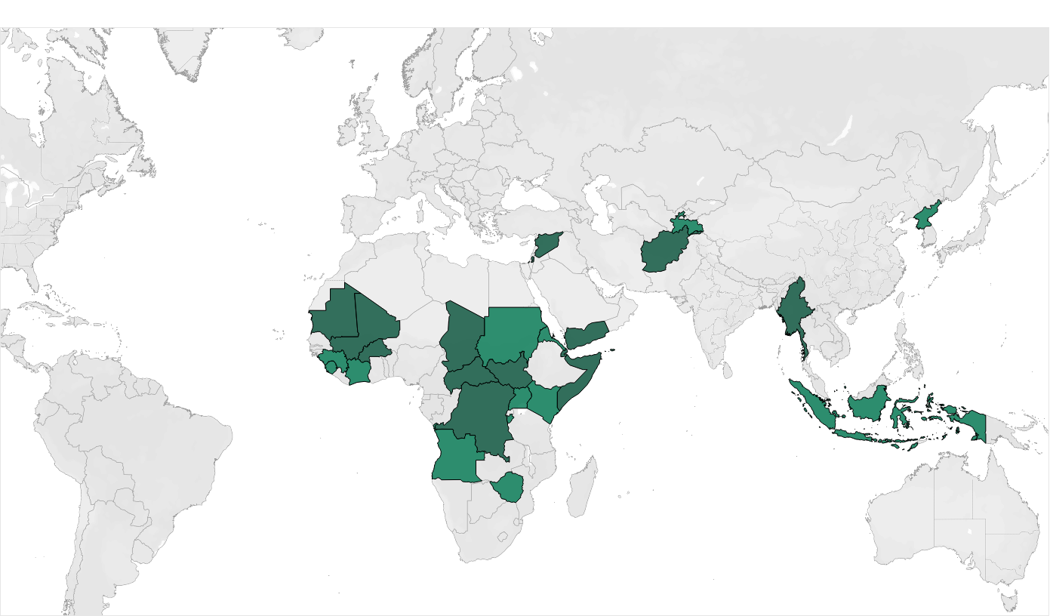
Countries in protracted crisis
Source: Development Initiatives based on OECD and UN-OCHA data
Notes:
Of these 27 countries, 14 of them – the ones you can see highlighted in the slightly darker shade of green on the map – were still the subject of a humanitarian response plan in 2017.
Our analysis excludes countries that have become protracted crisis countries since 2017.

Slide 7
Aid dominates international flows to PCC in 2017
Protracted crisis countries
Other developing countries
Source: Development Initiatives based on OECD and UN-OCHA data
Notes:
So, what financing flows matter in protracted crisis countries?
The slide shows the mix of resources in protracted crisis countries, and compares this with the mix of resources in other developing countries.
A stark difference can be seen, with protracted crisis countries relying on aid much more than other developing countries.
(On the left, a third of the section of the doughnut showing ODA is humanitarian assistance and the other two thirds of this section is non-humanitarian development assistance).
Other developing countries instead have much more access to resource flows beyond aid.
This difference can be explained, at least in part, by weaker domestic capacity and weaker private sector enabling environments in protracted crisis countries.
However, it’s interesting to note that, notwithstanding this, there is still a range of resources that flow into protracted crisis countries, spanning across public, commercial and private sources.
For example, remittances account for a fifth of inflows, and foreign direct investment for 14%.
I’ll now hand over to Rob to talk through the top line ODA trends.

Slide 8
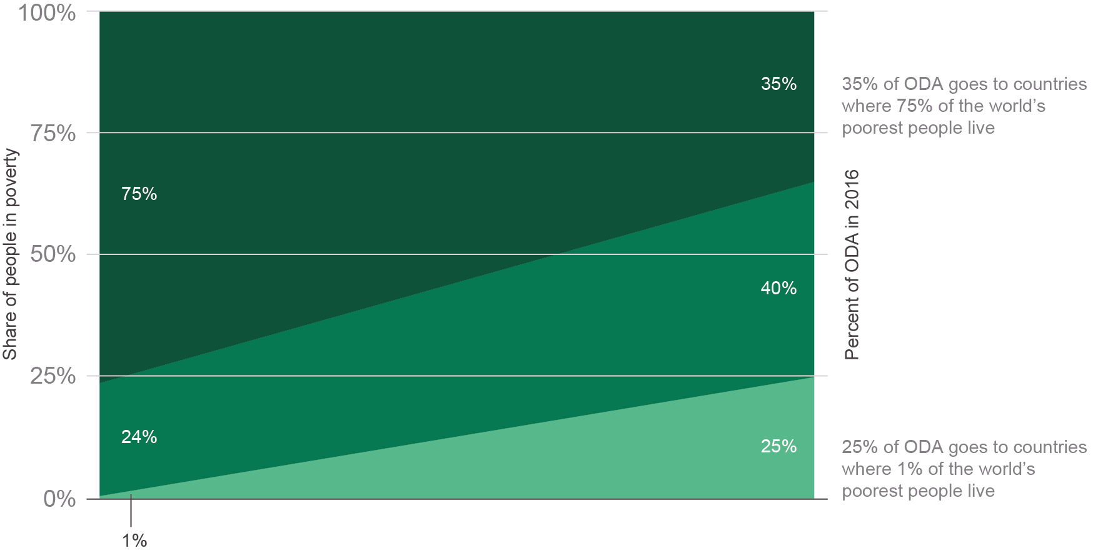
A substantial amount of ODA is not targeted at the poorest
Source: Development Initiatives based on OECD and UN-OCHA data
Notes:
We will now look more closely at the use of official development assistance, in particular.
Our research shows that aid from DAC donors and multilateral bodies is not as focused as it should be on the poorest people.
As you can see from this chart, countries that are home to 75% of the world’s poorest people receive just 35% of ODA targeted at specific countries. 40% of aid goes to countries housing 24% of people living in absolute poverty, and a quarter of aid goes to countries which collectively are home to just 1% of the world poorest people.
This is important to the current discussion because a growing proportion of the world’s poor is projected to reside in protracted crisis and fragile contexts by 2030, and development actors will be under increased pressure to target and engage in these contexts. So, this raises questions about the ways in which development aid is planned and delivered, and what needs to change to meet the unique challenges faced in these contexts?

Slide 9
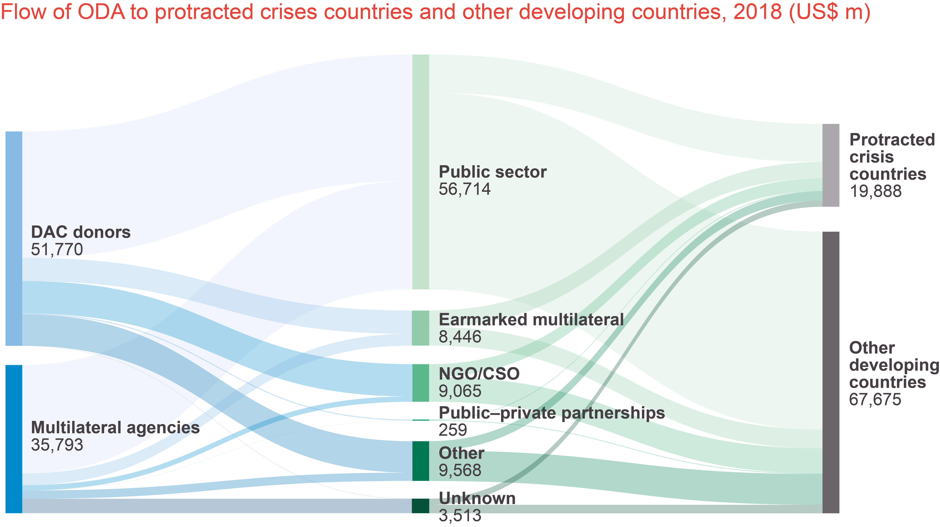
The flow of development aid
The flow of official development assistance (ODA), excluding humanitarian aid, to protracted crisis countries (PCC) and other developing countries in 2017, US$ million
Source: Development Initiatives based on OECD and UN-OCHA data
Notes:
When aid is disbursed by donor countries or multilateral bodies, it flows through a variety of agencies responsible for the implementation of aid-funded projects.
This chart illustrates the flow of developmental ODA – that is, excluding humanitarian aid.
Much of this aid goes via government ministries or other public sector bodies within the developing countries.
Smaller, but still substantial amounts are disbursed via NGOs & CSOs.
Multilateral bodies, as well as funding development projects from their core funding also act as implementation partners in some projects.
The flow marked as ‘other’ represents development aid implemented through private-sector firms, teaching institutions and think-tanks.

Slide 10
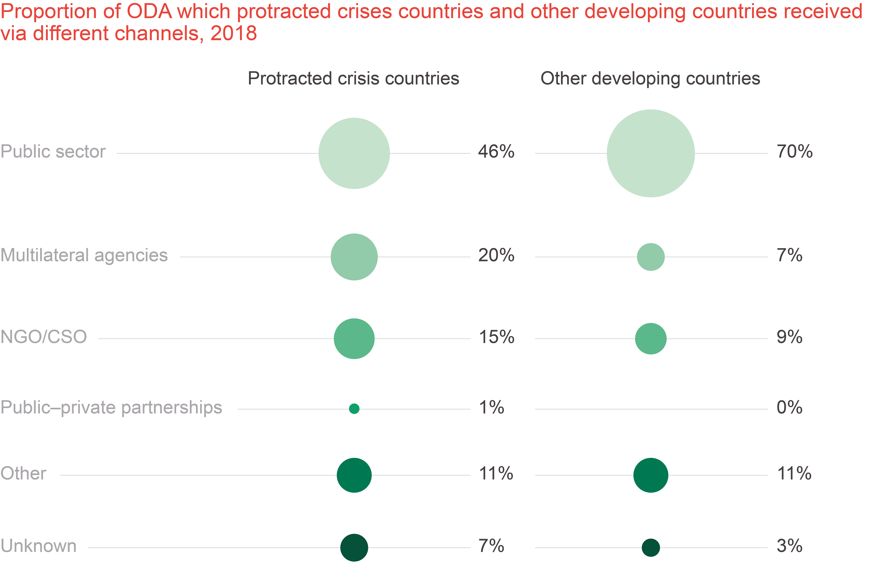
PCC receive less ODA via government
Proportion of ODA which PCC and other developing countries received via different channels in 2017
Source: Development Initiatives based on OECD and UN-OCHA data
Notes:
There is a noticeable difference between protracted crisis countries and other developing nations when it comes to the amount of aid channelled through different types of implementing agents.
In non-crisis-affected countries 70% is channelled though governments. However, in protracted crisis countries, less than half of developmental ODA is channelled via government agencies.
This largely reflects the greater challenge of working with, and through, governments in many crisis contexts - as in these contexts, capacity is often lower.
Also, as you’ll be able to see, multilateral bodies handle a much greater proportion of developmental aid in PCCs than in other countries, and the proportion of developmental aid going via NGOs is substantially higher in PCCs.

Slide 11
Rise in humanitarian aid does not cover fall in other ODA
Official humanitarian assistance
Non-humanitarian ODA
US$ billions
Data: All 27 protracted crisis countries
Source: Development Initiatives based on OECD DAC, UN OCHA’s FTS and UN CERF data.
Notes:
[The content on this slide and notes below were updated on 18.07.19]
Now, let us look at what happens to overall level of aid – both developmental and humanitarian – in the first 5 years of crisis.
For the 27 countries we identified, developmental ODA fell sharply between the first and fourth years of crisis, before recovering slightly whilst remaining at a lower level. Although humanitarian assistance rose throughout the first five years of crisis, this rise was not enough to replace the fall in developmental ODA.
By year four, developmental ODA was almost US$5 billion lower than in year one, but humanitarian assistance had increased by just US$2.6 billion.
At the end of year five, developmental ODA had recovered slightly but was still almost US$4 billion below the year one level, while humanitarian aid rose to US$2.9 billion higher than in year one.
This raises questions about the ways in which development finance complements humanitarian assistance in a protracted crisis context.
ODA should be able to be counter-cyclical - increasing to counter the impact of crises. But is this always the case? Here we can see overall levels of assistance decreasing in the face of crises.
To ensure that people’s livelihoods and access to basic services is sustained, should development assistance adapt and continue, where possible, through a crisis. Could this even prevent some crises from becoming protracted?
Obviously, much depends on the specific context, but it is food for thought.

Slide 12
ODA levels can recover quickly in post-crisis countries
Data: 12 countries for which there is at least three years of post-crisis data
Source: Development Initiatives based on OECD and UN-OCHA data
Notes:
It’s also interesting to look at what can happen when a country exits a crisis situation.
For 12 of the 27 countries we have data on aid levels for at least 3 years after the last humanitarian response plans.
For these countries, in these first 3 post-crisis years, the situation shown in the previous chart was reversed.
Although humanitarian aid fell as soon as the crisis had passed, the rise in development aid was substantially larger than the fall in HA – meaning that overall levels of ODA were higher than during the crisis.

Slide 13
ODA loans to protracted crisis countries have grown rapidly
Source: Development Initiatives based on OECD and UN-OCHA data
Notes:
Finally, let us turn to the issue of loans.
Concessional loans have been part of the aid finance landscape for decades – both bilateral loans from DAC donors to developing countries, and loans from the World Bank or regional development banks.
Since 2007 there has been a marked increase in the use of loans as a form of aid. Loans made up 14% of total ODA in 2007, and almost doubled to 26% in 2017.
What is interesting to note is that donor and, especially, multilateral lending to crisis affected countries has increased much more rapidly than lending to non-crisis countries.
Loans to non-crisis countries doubled between 2007-2017, but loans to countries in crisis rose by 875% over the same period.
This rise is from a low base, however, as prior to 2007 very little lending was advanced to crisis-affected countries.
And, it’s important to note here, we are not suggesting loans are necessarily an inappropriate form of financing in PCCs, but raising questions for discussion.
In particular, are the right financing mechanisms being used in the right places?
To answer this, there is a need for stronger evidence on how these loans are being used and targeted, and the impact on vulnerable and crisis-affected people.

Slide 14
ODA loans to protracted crisis countries in 2017
Country | ODA loans (US$ million) | ODA loans (% of total development ODA)
Yemen | 547 | 69%
Myanmar | 426 | 31%
Mali | 331 | 27%
Burkina Faso | 237 | 25%
Mauritania† | 209 | 64%
Chad† | 200 | 38%
Democratic Republic of the Congo | 156 | 8%
Afghanistan† | 105 | 3%
Central African Republic† | 75 | 25%
South Sudan†† | 71 | 8%
Djibouti† | 30 | 24%
West Bank and Gaza Strip | 22 | 1%
† Countries at high risk of debt distress †† Country in debt distress
Source: Development Initiatives based on OECD and UN-OCHA data
Notes:
In 2017, 12 of the 14 countries still in protracted crisis received at least some of their aid in the form of loans - with some of these countries taking on new debt totalling hundreds of millions of dollars.
Indeed, around two-thirds of developmental ODA – not including humanitarian assistance - to Yemen and Mauritania was in the form of loans. And, it should be noted that Mauritania was listed as a country at risk of debt distress in a recent IMF assessment.
Protracted crisis countries at risk of debt distress (or, in the case of S. Sudan actually in debt distress) received over $700 million of new loans in 2017.

Slide 15
ODA loans to protracted crisis countries in 2017
Donor | ODA loans (US$ million)
World Bank (IDA) | 1,428
IMF | 187
France | 158
Japan | 157
African Development Fund | 136
Arab Fund (AFESD) | 117
Korea | 54
EU Institutions | 50
Islamic Development Bank | 47
Asian Development Bank | 26
OFID | 23
IFAD | 17
Italy | 11
Source: Development Initiatives based on OECD and UN-OCHA data
Notes:
The majority of this new lending is coming from the World Bank –which is not surprising given that the bank is the largest single source of concessional loans to developing countries.
$1.4 billion of new loans came from IDA, the concessional lending arm of the WB, representing 12% of loans advanced by IDA in that year.
Smaller, but substantial, amounts of loans to PCCs came from the concessional trust funds of the IMF and a number of regional development banks.
Among DAC members the great majority of loans to PCCs came from Japan and France.
We hope this has provided a useful foundation for further presentations and discussion. If you have any questions on data, please email DI and we will respond individually.

Slide 16
Q&A
Facilitated by David Donoghue

