Slide 1
Can a Fragmented Business Model Manage Integrated Crises?
Jeremy Konyndyk
Senior Policy Fellow
Center for Global Development
October 2019

Slide 2
SecGen Guterres at WEF
“Global challenges are more and more integrated,
and the responses are more and more fragmented,
and if this is not reversed, it's a recipe for disaster.”
A rather good description of the humanitarian landscape as well!

Slide 3
Trending (or aspiring?) toward integration
New trends are challenging our traditional organizing principles:
Multi-purpose Cash
Multi-sector programming
Triple Nexus
Joint needs analysis
Feedback and accountability
But many of these are struggling!
Integration may be our future – but it is held back by our past.

Slide 4
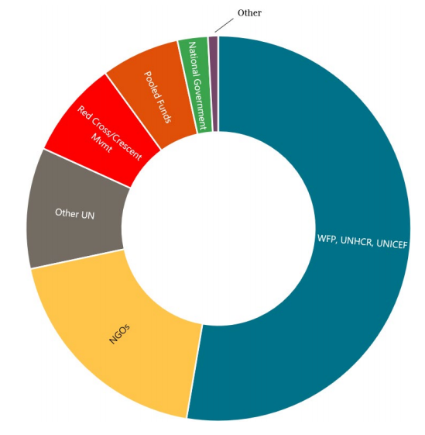
Change is hard: Budget edition
Total Humanitarian Funding (FTS)
2017
2017 Humanitarian Funding (FTS):
Big 3 get roughly half
Other UN 10%
Red Cross movement 10%
NGOs ~25%

Slide 5
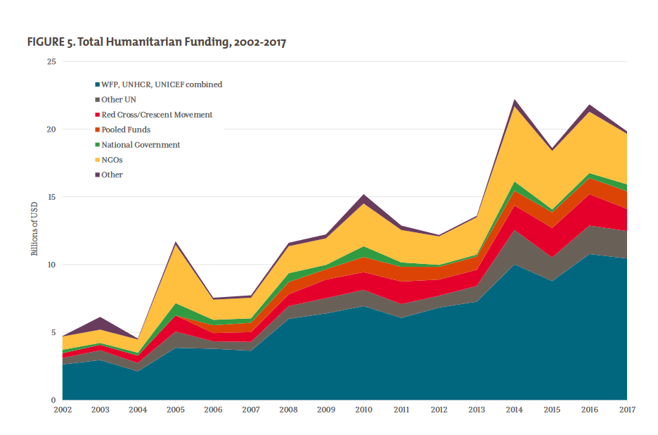
Donors have been giving a lot more money….
….is there any evidence past reforms affected their priorities?

Slide 6
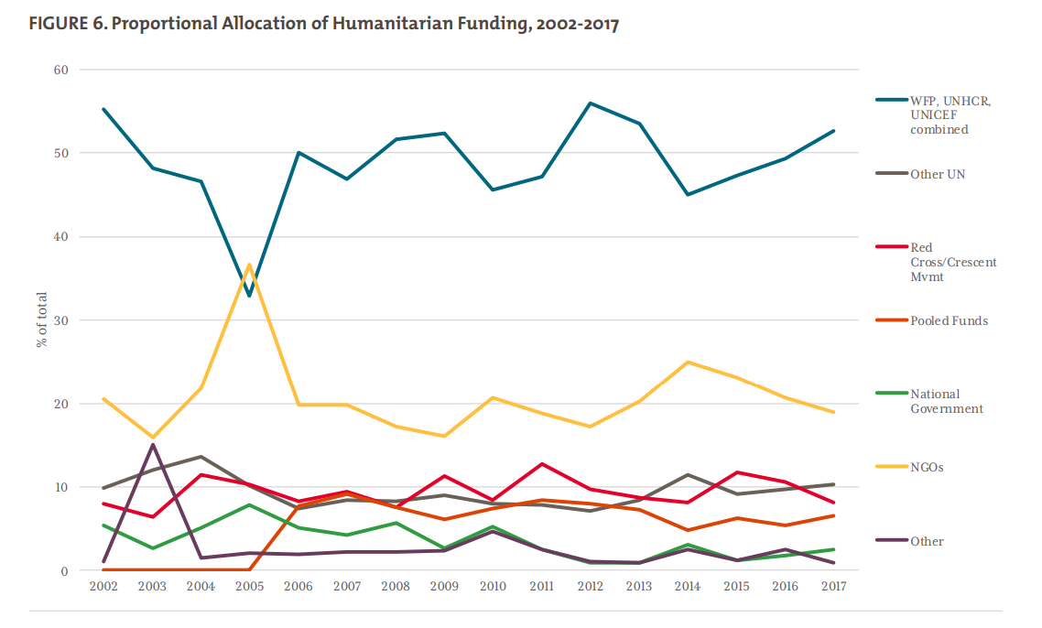
Not really.
Proportional funding allocation has been static for decades….
(…though Grand Bargain seems to be affecting cash & multi-year)

Slide 7
Fragmentation is our business model
Donor practices reinforce core institutional incentives and power dynamics – and undermine coherence:
Vertically siloed, one-stop-shop multilateral agencies
Funding allocated by agency mandate/sector – each agency acts as its own pooled fund
Response plans are built around agency mandate/sector
Coordination and planning built around individual sectors
Most donors are heavily reliant on this system for analysis, strategy, operations, and evaluation. The system audits its own performance.

Slide 8
New financing & costing models
Turn CBPFs into core response financing (e.g. pool funding based on geography rather than agency)
Construct appeals as prioritized tranches using activity-based costing
Amortize costs over 3 and 5-year timelines
If cash can be delivered independent of mandate, why not other programs too?

Slide 9
Redefine International-Local Partnership
Using big international organizations as funding intermediaries is probably inevitable.
But making them implementers-of-first-resort is not
In constrained-access settings, increasingly see umbrella partnership model – UN/INGOs administer $ and provide technical oversight; local groups lead on delivery.
Couldn’t that be the default model?

Slide 10
https://www.cgdev.org/expert/jeremy-konyndyk Drop me a line: jkonyndyk@cgdev.org

