Slide 1
INCAF Fragility Trends

Slide 2
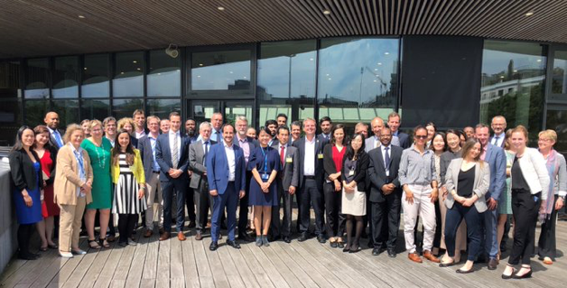
INCAF
The International Network on Conflict and Fragility (INCAF)
An OECD Development Assistance Committee member network
30 member state donors + UAE, Saudi Arabia, Kuwait, Turkey + MDBs + IMF + UNDP and OCHA
Tackling the tough challenges of delivering results in fragile contexts
Policy commitments / Good practice and learning / Emerging Trends
2019/20:
The HDP Nexus
Prevention
Fit for Fragility
States of Fragility
Financing for Stability

Slide 3
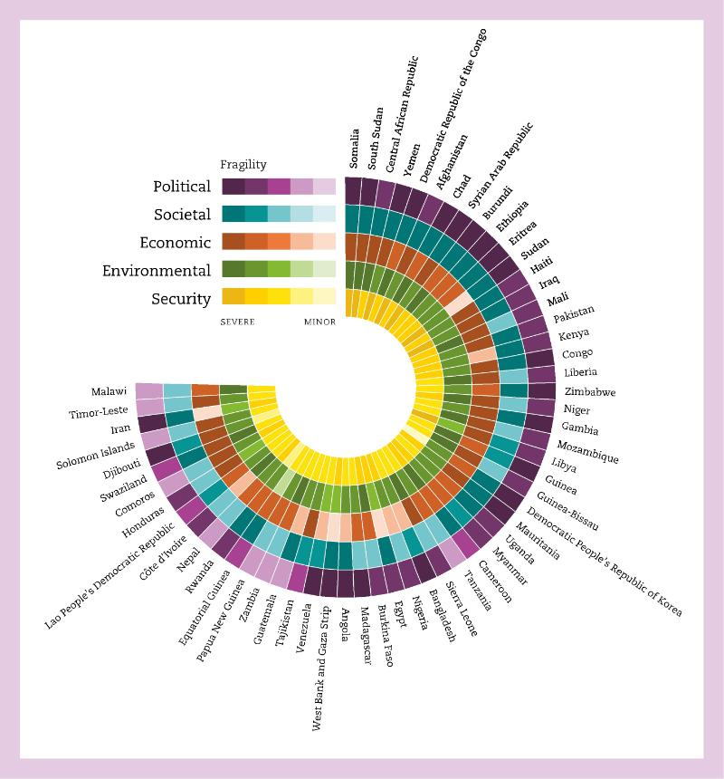
What is
Fragility?

Slide 4
States of Fragility 2018
By 2030, 2.3 billion people will be living in fragile contexts
The average median age is 20 years (vs 33 in rest of world)
More than half of fragile contexts are Middle Income Countries
Gender inequality is highest in fragile contexts
By 2030, if no action is taken, fragile contexts will be home to more than 80% of the world’s extremely poor

Slide 5
States of Fragility
In 2017, USD 74.3 billion, or 69% of ODA, went to fragile contexts

Slide 6
States of Fragility
In the 15 extremely fragile countries, ODA is critical

Slide 7
States of Fragility
Half of all ODA to fragile contexts goes to just ten countries

Slide 8
States of Fragility
The ten top donors:
Of this, two-thirds is bilateral, one-third multilateral

Slide 9
States of Fragility
Humanitarian ODA has more than doubled from 9.5 billion USD in 2010 to 20.1 billion USD in 2017 – or 26% of ODA to fragiles

Slide 10
States of Fragility
Some worrying trends:
In 2016, only 2% of total ODA to fragile contexts went to conflict prevention.
Only 10% went to peacebuilding
Between 2015-17, at least USD 26 billion was spent on refugee situations
Two-thirds of fragile contexts would have difficulty financing basic services from their own revenue – but only 0.2% of ODA was used for domestic resource mobilisation
Less than 10% of ODA to fragile contexts is for climate/environment
With humanitarian increasing, there may not be enough attention for ending need.

Slide 11

Trends in terms of programming:
New actors: World Bank, MDBs, IMF, Arab donors, China
People at the centre: Local systems / self-reliance (rather than statebuilding)
Shifting needs: OECD Lives in Crises surveys show that people in conflicts want jobs, and children in conflicts still need to go to school
Prevention: But uncertain what this means in practice
The Nexus: This wicked problem of fragility is too complex for one set of actors to tackle alone...

Slide 12
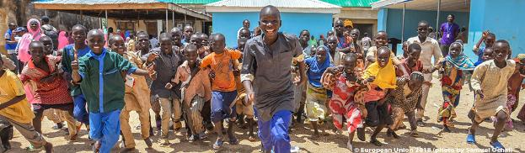
The Nexus
Because most humanitarian programming is UN/NGOs (88%)
But most development programming is bilateral (74%)
The DAC Recommendation on the Humanitarian Peace Nexus
Coordination
Programming
Financing

Slide 13

Challenges and Opportunities
Narrative – not LRRD with a new name!
Coordination – Strategic, Normative, Operational
Defining peace and linking to peace actors
Financing:
The right amount:
expensive in the short term…
The right tools:
not about a pooled fund - there is no silver bullet
do we need new instruments or a new approach to financing?
earmarking
financial literacy
The right time:
phasing and sequencing
contingency finance and crisis modifiers
The right incentives:
A return to the livelihoods model?
Sustainable solutions involve DRM and budget allocations
Making humanitarians comfortable in this space

Slide 14
Q & A

