Slide 1
Global Humanitarian
Assistance Report 2019: key findings
Angus Urquhart
Development Initiatives
Notes:
Hi everyone, this is Cecilia.
For those of you who are not familiar with the development financing landscape, I’ll take you through the key policy processes and stakeholders, skimming the surface of the background document that was shared ahead of the webinar. You can find a link to this in the email you should have received an hour ago, so please do refer to that for more detail.
For those of you who are familiar with all of this, please bear with us, as we’ll quickly be moving on to the findings from our analysis.

Slide 2
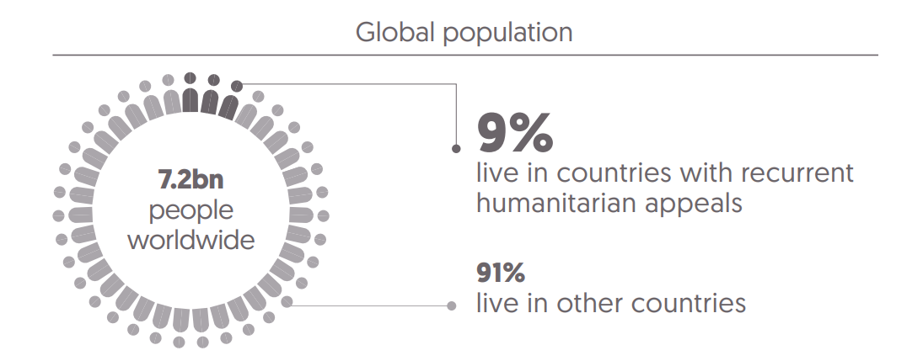
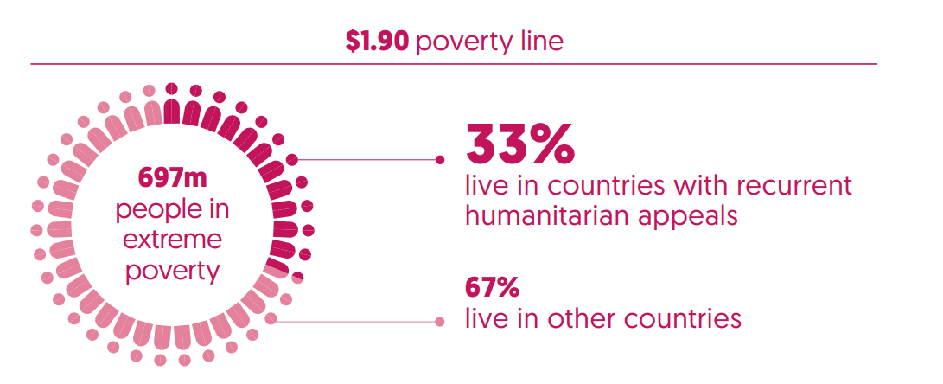
Countries with recurrent crises are home to less than a tenth of the global population, but more than a third of people in extreme poverty
Notes:
FIG. E4
Initial appearance: ‘People living in poverty’ bar
Click one: ‘People living in extreme poverty’ bar

Slide 3
International humanitarian assistance increases but pace of growth slows
Total
Governments and EU institutions
Private
US$ billions
Notes:
FIG. E1
Initial appearance: Stacked bars plus total figures and total line for 2014–2017
Click one: Stacked bar plus total figure for 2018 appears, with total line extending over

Slide 4
Multi-year funding grows markedly by volume but more slowly as a proportion of total funding
14
12.6
12.9
60%
Multi-year contributions
12
as % of total funding
50%
Single-year contributions
10
37%
40%
8.4
33%
Multi-year contributions
8
Multi-year contributions as % of total funding
US$ billions
32%
8.1
30%
6
5.7
8.4
20%
4
2
4.2
4.8
10%
2.7
0
0%
2016
2017
2018
Notes:
FIG. E11
Initial appearance: Stacked bars
Click one: Percentage line, from left to right

Slide 5
Unearmarked funding to UN increases in total but continues to fall in relative terms
Unearmarked funding as % of total
Earmarked funding
Unearmarked
US$ billions
Notes:
FIG. E10
Initial appearance: Stacked bars
Click one: Percentage line, from left to right

Slide 6
Volume of cash and voucher programmes reaches new high
5.0
4.7
4.5
4.3
0.01
Other
0.1
0.9
4.0
NGOs
3.5
0.9
2.8
1.0
RCRC
3.0
0.004
1.0
US$ billions
UN agencies
2.5
2.0
0.004
0.7
2.0
0.1
0.5
1.5
0.1
2.8
1.0
2.0
2.2
0.5
1.4
0
2015
2016
2017
2018

Slide 7
Direct funding to local and national actors grows in 2018 but remains a small proportion of all funding
Southern international NGOs 0.3%
RCRC National Societies 0.1%
Local NGOs 0.1%
National NGOs 0.3%
International responders
96%
Local and national responders 3.1%
Internationally affiliated NGOs
0.1%
National governments 2.6%
National foundations 0.002%
National academia/think tanks/research institutions 0.003%
National private sector corporations 0.1%
Notes:
FIG. E7
Initial appearance: Donut appears with wheel animation, revealing labels also as each section is revealed (fairly quickly)
Click one: Dotted lines extend, then bar appears section by section, revealing labels also as each section is revealed (fairly quickly)

Slide 8
Both domestic and international resources are lower per person in countries in crisis
Long-term
Developmental ODA gross
debt (commercial)
US$39 per person
US$22 per person
Remittances
US$72 per person
Official humanitarian
assistance
US$16 per person
Other official
20%
11%
Foreign direct
flows gross
37%
investment
US$4.8 per person
8%
US$23 per person
2.4%
12%
Peacekeeping
Net short-term debt
US$8.1 per person
1.2%
US$2.3 per person
4.1%
Long-term
Net portfolio equity
debt (official)
2.2%
2.2%
US$4.3 per person
US$4.2 per person
Notes:
FIG. 3
Initial appearance: Inner circle (international resources and government revenue).
Click one: Except for ‘Official humanitarian assistance’, outer circles appear one by one from left to right (fairly quickly).
Click two: ‘Official humanitarian assistance’ appears and then the label and volume turns bold.

Slide 9
Foreign direct investment is volatile and inflows can fall rapidly in the early years of a protracted crisis response
10%
0
Year 1
Year 2
Year 3
7%
Year 4
Year 5
Lower middle income countries
-3%
-6%
-2%
-16%
-11%
Low income countries
-10%
-21%
-20%
-43%
-42%
% change in FDI since year before appeal
-48%
-30%
-40%
-50%
-60%

Slide 10
International funding related to disaster risk reduction increasingly targets high-risk countries
41
43
48
46
104
101
97
100
6,000
5,
69
4
5,
2
7
4
257
306
5,000
4,7
6
3
757
4,
6
7
1
67
311
4,
3
8
2
205
763
128
4,
2
9
6
128
289
s
4,000
3,
5
1
2
508
3,87
7
318
n
162
io
83
465
l
il
467
m
3,000
$
S
U
4,385
4,254
4,632
4,254
2,000
3,669
3,329
3,849
2,883
1,000
0
High risk
Other
High risk
Other
High risk
Other
High risk
Other
2014
2015
2016
2017

Slide 11
Conclusion
Growth in international humanitarian assistance but slowing and still inadequate to meet need
Mixed progress in adapting to more efficient and effective programming – significant gaps in reporting and evidence of impact.
New financing mechanisms are being developed and new sources of funding accessed – more evidence needed on targeting, impact and coordination

