Slide 1



Team Cara Dune
Project 1
Currency Converter

Slide 2
SCOPE
Create an interface that will allow a user to select 2 different currencies and an amount to be calculated.

Slide 3
SCOPE
Create an interface that will allow a user to select 2 different currencies and an amount to be calculated.
The currency ratio will come from an API and will be relatively “Live”.

Slide 4
SCOPE
Create an interface that will allow a user to select 2 different currencies and an amount to be calculated.
The currency ratio will come from an API and will be relatively “Live”.
A map will be displayed that will show all countries both currencies are circulated.

Slide 5
Features
Supports 168 currencies.
“Live” updates for currencies using the CurrencyLayer API
“Smart” Caching for Currency Pair Calls
Dynamic Map that will display all countries which will use selected currencies.

Slide 6
Main Components
Entity Relationship
between countries, currencies, symbols, readable names and valid pairs for our API
Mapping Function
Currency Converter
Interface
Breakdown

Slide 7
Currencies.CSV
validCurrencies.CSV
These Data structures are made to create some basic Entity Relationship between data for quick lookups and for some validation.
countries.CSV
DATAFRAME
Currency
LIST
ValidCurrencis
DATAFRAME
Countries
Uses both DFs to find all country Codes where Currency is used. Used for Mapping
Dictionary
Used to lookup the Currency Symbol
USD -> $
Dictionary
Used to Reference Friendly Names to Currency ISO3 Codes
LIST
Dropdown Selector with readable currency Names
Initial Data

Slide 8
Currency Conversion
Top level function handles how the API call works, how to determine to pull from cache along with it’s management.
Cache is a dictionary with the currency pair as a string and a list object with the currency ratio along with a timestamp.
advGetCurrencyPairRatio
useCacheOrGetNew
Cache ( DICTIONARY )
GBPUSD : [ .07 , <timestampe> ]
USDINR : [ 20.1 , <timestampe> ]
USDEUR : [ .92 , <timestampe> ]
…
...
GetJsonFromCurrencyLayer
extractPairRatioFromJson
updateCache

Slide 9
Use Case
How would a potential traveler be able to track the cost of exchanging currencies before going on a trip?
Are there any recent examples of a period when a particular currency pair changed rapidly?

Slide 10
Example
The 2016 Brexit referendum led to a noticeable decline in the GBP relative to the USD
During the 5-day period following vote, the USD strengthened versus the GBP roughly 9%

Slide 11
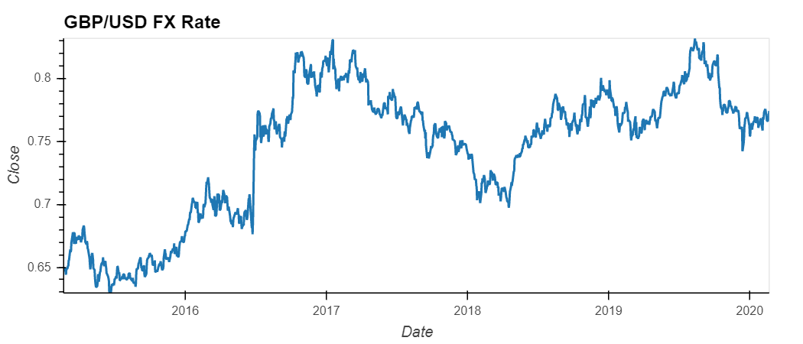
Figure
Brexit 2020
Days after Brexit the GBP weakened

Slide 12
Interesting Takeaways
Currency pairs may provide indicative levels of economic conditions, but do not fully account for all costs that a traveler may incur when estimating cross-border expenses.

Slide 13
Questions

