Slide 1
Advanced Filters and Sorts

Slide 2
Agenda
Sorts
Temporary
Creating a new Sort
Complex sorts
Filters
Creating a Filter
Fields, Operators and Values
Compound Filters
Copying a Filters
Character String considerations
Outlining
Expression box/Validate
Exercises

Slide 3
SORTS

Slide 4
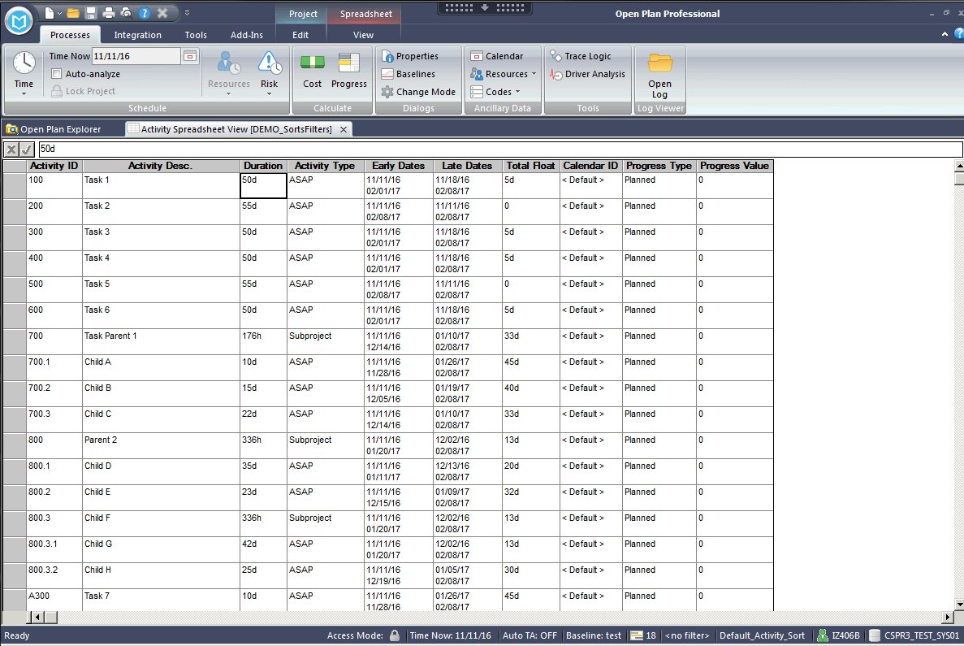
Sorts
When opening any View in OPP, the order in which the records are displayed are controlled by “Sorts”.
The Sort being applied to Views is shown in the bottom right corner, here “Default_Activity_Sort” is enabled.
Sort is Identified
Notes:
Each of the students need to make a copy of the working project TRAIN_136 to use throughout the class.
Open TRAIN_136 in Read Only mode. File … Save As … {yourID}_136. Copy the Test Baseline.
Open the SPREADVW - Activity Spreadsheet View.
Note that the filter that is applied is identified in the lower right of the screen on the status bar.

Slide 5
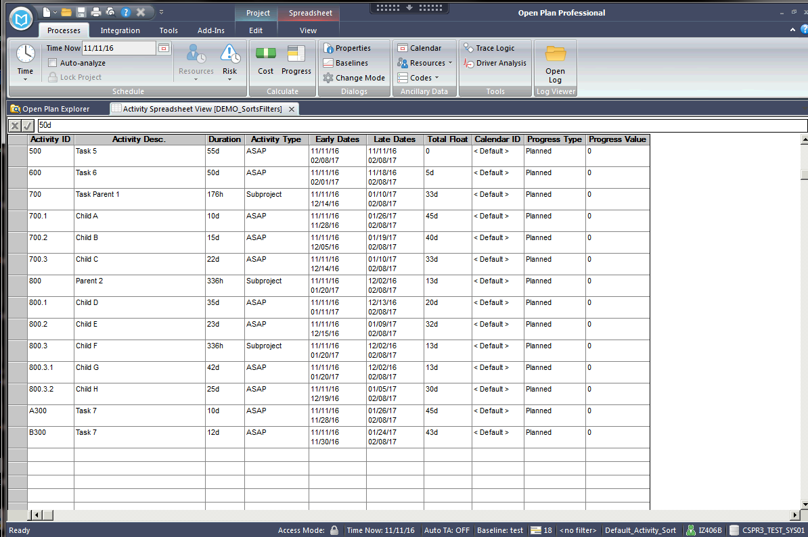
Sorts
‘Default_Activity _Sort’ in on the Activity ID.
Notice Alphas are after numbers (when ascending).
Alphas Sorted last
Notes:
Note that the Default_Activity_Sort shows the numeric values are sorted in the way that we would expect – with lowest number first. The alphas are sorted to the end.

Slide 6
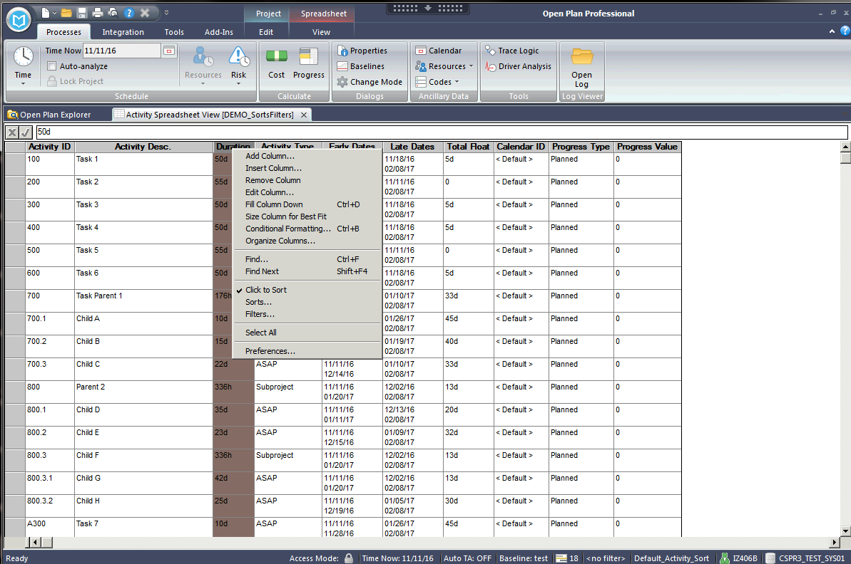
Sorts - Temporary
A fast way to sort records, is to right click on the columns and select Click to Sort, then left click on that column. In this example Original Duration is selected.
Right Click
Select
Notes:
The fastest way to quickly sort data is the Click to Sort feature. Right-click on any column heading and select the Click to Sort. Then left clicking on any column heading will cause the data in the project to be sorted by that column.

Slide 7
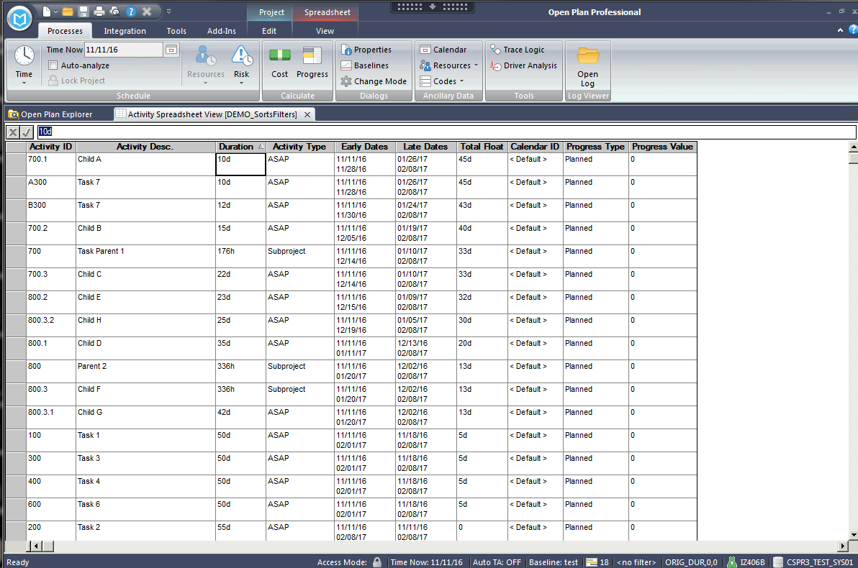
Sorts - Temporary
Left click on Duration (Original Duration) and records are sorted from low to high (ascending).
Left Click
Sort is Identified
Notes:
Select the Duration column and you will see the data is not presented in increasing duration order. The order is indicated in the Status Bar.

Slide 8
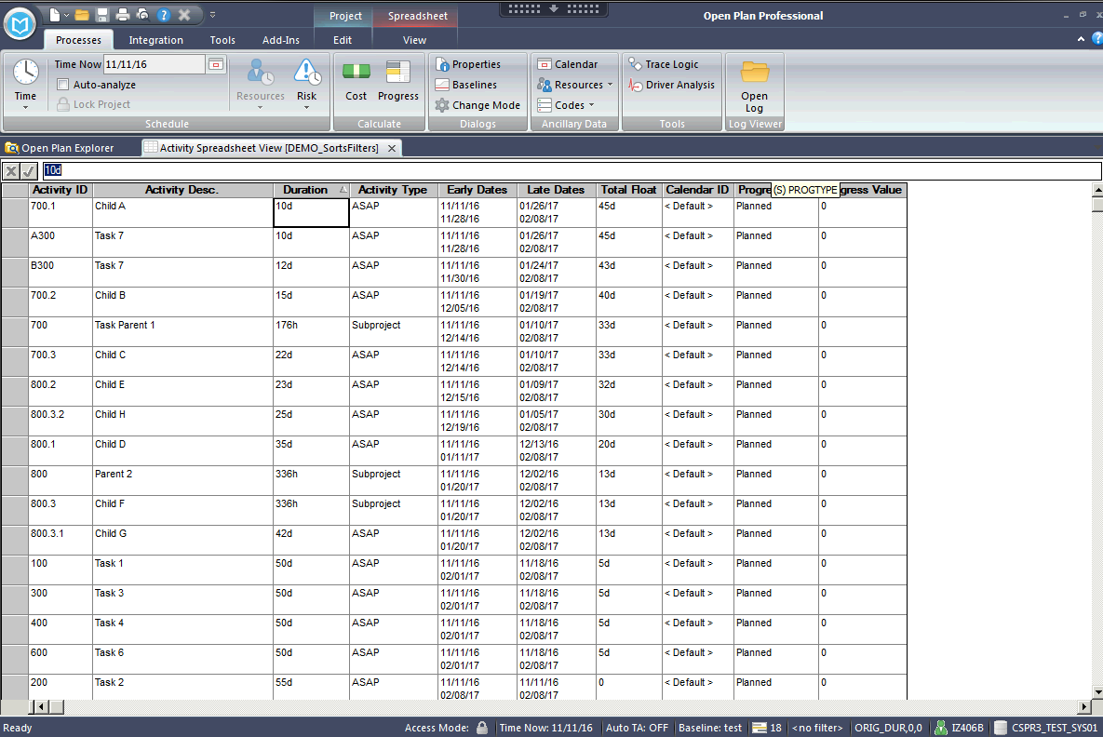
Sorts - Temporary
176 is higher than 22. Why is this not in order? Original Duration for the Subproject is shown in Hours, not Days.
Units are important
Notes:
Users should not be confused if the duration units are not all the same – the sort is truly by increasing duration. (176 hr is equal to 22 days.)

Slide 9
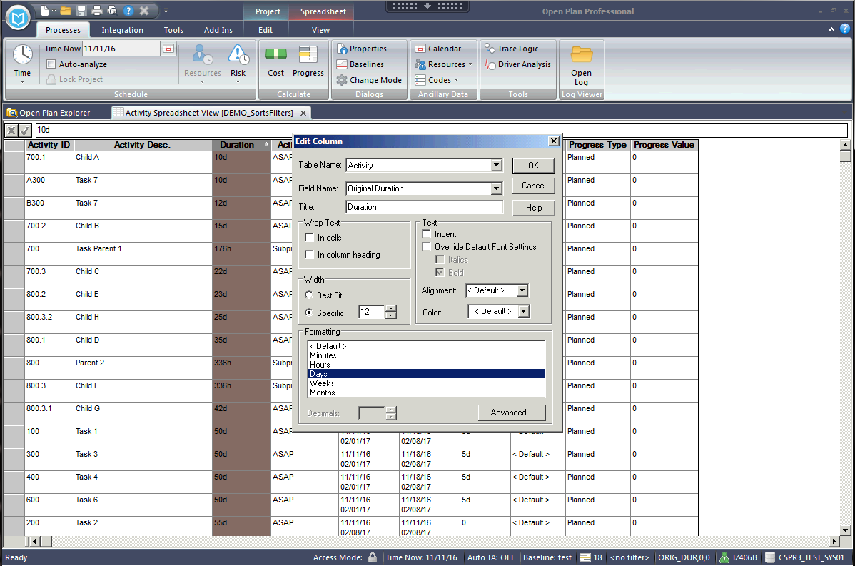
Sorts - Temporary
Edit column to depict all records in Days.
Right Click
Notes:
Double-click on the duration column and select the formatting to be in “days”

Slide 10
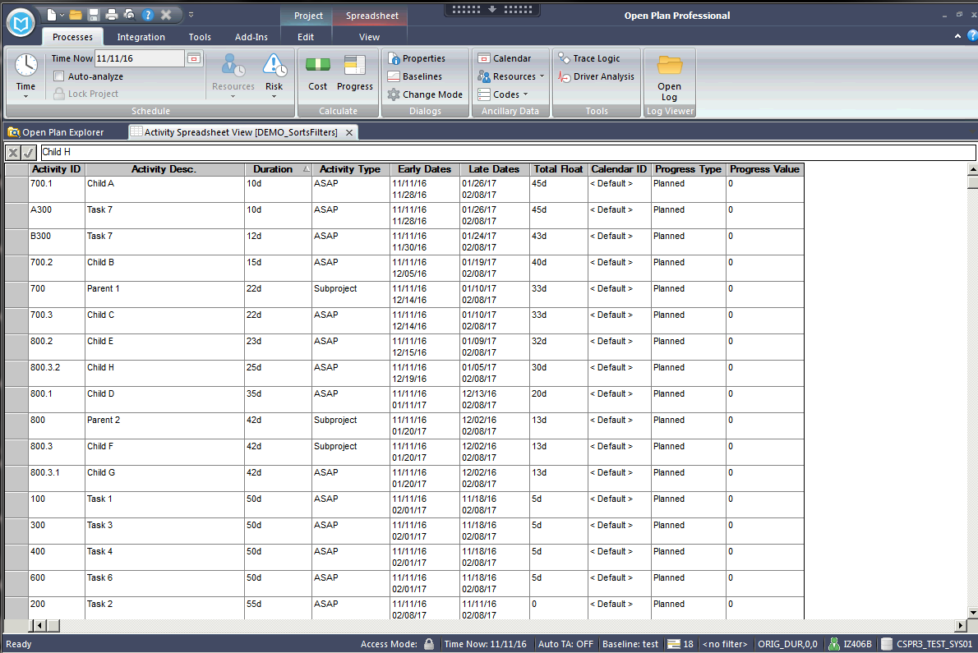
Sorts - Temporary
That looks right. Make sure you are aware what type of data you are sorting on (Duration, Date, Character, etc.)
Notes:
When all tasks presented in common units, the sort is clear.

Slide 11
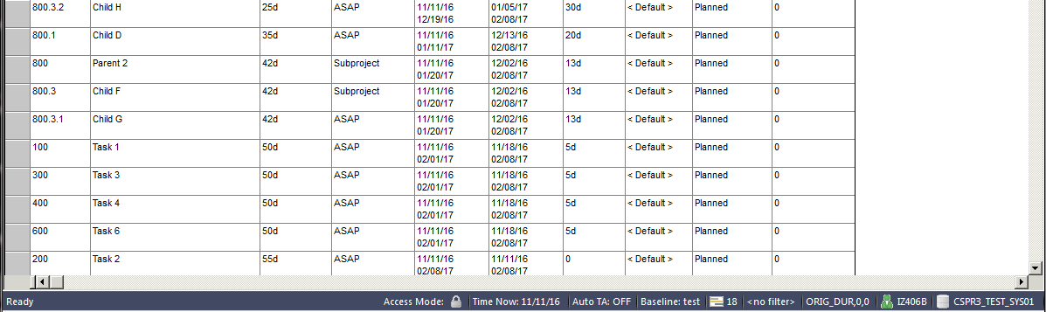
Sorts - Temporary
When a “Click to Sort” is performed, the sort criteria will be shown in the bottom right hand corner of the view.
ORIG_DUR, 0, 0
OPP System Field Name
0 – Ascending
1 - Descending
Notes:
Let’s return to the Status Bar display of the filter. The first parameter is the field that is being used for the sort. The second parameter shows whether the sort is ascending (first time the field is clicked) or decreasing – if selected again. Click on the Orig Duration column again to set the sorting as decreasing. (see the 1 as the second parameter of the identified sort.

Slide 12
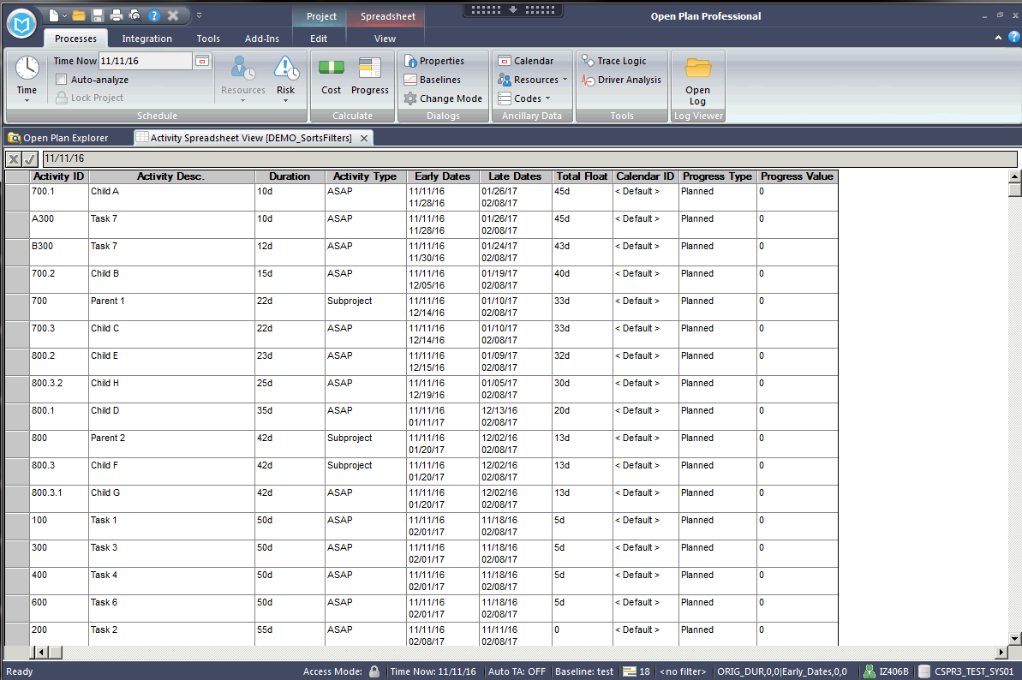
Sorts - Temporary
Multiple columns can be sorted by clicking on the first column and then holding “Ctrl” key down and selecting the second column.
Ctrl Left Click
Notes:
The Click to sort is not restricted to sorting only on one column. After clicking once (or twice) on the first column, hold down the CNTL key and click on another column to sort by that field. Having clicked the original duration column, hold down the CNTL key and select the Early Start column.

Slide 13
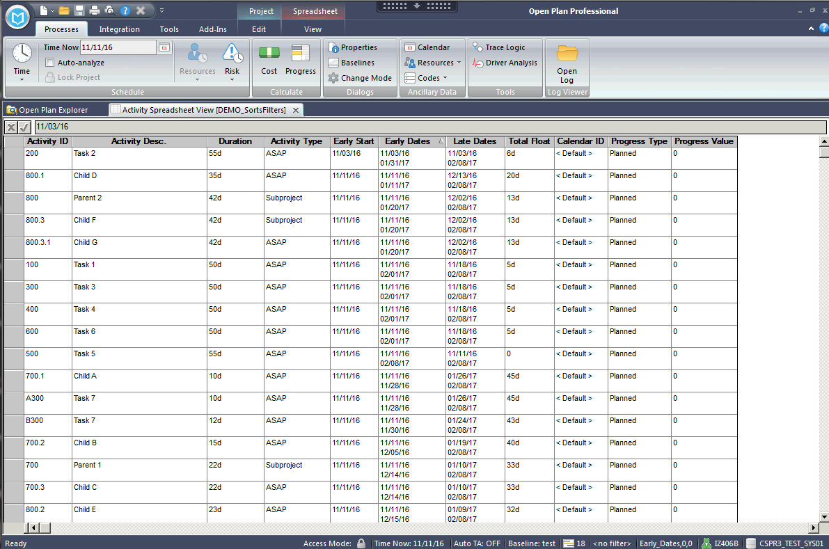
Sorts - Temporary
Sort by Early Start (ascending by date):
Notes:
Users should be aware that the results of sorts are dependent on the data type of the column. Right-Click add the Early start column. Then Click to sort on the early start.
Note that the first three tasks are:
200 100 300
Since the Early Dates column is a combination of the early start and early finish, shouldn’t sorting on that column yield the same results?

Slide 14
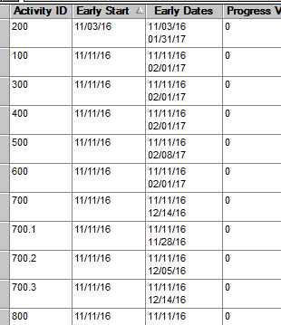
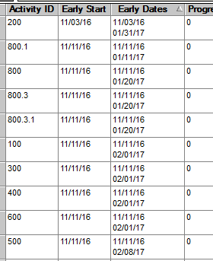
Sorts - Temporary
Sort on left is “Early Start” and on the right is “Early Dates”.
They return different results because “Early Dates” is a calculated field and is sorted as a character string.
Notes:
Sorting by the Early Dates column gives first three tasks of 200 100 700.1 Why the difference?

Slide 15
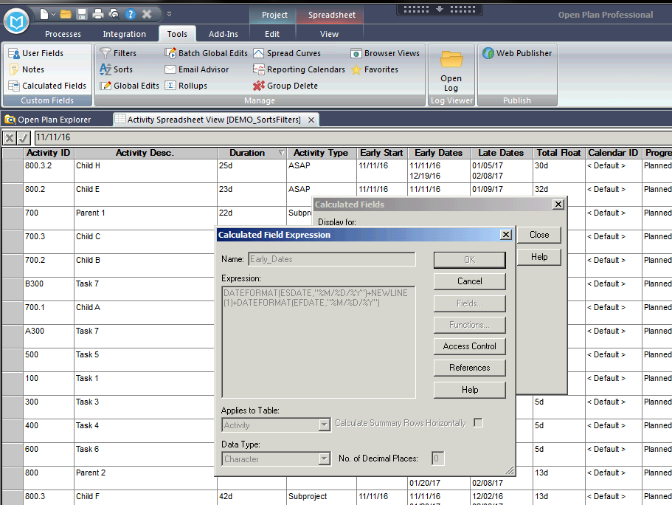
Sorts - Temporary
“Early Dates” is a character string. Again, understand the type of data that you are attempting to sort.
Notes:
Users should be aware that sorting the early dates is a character sort and therefore the sorting is dependent on the format options used in the calculated fields. Lets demonstrate by creating a copy of the Early_Dates Field and changing the format to be dayMonthYear -- %D%A%Y. Name the New Calculated Field {yourID}_Early Dates.
Applying the sort to the new calculated fields we find that tasks 400 800.2 500.

Slide 16
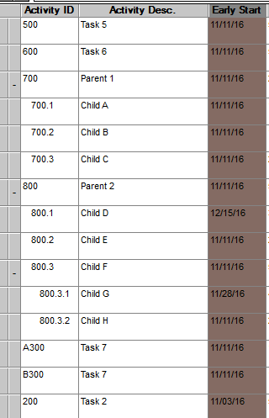
Sorts - Temporary
A sort was applied by Early Start, and Outlining is enabled.
The sort order appears to be incorrect.
Notes:
Click on the early start column and sort again. Next right-click on the spreadsheet and select Preferences and then enable outlining. Note that task 800.2 comes before task A300 even though the early is later. This is due to the outlining.

Slide 17
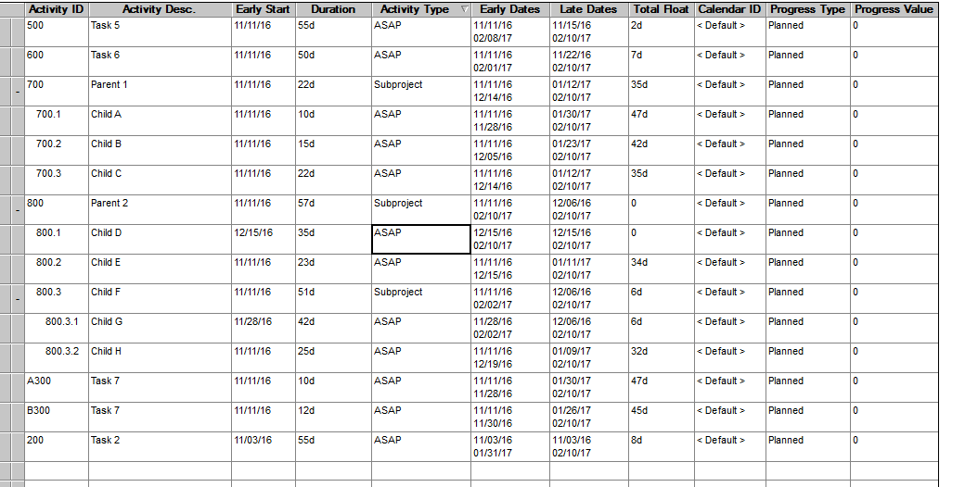
Sorts - Temporary
Actually with Outlining enabled the “Parent” will be sorted in order with all of it’s children. The Parents’ Early Start is 11/11/16, so all of its children will be sorted first by that group.
Sorted as
a group
Notes:
As explained on Chart 16, with the outlining enabled, the sorting occurs within a subproject.

Slide 18
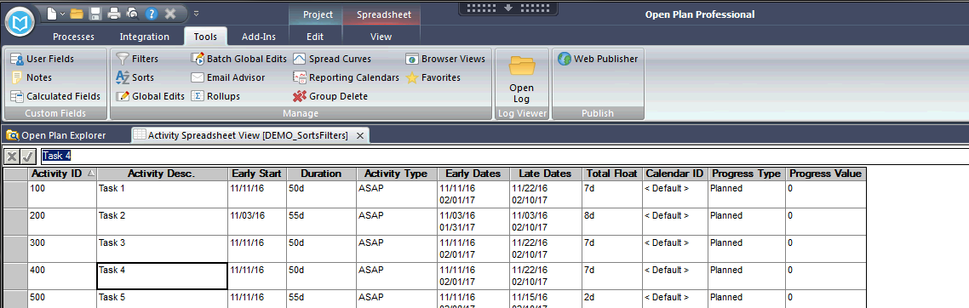
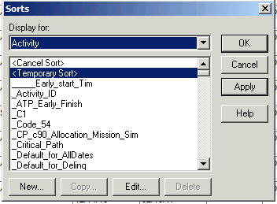
Sorts - Temporary
Sorts can be created (saved) to use again or to create a sort with more than one criteria (compound sort).
Select Tools>Sorts and select “New” on the sort dialog box.
Notes:
While click to sort gives users lots of flexibility, user may want the ability to create even more complex sorts – or to create and save sorts that can be quickly reused many times in the future. This is accomplished by selecting Tools … Sorts and click the New button.

Slide 19
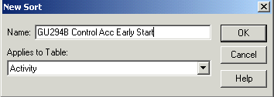
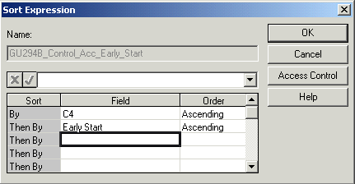
Sorts - Creating a New Sort
Name Sorts stating with your User Id.
Most will be created in the Activity
Table, but can be created for
others
Allows for multiple criteria {
Access rights can be granted to groups or individuals.
Notes:
Let’s create a new sort that will present the data sorted first by the Control Account and then by Early start.
At the New Sort dialog box enter a new for the Sort. It is advised that the name begin either with a program abbreviation or your logon ID. Lets call our new sort {yourID}_CA _and_Early_Start.
Most frequently the sort will apply to the Activity table. Click OK
The sort Expression dialog box allows the user to select any OPP field and whether to sort ascending or descending. The user can continue to select addition fields that will be used to sort any ties in the initial fields. We select the C4 code – which is Control Account and accept the default of ascending order. In the second row, we select the Early Start field and again accept the default of ascending order.
Users should be very cautious and not use the Share Item with Others check box frequently – Shares with all other users.

Slide 20
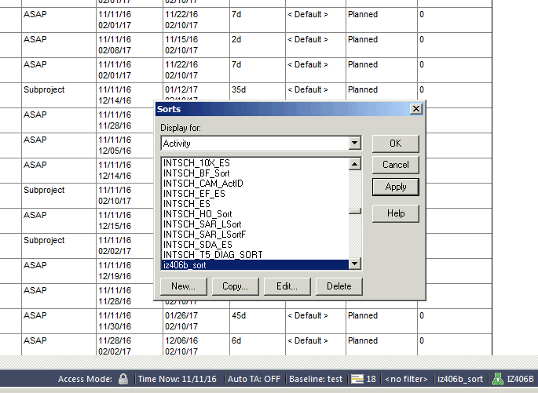
Sorts - Creating a New Sort
Records sorted by multiple criteria.
Sort Name
Notes:
When the sort is applied, the name is displayed in the Status bar. Let’s insert the C04 field into the spread sheet to verify that the sort has been performed as request.

Slide 21
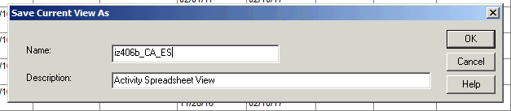
Sorts - Creating a New Sort
The view can be saved with this sort order.
Notes:
Each time a view is saved, the applied sort is saved and applied when the view is used. Let’s demonstrate this by saving a view. Call the view {yourID}_CA_ES - for Control Account & Early Start
Select File … Save View and enter the name and the description “Spreadsheet with CA&ES Sort Applied” Click OK

Slide 22
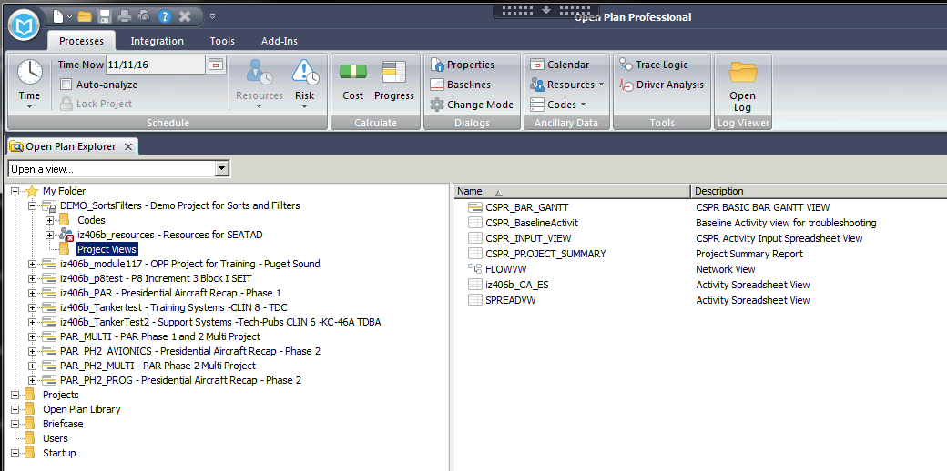
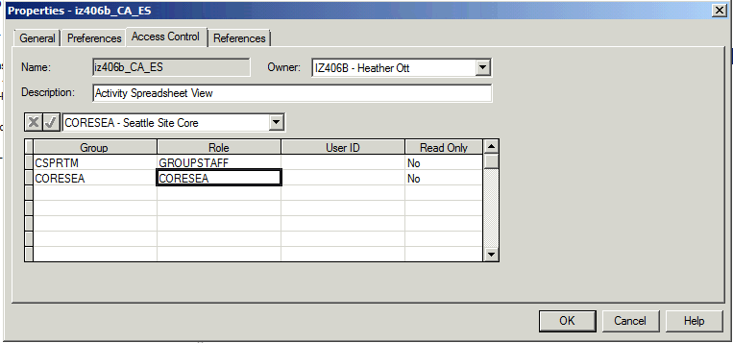
Sorts – Complex
Compound Sort View
Notes:
The user can see the saved view in the views folder of the Open Plan Library. The Saved View can be used on other project. Access to the view can be granted to groups and individuals. Grant the students access.

Slide 23
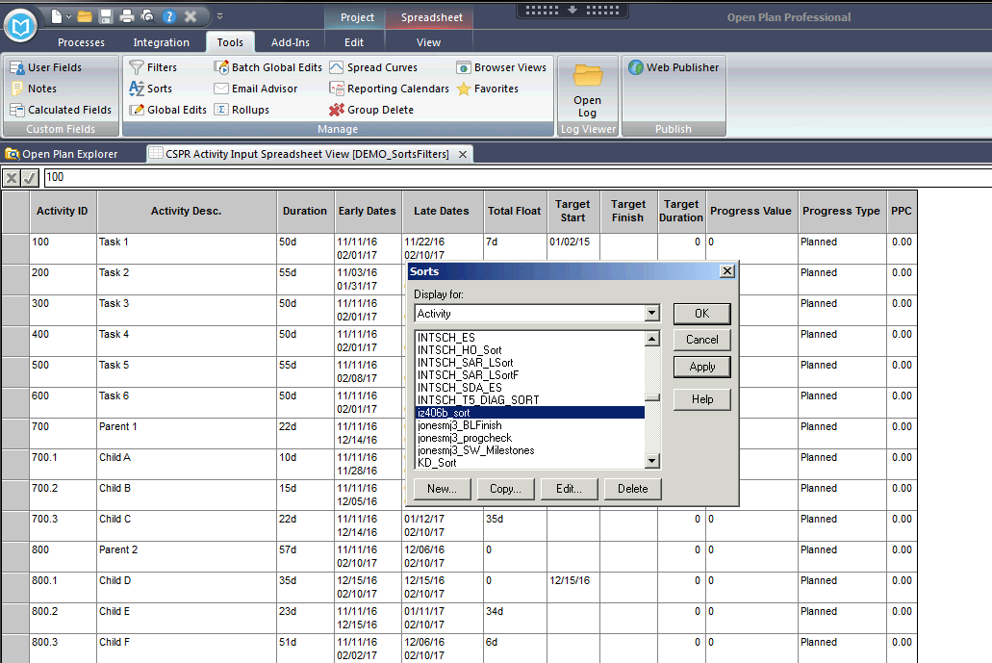
Sorts – Complex
It can be applied to other views (provided it is the same table).
Notes:
The saved Sort can be used with other views on this and other projects – as long as the views is based on the same table.

Slide 24
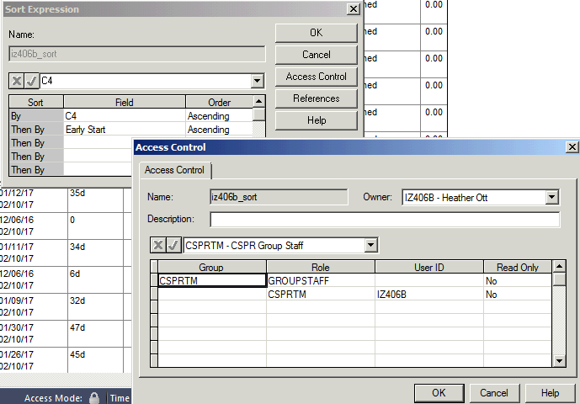
Sorts – Access Control
Sorts can be shared with groups or individuals.
Notes:
Sorts can be shared with read or write access to groups and individuals. All sorts that one has access to will be available when opening the sorts dialog box from the tools drop down menu.

Slide 25
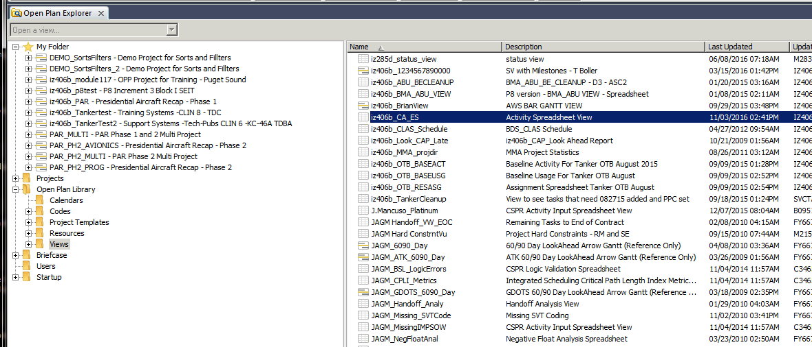
Copy Shared View to {yourID}_xx Project
Copy this View into your project
Notes:
Returning to the OPP Explorer, have the students add the TRAIN_CA_ES view to their {yourID}_136 project using either drag and drop method or copy and paste.

Slide 26
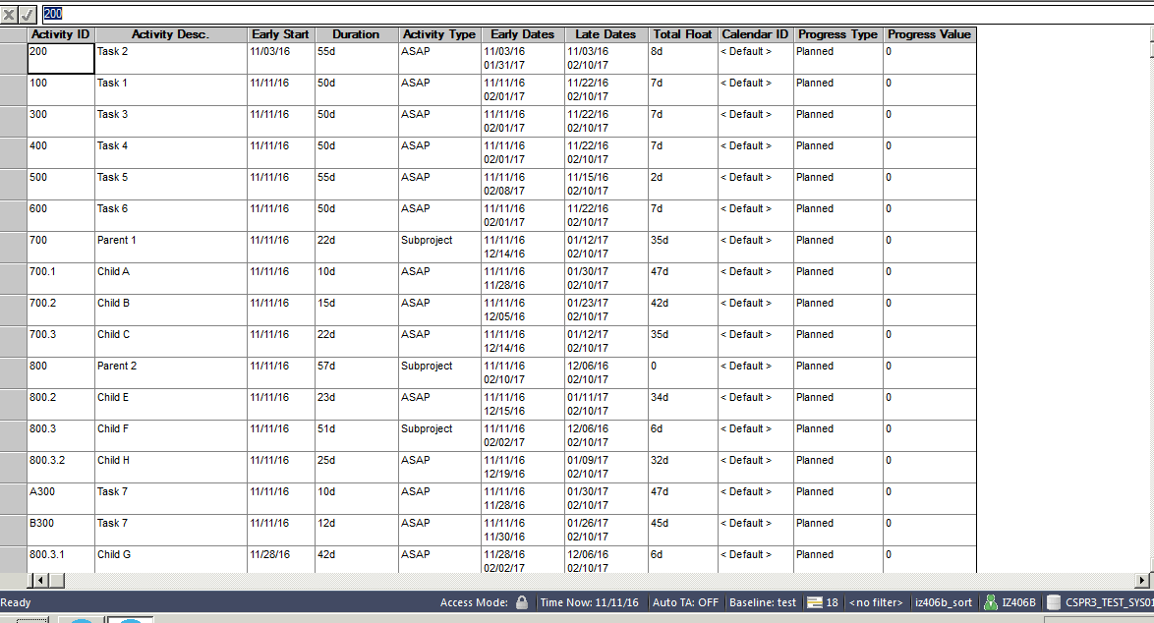
Shared Views can “share” Sorts that are Not-Shared
Users can now use the sort that they could not see before
Notes:
Opening the new view, the students will see in the status bar that the sort that they could not see before is now applied to the view.

Slide 27
FILTERS

Slide 28
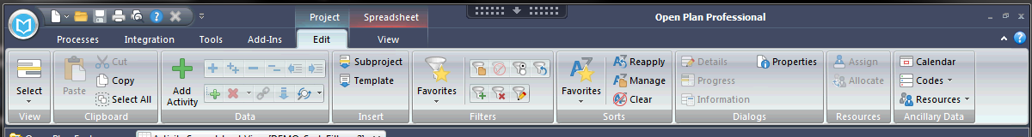
Filter Shortcuts
Filtering in Open Plan is now easier and more interactive. Filtering shortcuts are available on the Edit ribbon:
Display the Filters dialog box
Clear the current filter
Toggle the current filter on/off
Reapply the current filter/sort
Add a selected value to the current filter
Remove the selected value from the current filter
Edit the current filter

Slide 29
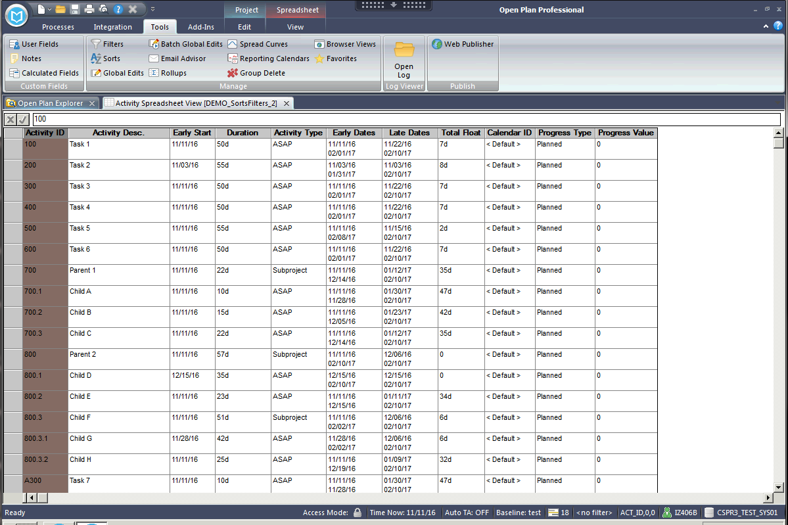
Filters Identified in Status Bar
When opening any View in OPP, the records being displayed are controlled by Filters.
The Filter being applied to Views is shown in the bottom right corner. Here “No Filter” is enabled meaning all records are displayed.
Notes:
The users are accustomed to seeing Filters identified in the status bar when applied.

Slide 30
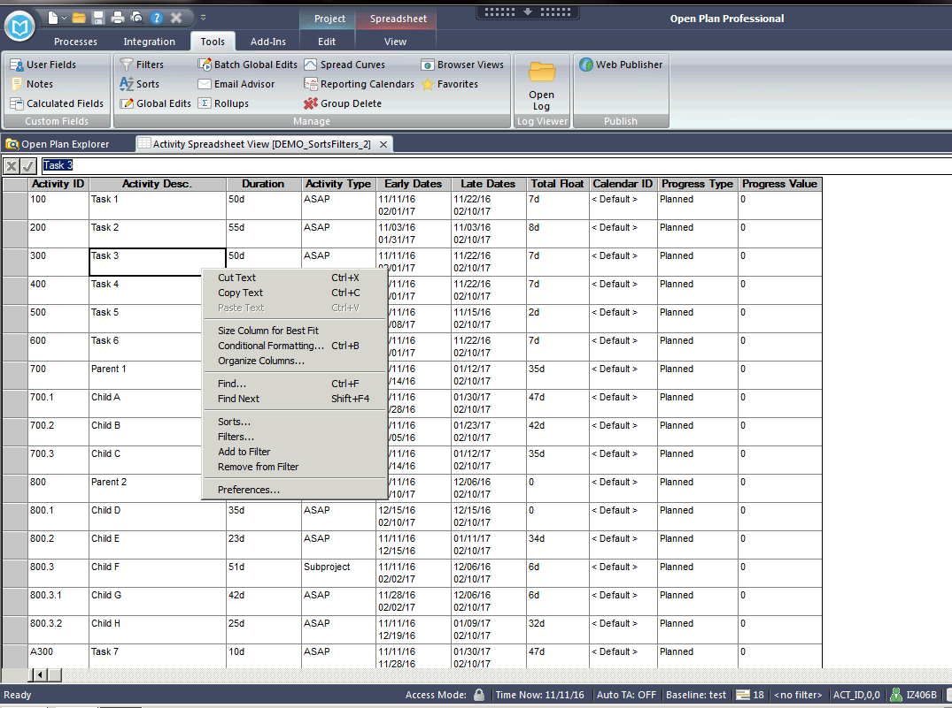
Selecting Filters from Shortcut Menu
Creating or modifying a Filter can be done by right-clicking in a spreadsheet and selecting “Filters”.
Notes:
User can access Filters by right-clicking and selecting from the short cut menu.

Slide 31
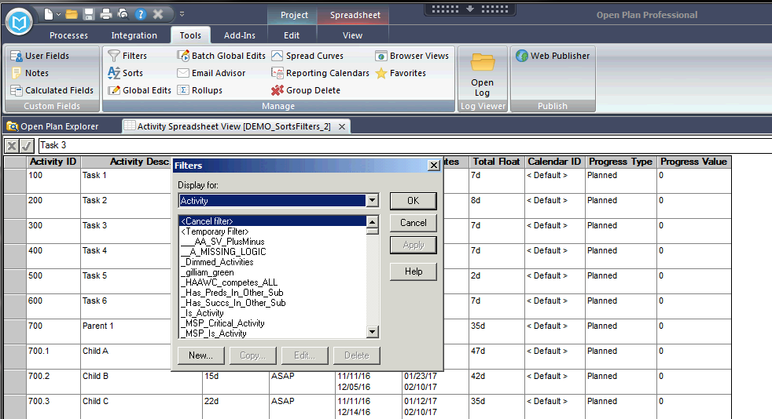
Selecting Filters from Tools Ribbon
Notes:
Or the user can select Filters from the Tools ribbon.

Slide 32
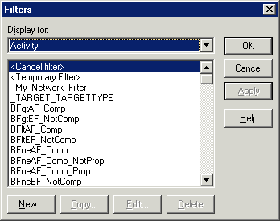
Filters Dialog Box
Filter can be created for many tables – most frequently we will use Activity table
Cancel Filter
will return all
records in a view.
The user can create
a Temporary Filter
that is not saved.
Other filters the user
has access to are
listed alphabetically
Notes:
Either of the above methods will bring up the Filters Dialog box. At the top, the drop down allows the user to determine which of the table in OPP the filter will be used with. – Most frequently, we will be defining filters that apply to the Activity table.
<Cancel Filter> selection results in all records being shown
<Temporary Filter> allows the user to create a filter but it will not be saved for use later
The remaining alphabetical list shows all the filters that the user has access to use. This list will include those created by the user and those created by others and “shared” with other users.

Slide 33
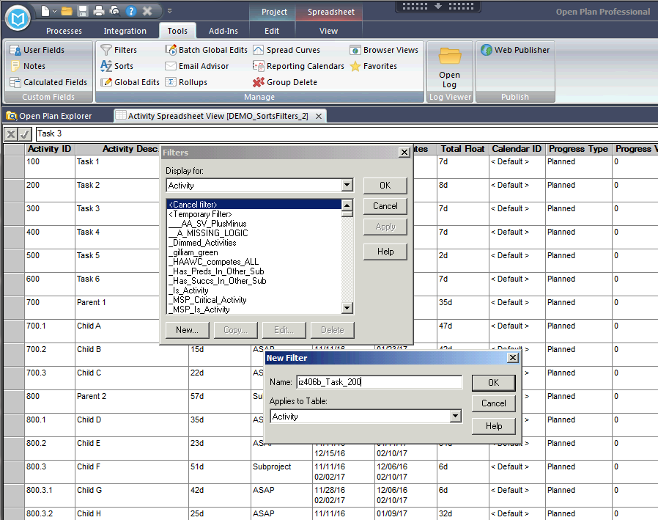
Creating a New Filter
A Filter is required that will return the Work Package Activity Id of 200. Go into Tools/Filters and select “New”.
A name is needed for a new filter. As with sorts, name filters starting with your CSPR Id. Let’s use {yourID}_Task_200
Notes:
Have each student return to the view that they created {yourID}_CS_ES. Let’s practice making filters by creating a filter to select only task 200 of the project. Give the new filter the name {yourID}_Task_200.

Slide 34
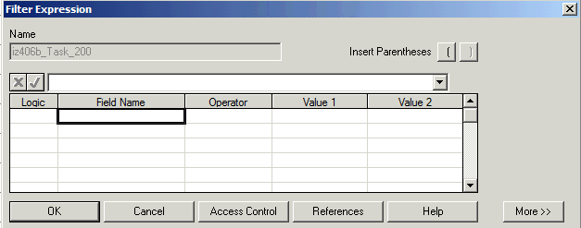
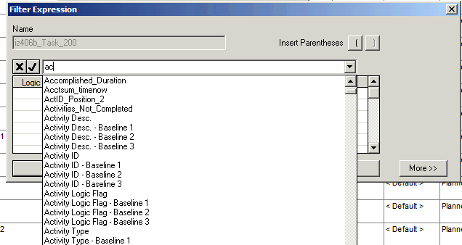
Creating a New Filter
Read and Write access to filters can be granted to other users and/or individuals.
Do not grant others access to this filter.
Select the Field Name
box on the first line
Select the desired field from the drop down list.
Notes:
Select the field name box in the first row and then the drop down arrow and choose the Activity ID field.

Slide 35
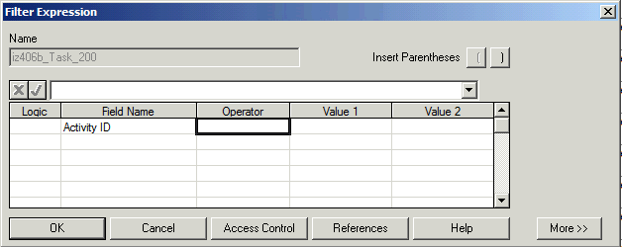
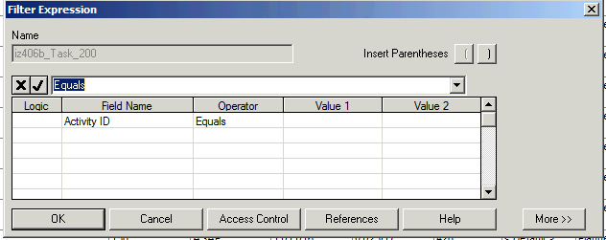
Filters
Operators:
Between
Contains
Equals
Gr. or Equal
Greater Than
Is Empty
Less or Equals
Lee Than
Not Contains
Not Empty
Not Equals
Notes:
Select the Operator box in the first line and then choose the drop down arrow. From the list of operators available, select Equals. Users can see the full list of choices for the operator on the chart. We will explore more of these operators in just a bit.

Slide 36
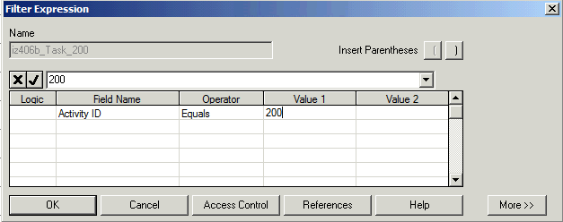
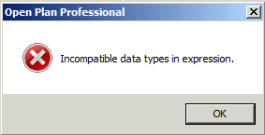
Entering Value1 into New Filter
Enter 200 in Value1.
Click OK
Notes:
The last step is to enter the value 200 into the Value1 cell. And then click OK and then OK again.
What do we see? Should be No tasks
Why? - Students should suggest or be led to a discussion about delimiters around the text
Explain that in most cases OPP will identify errors like this.

Slide 37
Delimiters for Constants in Filters
Text must be enclosed between quotation marks, “ ”.
Dates must be enclosed between curly brackets, { }.
Durations must be enclosed between piping symbols | |.
Numeric can be positive or negative and can include decimals.
Logical values are: True, False, and their abbreviations, T and F.
Enumerated values must be enclosed between square brackets, [ ].
Notes:
Just as when working with Calculated Fields, the user must use the correct delimiters around different data types. The Activity ID field is a text field so we must enter quotes – either single or double quotes – around the activity ID.

Slide 38
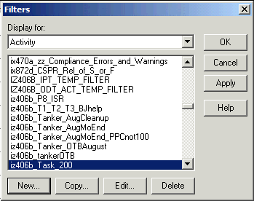
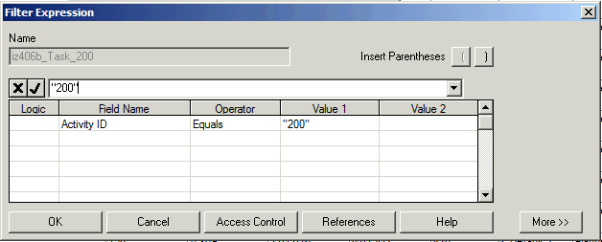
Entering Delimiter Around Value1
Note the quotes around
the text value.
Click OK
Notes:
After selecting the edit of {yourID}_Task_200 filter the user can add the quotes around 200.

Slide 39
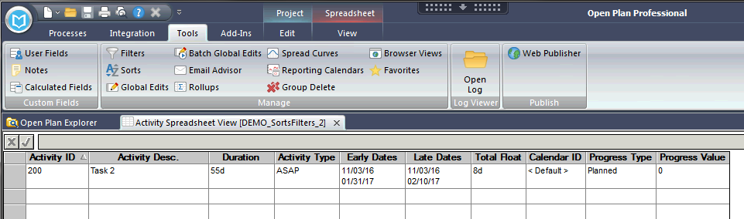
Project with Task_200 Filter applied
Filter returns only a single activity
Notes:
After applying the revised filter the single task is selected.

Slide 40
Filter – Find Dates Between
For the next filter challenge, let create a new filter:
Title Filter: {yourID}_Between
Filter should identify tasks which have Early Finish between
11/11/16 and 2/01/17
OR
Task type is Finish Milestone
Notes:
Our next filter will use the Between operation to identify all the tasks with Early Finish between 11/11/16 and 02/01/17

Slide 41
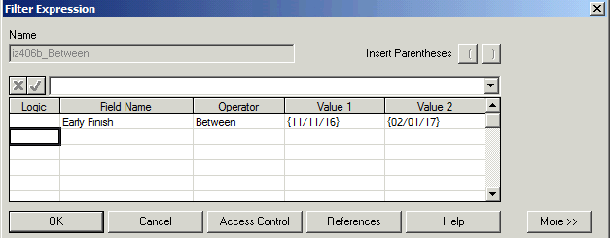
Using Between Operator in Filter
Note - The Between & Not Between Operators will
require Value1 & Value2
Notes:
After creating the new filter the user selects the Between Operation which requires entries in both the Value1 and Value 2 fields. Remember the proper delimiters for constants – in this case dates are set off by curly brackets - {}
Applying this filter gives only one task – 500

Slide 42
Compound Filter
The Between Operation works well if only comparing values in a single field. However, frequently we need to work with more fields. We do so using the Logic field. Let’s demonstrate by creating:
Title Filter: {yourID}_Between_or_Finish MS
Filter should identify tasks which have Early Finish between
11/11/16 and 2/01/17
OR
Task type is Finish Milestone
Notes:
Let’s increase the complexity of the filters we are working with by using the Logic field to create a compound filter. Let’s do create one that will identify values with Early finish as defined in our Between Filter but also include any task with type of Finish Milestone.

Slide 43
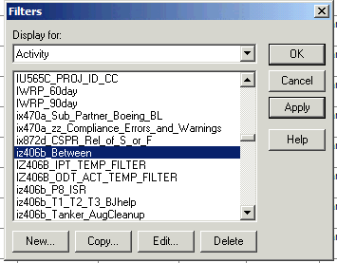
Create New Filter Using Copy
Select {yourID}_Between filter and then Copy
Notes:
Because we are going to reuse the Between filter logic in the new filter, let’s create a new filter by using Copy button after selecting the Between Filter.

Slide 44
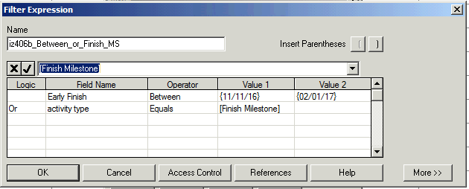
Compound Filter using OR
Note that enumerated values
appear in drop down for Value1
after selecting Activity Type field
Select OR from the Logic dropdown
Notes:
Rename the filter {yourID}_Between_or_Finish_MS. Click into the logic field on the second line and then choose OR from the dropdown. After selecting the Activity Type field and the Equals operation, the user sees that clicking into the Value1 field, the drop shows a lists of the valid values – also called enumerated values. From the drop down, select the Finish Milestone. Click OK and OK.
After applying the new filter there are now 2 items shown.

Slide 45
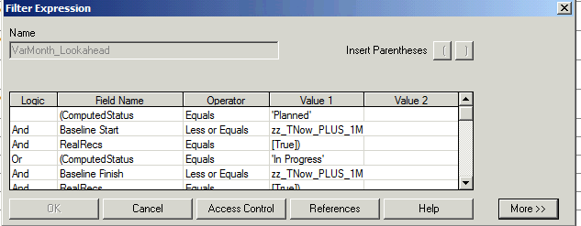
Using Parentheses for more Complicated Filters
Parenthesis ‘()‘ can be used to group Filter criteria.
This filter contains several.
To insert into
expression
Notes:
The use of parentheses can lead to very complicated filters – like the one shown on slide 44. We will not attempt to replicate this one, but let’s do a little practice with parentheses.

Slide 46
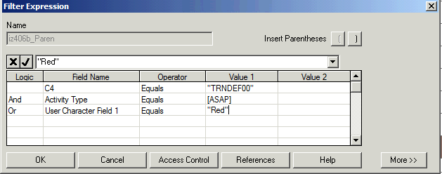
Compound Filter – No Parentheses
Notes:
Let’s demonstrate the effects of parentheses by creating a new Filter titled {yourID}_Paren. Define the filter as
C4 Equals THA43EN2
And Activity Type Equals ASAP
Or User Char 1 Equals Red
Click OK. And OK again. This filter to 5 tasks

Slide 47
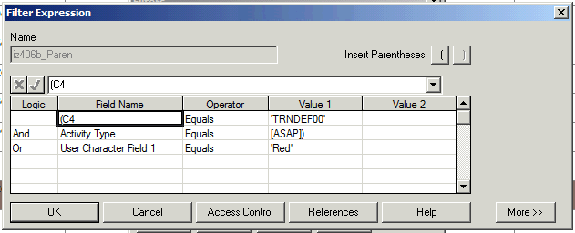
Compound Filter – Parentheses Added by OPP
Although we did not manually add the parentheses,
OPP has added to clarify the order of operations
Notes:
Let’s Edit our filter. We see that OPP has added parentheses in front of C4 and after [ASAP] indicating that it will perform the AND operation prior to the OR operation.
Let’s modify – first we need to remove the existing parentheses. Click into field (C4)on first line and click into the edit bar and use click /arrows to move to and then delete the open parenthesis. Next click on the Value1 in second line [ASAP] – an easy way to delete the parenthesis is to reselect the [ASAP] form the drop down.

Slide 48

Filters
Use these buttons to add parentheses
Open parenthesis
goes here
Close parenthesis
goes here
Notes:
Now to add the parentheses where we want – select the Activity type field in line 2 and then the left parenthesis button. Finally select the Value2 field in line 2 and then the right parenthesis.
Click OK twice and we see that the modified filter shows only 1 value. The parentheses can significantly alter the definition of any filter.

Slide 49
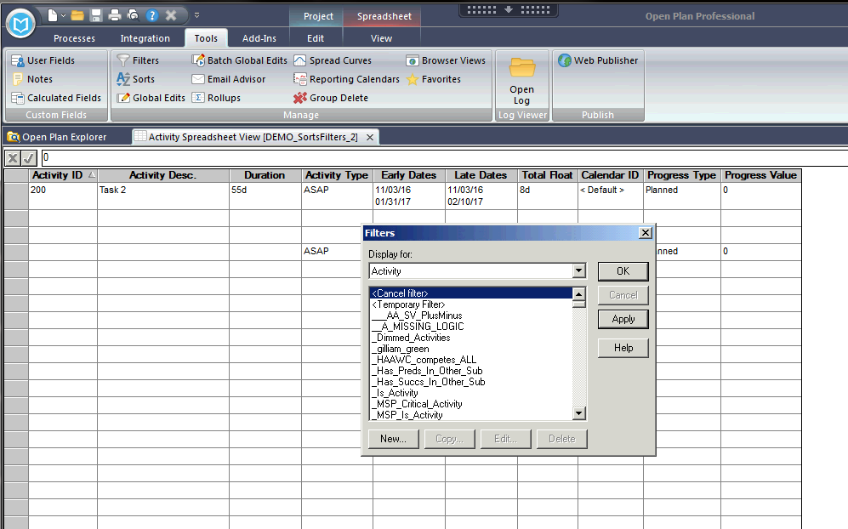
Selecting <Cancel Filter> Removes Filter Criteria
Notes:
Just a reminder that the Cancel Filter selection at the top of the filter list removes all filters …

Slide 50
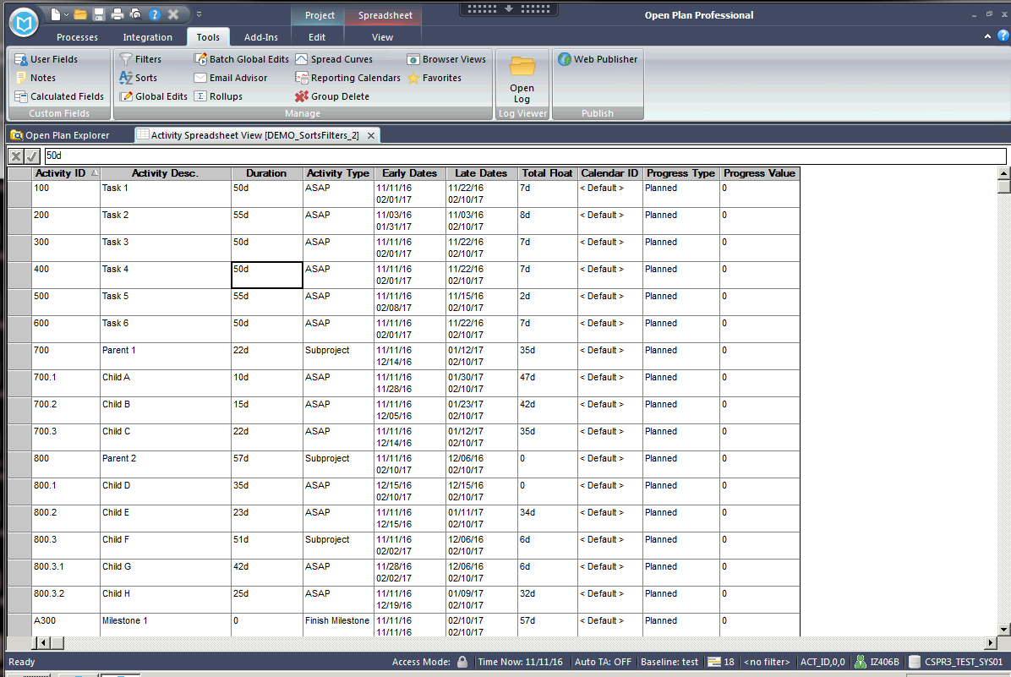
<Cancel Filter> Shows All Records in a Project
Note – No Filter Applied
Notes:
… and shows all tasks in the project.

Slide 51

Character Fields in Filters are Case Sensitive
Create a filter titled {yourID}_Green to display all tasks with User Character Field 1 equal to “Green”
Notes:
Students need to remember that filters that operate on Text fields are Case sensitive. Create a new Filter titled {yourID}_Green. With User Character Field 1 Equal to “Green”. Applying the filter shows that 3 tasks are selected. Are there really more?

Slide 52

Examining Filter Results in the Spreadsheet View
Filter shows True/False values
May want to change filter
to use Contains Operation
Shows the filter is
Case Sensitive
Notes:
Remove the Filter and add the User Character Field 1 and the {yourID}_Green to the spreadsheet so that we can see the data and the evaluation of the filter. In the sheet that we see several tasks (like 80.2 and 700.2) for which the spelling of green has lead to a False value.
The user had several options - 1) data cleanup, or 2) modification of the filter to include alternate entries like all lower case.
Note that the user could also consider modifying the Operation used in the filter to be “Contains” if they want the task 800.3.2 to be included.
We should note to the students that the variability of the spelling of key values is a strong reason why Code fields are frequently used for identifying values for key fields.

Slide 53

Filters Results Can be Evaluated Top Down or Bottoms up
Enabled Outlining and then create a new filter {yourID}_Outline that will display User Character Field 2 Equal to 1. Replace the User Character Field 1 with User Character Field 2 in the display
Filter displays 6 tasks – 3 details tasks and 3 Subproject tasks
Notes:
Filters can very depending on whether they are applied Bottom-Up or Top- Down. Demonstrate by right-clicking in the spread sheet and under Preferences enable outlining. Check the Outlining tab and choose a light color for the background.
Create a New filter titles {yourID}_Outline and filter for values of User Character Field 2 Equal to 1. (Remember quote delimiters!) Apply the Outline Filter.
Replace the User Character Field 1 with User Character Field 2 on the spreadsheet.
Note that filter display 3 subproject tasks and three detail tasks. The default is for filters to be applied from Bottom-to-Top.

Slide 54

Changing Filter Setting to Apply Top-Down
Select Top-down with Check
Notes:
Right-click on the spreadsheet and select Preferences. On the Outlining tab select the check box on left side to apply filters from the top down. Click OK.
Now we see that only 4 tasks are displayed. (Note the task 800.3 and it’s sub task 800.3.2 are not displayed.)

Slide 55


Selecting More Button on Filter
Select More to see internal
Format for filters
Can edit filter, including selecting
Fields and function in this display
Select Less to return to
Standard display
Notes:
Let’s take a look at the most advance screen in the filters dialog. Select Tools … Filters … and then the {yourID}_Paren filter. On the Filter Expression dialog select the More button on the lower right.
The display now show the filter expression in internal format. The user can actually use the Fields and functions buttons in creating filters.

Slide 56

Creating Filter with Functions/Fields
Fields are populated when
Validate is selected
Notes:
Let’s experiment with the More feature. Create a new Filter titled {yourID}_SQRT. At the Filter Expression dialog box, select More.
Select the Functions button and then choose the SQRT function. Click OK.
Select the Fields Button – and then click into the right pane and select the User Character Field 2. Click OK.
Move cursor to the right of the parentheses and type
= “1” Click Validate. Click OK And OK.
Right click on the spreadsheet and select Preferences. Disable outlining and Subsections.
The filter displays 5 tasks.

Slide 57
EXERCISES

Slide 58

Sorts - Exercises
Sort the class file by:
Early Start
Late Dates
Original Duration & Total Float
Activity Id
Notes:
Students perform exercises

Slide 59
Filters - Exercises
Filter the class file by:
Early Start is greater than 12/15/16
User Character Field 1 is Blue
Activity Description contains “Task”
Activity Description contains “Task” and User Character Field 2 = “1”
Notes:
Students perform exercises

Slide 60
Clean Up – Delete Objects Created During Class
Sorts
{yourID}_CA_and_Early_Start
and any other sort beginning with {yourID}_ created during the exercises
Calculated Field
{yourID}_}_CA_and_Early_Start
Filters
{yourID}_Task_200
{yourID}_Between
{yourID}_Between_or_Finish MS
{yourID}_Paren
{yourID}_Green
{yourID}_Outline
{yourID}_SQRT
And any other Filters created for exercises
Notes:
Cleanup – Students should delete the objects created in the class.

Slide 61
CHANGE LOG
DATE | SLIDE | DESCRIPTION OF CHANGE
10/21/09 | Slide 28 | Added slide to show the new filter toolbar icons.
11/3/16 | Several | Updated screenshots for OPP 8.0

