Slide 1
Advanced Global Edits
Notes:
Introduce the Advanced Global Edit Module.

Slide 2
Agenda
Global Edit Definition
Review – Creating/Copying
Tables
Elements
Rules/syntax
Operators
Batch Global Edits
Exercises
Clean Up
Notes:
Read the Agenda to the class and mention that is about a two hour module. We will also look at a new feature in 3.1 (was available in IPAS) Batch Global Edits. There are some hands on Global Edits that the students will be asked to create and execute.

Slide 3
Global Edits
Global Edits allow the user to change quickly change values for all tasks in a project. Global Edits can apply to activity, resource description or resource assignment fields.
A filter can be applied to limit the change to a set of records.
Notes:
A Global Edit will allow you to change values in a field for many activities with one command. It’s a very powerful function.
For this class, lets create our own copies of the module starting file. Open TRAIN_137 in read only mode. Select File … Save As … and name the file {yourID}_137. Select to include the Class baseline. Open the SPREADVW view.

Slide 4
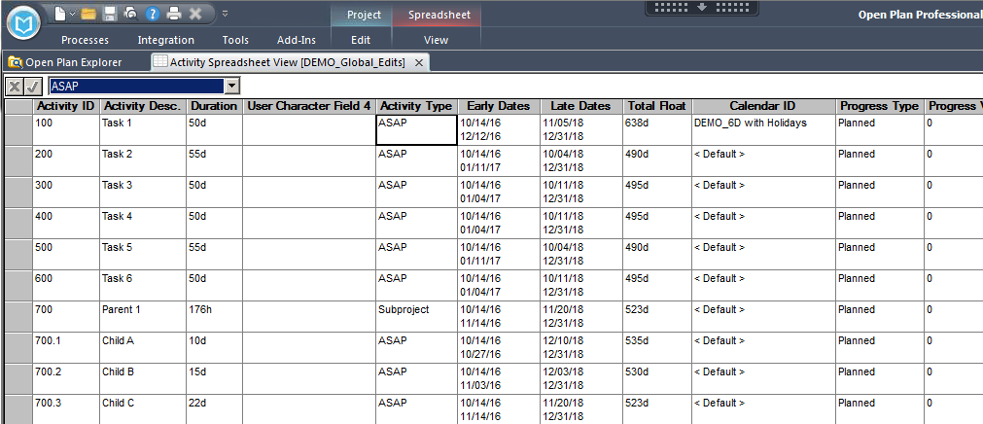
Desire for a New Global Edit
Identify what data you’d like to move (copy) into a new field
In this case, we want to move the Activity Description, into the User Character Field 4 field using a Global Edit.
Notes:
A good way to illustrate what a Global Edit can do lets look at creating and applying one. In this example, we are interested in creating a Global Edit that will move the information contained in the Activity Description field into User Character Field 4. In the example I have inserted both fields into this view. Notice Activity Descriptions are things like “Task 1”, “Task 2” and “Child 1”. Point out that User Character Field 4 is empty.

Slide 5
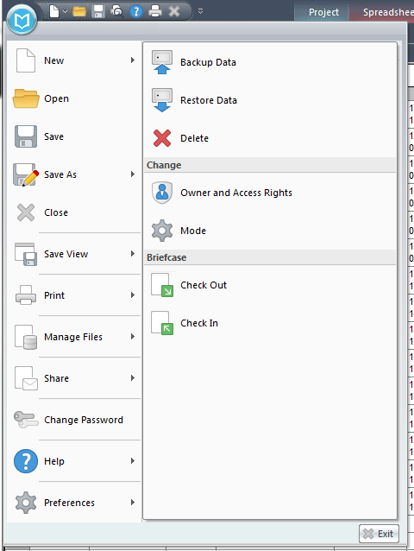
Backup a Project before Global Edits
Before executing a global Edit it is a good idea to backup your file.
Notes:
It’s a good practice to save or backup files before making major changes to projects. Some Global Edits could be potentially irreversible, some are not.
Reversible – Add 5 days to each Original Duration (you could run a Global Edit removing ( – 5d) those days.
Non Reversible - Remove the first 8 Characters of the Activity Description.

Slide 6
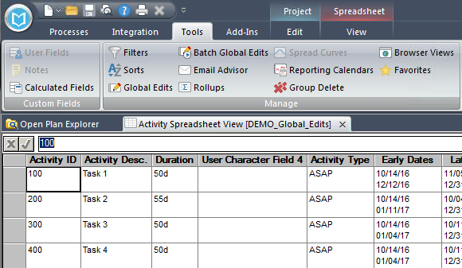
Launching Global Edit Tool
Select Global Edits in the Tools ribbon
Notes:
Show where the Global Edit function is located.

Slide 7
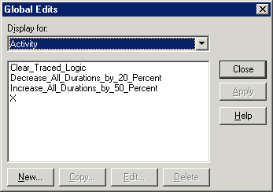
Global Edits Dialog Box
“Display for” referring
to the table selected
All pre-defined Global Edits
created by the user or
Shared by others will be listed
Select “New”
Notes:
The Global Edit Dialog Box. The User must indicate what table will be updated. In most cases, the Global Edit will apply to the Activity table. In this example the Activity Description and User Character Field 4 reside in that table.
We intend to create a new global Edit so select “New”. Notice the user can Edit, Delete or Copy any Global Edits associated with this Project.

Slide 8
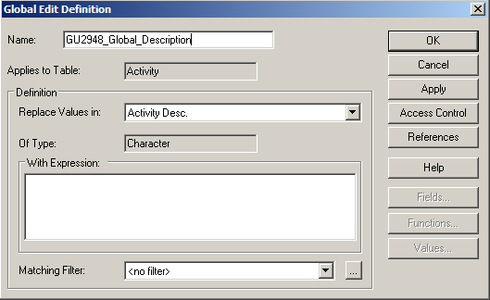
Global Edit Definition – Use Naming Convention
Use naming convention:
<Your ID>_Global_Description
Global edits can be shared with individuals or groups, with access defined as either write or read only.
Notes:
The first action that we will take is to name the Global Edit. It will be save in the project that we are working in. Use your User Id as a predecessor to the Global Edit name. It should be clear to all that good naming practice will allow the users to find/use the Global Edit again in the future.

Slide 9
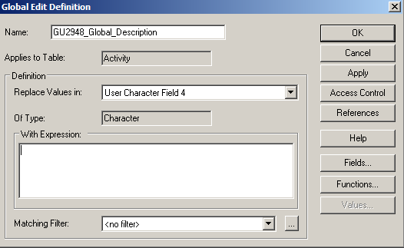
Global Edit Definition – Replace … With
This dialog box allows the user to select which field is being changed (‘Replace Values in:’ )
You also identify what you are using to change the selected field (in the ‘With Expression:’ box)
Notes:
Use the Global Edit name {yourID}_Act_Desc_Into_UCF4 . Next you will have to stipulate which field is being changed. The Global Edit dialog box requires what field is being changed and to what (Expression).

Slide 10
Global Edit Definition – Replace Values In
In this example, the information in User Character Field 4
Is being replaced with something else.
The system will display what
“data type” this field is.
Notes:
In this example User Character Field 4 is selected and the system will display what data type this is in the “Of Type” box. The data type of a User Character Filed is “Character”. Remember other data types include Dates,
Durations, Enumerated Values (discrete list of available results – like Activity Type), Decimal, Integer and Logical (True/False).

Slide 11
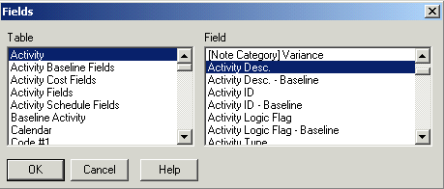
Global Edit Definition – With Expression
We are going to replace it with the contents of
Another field (Activity Description). Select “Fields”.
“Activity Description” is in the
Activity Table, select it.
Select Activity Description.
Select OK
Notes:
The user can then select how the data is to be changed, Field, Function or Values. The user can directly input the syntax into the “With Expression” dialog box.

Slide 12
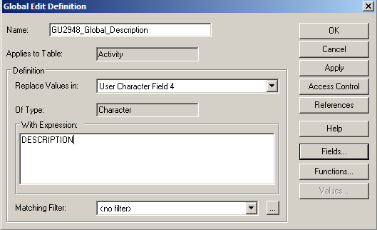
Global Edit Definition – Field names in Expression Box
Notice that the system name for that field is not the
same as what appears in the pull-down list.
Always populate the Expression box with field names
that you selected. Do not type them in, you could
make an input error.
Notes:
In this example we are going to replace User Character Field 4 with the Field Activity Description.
Select Field and select Activity Description from the Activity Table. Notice the System name for that field is non-intuitive. Better to select the field than try to type it in from memory – or what you think it might be.

Slide 13
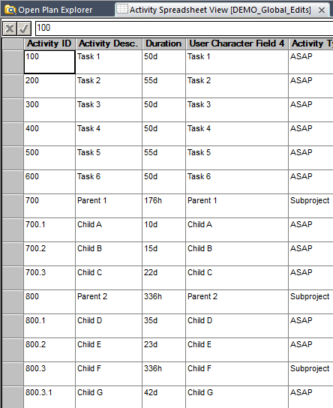
Global Edit - Applied
Select Apply*
Result of Global Edit.
* If the Apply button is not active, check that:
1) the project is open in Exclusive mode and
2) a View is open.
Notes:
The Global Edit is run when “Apply” is selected. We can see that the data has been moved into the field that we had selected. It does not matter if any selected fields are displayed on the screen or not – the values have populated in the fields.

Slide 14
Global Edits – Types of Data
In addition to Field Names, the Expression box can contain:
Character Operators
Constants
Duration Operators
Calculated Fields
Logical Operators
Mathematical Operators
Relational Operators
We will look at using some of these later
Notes:
The tool can work with any of the data types in OPP. We will be creating Global Edits that use a few of these.

Slide 15
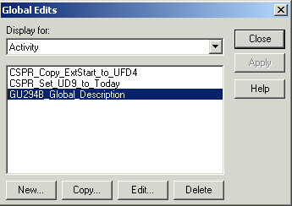
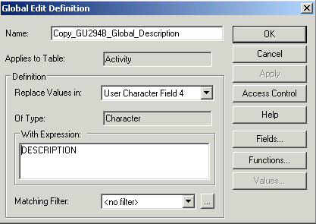

Creating a Copy of a Global Edit
OPP will place “Copy_” at
the beginning of Copied Global
Edits. Change the name using
standard naming convention.
You can also “copy” Global Edits
to make slight changes.
Notes:
Once a Global Edit has been created, it can be copied. The copy can be renamed and modified.
Make a copy of your {yourID}_Act_Desc_into_UCF4. Modify the name to be {yourID}_Act_Desc_into_UCF3. Change the Replace Values in to be UCF3

Slide 16
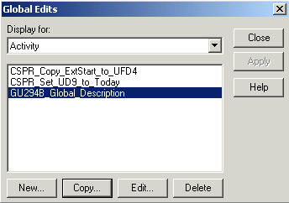
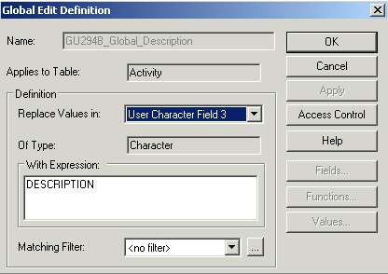
Editing a Global Edit
Changed from UCF4 to UCF3.
Global Edits can be changed
once created by selecting
“Edit”.
Notes:
To make a change to an existing Global Edit, select “Edit”. If we had not correctly changed the Replace Values in field to UCF3, we could do so from this screen.
Save the project

Slide 17
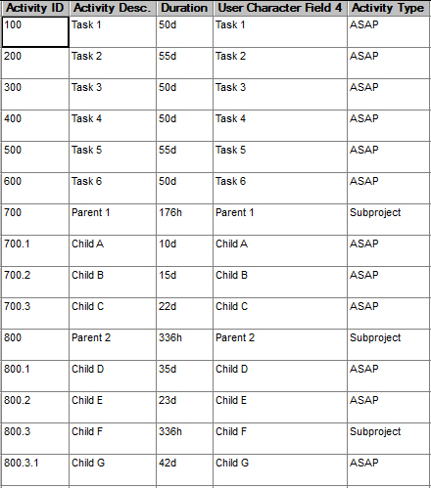
Global Edits Using Filters
Lets look at using a Global Edit to modify only a few records instead of all records.
The discrete set of records will be Identified by a filter.
As a first example, add the character string “Rollup“ to the beginning of the Activity Description field for all Subprojects.
Notes:
Unrestricted, Global Edits modify all records in the project, but Global Edits can be applied to a limited number of records using a filter. We will demonstrate by modifying the title of all Subproject tasks to include the term “Rollup”.

Slide 18
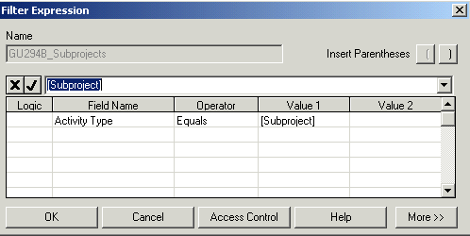
Create a Filter to use with Global Edit
First, create a filter that will return [Subprojects].
Notes:
The filter we need is very straight forward. Use name {yourID}_Subproject to select Activity Type = Subproject.

Slide 19
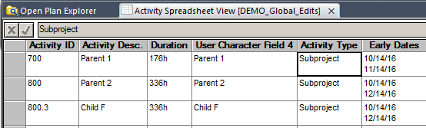
Subproject Filter Applied
Now only Subprojects are displayed
Now we will create the Global Edit to append “Rollup” to the beginning of the Activity Descriptions.
Notes:
When we create a new Global edit it has the matching filter of {yourID}_Subproject since the filter was a applied at the time the filter was defined. The objective is to create a Global Edit that append “Rollup “ to the front of just these records using Concatenation of a Text value + a field.

Slide 20
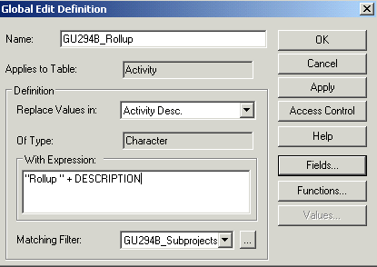
New Global Edit has Matching Filter
When ever a Global Edit is defined, the Matching Filter
will be set to the current active filter.
Use Character concatenation: “character string” + |field Name|
Notes:
Any filter on the view is automatically applied to the Global Edit in the Matching Filter field. In the Replace Values box we want to select the Activity Description in the With Expression we enter the data
“Rollup – “ + Description
This expression appends a text string to the front of another Character string.
Note - there is currently a “feature” in OPP 3.1 the Matching filter will not be “recognized if the user presses Apply here. Need to click OK and then select and Apply from the global Edit dialog. ( We can apply within the Global Edit Definition dialog any time after the initial creation or modification of the Matching Filter.) This is a Bug which should go away.

Slide 21
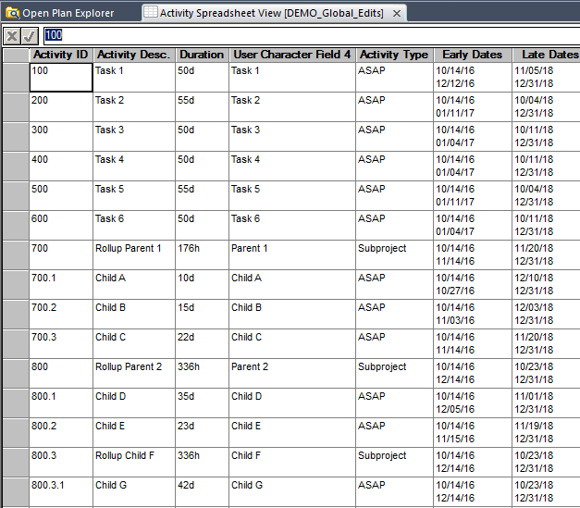
“Rollup” Global Edit Applied
The desired result.
Notes:
The Global Edit did what we expected. If there had not been a Matching Filter, all activities would have had the Description modified

Slide 22
What is Effect of Multiple Applications of Global Edit
What would happen if the Global Edit was run again?
Could you fix this? How?
Notes:
The Global Edit re-applied will put “Rollup “ in front of the current Activity Description. Ask the class if this is reversible? Answer is no (Unless save of project just before Global edit) – would have to write a “reverse Global Edit” to remove – Suggestions of how?

Slide 23
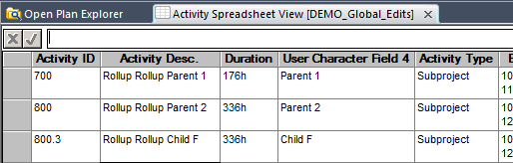
Recovery after applying Global Edit twice
You could create a Global Edit to move User Character Field 4
back into the Activity Description Field, then re-run the “Rollup”
Global Edit (once).
Notes:
Because of the backups we have made in this project, one fix would be to create a Global Edit that replaces Activity Description with User Character Field 4 and then Apply the “Rollup” Global Edit.

Slide 24
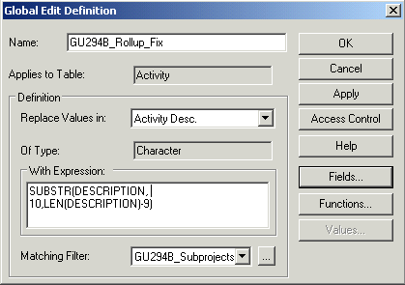
Another Fix using Global Edit Functions
Or you can use a Function. In this example
We will use SUBSTR(,,):
Notes:
You can also use any one of several functions. The Substring Function can be used to replace a field with a partial string. This example of using SUBSTR() along with the LEN() functions could be used to fix the Activity Description.

Slide 25
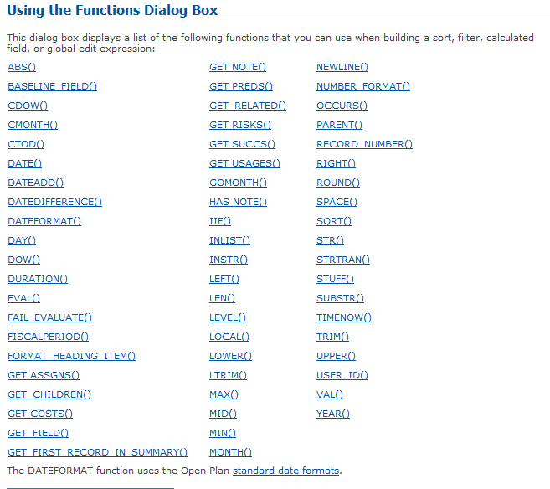
Function Help Dialog Box
There are many Functions available to the user.
Notes:
Easy for us as instructor to say that we could use those functions, but in the real world, we need to think through approaches that will achieve the desired effect. Often that begins with looking at the list of functions available for Global Edits that we can see as we press the Help button on the Functions dialog box.

Slide 26
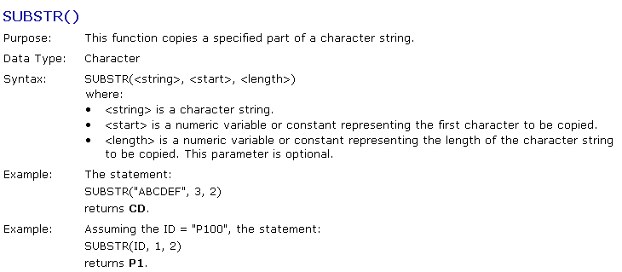
SUBSTR Function Help Screen
Example: SUBSTR(DESCRIPTION,10,(LEN(DESCRIPTION)-9)
So we took “Rollup - Rollup - Parent 1”
}
Move 9 characters over & take the remaining characters
Notes:
For any of these functions we can click the blue hyperlink to bring up specifics on the function including purpose, data type, syntax and examples.

Slide 27
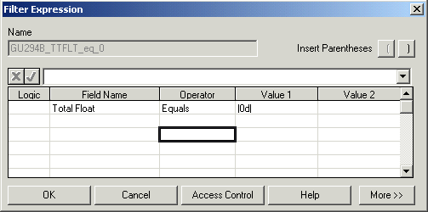
Performing Duration Math in Global Edit
Durations can be modified using Global Edits.
We want a Global Edit that will subtract 10 days
from the duration of all activities with Total Float = 0.
First create the filter for that condition.
Notes:
We will look at creating and applying another Global Edit. We looked at making a change to a character string before (Activity description). Now, lets look at modifying Original Durations using Global Edits.
In particular, we will subtract 10 days from every activity that has total float of 0d. First we create the appropriate filter.
Before we start, this is a good time to Save the Project.
Name the filter {yourID}_Total_Float_0 and define as Total Float = |0d|

Slide 28
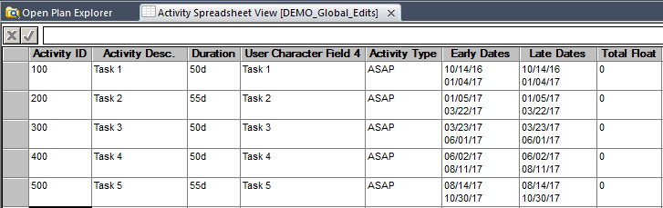
Zero Float Filter Applied
Notice Durations are 55d & 50d.
Notes:
After the filter is applied, the activities with total float = 0 are 55 or 50 days.

Slide 29
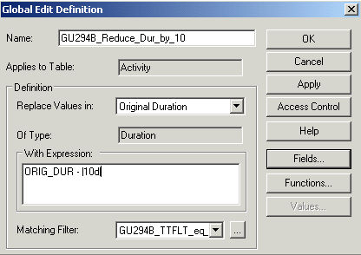
Define Global Edit to subtract 10 days for Critical Task Durations
Use {yourID}_Reduce_Dur_by_10
Replace Values in Original Duration
With Original Duration – 10 Days
- Remember Brackets ||
But only activities with 0 Total Float
Notes:
Create a New Global Edit – use name {yourID_Reduce_Dur_by 10d. The dialog box describes what we want to change (Original Duration) by or (Original Duration value – |10d| ) and to records which match the filter we just created .(Total Float = 0 filter).
Click OK.
From the Global Edit dialog, Apply this Global Edit.

Slide 30

Global Edit Had Changed Durations
Was
Now
The Early Dates have not changed, why?
Notes:
Original Durations have been reduced. Why are the Early dates unchanged?
Answer - of course - is that the Early Dates will not change until a time analysis is performed.

Slide 31
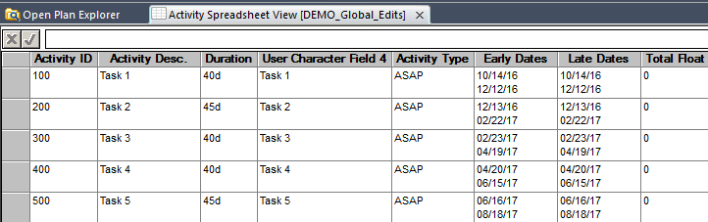
Time Analysis Reflects the Changed Durations
Was
Run Time Analysis
Now
What happened to Early Dates?
Notes:
After running Time Analysis, the Early Finish Date (and Late Finish Date) for Activity 500 is 1/31/05 – it had been 3/28/05. reflecting the 40d reduction in durations.

Slide 32
How to Remove the Global Edit Changes?
Would it be easy to change Durations back to the original values?
Was
Now
Notes:
After we have done the Global edit – How could we get back to the original model?
Revert to last save
Hand enter
A modified Global Edit?

Slide 33
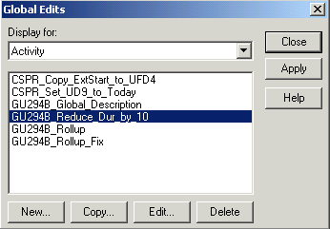
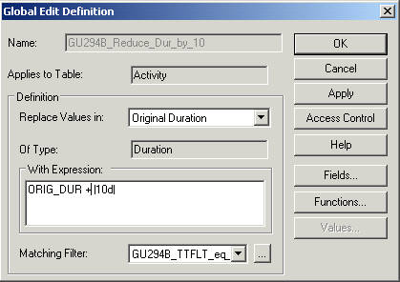
Edit the Global Edit to Reverse the Changes
Select Edit
Change “-” to “+”
and Apply
Notes:
An easy solution would be to modify the last global edit to change the “-” to “+” and Apply.
Personally, I would likely have recommended storing the duration in another field before the Global edit. Could even have captured the duration in a Baseline duration column.

Slide 34
Batch Global Edits
Frequently there is a requirement to execute multiple Global Edits, Which have been previously defined, in a specific order.
Let’s demonstrate that by making a copy of the starting file for training (TRAIN_137) and via File … Save As create another file titled {yourID}_137a.
Create a Batch Global Edit that applies the three Global Edits that we have created thus far to the New Project
Notes:
Batch Global edits allow a user to easily to execute a collection of Global Edits in a specified order.
We can demonstrate that by
- making another copy of the start project TRAIN_137
- Renaming to {yourID}_137a
- Setting a Batch Global Edit to execute the Global Edits we defined earlier
- executing the Batch Global Edit

Slide 35
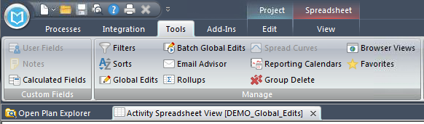
Launching Batch Global Edit
Select Tools ribbon… Batch Global Edit:
Notes:
Open the SPREADVW and insert the “User Character 4” Field.
Select Tools (ribbon) … Batch Global Edit.

Slide 36
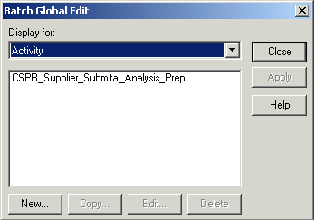
Define a New Batch Global Edit
Select New
Notes:
From the Batch Global Edit we could execute any of the previously defined BGE’s that we had access to. Instead we select the New button to prepare a new BGE.

Slide 37
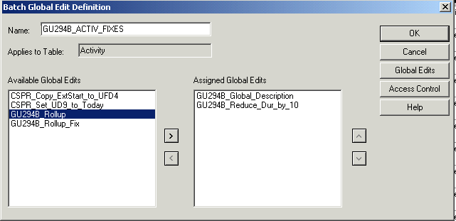
Selecting Global Edit for the Batch Global Edit
3 – Use Arrows to arrange
in desired order
1 – Select Global Edit to include
2 – Click Arrow to include
Notes:
Give the batch the name {yourID}_Activ_Fixes. From the Available Global Edit list select the required Global Edits for the Batch. Use Arrows in the center to move (or remove) the Global Edits into the Batch. Often order is important. It is executed from top to bottom.
The user can use the arrows on right side to rearrange the Global Edits until they are in the desired sequence.
Users can use the “Access Control” button to give others access to their Batch Global Edits.

Slide 38
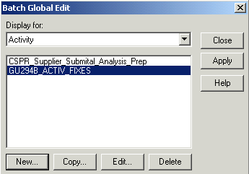
Applying the Batch Global Edit
Apply the Batch
Notes:
Apply the Batch. Batch Global Edits are saved in OPP, just like Global Edits themselves they are always available to the person that has created the Batch. They are only available to others

Slide 39
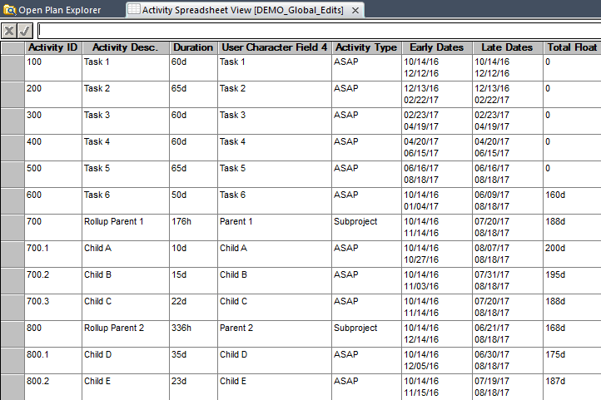
Batch Global Edits
gu294b_Reduce_Dur_by_10
gu294b_Act_Desc_into_UCF4
gu294b_Rollup
Notes:
The three Global Edits were executed. Remember that we had “edited” the <userid>_Reduce_Dur_by_10 to add 10d to the duration instead of the original purpose of the global edit (to subract 10d from the original duration of tasks with 0 float).
Be careful. Some Batches will need to be executed in specific order. For example, you plan to move Target Dates two weeks to the right then Update a User Character field with a flag for every Target Start later than a specific Date. You would need to run these two in a set order to obtain the desired results.

Slide 40
Global Edit Exercises
Create a Global Edit that will make all durations with positive Total Float 15% longer.
Create a Global Edit that will Place the Activity Id into User Character Field 3.
Create a Global Edit that will add “ - Critical “ to the end of all Activity Descriptions that have a Total Float of 0.
Return the Duration to original length created in #1 (above) using the Edit button.
Batch Global Edit (BGE) Exercises
Create a BGE that will run #1 and #2 above

Slide 41
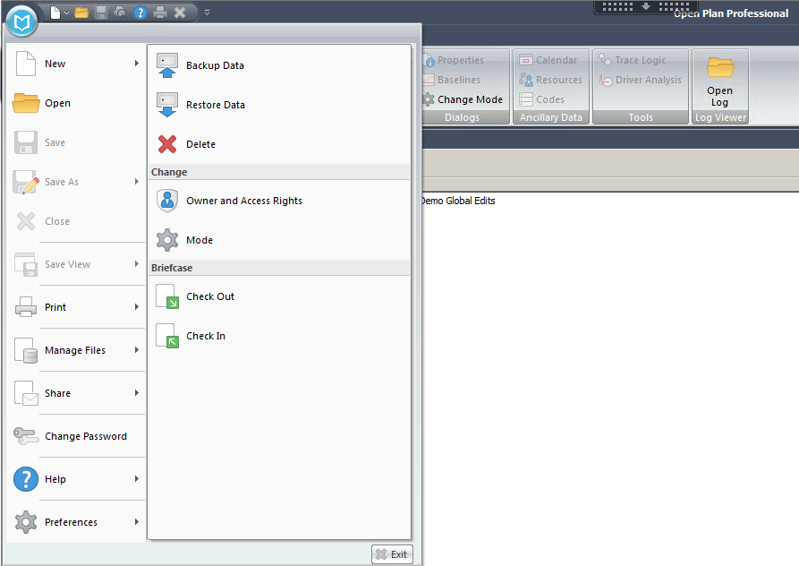
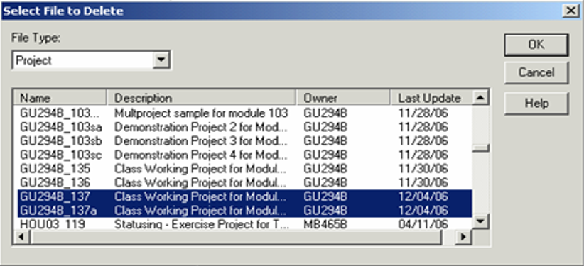
Clean Up - Delete Projects
Select type of Object
Select File > Manage Files > Delete
Delete Projects {yourID}_137
and {yourID}_137a

Slide 42
Delete other Objects Created for Class
Batch Global Edits
{yourID}_Activ_Fixes
Other created in Exercise
Filters
{yourID}_Subproject
{yourID}_Ttlft_0
Others created for Exercises
Global Edits
{yourID}_Act_Desc_Into_UCF4
{yourID}_Act_Desc_Into_UCF3
{yourID}_Rollup
{yourID}_Rollup_Fix
{yourID}_Reduce_Dur_by_10
Others created for Exercises
Notes:
Using a white board or OPP have the class provide you with the input to create the items on this slide.

Slide 43
CHANGE LOG
DATE | SLIDE | DESCRIPTION OF CHANGE
11/30/2006 | 4-41 | Updated all screen shots to include the “access control” button for global edits and filters. Also added the change log page43.
10/23/2016 | ALL | Update screenshots to reflect the new OPP 8.0

