Slide 1
Working with OPP Calendars

Slide 2
Agenda
General Information
Creating A Calendar File
Adding A Child Calendar
Defining Holidays
Defining Work Days
Defining Work Hours
Assigning a Calendar to a Project
Assigning a Calendar to a Task

Slide 3
Calendar Files
Open Plan contains a powerful calendar function that allows you to use any number of calendars to control when work can be performed.
When you first create a calendar file, Open Plan provides a default calendar that assumes Monday through Friday to be working days with an 8-hour work day. You then have the opportunity to modify these defaults and define non-working days as well as holidays and extra work days.
Calendars in Open Plan are hierarchical. This means that calendars can have both a parent and any number of children. Child calendars inherit from their parents dynamically.

Slide 4
Calendar Files
There is no limit to the number of working calendars for a project
Calendars can be assigned at the activity level
Multiple projects can share the same calendar set without duplication
Access to maintain calendars can be controlled separately from project access

Slide 5
Creating New Calendar Files
Creating New
Creating New as Copy of Existing

Slide 6
Create a new calendar

Slide 7
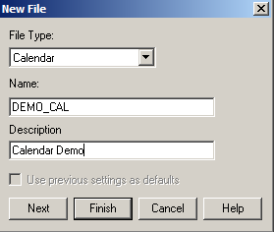
Creating a New Calendar File
Follow the steps below to create a New Calendar file for your OPP Project.
From the Open Plan Explorer, select File>New>Calendar File
The New File box opens with File Type ‘Calendar’ already selected
Type in the desired Name, using no spaces & adding ‘_CAL’ at the end
Type in the Description
Click Next

Slide 8
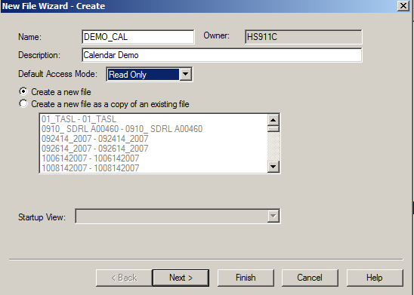
Creating a New Calendar File
The New File Wizard – Create box opens
Change the Default Access Mode to ’Read Only’
Select the Create a new file option
Click Next

Slide 9
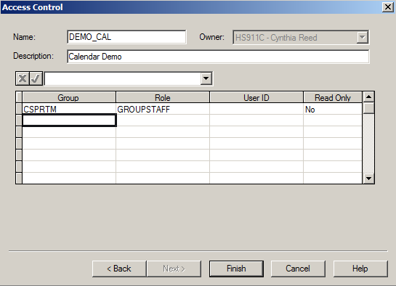
Creating a New Calendar File
The Access Control box opens
Assign the appropriate access for the calendar file
Identify if each group should have Read Only access, Yes or No
Click Finish
Notes:
Note: Adjust your Read Only selections appropriately. Not all groups should have Read Only set to ‘No’. This gives the group ‘Write’ access to the file.

Slide 10
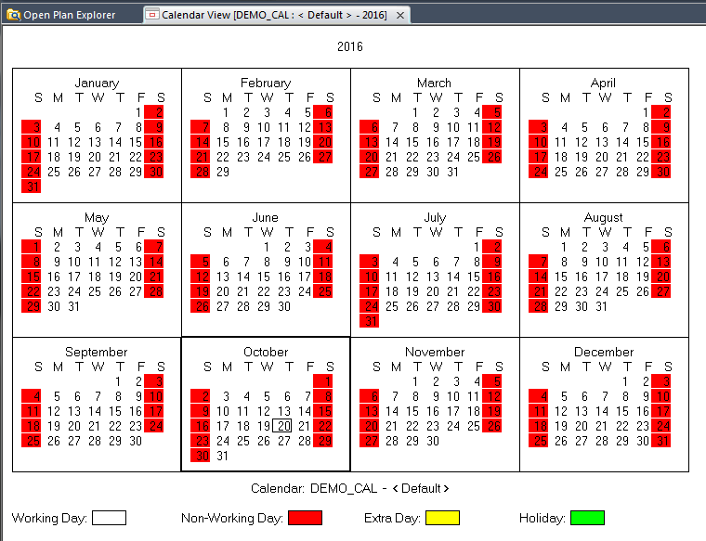
Creating a New Calendar File
The Calendar file has been created and will open to display the default calendar, in exclusive mode
Click File>Save to save the newly created Calendar file

Slide 11
Create a new calendar as copy of existing

Slide 12
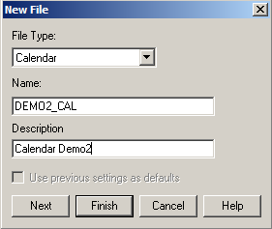
Creating New as Copy of Existing Calendar
Follow the steps below to create a New Calendar file for your OPP Project.
From the Open Plan Explorer, select File>New>Calendar File
The New File box opens with File Type ‘Calendar’ already selected
Type in the desired Name using no spaces & adding ‘_CAL’ at the end
Type in the Description
Click Next

Slide 13
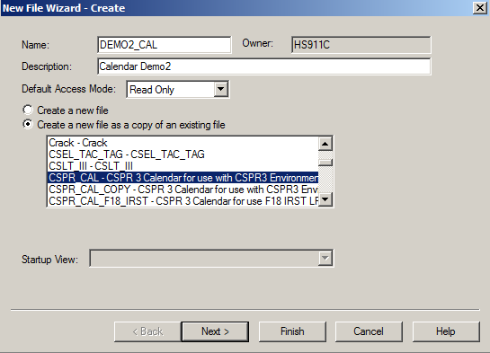
Creating New as Copy of Existing Calendar
The New File Wizard – Create box opens
Change the Default Access Mode to ’Read Only’
Select the Create a new file as a copy of an existing file option
Select an existing Calendar file to copy
Click Next

Slide 14
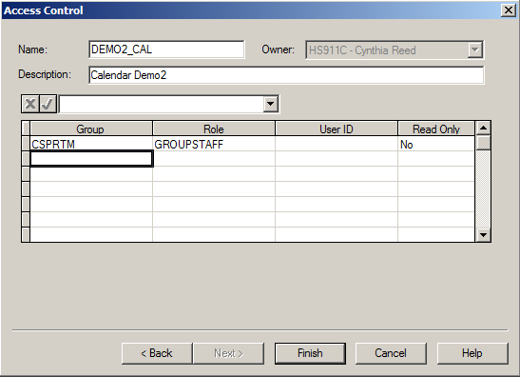
Creating New as Copy of Existing Calendar
The Access Control box opens
Any access from file copied will be displayed, update as required for this calendar file
Click Finish
Notes:
Note: Adjust your Read Only selections appropriately. Not all groups should have Read Only set to ‘No’. This gives the group ‘Write’ access to the file.

Slide 15
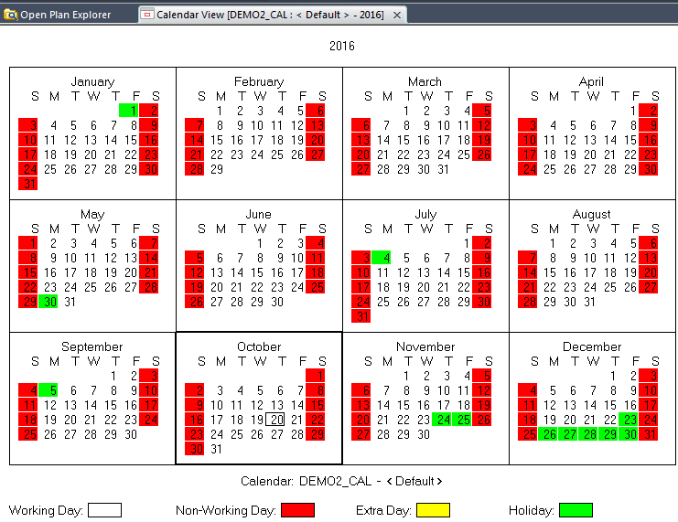
Creating New as Copy of Existing Calendar
The Calendar file has been created and will open to display the default calendar, in exclusive mode
Click File>Save to save the newly created Calendar code file

Slide 16
adding a child calendar

Slide 17
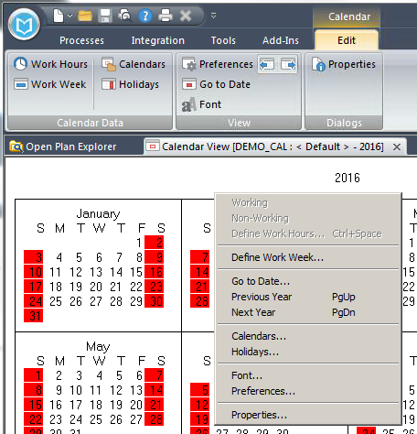
Adding a Child Calendar
Open the Calendar in Exclusive mode
This will open the default calendar
Right mouse click and select Calendars…, or select the Edit ribbon > Calendars

Slide 18
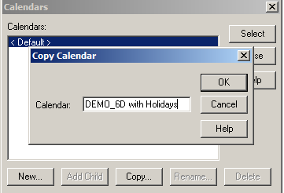
Adding a Child Calendar
Next click either New or Copy…
New allows you to define everything about the child calendar
Copy allows you to benchmark from the default so you only have to make minor changes (if applicable)
Name the child Calendar
Click OK

Slide 19
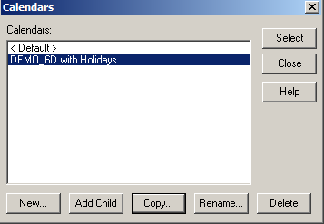
Adding a Child Calendar
The child calendar has now been created
All attributes have been inherited from the parent (<DEFAULT> in this case) calendar
Go to the next section to define Holidays and Work Hours
Name the child Calendar
Perform a File>Save to save your calendar

Slide 20
defining holidays

Slide 21
Defining Holidays for a Calendar
Open the Calendar file in Exclusive mode
The <Default> calendar view will open
Choose the sub-calendar you wish to define holidays on
Select the Edit ribbon, Calendars
The Calendars box will appear with the list of all its sub-calendars, highlight the desired one & click Select

Slide 22
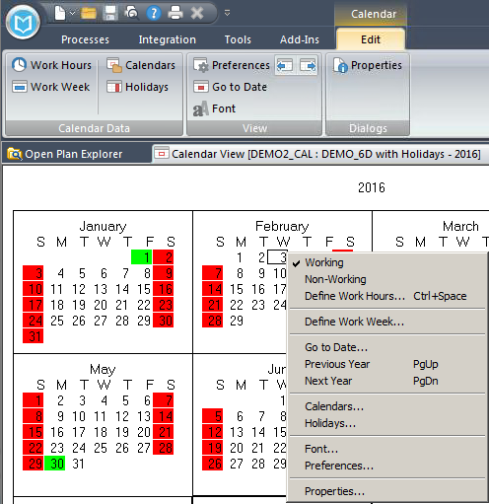
Defining Holidays for a Calendar
The selected calendar will now be displayed
Right mouse click and select Holidays…, or select the Edit ribbon, Holidays

Slide 23
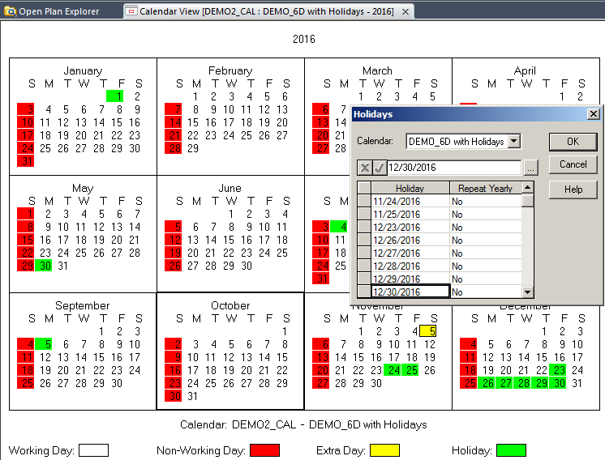
Defining Holidays for a Calendar
Add in the specific Holiday dates & identify if that date will repeat yearly (Yes or No), then click OK
The results can be seen in the calendar with the holidays highlighted in Green

Slide 24
defining Work days

Slide 25
Defining Work Days
Open the Calendar file in Exclusive mode
The <Default> calendar view will open
Choose the sub-calendar you wish to define holidays on
Select the Edit ribbon, Calendars
The Calendars box will appear with the list of all its sub-calendars, highlight the desired one & click Select

Slide 26
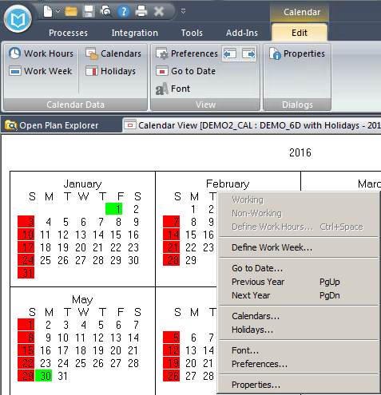
Defining Work Days
The selected calendar will now be displayed
Right mouse click and select Define Work Week…, or select the Edit ribbon, Work Week

Slide 27
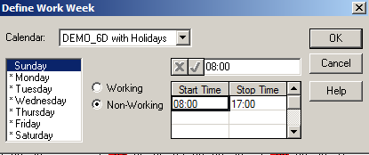
Defining Work Days
Click on each day of the week and toggle it either Working or Non-Working
Define the Working Hours here for each day (see also Define Work Hours section to update specific days)
When done, simply click OK

Slide 28
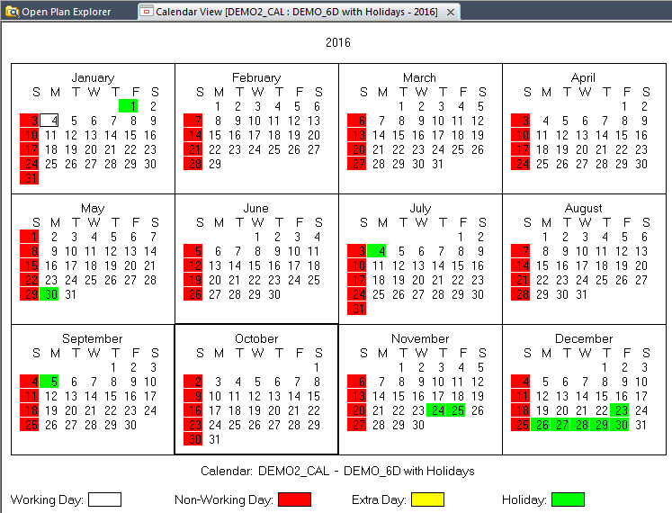
Defining Work Days
All of the Working and Non-Working days are now identified (displayed)

Slide 29
defining work hours

Slide 30
Defining Work Hours
Open the Calendar file in Exclusive mode
The <Default> calendar view will open
Choose the sub-calendar you wish to define holidays on
Select the Edit ribbon, Calendars
The Calendars box will appear with the list of all its sub-calendars, highlight the desired one & click Select

Slide 31
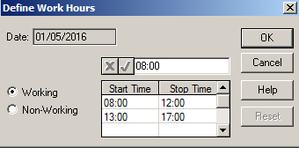
Defining Work Hours
The selected calendar will now be displayed
To update the Work Hours on a specific day, click on that day
Double click, or Right mouse click and select Define Work Hours…, or select the Edit ribbon, Work Hours
Make desired updates and click OK
See also (Define Work Days section for defining default Work Hours)

Slide 32
assign calendar to a project

Slide 33
Assigning Calendar Files to an OPP Project
Assign using Project Properties
Assign using Drag and Drop

Slide 34
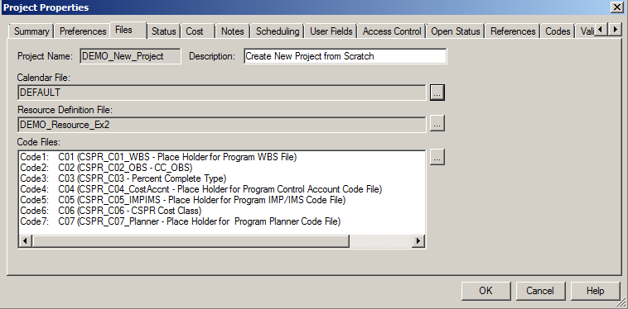
Assigning using Project Properties
Open the OPP project in exclusive mode
From the Processes ribbon, select Properties in the Dialogs section
Select the Files tab inside of the Project Properties window
Click on the ellipsis button next to the Calendar File box

Slide 35
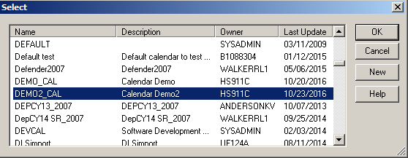
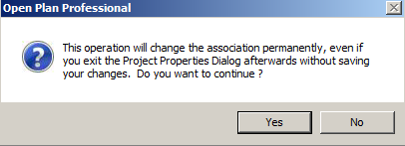
Assigning using Project Properties
A Select box opens
Scroll down and highlight the desired Calendar File
Click OK
Information box appears, click Yes to continue

Slide 36
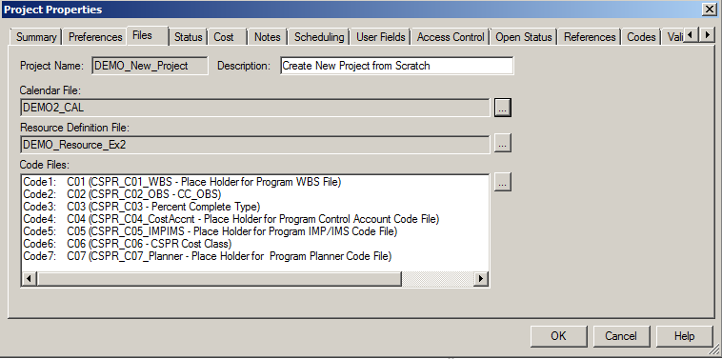
Assigning using Project Properties
The Calendar file is now associated to the OPP project

Slide 37
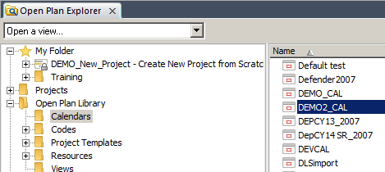
Assigning using Drag and Drop
Open the OPP project in exclusive mode
Highlight the Calendars folder in the OPP Library (left pane)
Highlight the Calendar file to be added (right pane)
Drag the highlighted file from the right and drop it onto the project you have open exclusively (in Open Plan Explorer, on left)

Slide 38
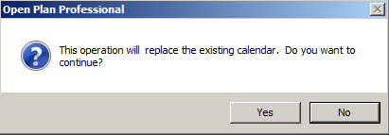
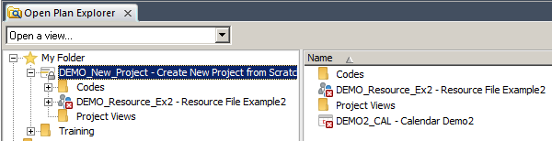
Assigning using Drag and Drop
If a Calendar code file is already attached, you will receive the message below. Click Yes to replace
The Calendar file is now associated with the OPP project

Slide 39
assign calendar to a task

Slide 40

Assign Calendar to a Task
Open a project file in Exclusive mode
Open any view (this walks us through in a Spreadsheet view)
On any give task, you can update the calendar in the view (ensure the Calendar ID field (column) is displayed
Simply toggle the <Default> calendar to the desired calendar
Or you can update via the Activity Details box
Either double click or in Edit ribbon, select Details(double click on task to display
Notes:
Manually adding Calendar IDs is highly discouraged if you are working with a project that is associated with a Cobra project. Then the OPP/Cobra mapping tool must be used for any Adds/Updates to the Calendar IDs.

Slide 41
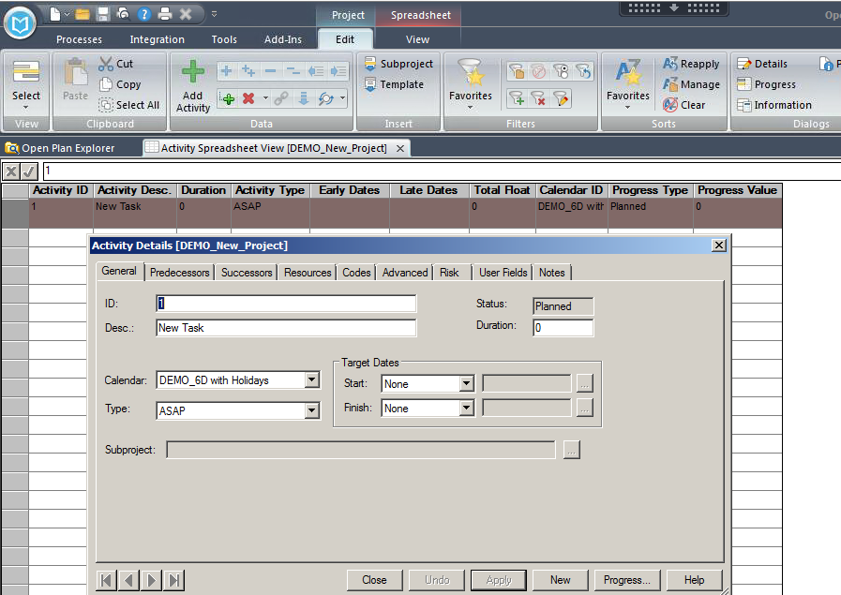
Assign Calendar to a Task
Select the desired calendar from the drop down
Click Apply
Notes:
Manually adding Calendar IDs is highly discouraged if you are working with a project that is associated with a Cobra project. Then the OPP/Cobra mapping tool must be used for any Adds/Updates to the Calendar IDs.

Slide 42
CHANGE LOG
DATE | SLIDE | DESCRIPTION OF CHANGE
10/23/16 | ALL | Updated slides to reflect OPP 8.0

