Slide 1
Access Controls

Slide 2
Topics
Object Access Controls
Object Access Controls Dialog Box
Baseline Access Controls
Baseline Access Controls Dialog Box
Tips and Tricks

Slide 3
OBJECT ACCESS CONTROLS

Slide 4
Object Access Controls (ACL)
Access Controls allows the owner of an object to grant User Groups (made up of multiple users) and/or individual Users the ability to access said object.
Access can be granted for Read Only access (users can see and open the object but cannot save changes to it)
Access can be granted for Write access (users can see, open and modify the object)
Objects are considered to be Projects, Views, Ancillary files, Filters, Sorts, Title Blocks, Calculated Fields, Global Edits, Batch Global Edits, Resource Files, Code Files and Calendar Files

Slide 5
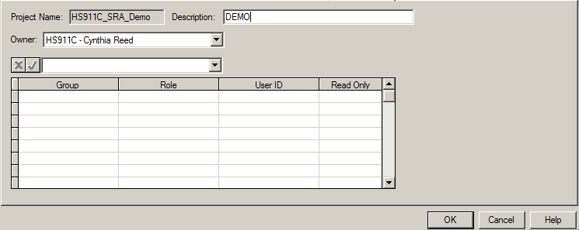
Object ACL Dialog Box
This dialog box allows you to change the access control information for the selected object
Below is an example of the dialog box you’ll see for all objects

Slide 6
Object ACL Dialog Box - Name
This field displays the name of the object for which you are defining properties.

Slide 7
Object ACL Dialog Box - Owner
Typically, the owner of the file or other object is the person who created it. While other users may have rights to modify many of the properties, only the owner or the system administrator can update the access rights or transfer the ownership of the object(s).

Slide 8
Object ACL Dialog Box - Description
This field controls the description of the object name.
If the object is an ancillary file & you have write access to it, you must have it open in Exclusive or Shared mode in order to modify the contents of this field. If the file is not open, or open in read-only mode, you may view – but not change – the information in this field.

Slide 9
Object ACL Dialog Box - Group
A Group has pre-defined access to Menus & Plug and Play tools and have multiple users assigned.
To make updates to Groups requires a CSPR Ticket.
As the owner of an object, you can select the Group you want to have access to this object by selecting a group name in the enabled dropdown list
On a single row, you can specify a Group or a User ID but not both.
Notes:
How a group controls access to OPP menu items and Plug and Play tools is outside of the range of this material

Slide 10
Object ACL Dialog Box - Role
Roles can control access to some of the OPP menu items as well as Plug and Play (PNP) tools
A Role must be populated whether giving access to a Group or a User ID
This value is automatically populated when a Group or User is selected.
It is possible to change the Role setting to override the default role of a group or user ID. For example, if you want to grant limited access to a user who has SYSADMIN (total) access to all files, you can specify a limited-access role for the user.

Slide 11
Object ACL Dialog Box - User ID
Access to an object can be given to an individual user, if access by Group is not applicable.
As the owner of an object, you can select a User ID you want to have access, by selecting the person’s W2K User ID from the enabled dropdown list
On a single row, you can specify a Group or a User ID but not both.

Slide 12
Object ACL Dialog Box - Read Only
The Read Only field acts as a limitation to the rights that might otherwise be permitted:
With Yes for this field, you limit the group or user to opening the object(s) in Read Only mode. (cannot save changes)
With No for this field, you place no limitations on the mode in which the object may be opened. Provided that no other user has it open in exclusive mode, the group or user may open the object in any mode they choose & save changes

Slide 13
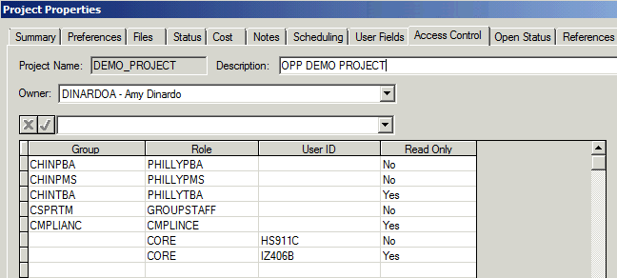
Example of OPP Object ACL

Slide 14
BASELINE ACCESS CONTROLS

Slide 15
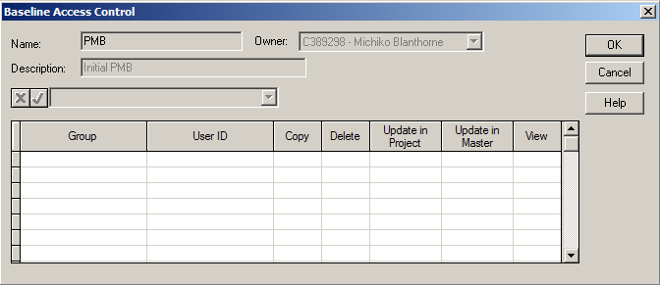
Baseline Access Control (ACL)
In Open Plan, you can set the security options for a baseline on a project that you have open in either Exclusive or Shared mode.
Only the owner of the baseline, owner of the project or SYSADMIN can modify a Baseline ACL
The Baseline ACL Dialog Box features a grid containing the following information:
Notes:
SYSADMIN = System Administrators

Slide 16
Baseline Access Control (ACL)
This dialog box allows you to change the access control information for the selected baseline

Slide 17
Baseline ACL Dialog Box - Name
This is the Name of the selected baseline as defined by the baseline owner
Note once the original pending baseline is approved, it becomes the ‘PMB’ baseline (tool creates/names it for you in level 4/5)

Slide 18
Baseline ACL Dialog box - Description
This is the description of the baseline name, as defined by the owner of the baseline

Slide 19
Baseline ACL Dialog Box - Owner
Typically, the owner of the baseline is the person who created it. While other users may have rights to view or modify the baseline, only the baseline owner, project owner or the system administrator can update the access rights or transfer the ownership of a baseline
Note the owner of the PMB is actually the person who approved the initial pending baseline which became the PMB (level 4/5)

Slide 20
Baseline ACL Dialog Box - Group
You can identify an access group in this column by selecting the group name from the enabled dropdown list to define rights to the baseline for the selected access group
You can assign baseline access control rights to either a group or an individual user on a single row, but not both.

Slide 21
Baseline ACL Dialog Box – User ID
You can identify an individual user in this column by selecting their W2K ID from the enabled dropdown list to define rights to the baseline for that specific User ID.
You can assign baseline access control rights to either a group or an individual user on a single row, but not both.

Slide 22
Baseline ACL Dialog Box - Copy
The entries in this column control whether the Group or User ID has the right to Copy the baseline. You would either mark them Yes (to be able to copy) or No (they can’t copy)
Copy needs to be marked YES for whatever Group or User will be approving baselines

Slide 23
Baseline ACL Dialog Box - Delete
The entries in this column control whether the Group or User ID has the right to Delete the baseline. You would either mark them Yes (to be able to delete) or No (they can’t delete)
Delete needs to be marked YES for whatever Group or User will be approving baselines

Slide 24
Baseline ACL Dialog Box – Update in Project
The entries in this column control whether the Group or User ID has the right to Update the baseline in this Project. You would either mark them Yes (to be able to update) or No (they can’t update)
Update in Project needs to be marked YES for whatever Group or User will be approving baselines
The Update in Project and Update in Master options are independent of each other. For example, if Update in Project was set to No, and Update in Master set to Yes, then the group or user will not be able to update the baseline if the project is opened on its own, but will be able to update the baseline if the project is opened as an external subproject.

Slide 25
Baseline ACL Dialog Box – Update in Master
The entries in the column control whether the group or user has the right to update this baseline when this project is opened in the context of a Multi project (Master project). The Multi project must have a baseline created with the “Use Baseline of the Same Name on External Subprojects” and the correct Update selections on the baseline* (for further information on this functionality see OPP 8 Documentation)
* This option is a functionality to be used by BCA. For BDS programs (especially those on level 4/5 change control), this field should always be marked NO.

Slide 26
Baseline ACL Dialog Box - View
The entries in this column control whether the Group or User ID has the right to View the baseline. You would either mark them Yes (to be able to view) or No (they can’t view)
Typically you’d mark this YES for all groups and/or users defined, but at a minimum, View needs to be marked YES for whatever Group or User will be approving baselines

Slide 27
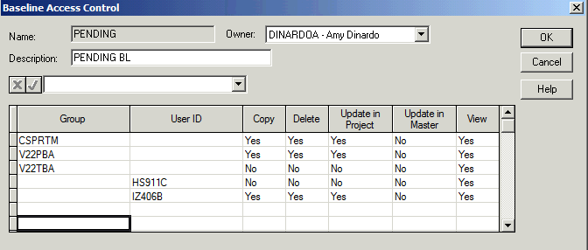
Example of Baseline ACL

Slide 28
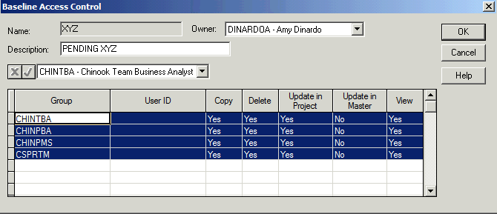
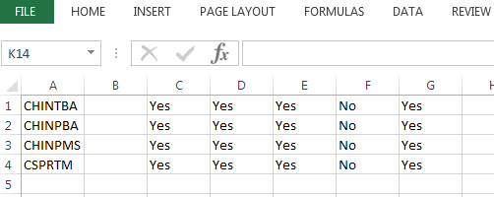
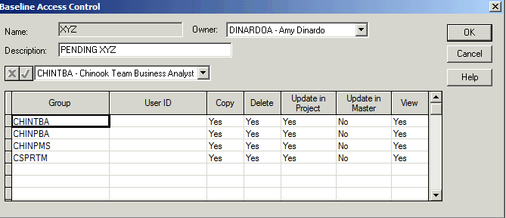
Baseline ACL – Tip for users
Tip & Trick / Short-cut
A template can be created in Excel and copied & pasted into the Access control window of pending baselines.
Build your standard settings in OPP, so all the Group names are listed properly
Highlight the rows > Copy
Open Excel > Paste > Save the Excel File
Next time you create a pending baseline
Open your excel file, highlight & Copy your settings and Paste into the Access control window.
Note
Settings for ‘Update in Master’ must match between the Pending & PMB baselines, for successful approval of the pending baseline.
***REMEMBER***
For BDS programs - Update in Master should ALWAYS be set to NO

Slide 29
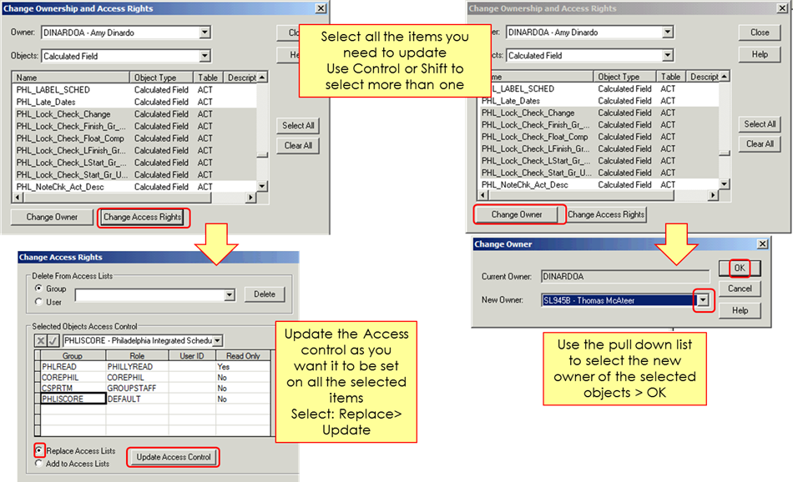
Tip for Updating Access Controls
Tip & Trick / Short-cut
On objects that you own, there is tool that allows users to mass update the Access Controls (or Ownership)
This can be accomplished via File / Manage Files / Change Owner and Access Rights
Once inside the tool, you can select which objects (or all objects)

Slide 30
Change Log
04/20/17 | ALL | New Material

