Slide 1
Terse browser extension
Devin Burke
Joshua Ray

Slide 2
AGENDA
Topic Introduction
Primary goals
Algorithms & Techniques
Implementation
Performance
Demo

Slide 3


INTRODUCTION & GOALS
Terse is an intelligent browsing extension for Google Chrome. It uses text retrieval and mining algorithms to minimize time spent reading web articles by summarizing its content.
Specifically, the extension extracts topics and sentences judged to be most relevant to the overall document.
4

Slide 4
Algorithms & techniques
Document / content filtering
Bag-of-words representation
Inverse document frequency (Stop words)​
Dot-matrix
Cosine similarity
Sentence length normalization
Sentence ranking / scoring
Topic extraction
Calculation of reading time savings
Precision at K to measure success

Slide 5
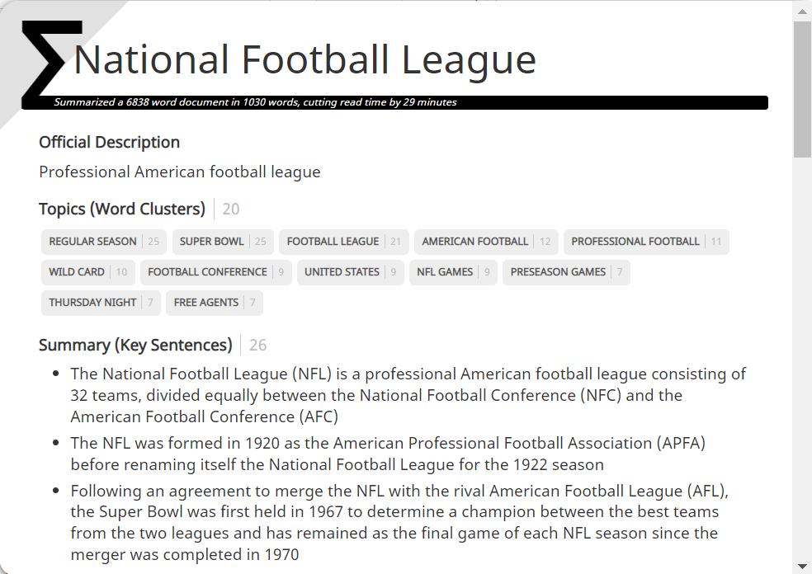
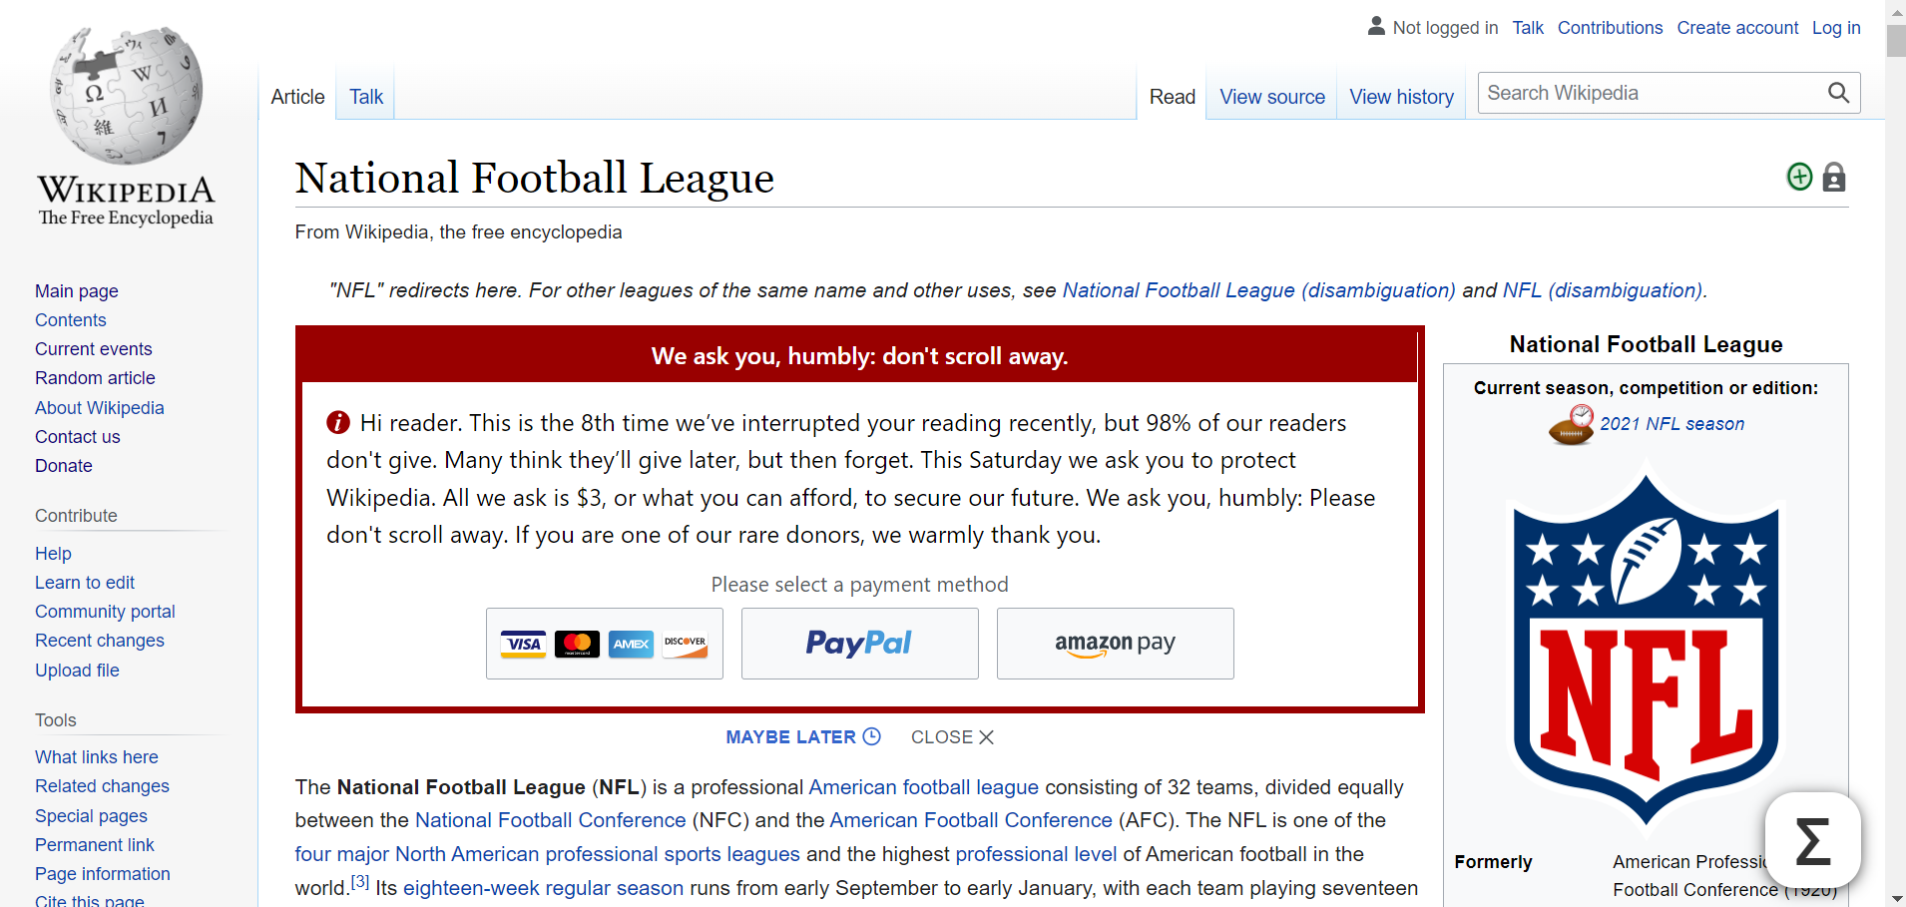
implementation
Our solution involved development of a Google Chrome extension using JavaScript and auxiliary web languages/technologies such as CSS3 and HTML5.

Slide 6
Summarization PERFORMANCE
A testing methodology was utilized which tested a pre-defined list of documents with known relevance-judgements. Like a Cranfield implementation, the tests measured system determined summarization sentences against existing relevance judgements to determine success thresholds. Precision at K of these results is also calculated, as shown below.

Slide 7
Installation process
1
Download Github repository
https://github.com/devinsburke/CourseProject
2
Enable Chrome developer mode
chrome://extensions
3
Load unpacked extension and choose the ‘Chrome’ folder from the downloaded repository
4
Browse web articles using the Terse icon for summarization
View instructions video for demo of installation and usage process.

Slide 8
demo

Slide 9
AREAS OF GROWTH
​ | CATEGORY 1 | CATEGORY 2 | CATEGORY 3​ | CATEGORY 4​
Q1 | 4.5​ | 2.3​ | 1.7​ | 5​.0
Q2 | 3.2​ | 5.1​ | 4.4​ | 3​.0
Q3 | 2.1​ | 1.7​ | 2.5​ | 2.8​
Q4 | 4.5​ | 2.2​ | 1.7​ | 7.0

Slide 10
BUSINESS OPPORTUNITIES ARE LIKE BUSES. THERE'S ALWAYS ANOTHER ONE COMING.​
Richard Branson

Slide 11




MEET OUR TEAM
TAKUMA HAYASHI
MIRJAM NILSSON
FLORA BERGGREN
RAJESH SANTOSHI
President
Chief Executive Officer
Chief Operations Officer
VP Marketing

Slide 12








MEET OUR TEAM
TAKUMA HAYASHI
MIRJAM NILSSON
RAJESH SANTOSHI
RAJESH SANTOSHI
President
Chief Executive Officer
Chief Operations Officer
VP Marketing
GRAHAM BARNES
ROWAN MURPHY
ELIZABETH MOORE
ROBIN KLINE
VP Product
SEO Strategist
Product Designer
Content Developer

Slide 13
PLAN FOR PRODUCT LAUNCH
Deploy strategic networks with compelling e-business needs
PLANNING
Synergize scalable e-commerce
MARKETING
Disseminate standardized metrics
DESIGN
Coordinate e-business applications
Foster holistically superior methodologies
LAUNCH
STRATEGY

Slide 14
SUMMARY
At Contoso, we believe in giving 110%. By using our next-generation data architecture, we help organizations virtually manage agile workflows. We thrive because of our market knowledge and great team behind our product. As our CEO says, "Efficiencies will come from proactively transforming how we do business."​

