Slide 1
Terse browser extension
Devin Burke
Joshua Ray

Slide 2
AGENDA
Topic Introduction
Primary goals
Algorithms & Techniques
Implementation
Performance
Demo

Slide 3
Topic INTRODUCTION
The topic our project will cover is intelligent browsing. Specifically, we will create a Google Chrome browser extension that summarizes the webpage the user is currently on. It will pull the most relevant/descriptive sentences from the page and display those as a bulleted summary to the user. The number of sentences shown will vary depending on the length of the document.

Slide 4


PRIMARY GOALS
The problem we will attempt to solve is efficient comprehension of the web pages with minimal time investment. Our solution will perform text retrieval using algorithms and techniques learned in the course to augment a user’s experience and make browsing more intelligent.
4

Slide 5
Algorithms & techniques
TEXT RETRIEVAL & PROCESSING
METHODS & ALGORITHMS
Dot-matrix
Cosine similarity
Bag-of-words representation
Stop-word filtering​
Sentence ranking / scoring
Document / content filtering
Calculation of reading time savings
Mean average precision to measure success

Slide 6
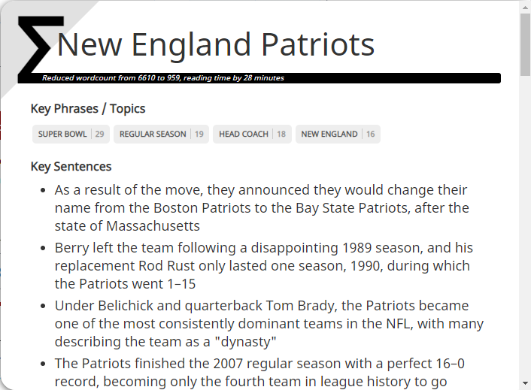
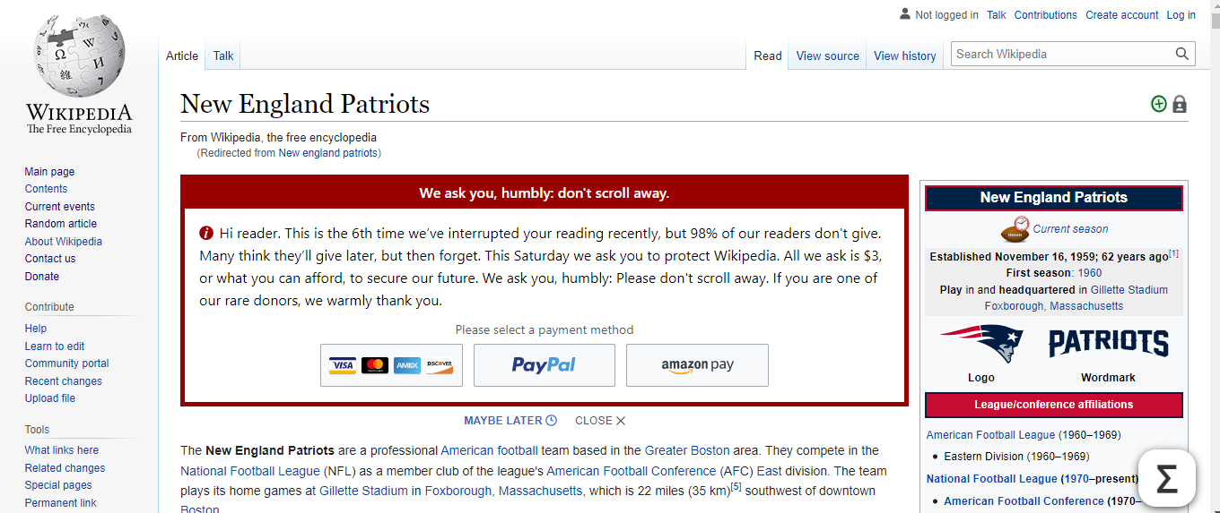
implementation
Our solution involved development of a Google Chrome extension using JavaScript and auxiliary web languages/technologies such as CSS3 and HTML5.

Slide 7
Summarization PERFORMANCE
A testing methodology was utilized which tested a pre-defined list of documents with known relevance-judgements. Like a Cranfield implementation, the tests measured system determined summarization sentences against existing relevance judgements to determine success thresholds. Precision at K of these results is also calculated, as shown below.

Slide 8
demo

Slide 9
AREAS OF GROWTH
​ | CATEGORY 1 | CATEGORY 2 | CATEGORY 3​ | CATEGORY 4​
Q1 | 4.5​ | 2.3​ | 1.7​ | 5​.0
Q2 | 3.2​ | 5.1​ | 4.4​ | 3​.0
Q3 | 2.1​ | 1.7​ | 2.5​ | 2.8​
Q4 | 4.5​ | 2.2​ | 1.7​ | 7.0

Slide 10
BUSINESS OPPORTUNITIES ARE LIKE BUSES. THERE'S ALWAYS ANOTHER ONE COMING.​
Richard Branson

Slide 11




MEET OUR TEAM
TAKUMA HAYASHI
MIRJAM NILSSON
FLORA BERGGREN
RAJESH SANTOSHI
President
Chief Executive Officer
Chief Operations Officer
VP Marketing

Slide 12








MEET OUR TEAM
TAKUMA HAYASHI
MIRJAM NILSSON
RAJESH SANTOSHI
RAJESH SANTOSHI
President
Chief Executive Officer
Chief Operations Officer
VP Marketing
GRAHAM BARNES
ROWAN MURPHY
ELIZABETH MOORE
ROBIN KLINE
VP Product
SEO Strategist
Product Designer
Content Developer

Slide 13
PLAN FOR PRODUCT LAUNCH
Deploy strategic networks with compelling e-business needs
PLANNING
Synergize scalable e-commerce
MARKETING
Disseminate standardized metrics
DESIGN
Coordinate e-business applications
Foster holistically superior methodologies
LAUNCH
STRATEGY

Slide 14
TIMELINE
Q1
Synergize scalable e-commerce
Q2
Coordinate e-business applications
Q3
Deploy strategic networks with compelling e-business needs
Q4
Disseminate standardized metrics

Slide 15
SUMMARY
At Contoso, we believe in giving 110%. By using our next-generation data architecture, we help organizations virtually manage agile workflows. We thrive because of our market knowledge and great team behind our product. As our CEO says, "Efficiencies will come from proactively transforming how we do business."​

