Slide 1

Artificial Intelligence
Arjang Fahim Ph.D.
Department of Computer Engineering and Science
California State University Long Beach
CECS 451, Summer 2020

Slide 2
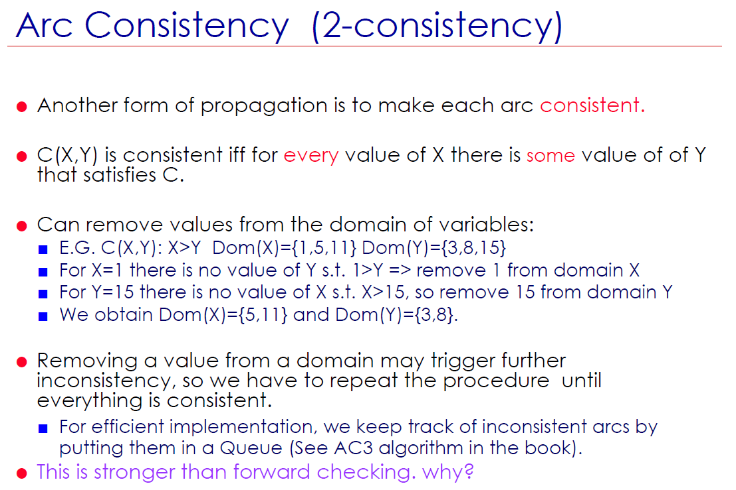
Some notes

Slide 3
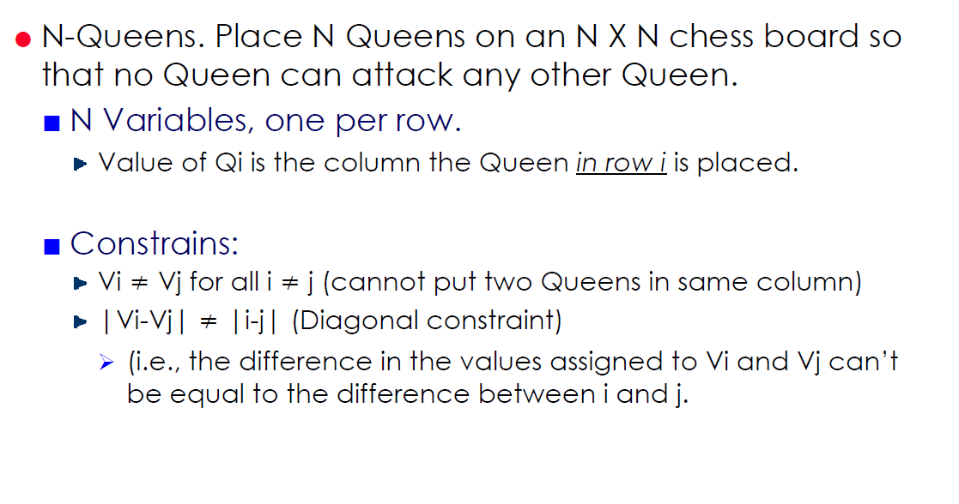
Some notes

Slide 4
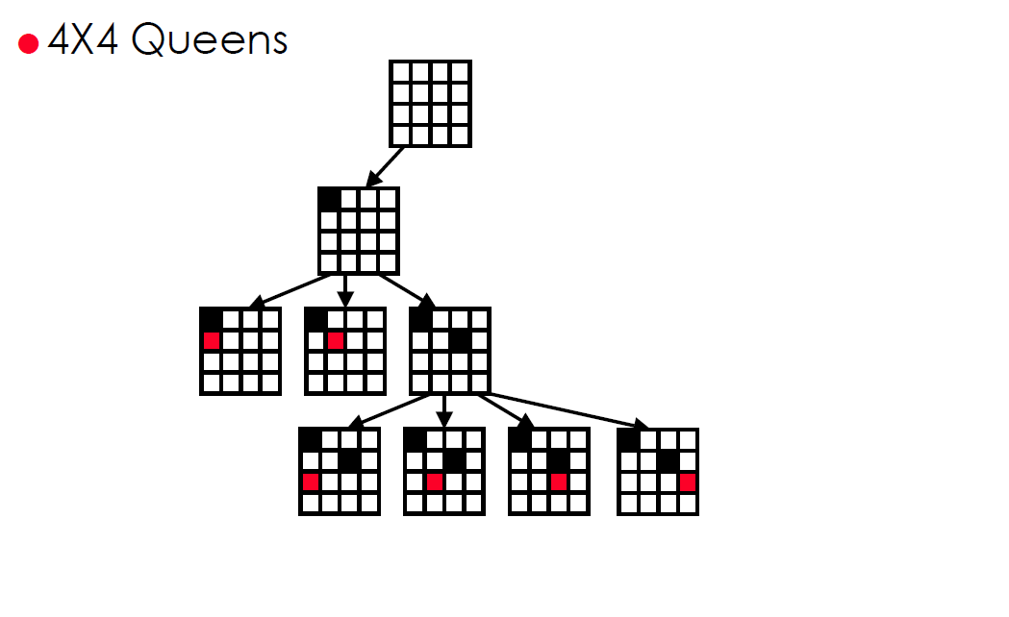
Some notes

Slide 5
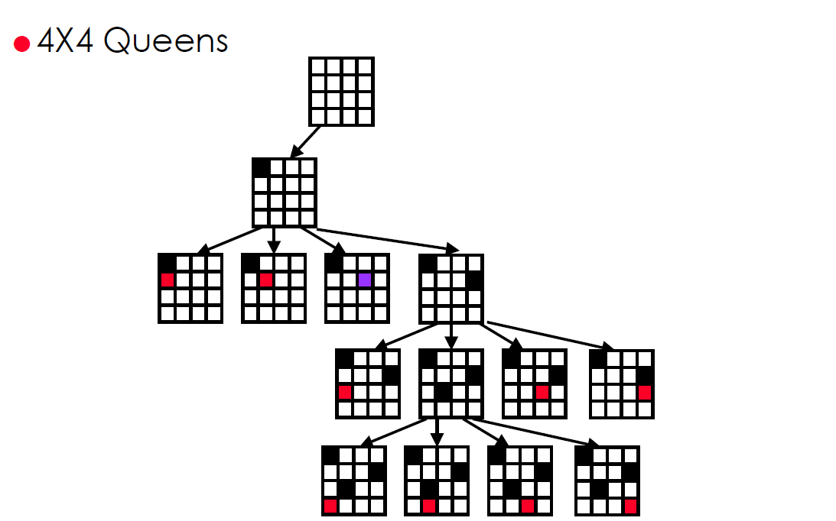
Some notes

Slide 6
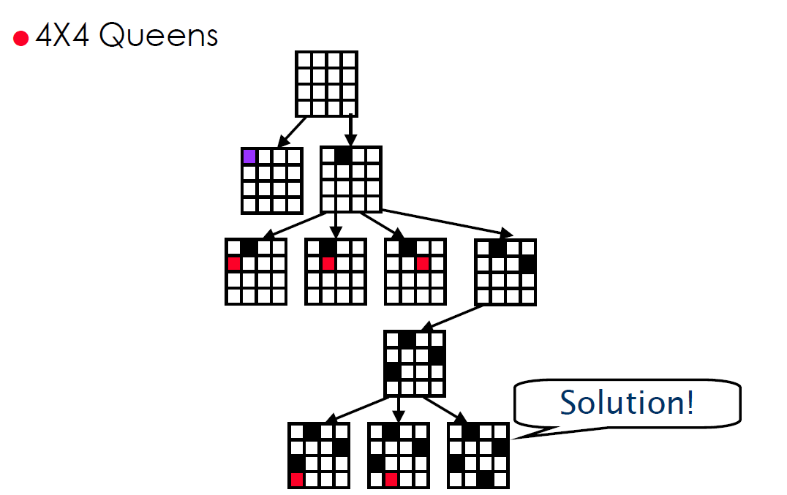
Some notes

Slide 7
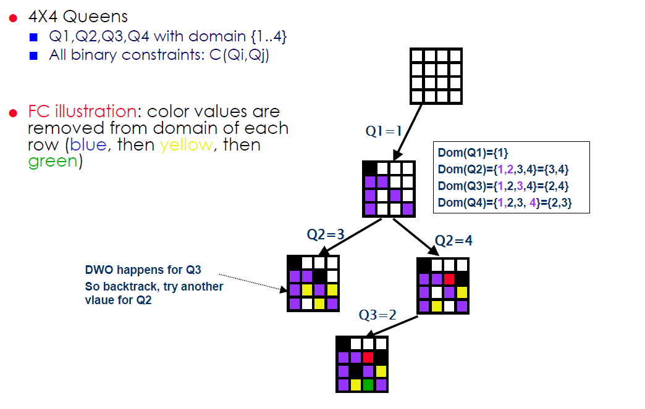
Some notes – Forward Checking Algorithm

Slide 8
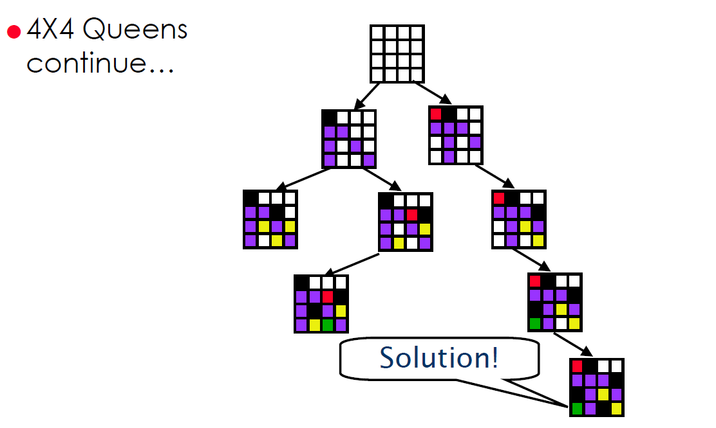
Some notes – Forward Checking Algorithm

