Slide 1
CampusMind AI
Empowering Academic Well-being & Productivity
Module: CMP 7003 – Emerging Mobile Applications
Assessment: PRES 01 – Professional Presentation
Academic Year: 2025–2026 | Semester 2
Cardiff School of Technologies
Cardiff Metropolitan University / ICBT Campus
1 / 12

Slide 2
Introduction & Problem Definition
The Academic Workload Crisis
The Solution: CampusMind AI
▸ University academics juggle teaching, research, administration, and committee responsibilities simultaneously.
✅ A unified mobile dashboard built specifically for university faculty members.
▸ Existing productivity tools are fragmented — separate apps for email, calendars, spreadsheets, and LMS platforms.
✅ Integrates academic scheduling, real-time burnout tracking, and AI-assisted task management into one app.
▸ This fragmentation leads to high cognitive load, missed deadlines, and severe burnout risk.
✅ Built with React Native + Expo for cross-platform deployment (iOS, Android, Web).
▸ According to HEPI (2023), over 60% of UK academics report high levels of work-related stress.
✅ Powered by Google Gemini AI for intelligent email drafting, schedule optimisation, and wellness advice.
▸ No single tool exists that unifies academic scheduling, wellness monitoring, and AI-assisted productivity.
✅ Uses Firebase for real-time data synchronisation and secure authentication.
✅ Addresses all 5 module learning outcomes including UI design, SDK integration, and critical evaluation.
2 / 12

Slide 3
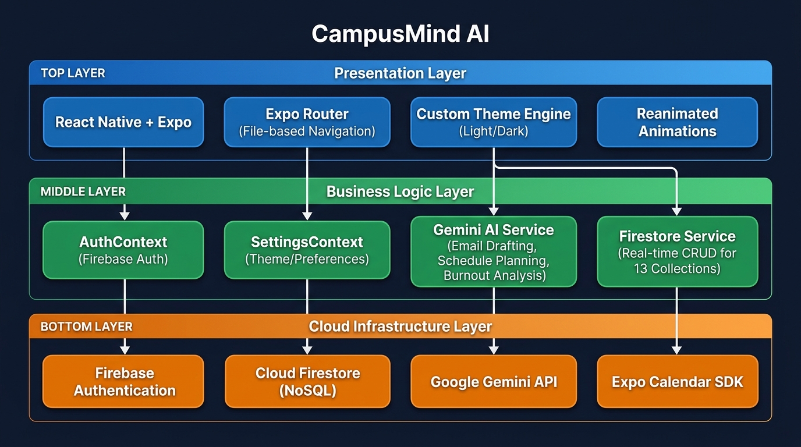
System Architecture & Technology Stack
React Native 0.81 | Expo SDK 54 | TypeScript 5.9 | Firebase 12 | Gemini 3.6 Flash
3 / 12

Slide 4
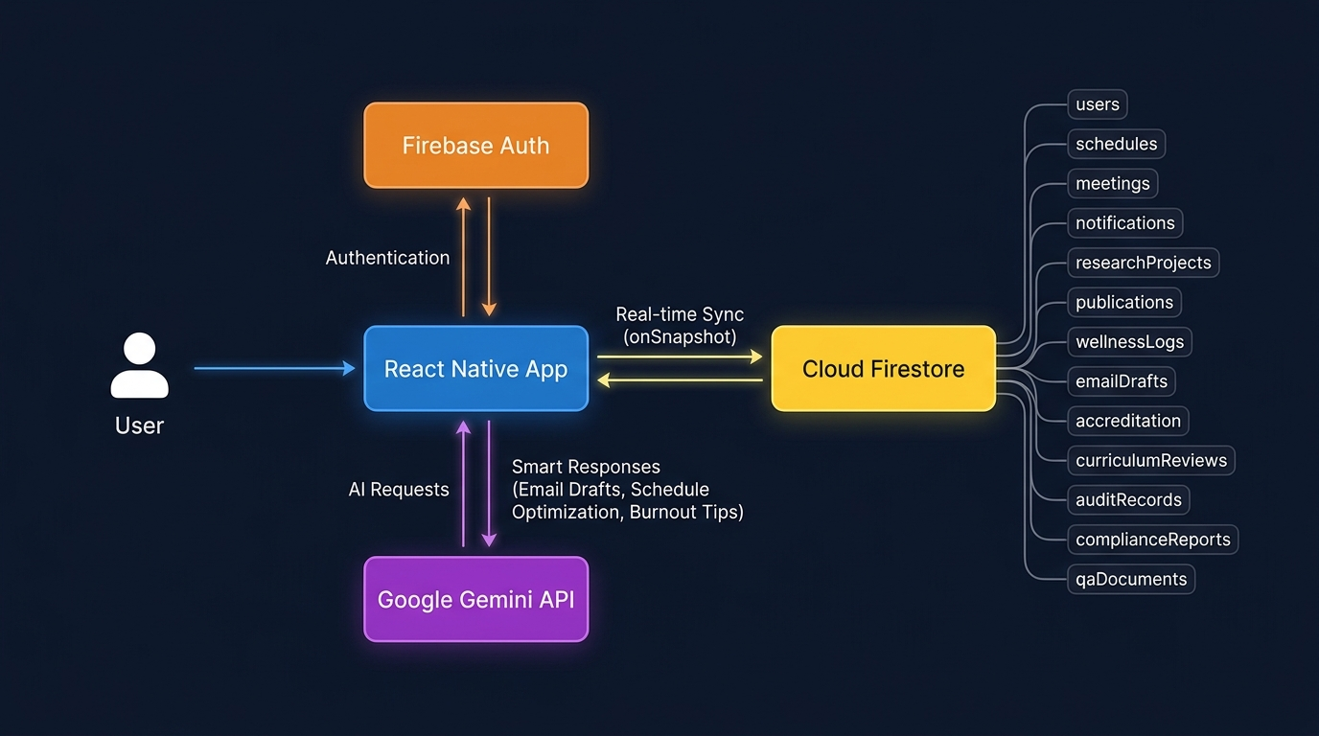
Data Flow & Real-Time Synchronisation
All data operations use Firestore onSnapshot() listeners for instant real-time updates across 13 collections — no polling, no manual refresh required.
4 / 12

Slide 5
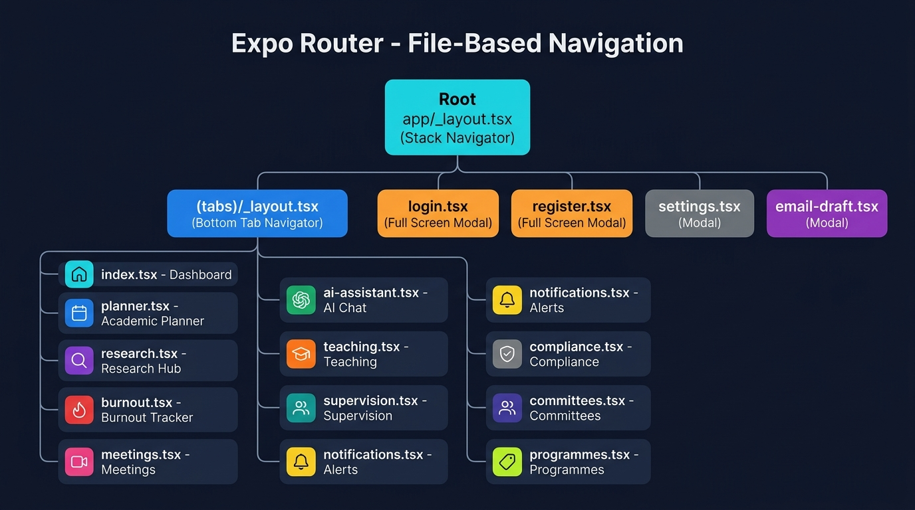
File-Based Navigation with Expo Router
Why Expo Router?
▸ File-based routing maps the directory structure directly to navigation — no separate route config files needed.
▸ The app/ directory IS the navigation tree. Adding a new screen is as simple as creating a new .tsx file.
▸ 12 tab screens + 4 modal screens organised into a clean Stack → Tab hierarchy.
▸ Supports typed routes (TypeScript) for compile-time safety against broken navigation links.
▸ Built-in deep linking via the 'campusmindai' URL scheme defined in app.json.
▸ Authentication guard in _layout.tsx automatically redirects unauthenticated users to /login.
5 / 12

Slide 6
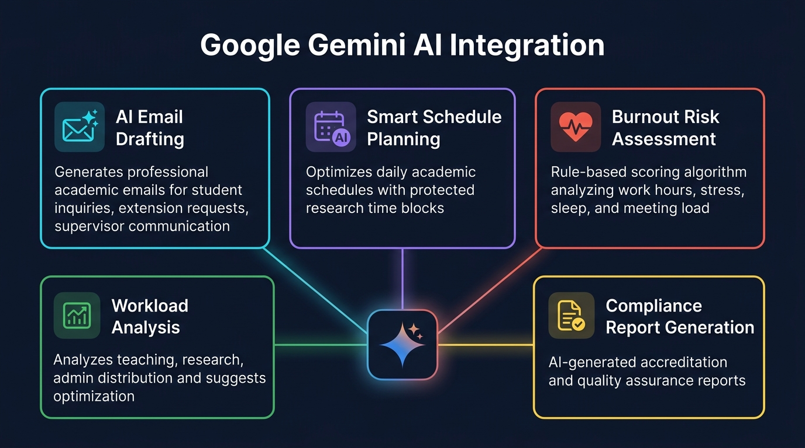
Google Gemini AI Integration
Model: gemini-3.6-flash | Max Tokens: 1024 | Temperature: 0.7 | 7 domain-specific system prompts | Graceful fallback to simulated responses
6 / 12

Slide 7
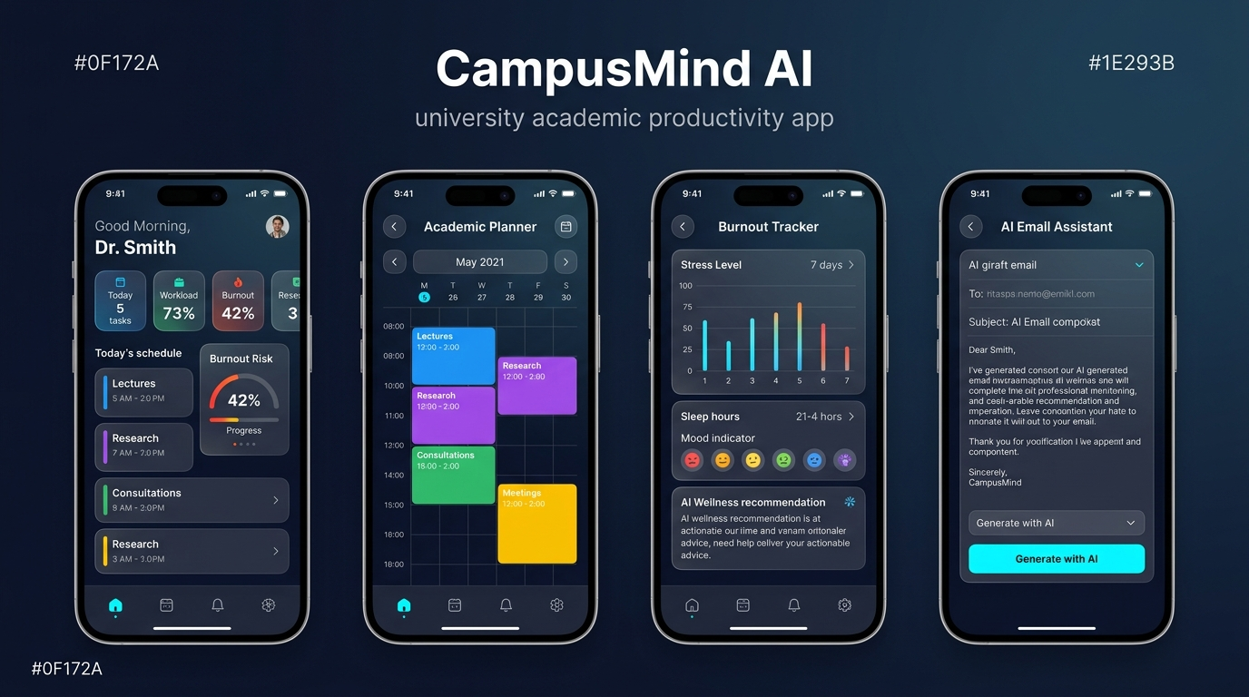
Application Demonstration – Key Screens
Dashboard · Academic Planner · Burnout Tracker · AI Email Assistant
7 / 12

Slide 8
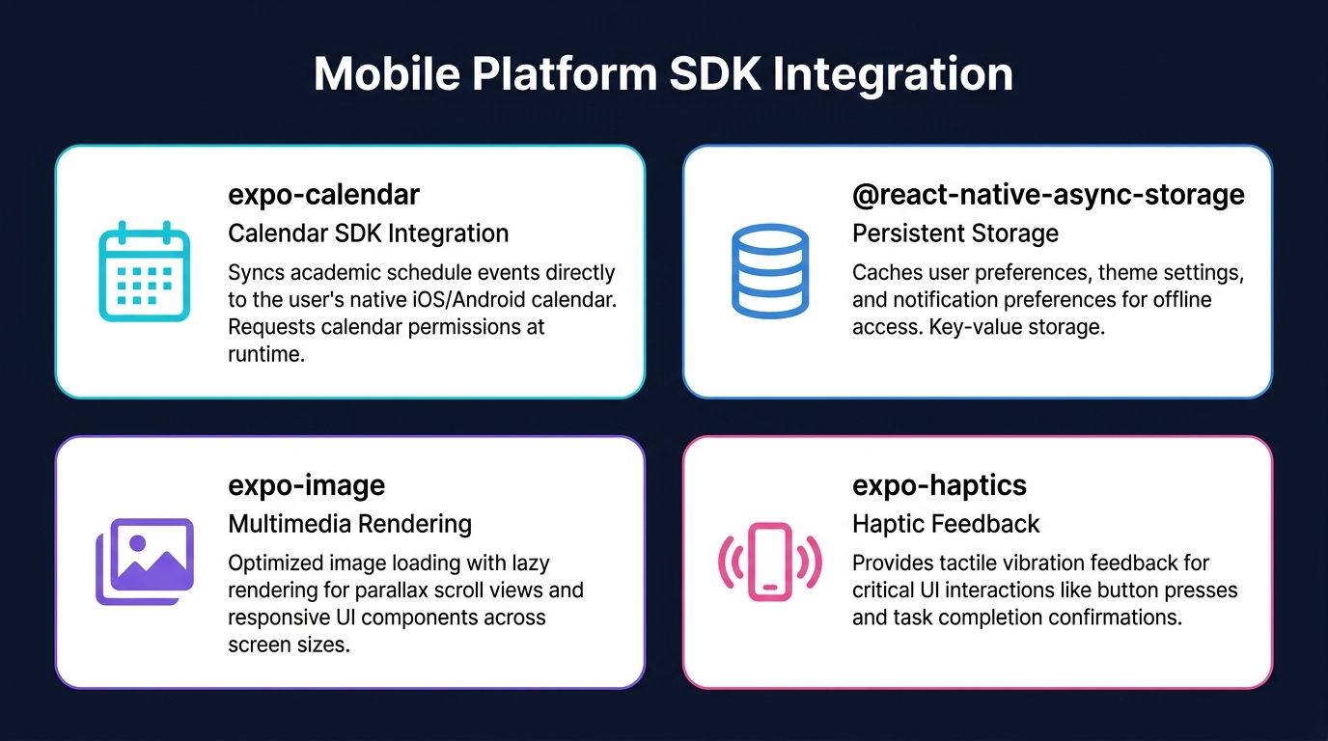
Mobile Platform SDK Integration
Fulfilling Key Mobile Platform Learning Outcomes (LO2)
8 / 12

Slide 9
UI/UX Design Principles
Fulfilling Learning Outcome 1: Appropriate User Interface Design Employing Best GUI Principles
Custom Theme Engine (SettingsContext)
Full Light and Dark mode support. Theme preference is persisted in AsyncStorage and synced across all screens. Users can choose System Default, Light, or Dark.
Colour Psychology & Semantics
Activities are colour-coded by type (Blue = Lectures, Purple = Research, Green = Consultations, Yellow = Meetings). Burnout risk uses a traffic-light system: Green ≤30%, Orange 31–60%, Red >60%.
Glassmorphism & Modern Cards
GlassCard component with subtle translucent overlays (rgba backgrounds + blur). Cards have rounded corners (BorderRadius.lg), soft shadows, and consistent spacing via Spacing constants.
Unified Dashboard
All critical metrics — Today's Schedule, Burnout Risk, Workload Score, Pending Emails, AI Insights — are accessible from a single scrollable dashboard. Quick Action grid provides one-tap access to all features.
Accessibility & Responsiveness
Typography uses a consistent scale (xs to 3xl). Dimensions.get('window') ensures responsive layouts. RefreshControl for pull-to-refresh. Smooth Reanimated animations maintain 60fps.
9 / 12

Slide 10
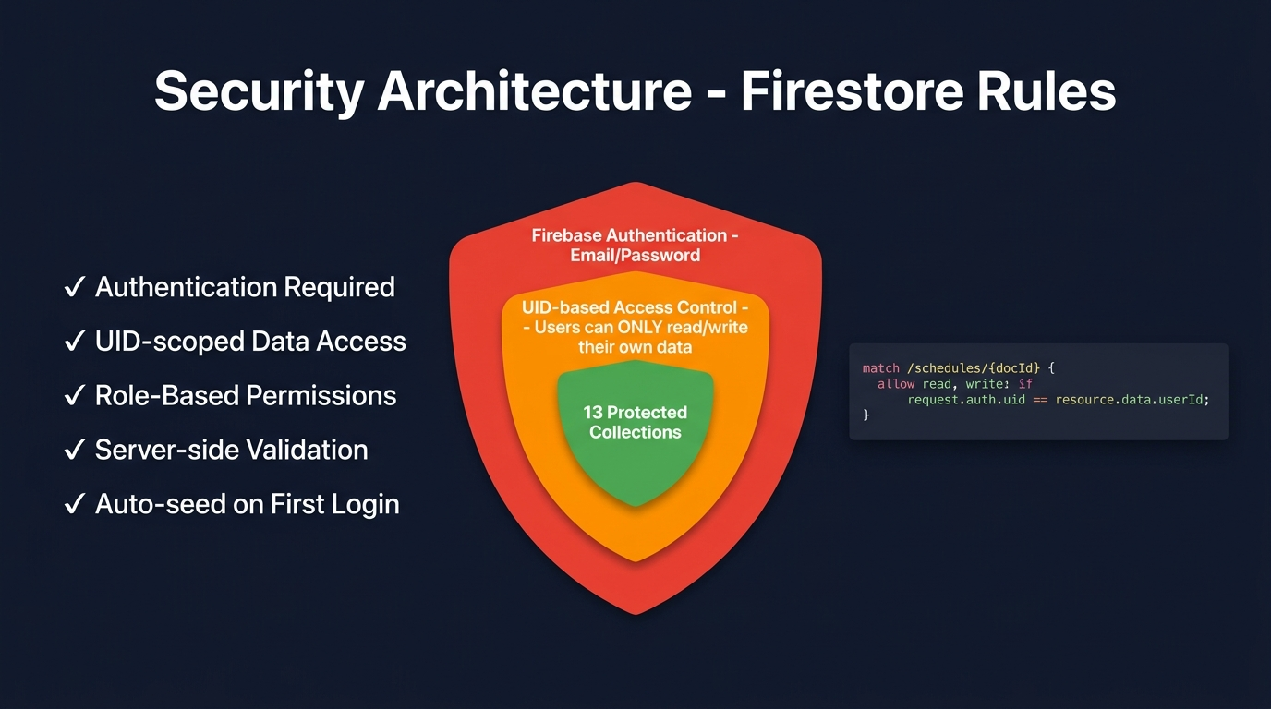
Security Architecture & Firestore Rules
Fulfilling LO4: Critically evaluate solutions to technical problems, including performance, security, and scalability.
10 / 12

Slide 11
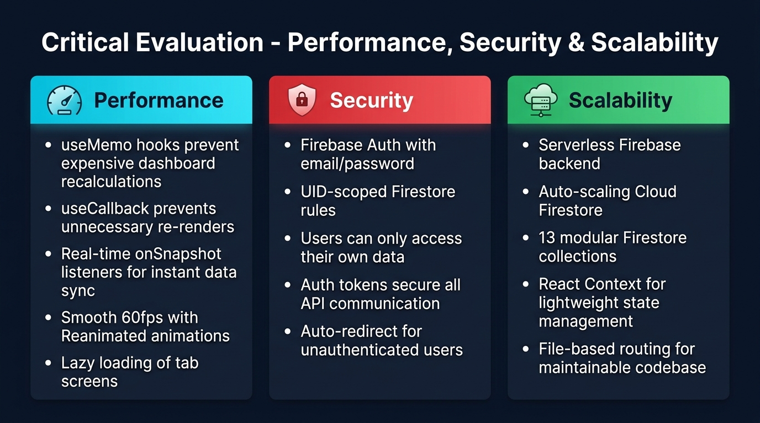
Critical Evaluation – Performance, Security & Scalability
Justification of Design Decisions
Why Expo Router over React Navigation?
File-based routing maps directory structure to navigation, making the codebase scalable and maintainable. No separate route configuration files needed.
Why Firebase Firestore?
Academics need instant updates across devices. Firestore's real-time NoSQL sync (onSnapshot) guarantees the dashboard is always current without polling.
Why React Context over Redux?
Used for global Auth and Theme state. Context API keeps architecture lightweight and avoids Redux boilerplate while maintaining performance.
Why Gemini AI?
Google's Gemini 3.6 Flash model provides fast, cost-efficient AI responses. Custom system prompts ensure domain-specific academic outputs.
11 / 12

Slide 12
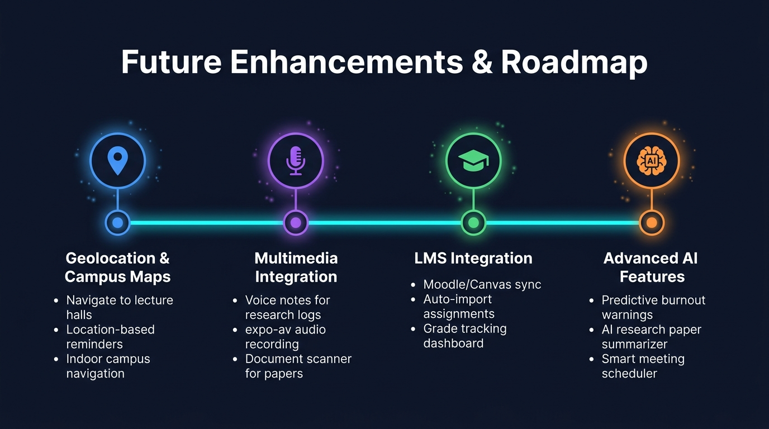
Summary, Future Enhancements & Conclusion
Summary
CampusMind AI is a scalable, intelligent mobile application that directly addresses the academic workload and well-being crisis. It unifies 12+ features — including AI email drafting, burnout tracking, academic planning, research management, and compliance reporting — into a single, theme-aware, cross-platform mobile app. Built with React Native + Expo, Firebase, and Google Gemini AI, it demonstrates proficiency across all 5 module learning outcomes.
12 / 12

Slide 13
Thank You
Questions & Discussion
CampusMind AI — Empowering Academic Well-being & Productivity
Module: CMP 7003 – Emerging Mobile Applications
Cardiff Metropolitan University / ICBT Campus

