Slide 1
When Are Categories More Useful Than Attributes? A Perspective From Induction
Gregory L. Murphy
New York University
Department of Psychology

Slide 2
Terms
category is a set of objects considered equivalent (e.g., all dogs)
concept is the mental representation of that set (idea of dog)
feature or attribute is an element of an object or category (color, part, shape)

Slide 3
Historically, concepts have been analyzed in terms of features (= “attributes”)
(e.g., Osherson et al., 1990; Smith et al., 1974)
Bird
feathers
two legs
wings
flies
lives in nest
has blood
More modern approach would probably use a schema to structure features

Slide 4
Why are concepts important?
(Smith & Medin, 1981, p. 3)
“Concepts ...allow us to go beyond the information given [= induction]; for once we have assigned an entity to a class on the basis of its perceptible attributes, we can then infer some of its nonperceptible attributes. Having used perceptible properties like color and shape to decide an object is an apple, we can infer the object has a core that is currently invisible but that will make its presence known as soon as we bite into it.”

Slide 5
Less useful concepts
e.g., square
four straight sides
interior angles are 90 deg
sides equal
You need to identify these features to classify a square; but then there aren’t many new features that follow.

Slide 6
Concepts leverage information
4 legs
eats meat
chases cars
has a liver
etc.
Barking
dog

Slide 7
Why are categories useful?
Currently
perceived
features
Even more
features
Concept
Classification
Induction

Slide 8
Early thinking: features are features
  perceptual, verbal, causal, whatever
e.g., “four legs” is used to identify a dog and could be an induction from identifying something as a dog

Slide 9
You can ask people to list features of a category
GRAND PIANO
keys foot pedals
strings legs
lid wood
black keys white keys
makes music large
used in concert halls
Rosch et al. (1976)

Slide 10
Traditional view of classification & induction
Other
features
from the list
Features
from the
list
Concept

Slide 11
Complications
Perceptual features may not be the same as verbally described features
  e.g., piano “has legs” and “has keys”
  but legs ≠ human legs, dog legs
  keys ≠ door keys, computer keys
People know much more than the verbal feature (Solomon & Barsalou, 2001)
Some features are never listed and are impossible to briefly describe

Slide 12


Verbal features don’t suffice for categorization
(ears, fur, nose, mouth, 2 eyes, neck...)

Slide 13
Different kinds of features
Those used for identification
  in perceptual format
  e.g., cat nose
“Knowledge” about the category
  perhaps amodal, abstract
  e.g., “cats have a nose”
  used in language, reasoning, etc.

Slide 14
Updated view of classification & induction
Knowledge
(abstract
features)
Perceptual
features
Concept
Classification
Induction

Slide 15
Bird can fly
lives in nest
etc.
Perceptual
features of
hopping bird
Bird
Classification
Induction

Slide 16
Disturbing possibility
Knowledge
(can fly)
Perceptual
features
(wings)
Bird
Direct feature induction

Slide 17
Possible direct feature inductions
wings → flies
eyes → sees
sharp teeth → carnivore
flat surface → manufactured
wears glasses → smart
eating at 3-star restaurant → wealthy

Slide 18
Category question:
What would you rather have as a pet...
a pit bull or
a Labrador retriever?

Slide 19
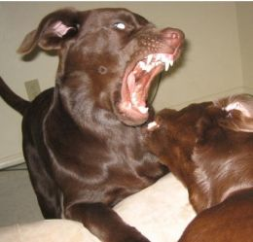
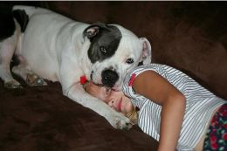
What about these two?
Category knowledge about labs and pit bulls doesn’t seem as effective as actual evidence about their friendliness... even based on a single sample taken from God knows where.

Slide 20
Test of direct feature induction
Murphy & Ross (JML, 2010)
Stimuli allegedly children’s drawings.
Categories = child
Features = shape & color
Induction: given one feature about a new drawing, what property do you think it will have?

Slide 21
Anna
Maura
Form 3
Elif
Karla

Slide 22
Question (prev. fig)
I have a new figure drawn by one of these children. It is a heart.
Who do you think is most likely to have drawn it?
What color do you think it most likely has?

Slide 23
Induction processes
Could answer question by category information
  blue is Karla’s most frequent color
Or by feature induction
  most hearts are blue
We can distinguish these by re-pairing features

Slide 24
Anna
Maura
Form 4
Elif
Karla

Slide 25
In one condition, heart → blue, 95% of the time in the other, heart → orange, 85% of the time
People are not predicting the feature given the category but rather predicting the feature given the other feature.

Slide 26
i.e., this is what we found
Perceptual
features
Concept
Knowledge
Direct feature induction

Slide 27
This tendency held up over heroic efforts to remove it.
  Such as telling people that the features were combined randomly
  Such as training people with dice so that they could see that features were combined randomly.
  Such as mentioning a property of the category but not saying that the new object had that property (weaker).

Slide 28
Conclusion
(Ross & Murphy experiments)
In induction, there seems to be a strong bias to use specific featural information over category-level information.
But is this specific to children’s drawings?
New experiments used familiar categories.

Slide 29
Two expts with Ching Sung
Very difficult to compare features to categories in general; apples & oranges problem.
Solution: identify ~equally efficacious categories and features and then put them into conflict.

Slide 30
Example
Lab vs. Pit Bull
  What is the chance that someone would want to pet it?
Dog wagging tail vs. growling.
  What is the chance that someone would want to pet it?
We equated the category diff and feature diff (~40%); see next slide

Slide 31
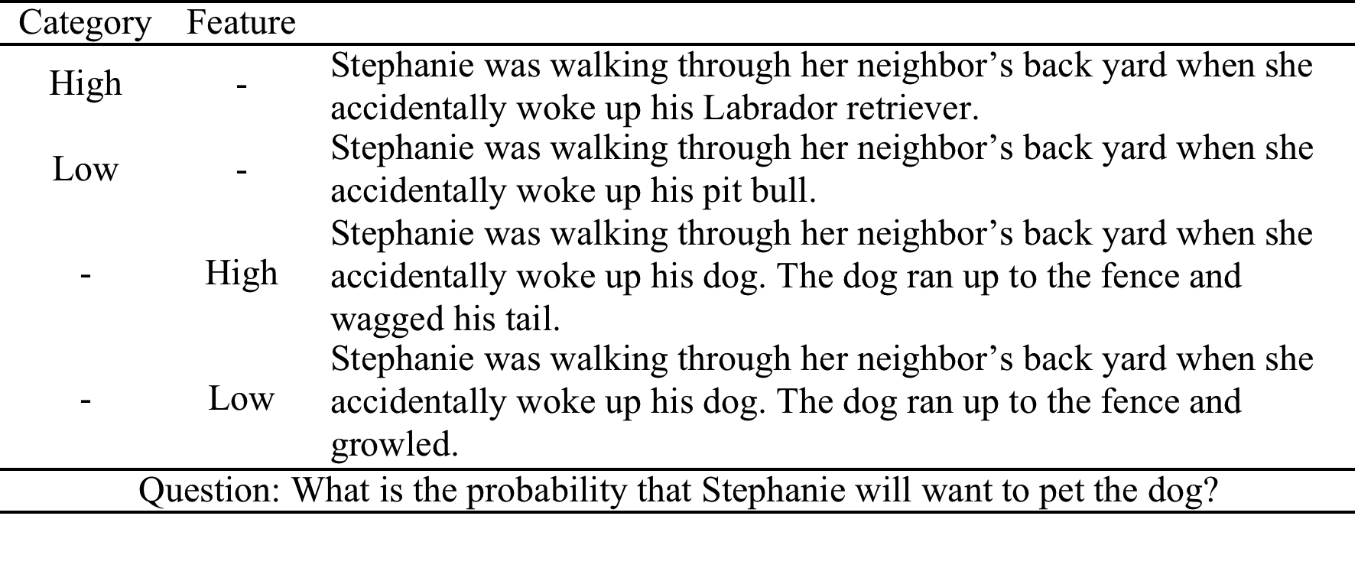
Pretest
Probabilities on 0 – 100% scale.
  Hi cat (Lab) = 73
  Lo cat (pit bull) = 32
  Hi feat (wagging) = 74
  Lo feat (growling) = 34.

Slide 32
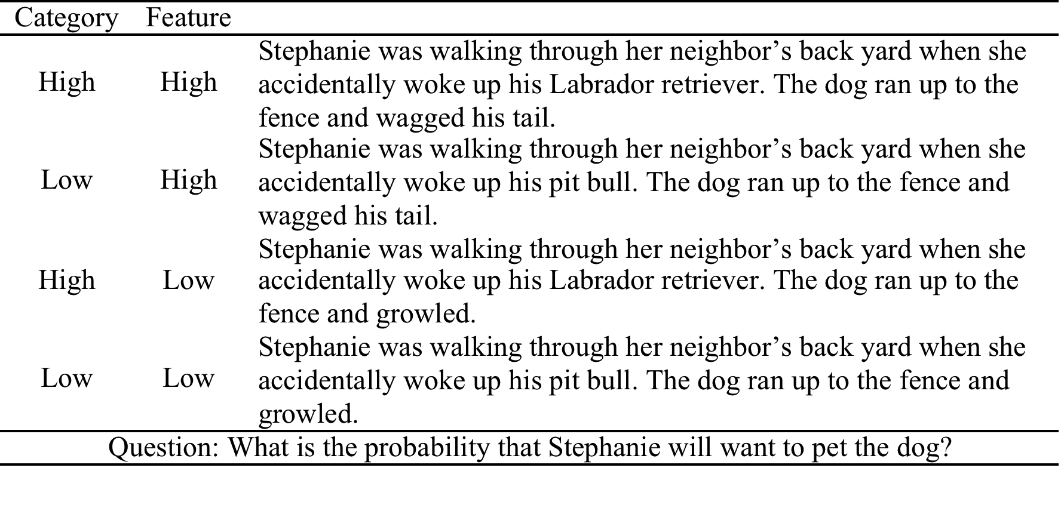
Stimuli of main experiment.
Each subject did only one version of each item (20 total items).

Slide 33

Results, Expt. 1
Both main effects are significant and equal in size (19.5, 21.5)
No interaction.
Categories and features seem to be equally strong in induction!

Slide 34
Expt. 2
Used only person categories: religion, race, profession, etc.
Literature suggesting that people attend to categories more than to distinguishing features of people....?
But we equated categories and features as before.
Also, changed dependent measure to “what would other people think” to try to reduce social desirability effects.

Slide 35
Examples
Categories
  American/Italian, marine/yoga instructor, gay/straight, Mormon/Buddhist, Christian/atheist
Features
  single/married, participated in Santacon/NYC marathon, taking home economics/woodshop class, studying child psychology/neuroscience

Slide 36
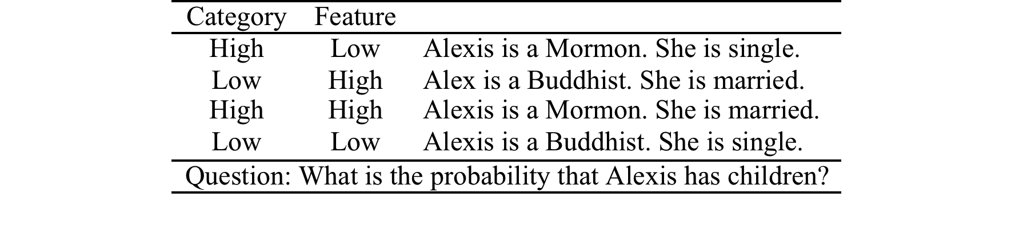
Same design as Experiment 1

Slide 37

Results similar to Expt. 1
Main effects of 18 points for category, 16 points for feature
Conclusion: features and categories are equally effective in induction
  in particular, categories don’t pre-empt feature effects

Slide 38
Could we just get rid of concepts and use direct feature induction?
No
Concepts are much richer than individual features
  thereby providing more inductions
Perceptual features may not tell you what you want to know right now
Concepts had an effect on induction in addition to the effect of features

Slide 39
Both routes seem to be involved in induction
Category-based induction
Knowledge
(abstract
features)
Features
Concept
Direct feature induction

Slide 40
Conclusion, of sorts
Object recognition (i.e., classification) is obviously important
  but some of the same goals can be achieved by feature identification
People apparently use both
Induction is more complex than concepts research has suggested

Slide 41
Question for Computer Vision
My expts used verbally encoded features like “green” or “growling”
Would direct feature induction be stronger for truly visual features?
  or are they more specific and therefore limited?

Slide 42
Thank You
Thanks to Brian Ross, Ching Sung, Jen Zhu
NSF grant BCS 1128769

Slide 43
Annoying problem of what is a category vs. feature
Categories were relatively permanent or long-term identities
  syntactically indicated by “is a ____”
Features were activities or temporary states (taking a class, going to a game, current activities or hobbies)
  used verbs or adjectives rather than noun labels (which makes a difference; Gelman & Heyman, 1999)

Slide 44
There’s no way to fend off determined skepticism about whether features and categories are different
but then there’s no way to investigate this issue

Slide 45
Stimulus examples
Categories: nurse/antique store owner, hockey/soccer game, mansion/apartment, coke/champagne
Features: diagnosed with cancer/fell down stairs, game was lopsided/tied, not renovated/fully renovated, bought at diner/rooftop lounge

